Slide 1

GETTING DECISIVE VICTORY OVER POWERS OF DARKNESS
SPECIAL SEMINAR
Ephesians 6:10-13
2 Corinthians 10:4-6

Slide 2
INTRODUCTION
The Bible is not intended to focus on Satan and his activities. However, we cannot be ignorant of the devices of the powers of darkness. They work in opposition to the plan of God for mankind. Their methods are characterized by fear, threats, promises of pleasure or power, intimidation, and suspicion. Their goal is to erode and finally destroy the Christian's faith in God. But the true Christian will experience resounding victory over them by having faith in Christ Jesus and by adhering to the Word of God.

Slide 3

QUESTION 1
Why is it important to know the works of the powers of darkness?
2 Corinthians 2:11.

Slide 4
Mark 9:20-22; 1 Peter 5:8; 2 Corinthians 11:13-15; Acts 13:7,8.
Manifestations and Activities of the Powers of Darkness
The plan of Satan and the powers of darkness is to supplant God. Since they cannot overcome the Omnipotent God, they continually work to exercise power over mankind to bring them into subjection. The activities of these powers tend to inflict mankind with pain, problems and difficulties. These include: One, long-standing sicknesses (Mark 9:20-22); Two, afflictions and bondages (Luke 13:16); Three devouring of ambitions, careers and homes (John 10:10; 1 Peter 5:8). Four, false miracles and hope (2 Corinthians 11:13-15). Five, hindrance to salvation (Acts 13:6-8; 2 Corinthians 4:4). Six, sowing chaos and confusing (Matthew 13:24-28).

Slide 5
QUESTION 2
What are some of the activities of the powers of darkness.

Slide 6
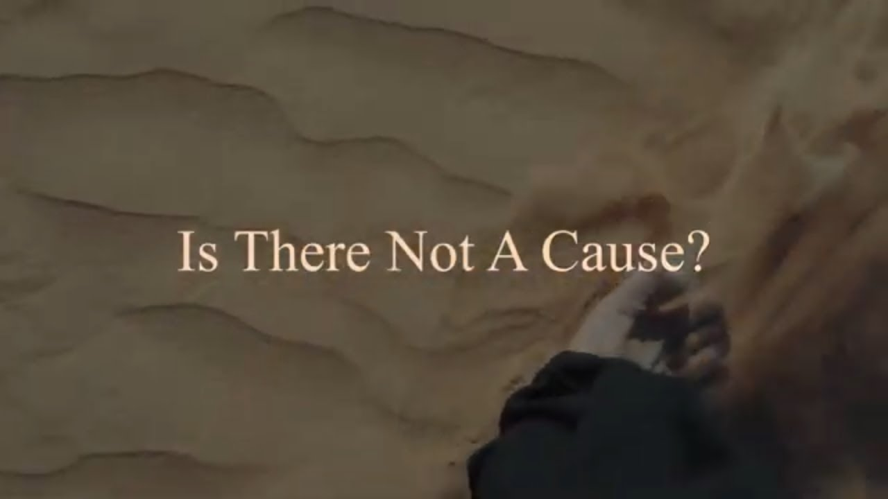

Slide 7
Mark 9:20-22; 1 Peter 5:8; 2 Corinthians 11:13-15; Acts 13:7,8.
Inroads for Powers of Darkness
How do powers of darkness gain access to torment a person? Sadly, many individuals experimenting with what they think to be rather normal have made themselves vulnerable for evil spirits to further trouble them. These include:
Sexual immorality.
Reading or possession of occultic books or materials.
Strange prayers of vengeance or to the deceased.
Horoscopes, palm reading & fortune telling.
Listening to false prophets.
Observing idolatrous family traditions.
Desire for knowing the unknown.
The lust of power.
Indulgence in stubbornness, anger, malice, etc.

Slide 8
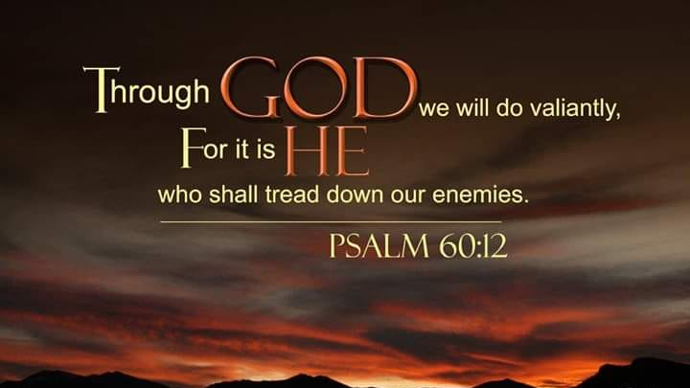

Slide 9
Psalm 60:12; Luke 4:18; Luke 10:19; Philippians 2:9,10.
Manifold Promises over Powers of Darkness
Our God is sovereign, awesome and unconquerable. He has all power and has make provisions for our victory over the powers of darkness. We can put our trust on His unfailing promises and be victorious. Here are some promises the believer could rely on:
Complete deliverance (Joel 2:32; Luke 4:18).
Preservation from all evil (Psalm 91:3-6; 2 Tim. 4:18).
Unconquerable weapon (Isaiah 54:15-17; 2 Corinthians 10:4-6).
Supernatural authority over all the powers of darkness (Luke 10:19).
Victory through the Name of Jesus (Philippians 2:9,10; Mark 16:17).

Slide 10
QUESTION 3
Mention any promise of God that guarantees the believer victory over the powers of darkness.

Slide 11
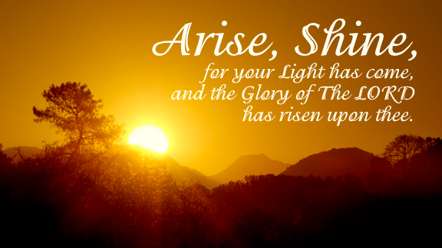

Slide 12
Acts 19:18,19; Luke 11:21,22; Ephesians 6:13; John 5:14.
Mankind’s Practical Actions for Victory over Powers of Darkness
There is deliverance today from the clutches of Satan and his co-hosts. Jesus on the cross declared the victory, “It is finished”. How can we avail ourselves for this victory and overcome these enemies of our souls?
Repent and burn all bridges to the powers of darkness (Acts 19:18,19).
Invite the Stronger Man (Luke 11:21,22).
Receive power through prayer with fasting (Matthew 17:21).
Put on the whole armour (Ephesians 6:13).
Be watchful and resist in faith (1 Peter 5:8,9; James 4:7)
Ask for prayers from the leaders (James 5:13-15).
Keep yourself in the Lord always, so that they do not return (Matthew 12:43-45; John 5:14).

Slide 13
QUESTION 4
How could you have a decisive victory over the powers of darkness?

Slide 14
CONCLUSION
The powers of darkness oppose all the plans and programs of God for mankind. Their goal is to keep humanity in perpetual bondage. However, there is victory today for anyone who would sincerely call upon the Lord with assurance and faith in His unfailing promises.
To continue enjoying the victory, the believer must separate himself from any association with the powers of darkness, watch and pray, fellowship with the godly and feed continually on the Word of God.

Slide 15

TIME TO PRAY

