Slide 1
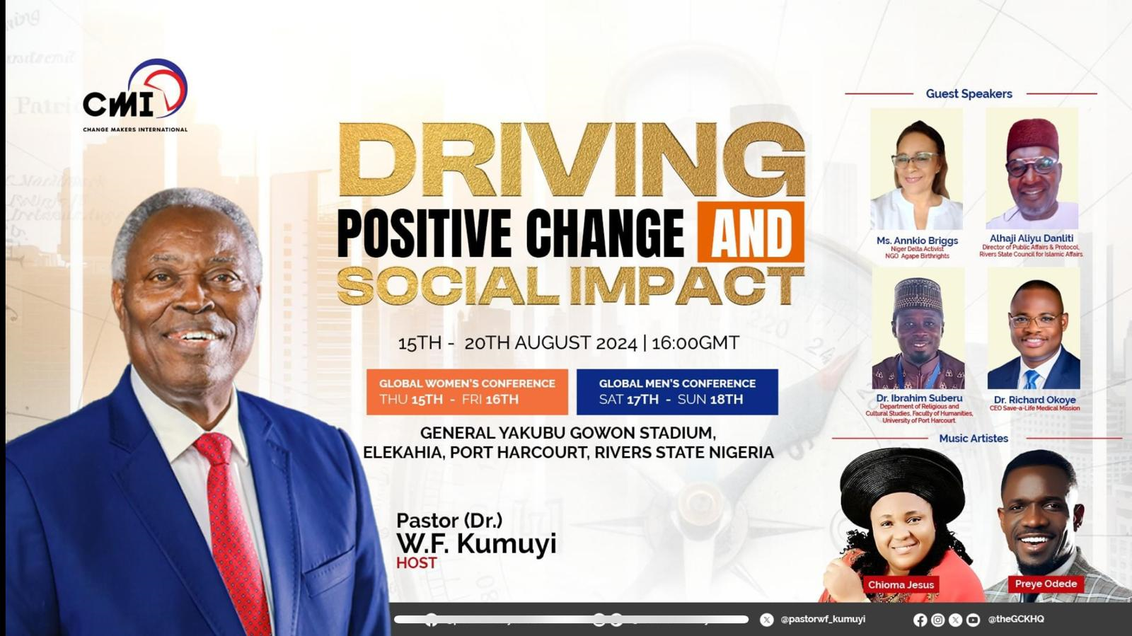

Slide 2


GLOBAL WORSHIP SERVICE
The Netherlands
18-08-2024

Slide 3
HYMN
GHS 258: OH, TO BE LIKE THEE

Slide 4
O! TO BE LIKE THEE [GHS 258]
1.
O! to be like Thee, blessed Redeemer,
This is my constant longing and prayer;
Gladly I’ll forfeit all of earth’s treasures,
Jesus, Thy perfect likeness to wear.

Slide 5
O! to be like Thee,
O! to be like Thee,
Blessed Redeemer,
Pure as Thou art;
Come in Thy sweetness,
come in Thy fulness;
Stamp Thine own image
Deep on my heart.

Slide 6
O! TO BE LIKE THEE [GHS 258]
2.
O! to be like Thee, full of compassion,
Loving, forgiving, tender and kind,
Helping the helpless, cheering the fainting,
Seeking the wand’ring sinner to find.

Slide 7
O! to be like Thee,
O! to be like Thee,
Blessed Redeemer,
Pure as Thou art;
Come in Thy sweetness,
come in Thy fulness;
Stamp Thine own image
Deep on my heart.

Slide 8
O! TO BE LIKE THEE [GHS 258]
3.
O! to be like Thee, lowly in spirit,
Holy and harmless, patient and brave;
Meekly enduring cruel reproaches,
Willing to suffer, others to save.

Slide 9
O! to be like Thee,
O! to be like Thee,
Blessed Redeemer,
Pure as Thou art;
Come in Thy sweetness,
come in Thy fulness;
Stamp Thine own image
Deep on my heart.

Slide 10
O! TO BE LIKE THEE [GHS 258]
4.
O! to be like Thee, Lord, I am coming,
Now to receive th’ anointing divine,
All that I am and have I am bringing,
Lord, from this moment all shall be Thine.

Slide 11
O! to be like Thee,
O! to be like Thee,
Blessed Redeemer,
Pure as Thou art;
Come in Thy sweetness,
come in Thy fulness;
Stamp Thine own image
Deep on my heart.

Slide 12
O! TO BE LIKE THEE [GHS 258]
5.
O! to be like Thee, while I am pleading,
Pour out Thy Spirit, fill with Thy love,
Make me a temple meet for Thy dwelling,
Fit me for life and heaven above.

Slide 13
O! to be like Thee,
O! to be like Thee,
Blessed Redeemer,
Pure as Thou art;
Come in Thy sweetness,
come in Thy fulness;
Stamp Thine own image
Deep on my heart.

Slide 14

SEARCH THE SCRIPTURES
18-08-2024

Slide 15
CONCLUSION OF OUR LAST STUDY
Confession and repentance provide a pathway to redemption and restoration. Through David’s example, we see the profound impact of acknowledging and confessing sins sincerely. This act leads to forgiveness; it frees the sinner from the burden of guilt and grants him the grace to live righteously. God’s forgiveness transforms lives, allows believers to enjoy His blessings and maintain a meaningful relationship with Him.
Confession of Sin and forgiveness

Slide 16
LESSON 968: Purity In A Faithful Church
MEMORY VERSE: ……
  “I know thy works: behold I have set before thee an open door and no man can shut it: for thou hast a little strength, and hast kept my Word and hast not denied my name” (Revelation 3:8).
TEXT: Revelation 3:7-13

Slide 17
INTRODUCTION
The church in Philadelphia was faithful despite opposition. We learn from the messages to the Churches that: One, a large majority displease the Lord while a few minority please Him. Two, the Lord evaluated and examined every church. Three, nothing is hidden from His all searching eyes. Four, man’s praise is worthless in the light of eternity. Five, Christ is an impartial Judge. Six, temptation is no excuse for compromise. And seven, God’s standard for holiness is universal.
The focus of this study is the purity, doctrinal integrity and uprightness of this Church. It gives hope and courage to those facing similar trials.

Slide 18
Revelation 3:7; Matthew 28:18-20; Hebrews 7:25
CHRIST’S PERFECTION, POWER AND FINALITY
Jesus introduces Himself to the church as “He that is Holy, He that is true, He that hath the key of David , He that openeth and no man shutteth; and shutteth and no man openeth.” He also reveals Himself as holy and true, as the One with final authority. He has ultimate power and sovereignty over the affairs of men. His perfection qualifies Him as the spotless Lamb of God “which taketh away the sins of the world.” He is the final Judge “who shall judge the quick and the dead at His appearing and His Kingdom.”

Slide 19
QUESTION 1
Explain the distinctive attributes of Christ as mentioned in our text?
Revelation 3:7

Slide 20
Psalms 32:5; 51:1-19, 38:18, 2 Samuel 12 :1-16, 1 John 1:9
CHRISTIAN PURITY, PERSEVERANCE AND FAITHFULNESS
Jesus has perfect knowledge of the life and character of the church and every person. He is holy, true and faithful and wants all believers to manifest these same qualities. The compromise, corruption and unfaithfulness found in other churches was not in Philadelphia. Christ found no moral failure or sinful practice in their church. Our lives should display the nature of Christ.
Their little strength produced great faith and commendable faithfulness. They remained faithful, loyal and dependable amidst intense persecution.

Slide 21
QUESTION 2
What can believers learn from the declaration “I know thy works” to the churches?
Psalm 139:7-12; Mark 4:22; 1 Corinthian 3:13

Slide 22
QUESTION 3
Highlight the commendable attributes of the church in Philadelphia
Revelation 3:8, 10

Slide 23
QUESTION 4
What qualities endeared the church in Philadelphia to Christ, the Bridegroom?

Slide 24
Revelation 3:11-13;2 Timothy 1:13,14 1 Thessalonians 4:7
CHRIST’S ADMONISION AND PROMISES TO OVERCOMERS
“Behold I come quickly, hold that fast which thou hast, that no man take thy crown.” The coming of the Lord is certain and imminent. He is not coming for the sinners and backsliders but for the pure that overcome and remain faithful to the end. God does not want us to be careless believers but expects us to be sober and watchful.
God has reserved special blessings – a crown and eternal citizenship – for all those who overcome and remain steadfast till the end.

Slide 25
QUESTION 5
a. Enumerate Christ’s admonition to victors Revelation 3:11; 22:7
b. Enumerate Christ’s promises to victors
1 Thessalonians 4:17

Slide 26
CONCLUSION
Philadelphia was one of two Churches without rebuke. They were faithful, upright and God fearing. Our Church can be likewise. Nothing is hidden before the Lord; we should be like the church in Philadelphia was, despite intense persecution. Knowing that the coming of Christ is imminent, we are admonished to remain steadfast till the end. Those who overcome will spend eternity with Christ.

Slide 27


SEARCH THE SCRIPTURES SUMMARY

Slide 28

INTERCESSION

Slide 29
TITHES AND OFFERING
Kindly pay via one of the following options:
Your phone
Bank transfer to
Cash
IBAN: NL90ABNA0416385699
Remarks: Tithes (name of region)
“… God loves a cheerful giver”
- 2 Corinthians 9:7

Slide 30

WELCOME TO
DEEPER LIFE BIBLE CHURCH
A CHURCH ON THE MOVE…
“Come thou with us and we will do thee good: for the Lord hath spoken good concerning [us]”
– Numbers 10:29
GOD’S FAMILY
GOD’S FOOD
GLOWING FOLD
We are a family, God’s family:
Our Father: God
Our Saviour: Jesus
Our Comforter: The Holy Spirit
Our destination: Heaven
We feast on God’s pure Word. We:
Read it
Study it
Believe it
Apply it
We want you to be part of us – a growing and glowing family. Join us and you will soon discover what makes our identity unique.
For your time and eternal profit, this is the place to be!

Slide 31








COUNSELLING
SERVICE SCHEDULES
Service | Day | Timing | Remarks
Worship Service | Sunday | 09:45-12:00 | Physical/Online
Bible Study | Tuesday | 19:30-20:30 | Online
Revival Service | Friday | 19:30-21:00 | Online/Physical
Night Vigil | Friday | 19:30-23:30 | First Friday Monthly
If you have questions or need guidance on challenging issues, kindly request for counselling.
Our pastor is here for you.
CONTACT
+31 207 856 683
info@deeperlife.nl
LOCATION DETAILS
Location | Telephone # | ZOOM Meeting ID
Amsterdam | +31 686 093 624 | 795-674-627
Eindhoven | +31 643 678 896 | 912-749-784
Rotterdam | +31 642 133 520 | 237-801-783
The Hague | +31 685 076 861 | 818-6898-8436
dclmnetherlands
www.dclm-nl.org

Slide 32


Slide 33


Slide 34
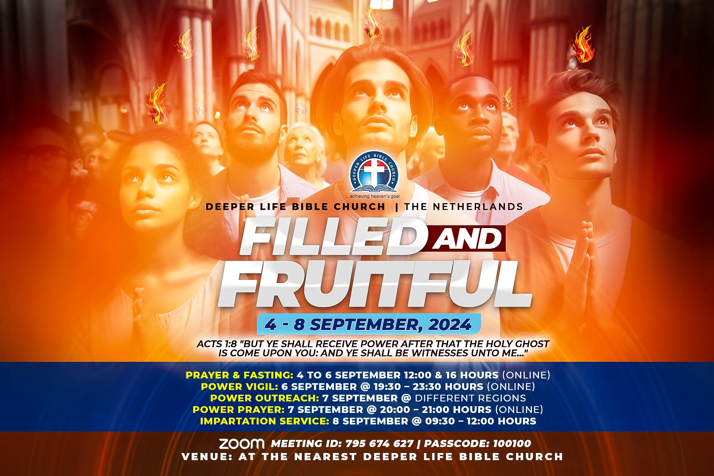

Slide 35


Slide 36
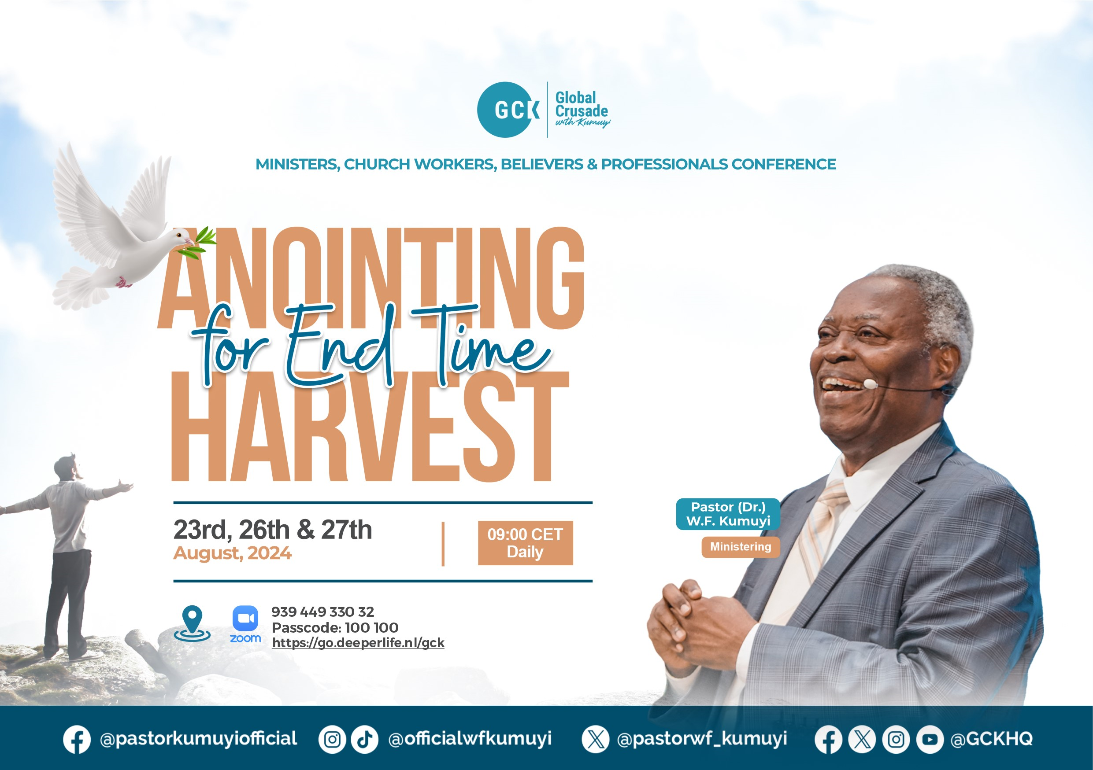

Slide 37


Slide 38
LESSON 969: Danger of
Lukewarmness
STS STUDY FOR NEXT WEEK:
MEMORY VERSE: ……
  “So then because thou art lukewarm, and neither cold nor hot, I will spue thee out of my mouth” (Revelation 3:16).
TEXT: Revelation 3:14–22

Slide 39

CHOIR

Slide 40
CONNECTION TO CMI

Slide 41

TIME TO PRAY

