Slide 1


SUPER SUNDAY SERVICE
The Netherlands
01-09-2024

Slide 2
HYMN
GHS 011: HOLY, HOLY, HOLY

Slide 3
HOLY, HOLY, HOLY [GHS 011]
1.
Holy, holy, holy,
Lord God Almighty!
Early in the morning
Our song shall rise to Thee;
Holy, holy, holy, merciful and mighty!
God in Three Persons, blessed Trinity!

Slide 4
HOLY, HOLY, HOLY [GHS 011]
2.
Holy, holy, holy!
All the saints adore Thee,
Casting down their golden crowns
Around the glassy sea;
Cherubim and seraphim
Falling down before Thee,
Who wert and art, and evermore shalt be.

Slide 5
HOLY, HOLY, HOLY [GHS 011]
3.
Holy, holy, holy!
Though the darkness hide Thee,
Though the eye of sinful man
Thy glory may not see,
Only Thou art holy;
There is none beside Thee,
Perfect in power, in love, and purity.

Slide 6
HOLY, HOLY, HOLY [GHS 011]
4.
Holy, holy, holy,
Lord God Almighty!
All Thy works shall praise Thy name,
In earth, and sky, and sea!
Holy, holy, holy, merciful and mighty!
God in Three Persons, blessed Trinity!

Slide 7

SEARCH THE SCRIPTURES
01-09-2024

Slide 8
CONCLUSION OF OUR LAST STUDY
The Lord rebukes us because He loves us. We should appreciate and not resent it, so we are not distanced from the Lord’s affection. The Laodicean church reflects the spiritual state of some believers today. God is displeased when we prioritise material possessions above spiritual vibrancy. Such should repent and focus on the heavenly race. Those who overcome will be rewarded in eternity.
Danger of lukewarmness

Slide 9
LESSON 970: The vision of God’s throne
MEMORY VERSE: ……
  “And immediately I was in the spirit: and, behold, a throne was set in heaven, and one sat on the throne”” (Revelation 4:2).
TEXT: Revelation 4:1-11

Slide 10
INTRODUCTION
Our text begins a section of this book, which focuses on events after the Rapture. The throne is at the centre of all things in the text; the Church will remain before it until heaven will be “opened” again before Christ’s millennial reign. John’s vision captures occupants, personalities and activities surrounding it. This special privilege was granted to John who was “in the Spirit”. For a deeper relationship with God and usefulness in His kingdom, we should be dead to self, consecrated, holy, prayerful and sensitive to the Spirit.

Slide 11
QUESTION 1
Highlight key lessons on the “door” opened in heaven and the centrality of the throne John saw.
Revelation 4:1,2.

Slide 12
Revelation 4:1-4; 1:9-11; 1 Corinthians 15:51,52; 1 Thessalonians 4:15-17; Isaiah 6:1-4; 66:1
THE THRONE AND TWENTY-FOUR ELDERS IN HEAVEN
John is translated to heaven to see the throne of God and the worship of saints before and around it. He heard a voice commanding him to “come up hither…”. God still calls sinners to salvation today and believers to holy living and service. God is the One on the throne. The rainbow shows God’s mercy and faithfulness, and the precious stones symbolise His brilliance and divine attributes. The twenty-four elders that John saw around the throne are overcomers who wear conquerors’ crowns. They are not angels. Their songs show that they praise Christ for their redemption by His blood.

Slide 13
QUESTION 2
Explain the reason for God’s invitation to John, sinners and believers.
1 Thess. 4:7; Rev. 22:17; Matt. 4:19; Gal. 1:15

Slide 14
QUESTION 3
What do believers learn from the personalities and activities around thrones?
Revelation 3:21; 4:3-5,8-11

Slide 15
Revelation 4:5- 8; 11:19; 16:17,18; Exodus 19:16-18; Psalm 18:12-15
TERRIFYING WONDERS FROM GOD’S THRONE AND SERVICE OF ANGELIC CREATURES
The “lightnings and thunderings and voices” present a preview of God’s explosive fury and wrath that would make all classes of unrepentant sinners tremble and flee for safety during the great tribulation. The “seven” burning lamps before the throne or the “seven Spirits of God” represent His perfection and illuminating attribute. The “sea of glass” describes the floor on which the throne stood. The four “beasts” or living creatures are cherubim who guard God’s holiness, glory and power (Ez. 1:5-10). Their faces symbolise strength and power, service, intelligence and speed in carrying out their tasks (Isa 6:2).

Slide 16
QUESTION 4
What do believers learn from the terrifying wonders from God’s throne?
Psalm 96:9; 1 Tim 6:14-16; Habakkuk 2:20

Slide 17
Revelation 4:8-11; 5:8-14; 7:11,12; 19:4; 15:4; 1 Chronicles 29:10-13; Psalm 96:1-9; Romans 11:36
TIMELESS WORSHIP AND WORTHINESS OF GOD
Worship is the central activity in heaven. We are created to praise and worship God (Isaiah 43:7,21). Our salvation through Christ prepares and makes us fit to praise and worship God acceptably (1 Peter 2:9). Redeemed and raptured, believers can now fulfil the purpose of God without hindrance or interruption. In heaven, angels and saints praise and worship before the Almighty who lives forever. God, the Creator of all things, is worthy of universal adoration. No one can meditate on the vast and wonderful universe without acknowledging that He is worthy to “receive glory and honour and power”.

Slide 18
QUESTION 5
What is the central activity in heaven and what should be the content of our praise?
Revelation 4:8,9,10,11.

Slide 19
CONCLUSION
John had the special privilege of seeing God’s throne. The occupants, personalities and activities surrounding the throne point to God’s holiness, majesty and power. We should always acknowledge God, Who alone is the Source of wisdom, power, goodness, beauty and glory. We must continue to praise Him for all the redemption benefits we have enjoyed and the privilege and hope of living with Him eternally.

Slide 20


SEARCH THE SCRIPTURES SUMMARY

Slide 21

INTERCESSION

Slide 22
TITHES AND OFFERING
Kindly pay via one of the following options:
Your phone
Bank transfer to
Cash
IBAN: NL90ABNA0416385699
Remarks: Tithes (name of region)
“… God loves a cheerful giver”
- 2 Corinthians 9:7

Slide 23

WELCOME TO
DEEPER LIFE BIBLE CHURCH
A CHURCH ON THE MOVE…
“Come thou with us and we will do thee good: for the Lord hath spoken good concerning [us]”
– Numbers 10:29
GOD’S FAMILY
GOD’S FOOD
GLOWING FOLD
We are a family, God’s family:
Our Father: God
Our Saviour: Jesus
Our Comforter: The Holy Spirit
Our destination: Heaven
We feast on God’s pure Word. We:
Read it
Study it
Believe it
Apply it
We want you to be part of us – a growing and glowing family. Join us and you will soon discover what makes our identity unique.
For your time and eternal profit, this is the place to be!

Slide 24








COUNSELLING
SERVICE SCHEDULES
Service | Day | Timing | Remarks
Worship Service | Sunday | 09:45-12:00 | Physical/Online
Bible Study | Tuesday | 19:30-20:30 | Online
Revival Service | Friday | 19:30-21:00 | Online/Physical
Night Vigil | Friday | 19:30-23:30 | First Friday Monthly
If you have questions or need guidance on challenging issues, kindly request for counselling.
Our pastor is here for you.
CONTACT
+31 207 856 683
info@deeperlife.nl
LOCATION DETAILS
Location | Telephone # | ZOOM Meeting ID
Amsterdam | +31 686 093 624 | 795-674-627
Eindhoven | +31 643 678 896 | 912-749-784
Rotterdam | +31 642 133 520 | 237-801-783
The Hague | +31 685 076 861 | 818-6898-8436
dclmnetherlands
www.dclm-nl.org

Slide 25
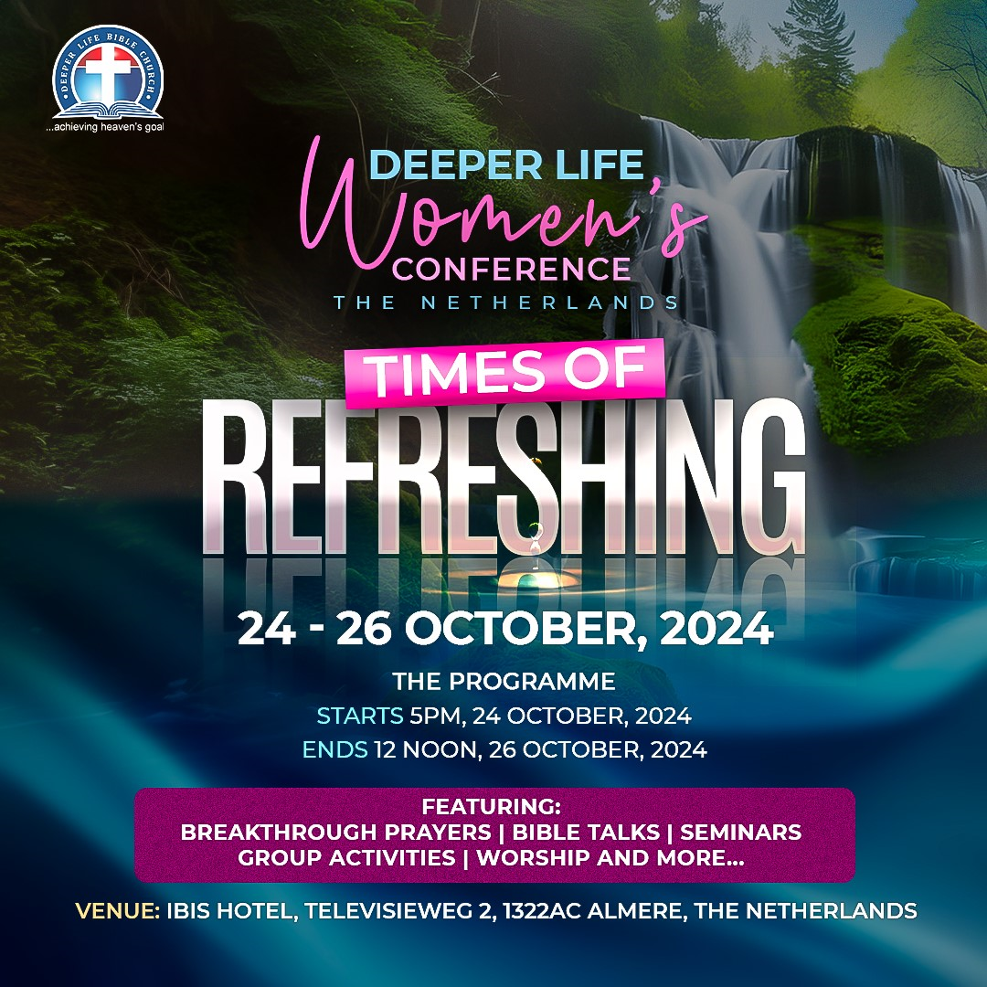

Slide 26
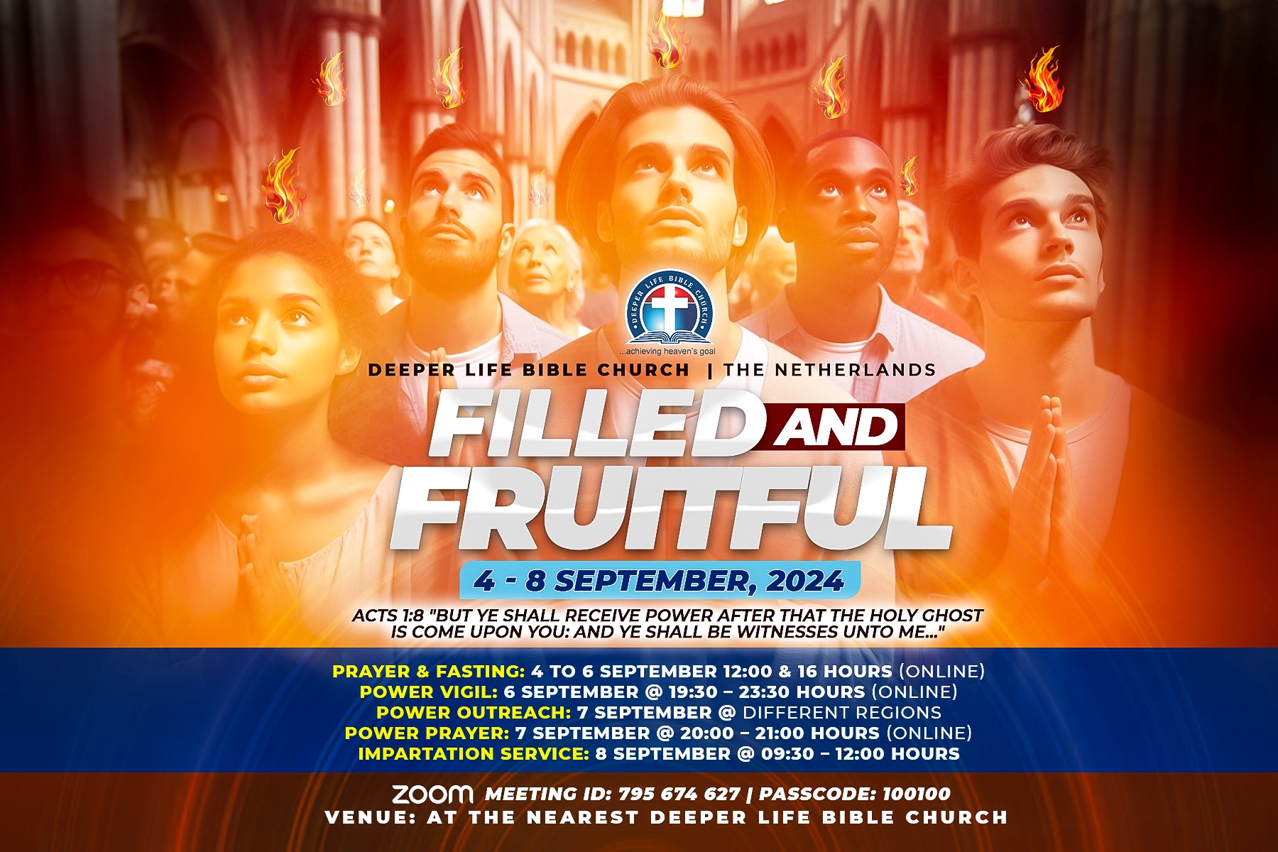

Slide 27
STS STUDY FOR NEXT WEEK:
SPECIAL SEMINAR

Slide 28
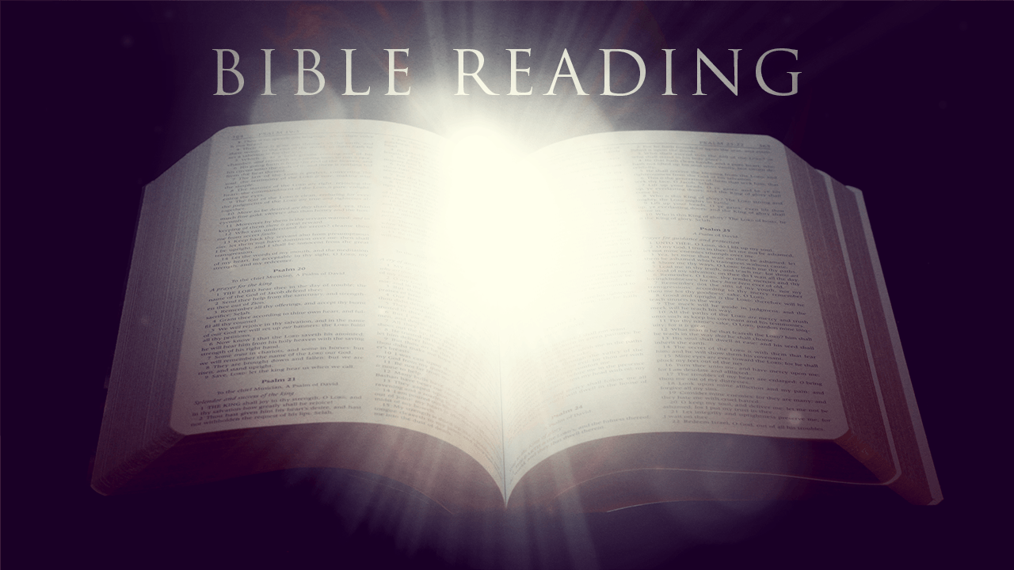

Mark 11:20-24

Slide 29
HYMN
GHS 181: ALL THINGS ARE POSSIBLE

Slide 30
ALL THINGS ARE POSSIBLE [GHS 181]
1.
All things are possible to him
That can in Jesus’ name believe;
Lord, I no more Thy name blaspheme,
Thy truth I lovingly receive.
I can, I do believe in Thee;
All things are possible to me.

Slide 31
ALL THINGS ARE POSSIBLE [GHS 181]
2.
’Twas most impossible of all
That here sin’s reign in me should cease;
Yet shall it be, I know it shall;
Jesus, I trust Thy faithfulness!
If nothing is too hard for Thee,
All things are possible to me.

Slide 32
ALL THINGS ARE POSSIBLE [GHS 181]
3.
Though earth and hell the Word gainsay,
The Word of God shall never fail;
The Lord can break sin’s iron sway;
’Tis certain, though impossible.
The thing impossible shall be,
All things are possible to me.

Slide 33
ALL THINGS ARE POSSIBLE [GHS 181]
4.
All things are possible to God;
To Christ, the power of God in man;
To me when I am all renewed,
In Christ am fully formed again.
And from the reign of sin set free, -
All things are possible to me.

Slide 34
ALL THINGS ARE POSSIBLE [GHS 181]
5.
All things are possible to God;
To Christ, the power of God in me;
Now shed Thy mighty Self abroad,
Let me no longer live, but Thee;
Give me this hour in Thee to prove
The sweet omnipotence of love.

Slide 35

CHOIR

Slide 36
TODAY’S SERMON
CENTRALITY OF FAITH TO DEMONSTRATION OF POWER

Slide 37

TIME TO PRAY

