Slide 1


SUPER SUNDAY SERVICE
The Netherlands
24-11-2024

Slide 2
HYMN
GHS 137: HOW BEAUTIFUL HEAVEN MUST BE

Slide 3
HOW BEAUTIFUL HEAVEN MUST BE [GHS 137]
1.
We read of a beautiful heaven,
Prepared for the pure and the free;
These truths in God’s word He has given,
How beautiful heaven must be.

Slide 4
How beautiful heaven must be,
Sweet home of the happy and free;
Fair haven of rest for the weary,
How beautiful heaven must be.

Slide 5
HOW BEAUTIFUL HEAVEN MUST BE [GHS 137]
2.
In heaven, no drooping nor pining,
No wishing for elsewhere to be;
God’s light is forever there shining,
How beautiful heaven must be.

Slide 6
How beautiful heaven must be,
Sweet home of the happy and free;
Fair haven of rest for the weary,
How beautiful heaven must be.

Slide 7
HOW BEAUTIFUL HEAVEN MUST BE [GHS 137]
3.
I’m longing to go to fair heaven,
To be with the happy and free;
To spend the long ages in singing,
How beautiful heaven must be.

Slide 8
How beautiful heaven must be,
Sweet home of the happy and free;
Fair haven of rest for the weary,
How beautiful heaven must be.

Slide 9
HOW BEAUTIFUL HEAVEN MUST BE [GHS 137]
4.
The angels so sweetly are singing,
Up there by the beautiful sea;
Sweet chords from their gold harps are ringing,
How beautiful heaven must be.

Slide 10
How beautiful heaven must be,
Sweet home of the happy and free;
Fair haven of rest for the weary,
How beautiful heaven must be.

Slide 11

SEARCH THE SCRIPTURES
24-11-2024

Slide 12
CONCLUSION OF OUR LAST STUDY
David’s prayers reveal the heart of a steadfast believer, reminding us that in times of trouble, God is our ultimate shield, refuge, and stronghold. His example encourages us to bring our needs to God in prayer and to respond to challenges with praise, maintaining our hope and trust in His faithfulness. As we seek justice and mercy, we can rely on God’s righteous timing and intervention, knowing He hears our cries and offers compassion in our moments of need.
Prayer of vindication and preservation

Slide 13
LESSON 981: The Sealing of God’s Servants
MEMORY VERSE: ……
  “After this I beheld, and, lo, a great multitude, which no man could number, of all nations, and kindreds, and people, and tongues, stood before the throne, and before the Lamb, clothed with white robes, and palms in their hands” (Revelation 7:9)
TEXT: Revelation 7:1-17

Slide 14
INTRODUCTION
Revelation chapter seven reveals the sealing and protection of some redeemed and righteous Jews. They will be protected from divine wrath on the sinful world during the great tribulation. The great tribulation is designed to judge the unbelieving world and prepare the nation of Israel for her Messiah who will “turn away ungodliness from Jacob” (Romans 11:26,27). Many Jews all over the world and multitudes of Gentiles will be saved during the great tribulation. Thus, this study focuses on the sealing of God’s servants and the revelation of countless tribulation saints in heaven.

Slide 15
Revelation 7:1-8; 14:1
COMMISSION TO SEAL GOD’S SERVANTS DURING
THE GREAT TRIBULATION
Between the opening of the sixth and the seventh seal, there will be a brief period of universal calm symbolized by the holding back of the winds. During this time, God’s 144,000 servants from the tribes of Israel will be sealed. The seal is a token of divine ownership and protection. Other Israelites will be saved during the great tribulation, but these sealed Jewish servants will be the initial group to be saved (Revelation 14:1,4). Every believer has God’s protecting seal. Sinners and backsliders do not have God’s seal and are exposed to Satanic attacks.

Slide 16
QUESTION 1
Who are the 144,000 people to be
sealed?
Rev 7:4; 14:1,4

Slide 17
QUESTION 2
When will the sealing of the 144,000 Jews be done?

Slide 18
QUESTION 3
Highlight the significance of God’s seal on His people?
2 Tim 2:19; 4:18
Notes:
xxxx

Slide 19
Revelation 7:9-12
COUNTLESS MULTITUDE OF TRIBULATION SAINTS
IN HEAVEN
John also saw multitudes of martyred tribulation saints gathered with palms – symbols of triumph in their hands before the throne of God. The angels will rejoice with these triumphant saints and join them to offer praise and glory to God. Although vast numbers of people will die in sin during the great tribulation, multitudes will hear the gospel through the sealed “servants of God” and get saved. They will endure intense persecution and be martyred during that same period. Persecution is a common experience of Christ’s servants and should not hinder you from getting to heaven. Earnestly contend for the faith which was once delivered unto the saints!

Slide 20
QUESTION 4
Who are the countless white-robed saints John saw and why are they different from the 144,000 sealed servants of God?
Rev 7:9,14

Slide 21
QUESTION 5
Why should believers render praises to God?
Psalm 103:1-5

Slide 22
Revelation 7:13-17
COMFORT FOR TRIUMPHANT SAINTS IN HEAVEN
The great multitude standing before the throne of God in heaven is not the redeemed, raptured church. The church had been in the presence of God in heaven, represented by the twenty-four elders. This multitude resisted the rule of the Antichrist during the great tribulation and were killed. They made it to heaven because they were washed and made holy by the blood of the Lamb. Like these triumphant saints, get saved, remain faithful and pure till the end. By God’s grace, You will get to heaven and receive your rewards.

Slide 23
QUESTION 6a
What are the essential qualifications for entering heaven?
Rev 21:27; Heb 12:14

Slide 24
QUESTION 6b
Which blessings that await triumphant pilgrims in heaven?
Rev 7:16,17; 22:3-5; 2 Tim 4:8

Slide 25
CONCLUSION
“The foundation of God standeth sure, having this seal, the Lord knoweth them that are his. And, let everyone that nameth the name of Christ depart from iniquity” (2 Tim 2:19).
The great tribulation will be a time of intense torment and agony. You may likely not survive it. Don’t defer your decision of salvation. Today, give your life to Jesus! You will enjoy God’s blessings on earth and eternal life in heaven.

Slide 26


SEARCH THE SCRIPTURES SUMMARY

Slide 27

INTERCESSION

Slide 28
TITHES AND OFFERING
Kindly pay via one of the following options:
Your phone
Bank transfer to
Cash
IBAN: NL90ABNA0416385699
Remarks: Tithes (name of region)
“… God loves a cheerful giver”
- 2 Corinthians 9:7

Slide 29

WELCOME TO
DEEPER LIFE BIBLE CHURCH
A CHURCH ON THE MOVE…
“Come thou with us and we will do thee good: for the Lord hath spoken good concerning [us]”
– Numbers 10:29
GOD’S FAMILY
GOD’S FOOD
GLOWING FOLD
We are a family, God’s family:
Our Father: God
Our Saviour: Jesus
Our Comforter: The Holy Spirit
Our destination: Heaven
We feast on God’s pure Word. We:
Read it
Study it
Believe it
Apply it
We want you to be part of us – a growing and glowing family. Join us and you will soon discover what makes our identity unique.
For your time and eternal profit, this is the place to be!

Slide 30








COUNSELLING
SERVICE SCHEDULES
Service | Day | Timing | Remarks
Worship Service | Sunday | 09:45-12:00 | Physical/Online
Bible Study | Tuesday | 19:30-20:30 | Online
Revival Service | Friday | 19:30-21:00 | Online/Physical
Night Vigil | Friday | 19:30-23:30 | First Friday Monthly
If you have questions or need guidance on challenging issues, kindly request for counselling.
Our pastor is here for you.
CONTACT
+31 207 856 683
info@deeperlife.nl
LOCATION DETAILS
Location | Telephone # | ZOOM Meeting ID
Amsterdam | +31 686 093 624 | 795-674-627
Eindhoven | +31 643 678 896 | 912-749-784
Rotterdam | +31 642 133 520 | 237-801-783
The Hague | +31 685 076 861 | 818-6898-8436
dclmnetherlands
www.dclm-nl.org

Slide 31


Slide 32
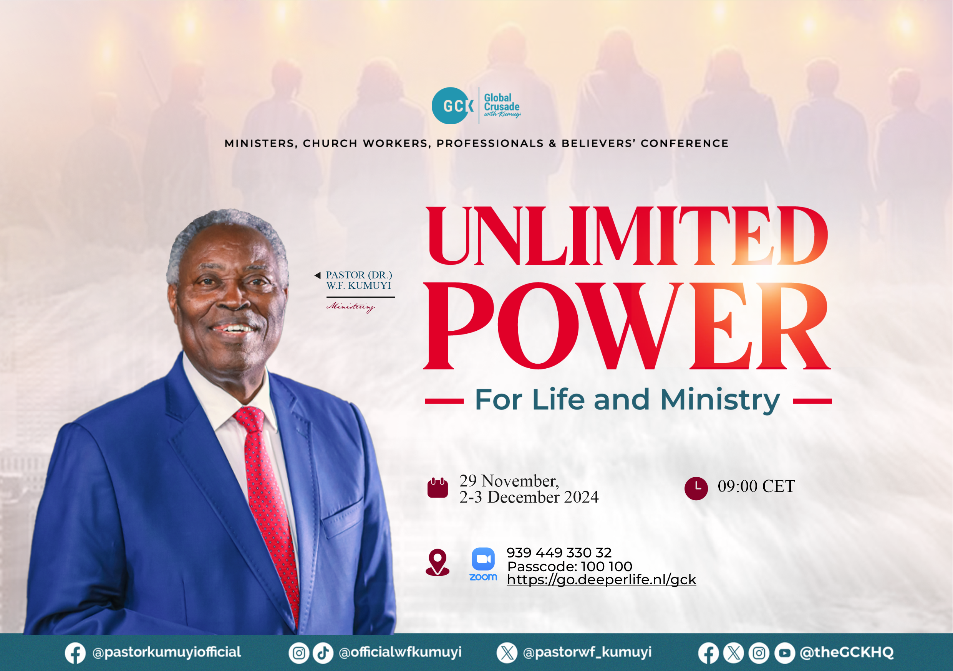

Slide 33


Slide 34
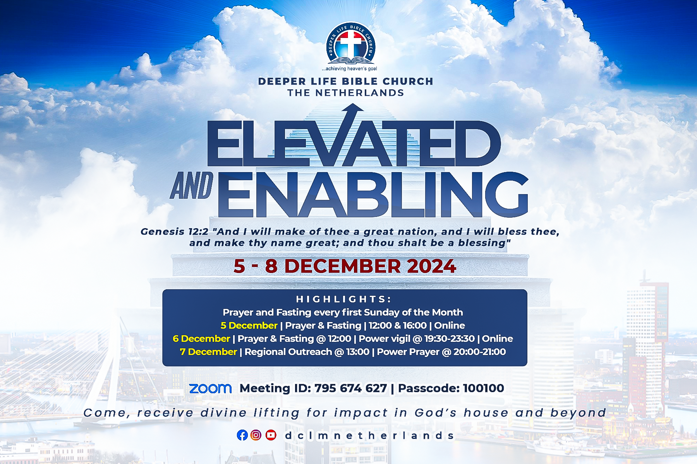

Slide 35
LESSON 982: Divine devastation of the unjust
STS STUDY FOR NEXT WEEK:
MEMORY VERSE: ……
  “The first angel sounded, and there followed hail and fire mingled with blood, and they were cast upon the earth: and the third part was burnt up, and all green grass was burnt up”( Revelation 8:7).
TEXT: Revelation 8:1-13

Slide 36
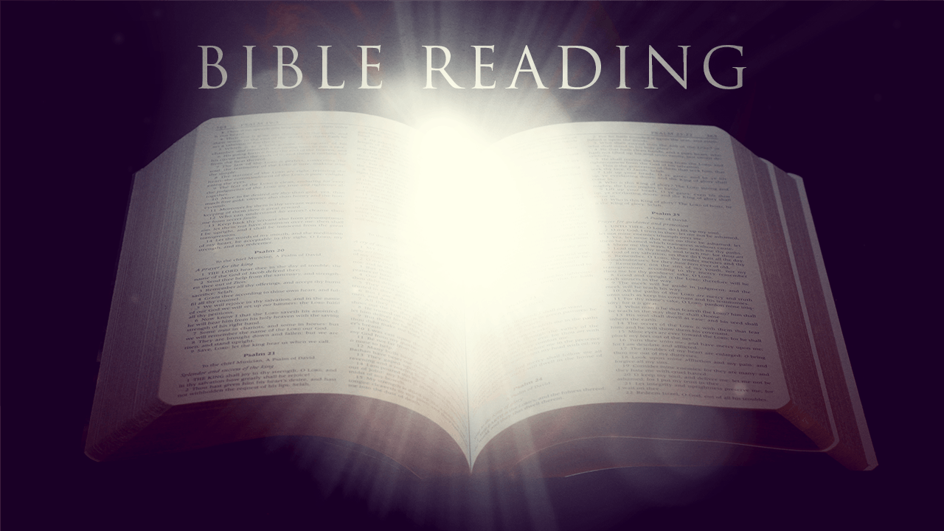

Leviticus 6:8-13

Slide 37
HYMN
GHS 225: BURN, FIRE OF GOD!

Slide 38
BURN, FIRE OF GOD! [GHS 225]
1.
Burn, fire of God! my ransomed soul possessing;
Pure fire Thou art, and I would dwell in Thee.
Light of my life, true source of ev’ry blessing,
Grant all my days one holy flame to be.

Slide 39
BURN, FIRE OF GOD! [GHS 225]
2.
Burn, fire of God! Thy grace and glory knowing,
My cleansed heart shall be all fire within:
Love all-constraining, tenderness o’erflowing,
One kindling passion other lives to win.

Slide 40
BURN, FIRE OF GOD! [GHS 225]
3.
Burn, fire of God! Thy cloven tongue bestowing,
Baptizing me with heavenly energy.
Touched with live coals from off Thine altar glowing,
My purged lips shall speak alone of Thee.

Slide 41
BURN, FIRE OF GOD! [GHS 225]
4.
Burn, fire of God! with seven-fold refining,
Till mirrored from my deeps Thine eyes shall see.
In purest gold Thy perfect image shining:
Thy Christ revealed in clear irradiancy.

Slide 42
BURN, FIRE OF GOD! [GHS 225]
5.
Burn, fire of God! by Thine own love transcending,
Let all I hold be Thine, and Thine alone!
Heart, mind and will, a sacrifice ascending,
Consumed by fire from out Thy fiery Throne.

Slide 43

CHOIR

Slide 44
FASTING AND PRAYER
“THE FIRE… SHALL NEVER GO OUT”

Slide 45
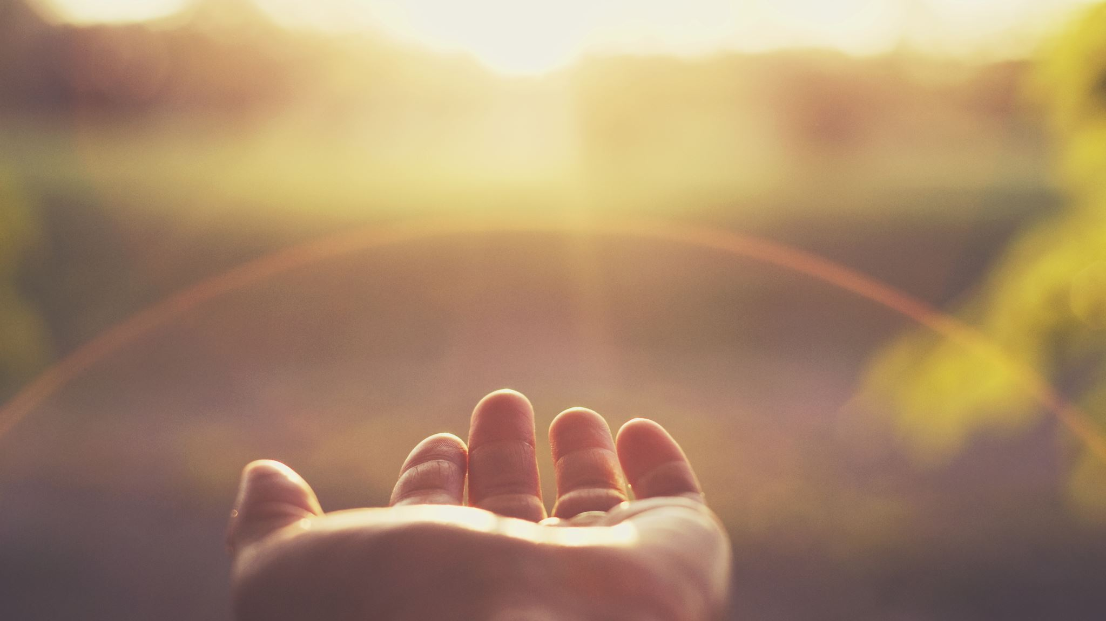
TIME TO PRAY

