Slide 1


Slide 2


GLOBAL WORSHIP SERVICE
The Netherlands
01-12-2024

Slide 3
HYMN
GHS 207: THERE’S A GREAT DAY COMING

Slide 4
THERE’S A GREAT DAY COMING [GHS 207]
1.
There’s a great day coming
A great day coming
There’s a great day coming by and by
When the saints and the sinners shall be
Parted right and left
Are you ready for that day to come?

Slide 5
Are you ready? Are you ready?
Are you ready for the judgment day?
Are you ready? Are you ready?
For the judgment day?

Slide 6
THERE’S A GREAT DAY COMING [GHS 207]
2.
There’s a bright day coming
A bright day coming
There’s a bright day coming by and by;
But its brightness shall only come
To them that love the Lord,
Are you ready for that day to come?

Slide 7
Are you ready? Are you ready?
Are you ready for the judgment day?
Are you ready? Are you ready?
For the judgment day?

Slide 8
THERE’S A GREAT DAY COMING [GHS 207]
3.
There’s a sad day coming
A sad day coming
There’s a sad day coming by and by
When the sinner shall hear his doom
“Depart, I know ye not,”
Are you ready for that day to come?

Slide 9
Are you ready? Are you ready?
Are you ready for the judgment day?
Are you ready? Are you ready?
For the judgment day?

Slide 10

SEARCH THE SCRIPTURES
01-12-2024

Slide 11
CONCLUSION OF OUR LAST STUDY
“The foundation of God standeth sure, having this seal, the Lord knoweth them that are his. And, let everyone that nameth the name of Christ depart from iniquity” (2 Tim 2:19).
The great tribulation will be a time of intense torment and agony. You may likely not survive it. Don’t defer your decision of salvation. Today, give your life to Jesus! You will enjoy God’s blessings on earth and eternal life in heaven.
The sealing of God’s servants

Slide 12
LESSON 982: Divine devastation of the unjust
MEMORY VERSE: ……
  “The first angel sounded, and there followed hail and fire mingled with blood, and they were cast upon the earth: and the third part was burnt up, and all green grass was burnt up”( Revelation 8:7).
TEXTS: Revelation 8:1-13

Slide 13
INTRODUCTION
The study today is a continuation of God’s judgement and wrath on the ungodly during the great tribulation. Six of the seven seals have been broken already. In this chapter, the seventh seal is opened, unveiling seven angels and seven trumpets of judgement and devastations on the earth. Heaven will stand in silence while expecting God’s wrath on the earth. God is a righteous Judge. His justice demands that He shows mercy to those that repent and punish the unrepentant.

Slide 14
QUESTION 1
Why is the Lord justified to visit the earth with these calamitous events?
Prov. 11:21; Rom. 11:22; Nah. 1:3

Slide 15
Rev. 8: 1-6; Amos 3:6-11; Num. 10:1-2,9; Rev. 6:10; Luke 18:7-8
SOLEMN PREPARATION AND SAINTS’ PRAYER BEFORE SEVERE JUDGEMENT
The fearful nature of the calamity ahead brought silence in heaven. The seven trumpets are symbolic of warnings to the ungodly world of approaching calamity. The martyred saints in heaven have been praying that God should vindicate His people and judge the earth. As their united prayers ascend, great and fearful calamities descend on earth. The way is now prepared for fearful commotions and death-producing changes to occur on earth.

Slide 16
QUESTION 2
Explain the use of trumpets in the Bible.
Num. 10:1-2,9

Slide 17
Rev. 8:7-9; Psalm 11:5-6; Zeph. 1:14-18
SINNERS’ PUNISHMENT AND POLLUTION OF THE SEA BY THE SOVEREIGN JUDGE
The sounding of the first and second trumpets will bring terrible ecological devastation on a third part of the earth and the sea. These punishments will negatively affect human economy and wellbeing including food supply, commerce and ocean transportation lines. Every corner of the earth will be affected. All these events should make sinners to heed God’s warning and flee from the wrath to come. Believers are to awake to the urgency of warning unbelievers of the coming danger.

Slide 18
QUESTION 3
Enumerate the effects of the judgment on vegetation and water to human life and economy.
Rev. 8:7,8,9

Slide 19
QUESTION 4
What should sinners and backsliders do in order to escape the impending judgment of God upon the sinful world?
Isaiah 1:18-20

Slide 20
Rev. 8:10-13; Luke 21:25-26, 34-36
SERIES OF PLAGUES UPON SINNERS AND THE UNJUST
The judgement of the third trumpet will also affect fresh water supplies and many people will die after drinking the water made bitter by the star called Wormwood. Sorrow and bitter judgement await the unjust who reject Christ and the gospel of salvation. The sound of the fourth trumpet will reduce the light of the sky by one third. All these judgments will be preparatory to a greater manifestation of divine wrath and woes which are still to come. The only way to escape God’s judgement is to be saved and holy.

Slide 21
QUESTION 5
What should be the believers’ duty in the light of the devastation upon the unjust?
Eze.33:7; Romans 10:13-14

Slide 22
CONCLUSION
It is not the will of God that any should perish. Therefore, He has given sufficient warnings to man to amend his ways and reconcile with His Maker. Should man reject these warnings, doom is inevitable.
“He that being often reproved hardeneth his neck, shall suddenly be destroyed and that without remedy” (Proverbs 29:1)

Slide 23


SEARCH THE SCRIPTURES SUMMARY

Slide 24

INTERCESSION

Slide 25
TITHES AND OFFERING
Kindly pay via one of the following options:
Your phone
Bank transfer to
Cash
IBAN: NL90ABNA0416385699
Remarks: Tithes (name of region)
“… God loves a cheerful giver”
- 2 Corinthians 9:7

Slide 26

WELCOME TO
DEEPER LIFE BIBLE CHURCH
A CHURCH ON THE MOVE…
“Come thou with us and we will do thee good: for the Lord hath spoken good concerning [us]”
– Numbers 10:29
GOD’S FAMILY
GOD’S FOOD
GLOWING FOLD
We are a family, God’s family:
Our Father: God
Our Saviour: Jesus
Our Comforter: The Holy Spirit
Our destination: Heaven
We feast on God’s pure Word. We:
Read it
Study it
Believe it
Apply it
We want you to be part of us – a growing and glowing family. Join us and you will soon discover what makes our identity unique.
For your time and eternal profit, this is the place to be!

Slide 27








COUNSELLING
SERVICE SCHEDULES
Service | Day | Timing | Remarks
Worship Service | Sunday | 09:45-12:00 | Physical/Online
Bible Study | Tuesday | 19:30-20:30 | Online
Revival Service | Friday | 19:30-21:00 | Online/Physical
Night Vigil | Friday | 19:30-23:30 | First Friday Monthly
If you have questions or need guidance on challenging issues, kindly request for counselling.
Our pastor is here for you.
CONTACT
+31 207 856 683
info@deeperlife.nl
LOCATION DETAILS
Location | Telephone # | ZOOM Meeting ID
Amsterdam | +31 686 093 624 | 795-674-627
Eindhoven | +31 643 678 896 | 912-749-784
Rotterdam | +31 642 133 520 | 237-801-783
The Hague | +31 685 076 861 | 818-6898-8436
dclmnetherlands
www.dclm-nl.org

Slide 29
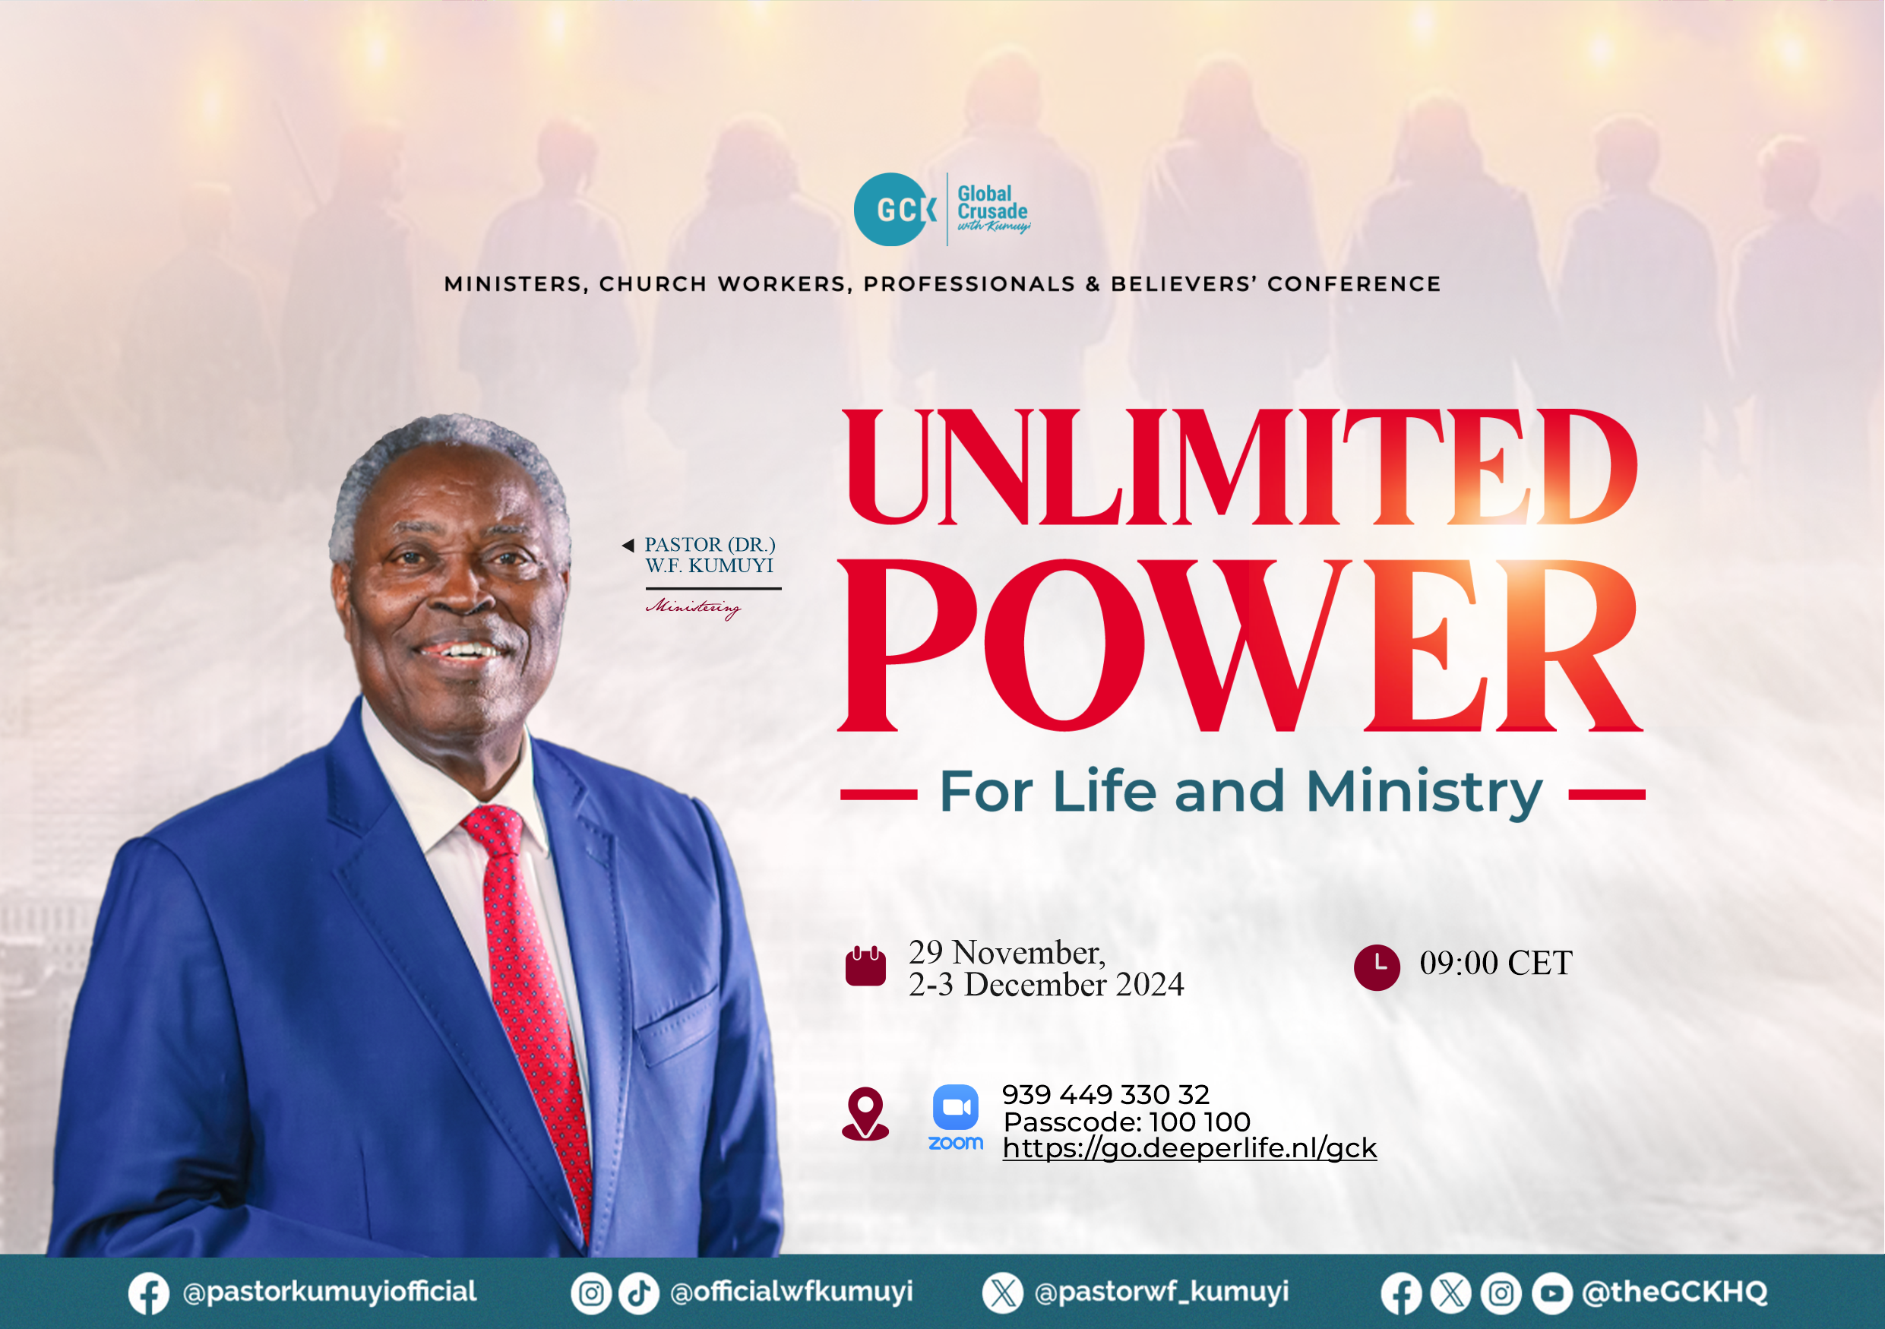

Slide 30
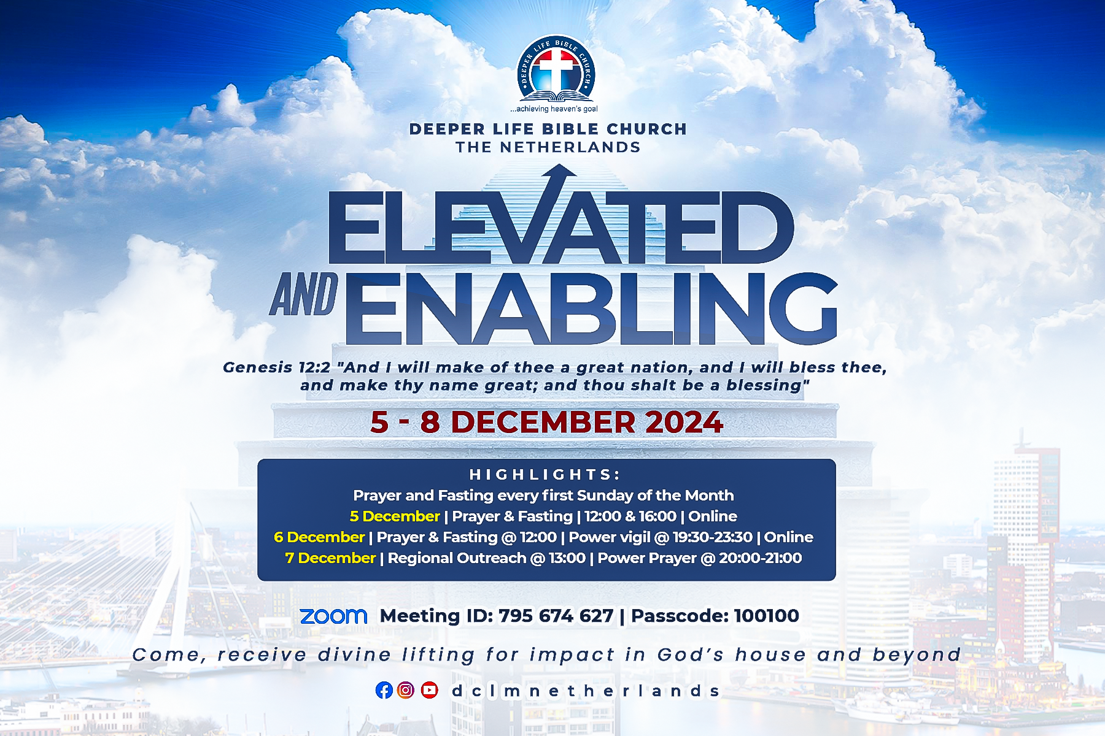

Slide 31
STS STUDY FOR NEXT WEEK:
SPECIAL SEMINAR

Slide 32

CHOIR

Slide 33
CONNECTION TO GCK

Slide 34

TIME TO PRAY

