Slide 1


SUPER SUNDAY SERVICE
The Netherlands
15-12-2024

Slide 2
HYMN
GHS 208: THE GREAT JUDGMENT MORNING

Slide 3
THE GREAT JUDGMENT MORNING [GHS 208]
1.
I dreamed that the great judgment morning
Had dawned and the trumpet had blown;
I dreamed that the nations had gathered
To judgment before the white throne;
From the throne came a bright shining angel,
And stood on the land and the sea,
And swore with his hand raised to heaven,
That time was no longer to be.

Slide 4
And O, what a weeping and wailing,
As the lost were told of their fate;
They cried for the rocks and the mountains,
They prayed, but their prayer was too late.

Slide 5
THE GREAT JUDGMENT MORNING [GHS 208]
2.
The rich man was there, but his money
Had melted and vanished away;
A pauper he stood in the judgment,
His debts were too heavy to pay;
The great man was there, but his greatness,
When death came, was left far behind!
The angel that opened the records,
Not a trace of his greatness could find.

Slide 6
And O, what a weeping and wailing,
As the lost were told of their fate;
They cried for the rocks and the mountains,
They prayed, but their prayer was too late.

Slide 7
THE GREAT JUDGMENT MORNING [GHS 208]
3.
The widow was there with the orphans,
God heard and remembered their cries;
No sorrow in heaven for ever,
God wiped all the tears from their eyes;
The gambler was there and the drunkard,
And the man that had sold them the drink,
With the people who gave him the license,
Together in hell they did sink.

Slide 8
And O, what a weeping and wailing,
As the lost were told of their fate;
They cried for the rocks and the mountains,
They prayed, but their prayer was too late.

Slide 9
THE GREAT JUDGMENT MORNING [GHS 208]
4.
The moral man came to the judgment,
But his self-righteous rags would not do;
The men who had crucified Jesus
Had passed off as moral men, too;
The soul that had put off salvation,
“Not tonight; I’ll get saved by and by,
No time now to think of religion!”
At last they all found time to die.

Slide 10
And O, what a weeping and wailing,
As the lost were told of their fate;
They cried for the rocks and the mountains,
They prayed, but their prayer was too late.

Slide 11

SEARCH THE SCRIPTURES
15-12-2024

Slide 12
REVIEW OF THE
ASSIGNMENT
FROM LAST
STUDY
God is patient and merciful, giving time for repentance. What are examples in the Bible where God showed mercy, people took His mercy for granted, ignored His warnings, and eventually perished?
Warn sinners of the impending judgment by preaching to at least three souls this new week
Divine devastation of the unjust

Slide 13
LESSON 983: Severe wrath on the unrepentant
MEMORY VERSE: ……
  “God judgeth the righteous, and God is angry with the wicked every day. If he turn not, he will whet his sword; he hath bent his bow, and made it ready” (Psalm 7:11,12).
TEXTS: Revelation 9:1-21

Slide 14
INTRODUCTION
This chapter describes the judgments associated with the sounding of the 5th and 6th trumpets, known as the woe-trumpets, signifying severe wrath targeted at the unrepentant who rejected God’s authority even after witnessing earlier fearsome judgments. Unbearable suffering will be inflicted by demonic locusts upon sinners during the great tribulation. The next phase will involve further disasters, with destructive angels and their vast army killing a third of the remaining people on Earth. When the dispensation of grace ends at the rapture, the ungodly will face His judgment.

Slide 15
Revelation 9:1-21
KEY LESSONS IN THE STUDY OF TODAY
Refusal to submit despite earlier judgments, underscores the deep-rooted nature of sin in humanity, and the reality of free will.
The fierceness of God’s judgment underscores the dual nature of His character: He is just in His judgments, yet merciful in offering a way of salvation.
The sealing of the saints symbolizes God’s ability to shield His chosen people even amidst unparalleled tribulation
Believers are expected to continue heralding the message of hope and warning sinners of the approaching calamity.

Slide 16
QUESTION 1
Mention those who will suffer divine judgment in the text and the reason for it.
Revelation. 9:4

Slide 17
QUESTION 2
Describe the plight of sinners in the hands of merciless demon-locusts.
Revelation 9:5-6

Slide 18
QUESTION 3
What is the way of escape from divine judgment during the great tribulation.
Revelation 14:6-7; Romans 10:9

Slide 19
QUESTION 4
What consolation do believers receive from the preservation of sealed saints from attack of spirit-locusts?
Psalms 91:3-4; 121:7-8

Slide 20
QUESTION 5
What do believers learn from the torments and deaths of the rebellious in the text?
Proverbs 29:1; Proverbs 11:21

Slide 21
CONCLUSION
The sounding of the fifth and sixth trumpets are to warn everyone to embrace God’s gift of salvation before it is too late. The great tribulation is real and all who miss the rapture shall suffer divine judgment. "For our God is a consuming fire” (Hebrews 12:29).

Slide 22
ASSIGNMENT
List four (groups of) people in the Bible upon whom God pronounced judgment, who later repented and received mercy.
State lessons you learn from their actions.

Slide 23


SEARCH THE SCRIPTURES SUMMARY

Slide 24

INTERCESSION

Slide 25
TITHES AND OFFERING
Kindly pay via one of the following options:
Your phone
Bank transfer to
Cash
IBAN: NL90ABNA0416385699
Remarks: Tithes (name of region)
“… God loves a cheerful giver”
- 2 Corinthians 9:7

Slide 26

WELCOME TO
DEEPER LIFE BIBLE CHURCH
A CHURCH ON THE MOVE…
“Come thou with us and we will do thee good: for the Lord hath spoken good concerning [us]”
– Numbers 10:29
GOD’S FAMILY
GOD’S FOOD
GLOWING FOLD
We are a family, God’s family:
Our Father: God
Our Saviour: Jesus
Our Comforter: The Holy Spirit
Our destination: Heaven
We feast on God’s pure Word. We:
Read it
Study it
Believe it
Apply it
We want you to be part of us – a growing and glowing family. Join us and you will soon discover what makes our identity unique.
For your time and eternal profit, this is the place to be!

Slide 27








COUNSELLING
SERVICE SCHEDULES
Service | Day | Timing | Remarks
Worship Service | Sunday | 09:45-12:00 | Physical/Online
Bible Study | Tuesday | 19:30-20:30 | Online
Revival Service | Friday | 19:30-21:00 | Online/Physical
Night Vigil | Friday | 19:30-23:30 | First Friday Monthly
If you have questions or need guidance on challenging issues, kindly request for counselling.
Our pastor is here for you.
CONTACT
+31 207 856 683
info@deeperlife.nl
LOCATION DETAILS
Location | Telephone # | ZOOM Meeting ID
Amsterdam | +31 686 093 624 | 795-674-627
Eindhoven | +31 643 678 896 | 912-749-784
Rotterdam | +31 642 133 520 | 237-801-783
The Hague | +31 685 076 861 | 818-6898-8436
dclmnetherlands
www.dclm-nl.org

Slide 28
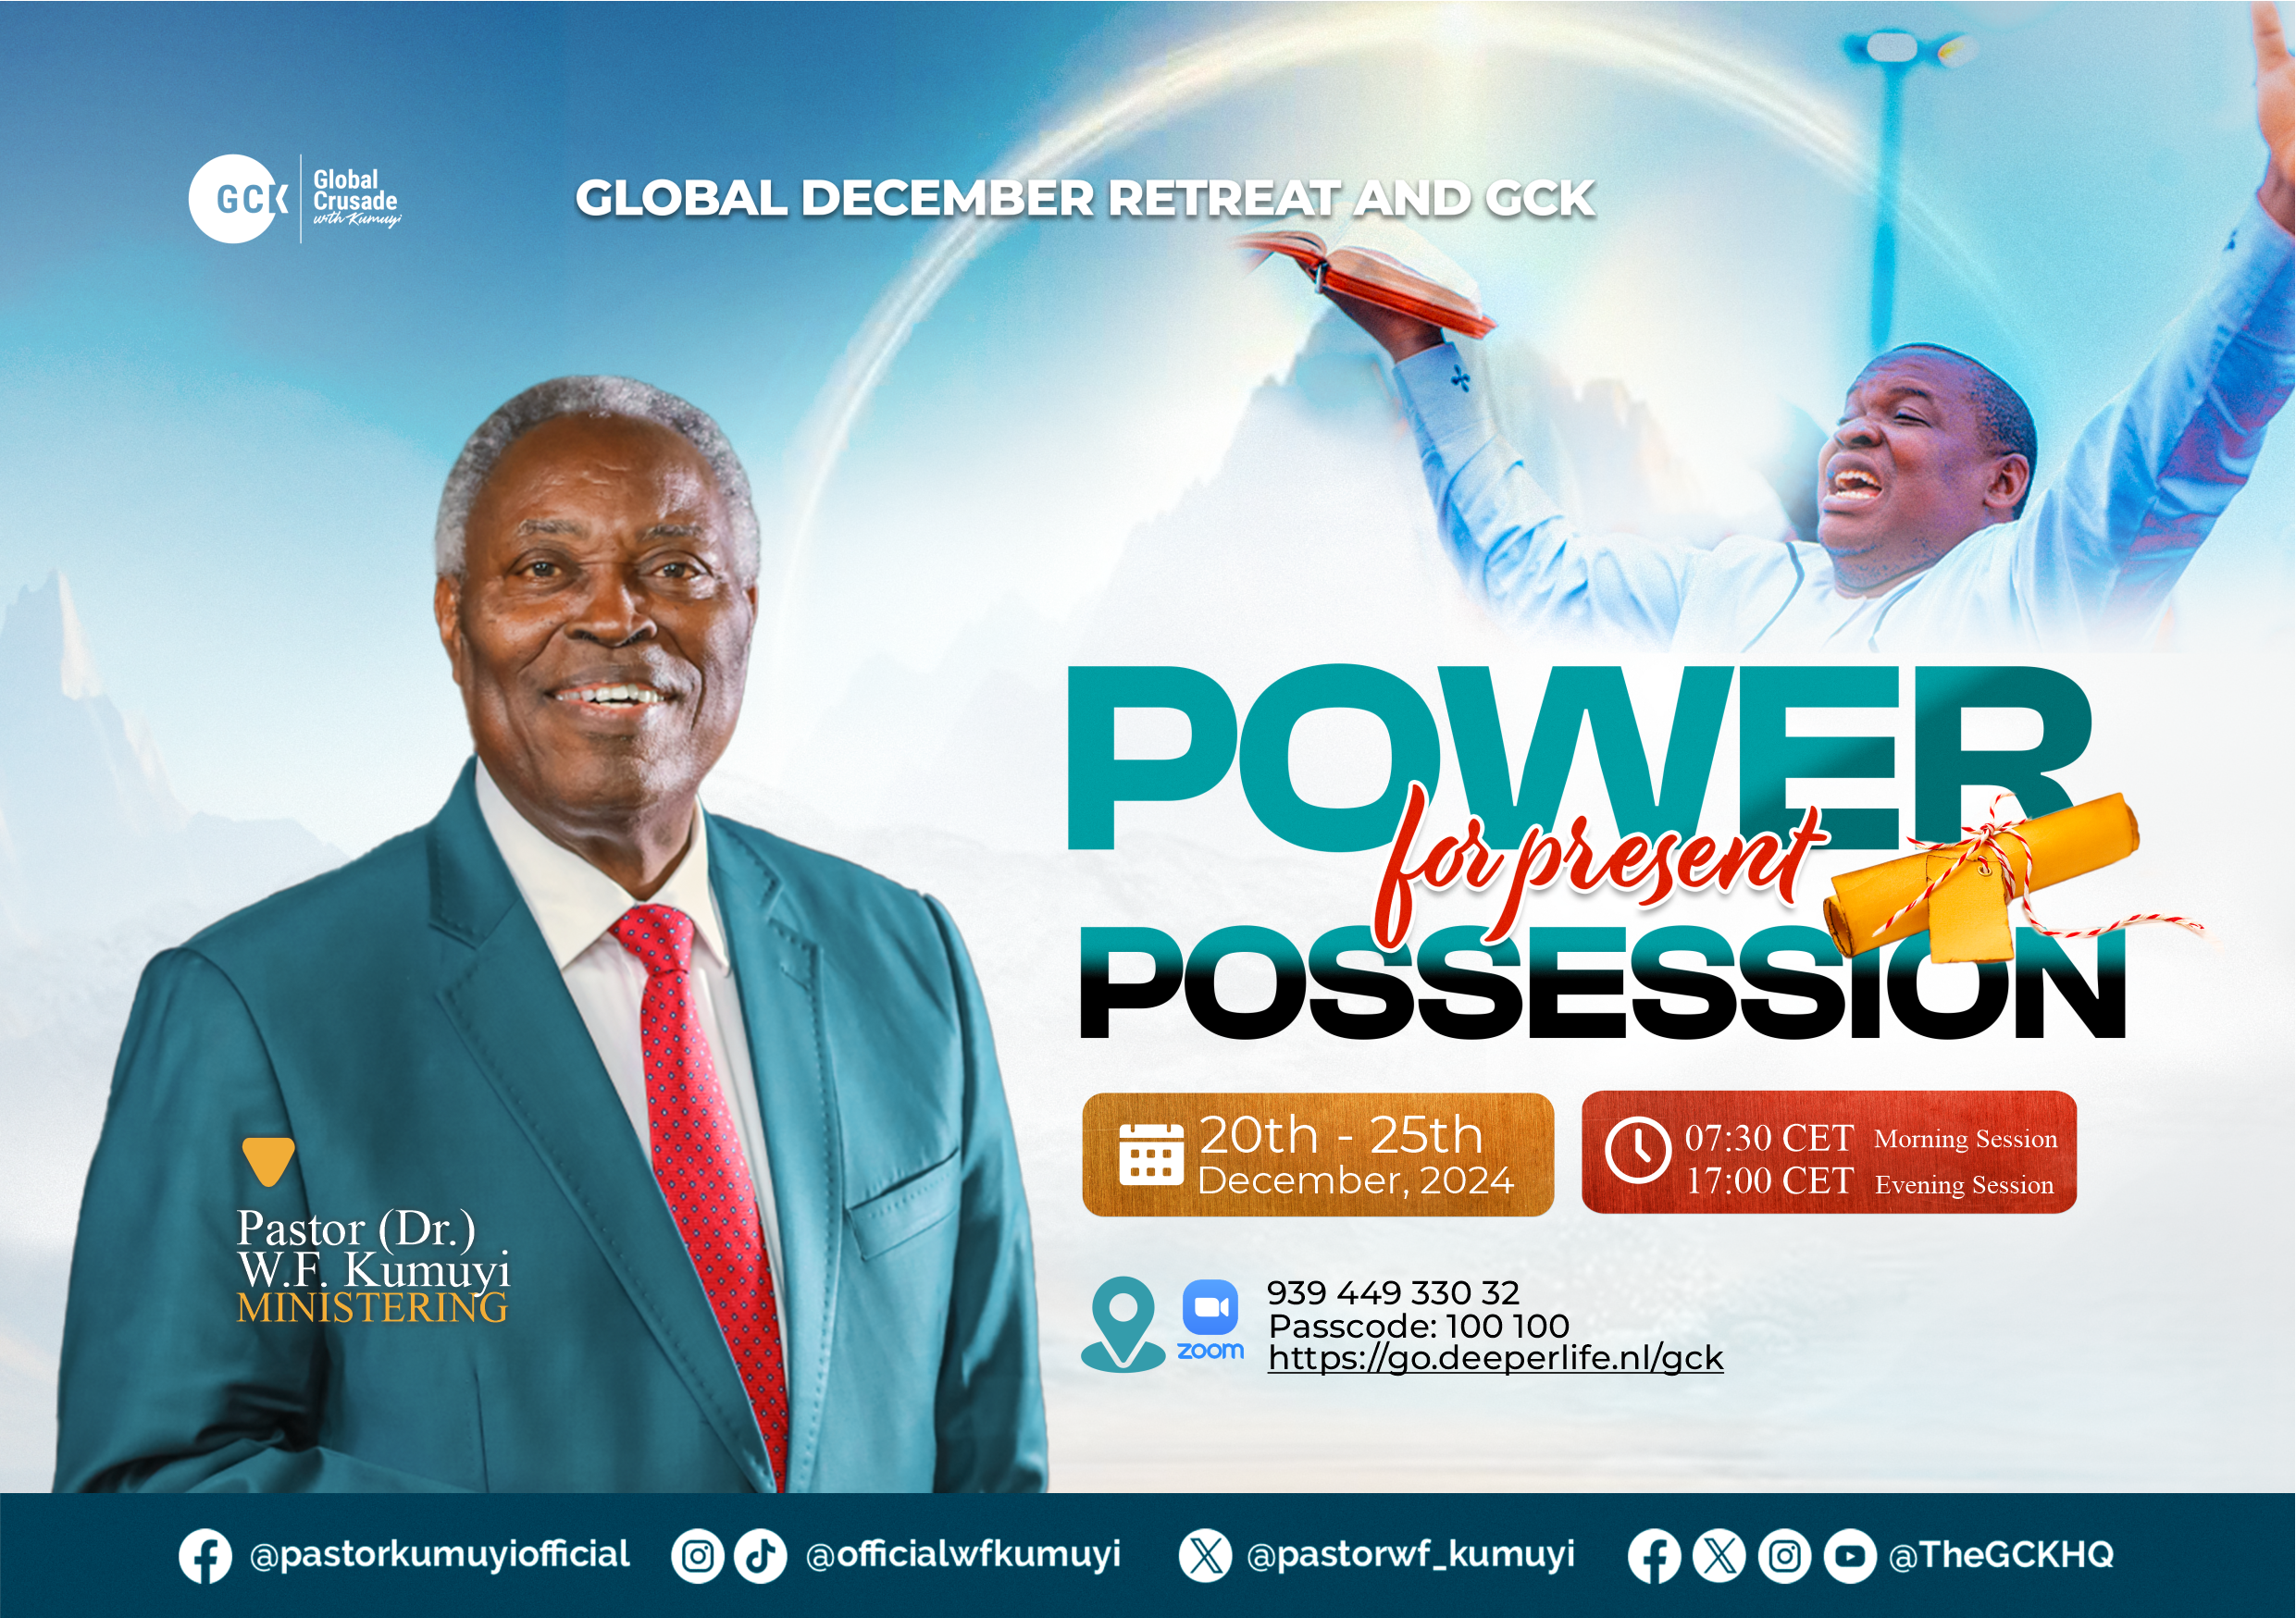

Slide 29


Slide 30
2024 DECEMBER RETREAT AND GLOBAL CRUSADE PLAN
 | 08:00-09:30 | 09:30-12:30 | 13:30-15:00 | 17:00-21:00
FRI 20 DEC |  |  |  | GLOBAL CRUSADE (GCK) GLOBAL ZOOM http://go.deeperlife.nl/gck
SAT 21 DEC | RETREAT: National Zoom ID: 795-674-627 Passcode: 100 100 http://go.deeperlife.nl/zoom
SUN 22 DEC |  | RETREAT: Regional (Physical in church)
MON 23 DEC
TUE 24 DEC
WED 25 DEC | RETREAT National Zoom | RETREAT National Zoom |  | Global crusade Zoom ID: 816-983-288 Passcode: 100 100
 |  | IMPACT ACADEMY
OR
Zoom ID: 939-449-330-32 Passcode: 100 100
National
Regional
Global (Personal)

Slide 31
NO LESSON :
STS STUDY FOR NEXT WEEK:
  GCK/RETREAT

Slide 32
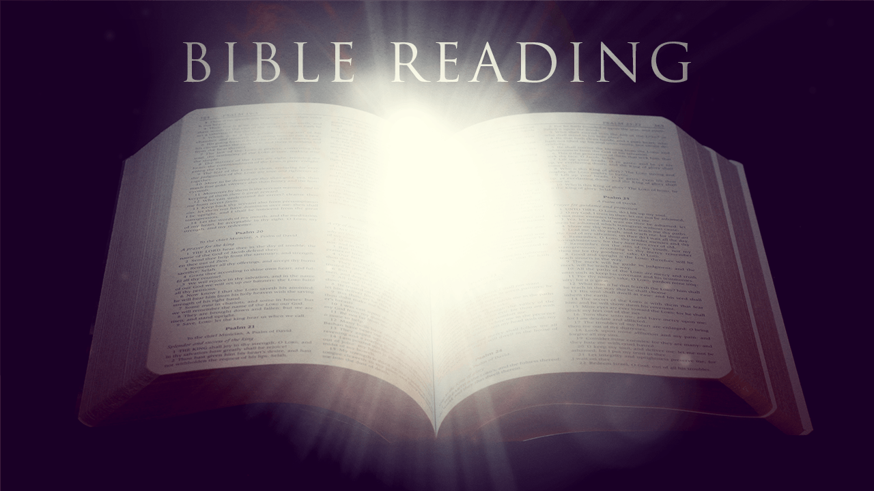

2 Samuel 23:1-39

Slide 33
HYMN
VICTORY ALL THE TIME

Slide 34
VICTORY ALL THE TIME
1.
They who know the Savior shall in Him be strong,
Mighty in the conflict of the right ’gainst wrong;
This the blessed promise given in God’s Word,
Doing wondrous exploits, they who know the Lord.

Slide 35
Victory! victory! Blessed, blood-bought victory!
Victory! victory! Vict’ry all the time!
As Jehovah liveth, strength divine He giveth
Unto those who know Him—vict’ry all the time!

Slide 36
VICTORY ALL THE TIME
2.
In the midst of battle be thou not dismayed,
Though the pow’rs of darkness ’gainst thee are arrayed;
God, thy Strength, is with thee, causing thee to stand,
Heaven’s allied armies wait at thy command.

Slide 37
Victory! victory! Blessed, blood-bought victory!
Victory! victory! Vict’ry all the time!
As Jehovah liveth, strength divine He giveth
Unto those who know Him—vict’ry all the time!

Slide 38
VICTORY ALL THE TIME
3.
Brave to bear life’s testing, strong the foe to meet,
Walking like a hero midst the furnace heat,
Doing wondrous exploits with the Spirit’s sword,
Winning souls for Jesus, praise, oh, praise the Lord!

Slide 39
Victory! victory! Blessed, blood-bought victory!
Victory! victory! Vict’ry all the time!
As Jehovah liveth, strength divine He giveth
Unto those who know Him—vict’ry all the time!

Slide 40

CHOIR

Slide 41
TODAY’S SERMON
BECOMING A LABOURER WITH DISTINCTION

Slide 42

TIME TO PRAY

