Slide 1
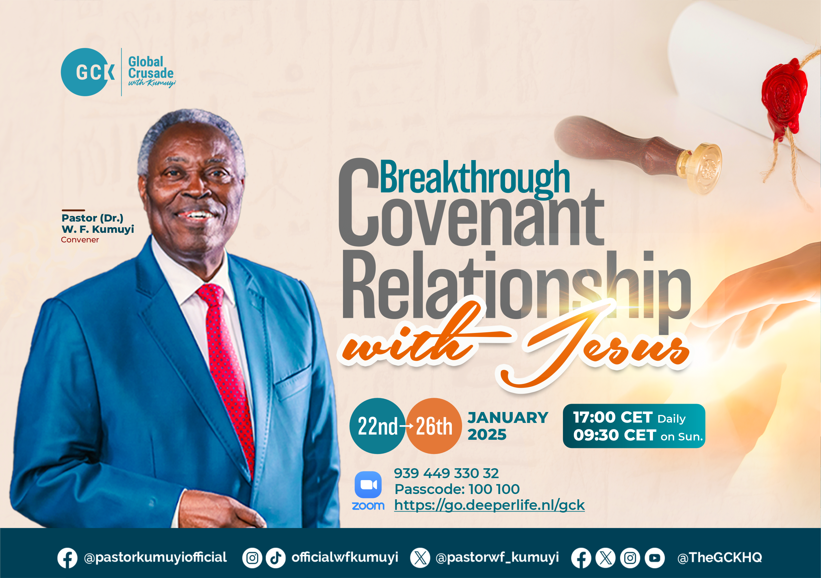

Slide 2

GLOBAL WORSHIP SERVICE
26-01-2025

Slide 3
HYMN
GHS 015: O WORSHIP THE KING

Slide 4
O WORSHIP THE KING [GHS 015]
1.
O worship the King,
All glorious above,
O gratefully sing
His power and His love:
Our Shield and Defender,
The Ancient of Days,
Pavillion’d in splendour,
And girded with praise.

Slide 5
O WORSHIP THE KING [GHS 015]
2.
O tell of His might,
O sing of His grace,
Whose robe is the light,
Whose canopy space.
His chariots of wrath
The deep thunder-clouds form,
And dark is His path
On the wings of the storm.

Slide 6
O WORSHIP THE KING [GHS 015]
3.
Thy bountiful care,
What tongue can recite?
It breathes in the air,
It shines in the light,
It streams from the hills,
It descends to the plain,
And sweetly distils
In the dew and the rain.

Slide 7
O WORSHIP THE KING [GHS 015]
4.
Frail children of dust,
And feeble as frail;
In Thee we do trust,
Nor find Thee to fail;
Thy mercies, how tender,
How firm to the end,
Our Maker, Defender,
Redeemer, and Friend!

Slide 8
O WORSHIP THE KING [GHS 015]
5.
O measureless Might!
Ineffable Love!
While angels delight
To hymn Thee above,
The humbler creation,
Though feeble their lays,
With true adoration
Shall lisp to Thy praise.

Slide 9

SEARCH THE SCRIPTURES
26-01-2025

Slide 10
REVIEW OF OUR ASSIGNMENT OF LAST STUDY
Choose one person this week as an evangelism target. Pray for him/her daily. Create an opportunity to share the gospel with him/her physically or over the phone. Come to share your testimony next Sunday.
Share your testimony on your experience with your evangelism contact of last week.
The act of soul-winning

Slide 11
LESSON 988: The nature and attributes of God
MEMORY VERSE: ……
  “God is a Spirit: and they that worship him must worship him in spirit and in truth” (John 4:24).
TEXTS: Psalm 139:1-16; Isaiah 40:9-28

Slide 12
INTRODUCTION
Man is born with an innate awareness of God because God created in man the instinct to know Him. Understanding God’s nature and attributes is essential, as no individual, nation, or church can rise above their concept of God. Wherever there is a proper understanding of God, there is prosperity, peace, spiritual growth, and material blessings. Daniel rightly said, “The people that do know their God shall be strong and do exploits” (Dan 11:32). The more you know God, the deeper your spiritual growth and the more significant your progress in life.

Slide 13
Rom 1:21-25; Gen
22:14; Exo 6:3; 15:26; Isa 40:9-17,21-
28; Dan 4:35
KEY LESSONS IN THE STUDY OF TODAY
We can know God through faith; yet man has devised false concepts of God through pride, ignorance, unbelief and hardness of heart.
God’s nature is revealed through His names, such as Elohim (The Strong One), Jehovah-Nissi (The Lord Our Banner), Jehovah-Rapha (The Lord Who Heals), Jehovah-Jireh (The Lord Who Provides), Jehovah-Ra’ah (The Lord Our Shepherd) etc.
God’s attributes reveal His perfect nature and call His people to live in holiness, worshipping and serving Him in spirit and truth.

Slide 14
QUESTION 1
Why is it important to know God? Dan 11:32 Hosea 4:6; Isa 5:13-14 Rom 1:28-29

Slide 15
QUESTION 2
What alternatives have men made beside God? Acts 17:16,22,23; Rom 1:21-25; Phi 3:18,19; Pro 18:10,11

Slide 16
QUESTION 3
Why is it dangerous to deny the existence of God? Rom 1:25; Psalm 10:2-11; 14:1

Slide 17
QUESTION 4
Mention four names of God and what they signify. Judges 6:23-24; Gen 22:13-14, Gen 17:1; Exo 15:26

Slide 18
QUESTION 5
What can we learn from God’s sovereignty, omnipotence, omniscience and omnipresence? Col 1:16- 17; Ps 62:11;139:4,6-10

Slide 19
QUESTION 6
What challenge does the holiness of God pose to every believer? Hab 1:13; 1 Pet 1:15-16

Slide 20
CONCLUSION
To experience the fullness of God’s grace, love, power, and goodness, we must first reject all unscriptural views that distort His true nature. By understanding God as He has revealed Himself through His names and attributes, we draw closer to Him and partake in the blessings He offers. Only by aligning our lives with His nature can we fully experience the richness of His presence and power.

Slide 21
ASSIGNMENT
The attributes of God are divided into two categories. Those that man can share with Him are called ‘communicable attributes’, e.g., holiness. Those that man does not share with Him are called ‘incommunicable attributes’, e.g., omniscience (all-knowing).
Make a list of other attributes in both categories.

Slide 22


SEARCH THE SCRIPTURES SUMMARY

Slide 23

INTERCESSION

Slide 24
TITHES AND OFFERING
Kindly pay via one of the following options:
Your phone
Bank transfer to
Cash
IBAN: NL90ABNA0416385699
Remarks: Tithes (name of region)
“… God loves a cheerful giver”
- 2 Corinthians 9:7

Slide 25

WELCOME TO
DEEPER LIFE BIBLE CHURCH
A CHURCH ON THE MOVE…
“Come thou with us and we will do thee good: for the Lord hath spoken good concerning [us]”
– Numbers 10:29
GOD’S FAMILY
GOD’S FOOD
GLOWING FOLD
We are a family, God’s family:
Our Father: God
Our Saviour: Jesus
Our Comforter: The Holy Spirit
Our destination: Heaven
We feast on God’s pure Word. We:
Read it
Study it
Believe it
Apply it
We want you to be part of us – a growing and glowing family. Join us and you will soon discover what makes our identity unique.
For your time and eternal profit, this is the place to be!

Slide 26








COUNSELLING
SERVICE SCHEDULES
Service | Day | Timing | Remarks
Worship Service | Sunday | 09:45-12:00 | Physical/Online
Bible Study | Tuesday | 19:30-20:30 | Online
Revival Service | Friday | 19:30-21:00 | Online/Physical
Night Vigil | Friday | 19:30-23:30 | First Friday Monthly
If you have questions or need guidance on challenging issues, kindly request for counselling.
Our pastor is here for you.
CONTACT
+31 207 856 683
info@deeperlife.nl
LOCATION DETAILS
Location | Telephone # | ZOOM Meeting ID
Amsterdam | +31 686 093 624 | 795-674-627
Eindhoven | +31 643 678 896 | 912-749-784
Rotterdam | +31 642 133 520 | 237-801-783
The Hague | +31 685 076 861 | 818-6898-8436
dclmnetherlands
www.dclm-nl.org

Slide 28

BELIEVER’S DEVELOPMENT PROGRAMME (BDP)
BDP Beginners’ Classes Begins:
START DATE: SUN. 2ND FEB. 2025
TIME: 19:30 - 20:30
VENUE: Via Zoom ( The Zoom ID will be shared soon)
NOTE:
This BDP session is for the beginners.
The date for the intermediate session
will be communicated soon.
“Know ye not that they which run in a race run all, but one receiveth the prize? So run, that ye may obtain” (1 Cor 9:24 )

Slide 29
LESSON 989: Comfort and confidence in god’s presence
STS STUDY FOR NEXT WEEK:
MEMORY VERSE: ……
  “Truly my soul waiteth upon God: from Him cometh my salvation; he is my defence; I shall not be greatly moved” (Psalm 62:1,2).
TEXT: Psalm 61 to 63

Slide 30

CHOIR

Slide 31
CONNECTION TO GCK

Slide 32

TIME TO PRAY

