Slide 1

SUPER SUNDAY
SERVICE
19-01-2025

Slide 2
HYMN
GHS 110: TILL THE WHOLE WORLD KNOWS

Slide 3
TILL THE WHOLE WORLD KNOWS [GHS 110]
1.
I'll tell to all that God is love;
For the world has never known
The great compassion of His heart
For the wayward and the lone.

Slide 4
Till the whole world knows,
Till the whole world knows,
I will shout and sing
Of Christ my King,
Till the whole world knows.

Slide 5
TILL THE WHOLE WORLD KNOWS [GHS 110]
2.
I'll tell of mercy's boundless tide,
Like the waters of the sea,
That covers ev'ry sin of man;
'Tis salvation full and free.

Slide 6
Till the whole world knows,
Till the whole world knows,
I will shout and sing
Of Christ my King,
Till the whole world knows.

Slide 7
TILL THE WHOLE WORLD KNOWS [GHS 110]
3.
I'll tell of grace that keeps the soul,
Of abiding peace within,
Of faith that overcomes the world,
With its tumult and its din.

Slide 8
Till the whole world knows,
Till the whole world knows,
I will shout and sing
Of Christ my King,
Till the whole world knows.

Slide 9
TILL THE WHOLE WORLD KNOWS [GHS 110]
4.
Eternal glory is the goal
That awaits the sons of light;
Eternal darkness, black as death,
For the children of the night.

Slide 10
Till the whole world knows,
Till the whole world knows,
I will shout and sing
Of Christ my King,
Till the whole world knows.

Slide 11

SEARCH THE SCRIPTURES
19-01-2025

Slide 12
REVIEW OF OUR ASSIGNMENT OF LAST STUDY
Explain the event recorded in Mat. 27:50-53 in the light of our study of today. Where do we classify this?
Which class of resurrection does this event belong?
The resurrection of the dead

Slide 13
LESSON 987: The Act of Soul-winning
MEMORY VERSE: ……
  “The Lord gave the word: great was the company of those that published it” (Psalm 68:11).
TEXT: Acts 16:1-10

Slide 14
INTRODUCTION
The New Testament recounts the life and ministry of Jesus Christ, highlighting His mission (Acts 10:38). At the end of His earthly ministry, Jesus gave His disciples the Great Commission, instructing them to preach repentance and salvation to the world. This remains the primary mission of the Church. The early apostles exemplified this commitment, prioritizing evangelism over administrative tasks or social activities. The Lord calls every member of the Church to take up the responsibility of spreading the gospel.
John 14:6; 17:3;Matthew 28:19-20; Mark 16:15-16

Slide 15
Matt. 28:19-20; Mark 16:15; 2 Tim. 2:21-25;4:2-4; Col. 4:5-6
KEY LESSONS IN THE STUDY OF TODAY
The church’s mission is global evangelism; it is a divine mandate, not an option.
An exemplary life of holiness makes the gospel appealing to those we attempt to win.
A soul-winner must be spiritually ready.
A wise and gracious approach opens doors for the gospel to be received.
As a steward, you must keep to the content of the gospel in its purity to ensure its truth is passed on to future generations.
Reliance on the Spirit by meditation, prayer, and listening ensures success in soul-winning.

Slide 16
QUESTION 1
Why is the work of the soul-winner a weighty or serious matter? Mark 16:15-16; Ezekiel 33:8-9

Slide 17
QUESTION 2
Describe the right disposition to the gospel work from these references:
Matthew 9:36; Romans 9:1-3

Slide 18
QUESTION 3
What precautions must soul-winners take to be effective?
Colossians 4:5-6 ; 1 Peter 3:15

Slide 19
QUESTION 4
How can you make yourself fit for soul-winning from these references?
2 Timothy 2:21; 1 Corinthians 9:27

Slide 20
QUESTION 5
How can we preserve and defend the truth of the gospel in a world of false doctrines? Jude 1:3-4,17-21

Slide 21
QUESTION 6
What is the role of the Holy Ghost in guiding soul-winning efforts?
Acts 1:8; Acts 16:6-10

Slide 22
CONCLUSION
Soul-winning is the heartbeat of God and Christ’s central mission for His followers. It requires compassion, unwavering focus, and reliance on the Holy Spirit for guidance. Through obedience to the Great Commission, we fulfil God’s eternal plan to reconcile humanity to Himself. We should be diligent in spreading the gospel with passion, precision, and persistence, knowing that our labour in the Lord is not in vain (1 Corinthians 15:58).

Slide 23
ASSIGNMENT
Choose one person this week as an evangelism target. Pray for him/her daily. Create an opportunity to share the gospel with him/her physically or over the phone. Come to share your testimony next Sunday.

Slide 24


SEARCH THE SCRIPTURES SUMMARY

Slide 25

INTERCESSION

Slide 26
TITHES AND OFFERING
Kindly pay via one of the following options:
Your phone
Bank transfer to
Cash
IBAN: NL90ABNA0416385699
Remarks: Tithes (name of region)
“… God loves a cheerful giver”
- 2 Corinthians 9:7

Slide 27

WELCOME TO
DEEPER LIFE BIBLE CHURCH
A CHURCH ON THE MOVE…
“Come thou with us and we will do thee good: for the Lord hath spoken good concerning [us]”
– Numbers 10:29
GOD’S FAMILY
GOD’S FOOD
GLOWING FOLD
We are a family, God’s family:
Our Father: God
Our Saviour: Jesus
Our Comforter: The Holy Spirit
Our destination: Heaven
We feast on God’s pure Word. We:
Read it
Study it
Believe it
Apply it
We want you to be part of us – a growing and glowing family. Join us and you will soon discover what makes our identity unique.
For your time and eternal profit, this is the place to be!

Slide 28








COUNSELLING
SERVICE SCHEDULES
Service | Day | Timing | Remarks
Worship Service | Sunday | 09:45-12:00 | Physical/Online
Bible Study | Tuesday | 19:30-20:30 | Online
Revival Service | Friday | 19:30-21:00 | Online/Physical
Night Vigil | Friday | 19:30-23:30 | First Friday Monthly
If you have questions or need guidance on challenging issues, kindly request for counselling.
Our pastor is here for you.
CONTACT
+31 207 856 683
info@deeperlife.nl
LOCATION DETAILS
Location | Telephone # | ZOOM Meeting ID
Amsterdam | +31 686 093 624 | 795-674-627
Eindhoven | +31 643 678 896 | 912-749-784
Rotterdam | +31 642 133 520 | 237-801-783
The Hague | +31 685 076 861 | 818-6898-8436
dclmnetherlands
www.dclm-nl.org

Slide 29


Slide 30


Slide 31
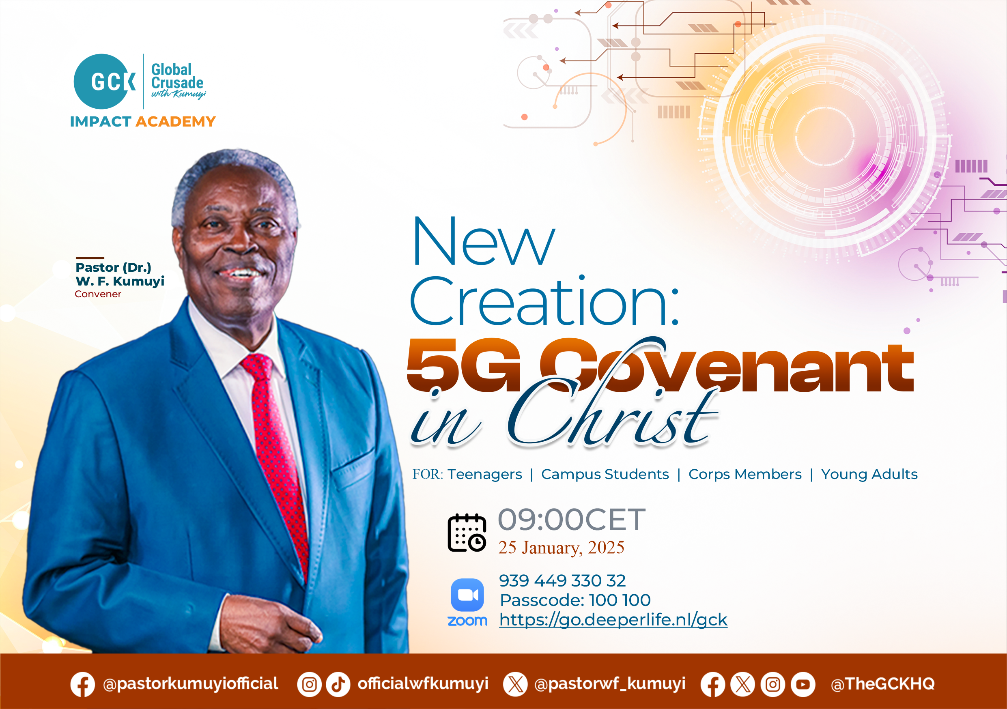

Slide 32
LESSON 988: The nature and attributes of God
STS STUDY FOR NEXT WEEK:
MEMORY VERSE: ……
  “God is a Spirit: and they that worship him must worship him in spirit and in truth” (John 4:24).
TEXT: Psalm 139:1-16; Isaiah 40:9-28

Slide 33


Acts 17:22-30

Slide 34
HYMN
GHS 014: HOW GREAT THOU ART

Slide 35
HOW GREAT THOU ART [GHS 014]
1.
O Lord my God! When I in awesome wonder,
Consider all the works Thy hands hath made,
I see the stars, I hear the rolling thunder,
Thy pow’r thro’ out the universe displayed,

Slide 36
Then sings my soul, my Saviour God to Thee;
How great Thou art, how great Thou art!
Then sings my soul, my Saviour God to Thee;
How great Thou art, how great Thou art!

Slide 37
HOW GREAT THOU ART [GHS 014]
2.
When through the woods and forest glades I wander,
And hear the birds sing sweetly in the trees;
When I look down from lofty mountain grandeur,
And hear the brook and feel the gentle breeze;

Slide 38
Then sings my soul, my Saviour God to Thee;
How great Thou art, how great Thou art!
Then sings my soul, my Saviour God to Thee;
How great Thou art, how great Thou art!

Slide 39
HOW GREAT THOU ART [GHS 014]
3.
And when I think that God, His Son not sparing,
Sent Him to die, I scarce can take it in;
That on the cross, my burden gladly bearing,
He bled and died to take away my sin;

Slide 40
Then sings my soul, my Saviour God to Thee;
How great Thou art, how great Thou art!
Then sings my soul, my Saviour God to Thee;
How great Thou art, how great Thou art!

Slide 41
HOW GREAT THOU ART [GHS 014]
4.
When Christ shall come with shout of acclamation,
And take me home, what joy shall fill my heart!
Then I shall bow in humble adoration,
And there proclaim, my God, how great Thou art!

Slide 42
Then sings my soul, my Saviour God to Thee;
How great Thou art, how great Thou art!
Then sings my soul, my Saviour God to Thee;
How great Thou art, how great Thou art!

Slide 43

CHOIR

Slide 44
TODAY’S SERMON
GOD IS!

Slide 45

TIME TO PRAY

