Slide 1

SUPER SUNDAY SERVICE
02-02-2025

Slide 2
HYMN
GHS 022: SIMPLY TRUSTING EVERYDAY

Slide 3
SIMPLY TRUSTING EVERYDAY [GHS 022]
1.
Simply trusting ev’ry day,
Trusting through a stormy way;
Even when my faith is small,
Trusting Jesus, that is all.
Trusting as the moments fly,
Trusting as the days go by;
Trusting Him whate’er befall,
Trusting Jesus, that is all.

Slide 4
SIMPLY TRUSTING EVERYDAY [GHS 022]
2.
Brightly doth His Spirit shine
Into this poor heart of mine;
While He leads I cannot fall;
Trusting Jesus, that is all.
Trusting as the moments fly,
Trusting as the days go by;
Trusting Him whate’er befall,
Trusting Jesus, that is all.

Slide 5
SIMPLY TRUSTING EVERYDAY [GHS 022]
3.
Singing if my way be clear;
Praying if the path be drear;
If in danger, for Him call;
Trusting Jesus, that is all.
Trusting as the moments fly,
Trusting as the days go by;
Trusting Him whate’er befall,
Trusting Jesus, that is all.

Slide 6
SIMPLY TRUSTING EVERYDAY [GHS 022]
4.
Trusting Him while life shall last,
Trusting Him till earth be past;
Till within the jasper wall:
Trusting Jesus, that is all.
Trusting as the moments fly,
Trusting as the days go by;
Trusting Him whate’er befall,
Trusting Jesus, that is all.

Slide 7

SEARCH THE SCRIPTURES
02-02-2025

Slide 8
REVIEW OF OUR ASSIGNMENT OF LAST STUDY
The attributes of God are divided into two categories. Those that man can share with Him are called ‘communicable attributes’, e.g., holiness. Those that man does not share with Him are called ‘incommunicable attributes’, e.g., omniscience.
Enumerate communicable and incommunicable attributes of God.
The nature and attributes of God

Slide 9
LESSON 989:
COMFORT AND CONFIDENCE IN GOD’S PRESENCE
MEMORY VERSE: ……
  “Truly my soul waiteth upon God: from Him cometh my salvation; he is my defence; I shall not be greatly moved” (Psalm 62:1,2).
TEXTS: Psalm 61 to 63

Slide 10
INTRODUCTION
Psalms 61 to 63 reflect David’s profound experiences, expressing his unwavering trust in God amidst both the highs and lows of his life. Despite being known as ‘a man after God’s own heart’, David faced many challenges. These psalms teach us that being in a relationship with God does not free us from difficulties. Yet, David’s responses provide us with valuable lessons: (i) Permanent, profound confidence in God, (ii) Passionate pursuit of God’s presence, (iii) Persistent prayer for help, (iv) Profession of God’s ability and power, and (v) Principles for godly living.

Slide 11
Jer. 33:3; 1 Sam. 17:34-37; Ps.42:1,2; Isaiah 26:3; Jh. 15:4,5
KEY LESSONS IN THE STUDY OF TODAY
Like David, make prayer your companion in the overwhelming challenges of life.
Effective prayer is anchored in relationship with God and trust in His faithfulness.
Surrender to God’s will and care; He will take care of enemies and their plots.
Refrain from evil; do not trust in riches.
Power belongs to God: exalt Him above whatever forces may rise against you.
Despite adversity, continue to thirst after God and let His praise remain on your lips.

Slide 12
QUESTION 1
How can prayer aid you in trying circumstances?
Psalm 61:2,3; 62:1,5-7

Slide 13
QUESTION 2
What did David mean by the prayer, “Lead me the rock that is higher I” and why?
Psalm 61:1-3; 62:5-8; Exo 33:21

Slide 14
QUESTION 3
What is the best defence against the threat of enemies?
Psalm 62:3-6; Philippians 4:6,7

Slide 15
QUESTION 4
From each of the verses below where should your security lie or not lie as a believer?
Psalm 62:5,6,7,8,9,10,11

Slide 16
QUESTION 5
Describe the comfort that comes from seeking and thirsting after God.
Psalms 63:1-6

Slide 17
CONCLUSION
Relationship with God is the secret of triumph over adversity. It aids faith and strengthens prayer. Shift your focus away from enemies; wait on the Lord and seek Him. Refrain from evil or trust in man. No matter the adversity, stand on the Rock that is higher than you; this will make you triumph and rejoice in the testimony of praise.

Slide 18
ASSIGNMENT
Read 1 Samuel 26:5-12 carefully a few times and summarise the noble principles David demonstrated in his dealing with Saul his enemy.
What do you learn from them?

Slide 19


SEARCH THE SCRIPTURES SUMMARY

Slide 20

INTERCESSION

Slide 21
TITHES AND OFFERING
Kindly pay via one of the following options:
Your phone
Bank transfer to
Cash
IBAN: NL90ABNA0416385699
Remarks: Tithes (name of region)
“… God loves a cheerful giver”
- 2 Corinthians 9:7

Slide 22

WELCOME TO
DEEPER LIFE BIBLE CHURCH
A CHURCH ON THE MOVE…
“Come thou with us and we will do thee good: for the Lord hath spoken good concerning [us]”
– Numbers 10:29
GOD’S FAMILY
GOD’S FOOD
GLOWING FOLD
We are a family, God’s family:
Our Father: God
Our Saviour: Jesus
Our Comforter: The Holy Spirit
Our destination: Heaven
We feast on God’s pure Word. We:
Read it
Study it
Believe it
Apply it
We want you to be part of us – a growing and glowing family. Join us and you will soon discover what makes our identity unique.
For your time and eternal profit, this is the place to be!

Slide 23








COUNSELLING
SERVICE SCHEDULES
Service | Day | Timing | Remarks
Worship Service | Sunday | 09:45-12:00 | Physical/Online
Bible Study | Tuesday | 19:30-20:30 | Online
Revival Service | Friday | 19:30-21:00 | Online/Physical
Night Vigil | Friday | 19:30-23:30 | First Friday Monthly
If you have questions or need guidance on challenging issues, kindly request for counselling.
Our pastor is here for you.
CONTACT
+31 207 856 683
info@deeperlife.nl
LOCATION DETAILS
Location | Telephone # | ZOOM Meeting ID
Amsterdam | +31 686 093 624 | 795-674-627
Eindhoven | +31 643 678 896 | 912-749-784
Rotterdam | +31 642 133 520 | 237-801-783
The Hague | +31 685 076 861 | 818-6898-8436
dclmnetherlands
www.dclm-nl.org

Slide 24



BELIEVER’S
Development
Programme
2024
Starts: Sunday 2 Feb. 2025
19:30 – 20:30
Zoom Meeting ID: 795 674 627
"Know ye not that they which run in a race run all, but one receiveth the prize? So run, that ye may obtain." (1 Cor 9:24)

Slide 25
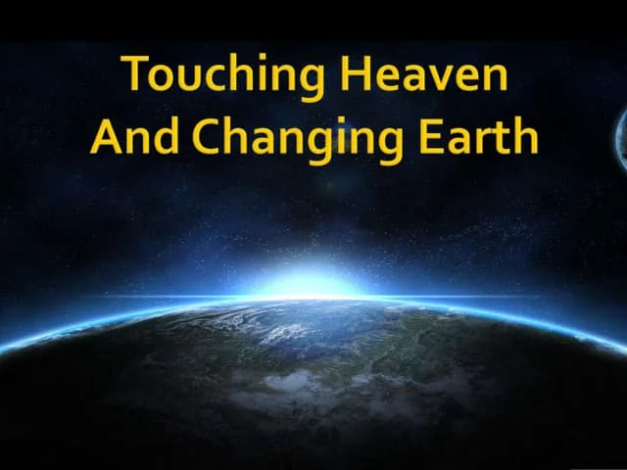
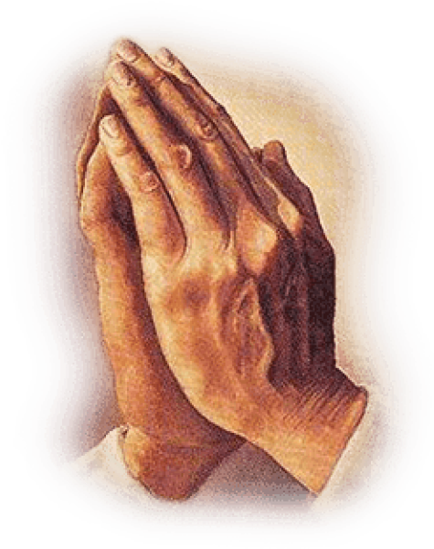
NIGHT VIGIL
This FRIDAY
07. FEB.2025 WILL BE HELD PHYSICALLY
IN THE CHURCH
And all things, whatsoever ye shall ask in prayer, believing, ye shall receive (Mat. 21:22)

Slide 26
LESSON 990: Exhortation to Praise God
STS STUDY FOR NEXT WEEK:
MEMORY VERSE: ……
“O bless our God, ye people, and make the voice of his praise to be heard: Which holdeth our soul in life, and suffereth not our feet to be moved” (Psalm 66:8,9).
TEXT: Psalm 64 to 68

Slide 27


1 John 5:7

Slide 28
HYMN
GHS 011: HOLY, HOLY, HOLY

Slide 29
HOLY, HOLY, HOLY [GHS 011]
1.
Holy, holy, holy,
Lord God Almighty!
Early in the morning
Our song shall rise to Thee;
Holy, holy, holy, merciful and mighty!
God in Three Persons, blessed Trinity!

Slide 30
HOLY, HOLY, HOLY [GHS 011]
2.
Holy, holy, holy!
All the saints adore Thee,
Casting down their golden crowns
Around the glassy sea;
Cherubim and seraphim
Falling down before Thee,
Who wert and art, and evermore shalt be.

Slide 31
HOLY, HOLY, HOLY [GHS 011]
3.
Holy, holy, holy!
Though the darkness hide Thee,
Though the eye of sinful man
Thy glory may not see,
Only Thou art holy;
There is none beside Thee,
Perfect in power, in love, and purity.

Slide 32
HOLY, HOLY, HOLY [GHS 011]
4.
Holy, holy, holy,
Lord God Almighty!
All Thy works shall praise Thy name,
In earth, and sky, and sea!
Holy, holy, holy, merciful and mighty!
God in Three Persons, blessed Trinity!

Slide 33

CHOIR

Slide 34
TODAY’S SERMON
TRINITY: THE DOCTRINE AND YOUR TOTAL SECURITY

Slide 35

TIME TO PRAY

