Slide 1

SUPER SUNDAY SERVICE
09-02-2025

Slide 2
HYMN
GHS 012: PRAISE HIM! PRAISE HIM!

Slide 3
PRAISE HIM! PRAISE HIM! [GHS 012]
1.
Praise Him! Praise Him!
Jesus our blessed Redeemer,
Sing, O earth, His wonderful love proclaim;
Hail Him! Hail Him!
Highest archangels in glory,
Strength and honour give to His holy name.

Slide 4
PRAISE HIM! PRAISE HIM! [GHS 012]
1 cont’d
Like a shepherd,
Jesus will guard His children,
In His arms He carries them all day long;
O ye saints that dwell on the mountain of Zion,
Praise Him! Praise Him! ever in joyful song.

Slide 5
PRAISE HIM! PRAISE HIM! [GHS 012]
2.
Praise Him! Praise Him!
Jesus our blessed Redeemer,
For our sins He
Suffer’d and bled and died;
He, our rock, our hope of eternal salvation,
Hail Him! Hail Him!
Jesus the Crucified.

Slide 6
PRAISE HIM! PRAISE HIM! [GHS 012]
2 cont’d
Loving Saviour,
Meekly enduring sorrow,
Crown’d with thorns that
Cruelly pierc’d His brow;
Once for us rejected,
Despis’d and forsaken,
Prince of Glory, ever triumphant now.

Slide 7
PRAISE HIM! PRAISE HIM! [GHS 012]
3.
Praise Him! Praise Him!
Jesus our blessed Redeemer,
Heav’nly portals,
Loud with hosannahs ring;
Jesus, Saviour, reigneth forever and ever,
Crown Him! Crown Him!
Prophet and Priest and King!

Slide 8
PRAISE HIM! PRAISE HIM! [GHS 012]
3 cont’d
Death is vanquish’d!
Tell it with joy, ye faithful,
Where is now thy victory, boasting grave?
Jesus lives!
No longer thy portals are cheerless,
Jesus lives, the mighty and strong to save.

Slide 9

SEARCH THE SCRIPTURES
09-02-2025

Slide 10
REVIEW OF OUR ASSIGNMENT OF LAST STUDY
Relationship with God is the secret of triumph over adversity. It aids faith and strengthens prayer. Shift your focus away from enemies; wait on the Lord and seek Him. Refrain from evil or trust in man. No matter the adversity, stand on the Rock that is higher than you; this will make you triumph and rejoice in the testimony of praise.
Recount some noteworthy principles David demonstrated in his dealing with Saul.
Comfort and Confidence in God’s Presence

Slide 11
LESSON 990:
EXHORTATION TO PRAISE GOD
MEMORY VERSE: ……
“O bless our God, ye people, and make the voice of his praise to be heard: Which holdeth our soul in life, and suffereth not our feet to be moved” (Psalm 66:8,9).
TEXTS: Psalm 64 to 68

Slide 12
INTRODUCTION
As is general in the Psalms, our texts today largely centre on extolling God’s power to save, sustain, secure and supply for His own in answer to their prayers. The Psalmist draws our attention to God’s great attributes as Supreme and His interventions in the various situations that confront people. He also prophesies about their hope of a glorious eternity with Christ. He then invites them to, in response to all these, “make a joyful noise unto God”, to “sing forth the honour of his name” and to “make his praise glorious” (Psalms 66:1,2).

Slide 13
Psalms 64:7; 65:5-7; 67:2,7; 2 Tim. 4:18; 1 Thes. 5:182 Chron. 20:22,23
KEY LESSONS IN THE STUDY OF TODAY
Focusing on God’s power to protect and preserve will inspire in us the confidence to pray to and praise Him.
God is praiseworthy and we are called to praise Him with our lips and lives.
Our praise should draw others to God to experience His goodness as we have.
We must praise God not only for past and present blessings, but also for expected interventions and in all situations.
Praise attracts blessings.

Slide 14
QUESTION 1
What thoughts can help our confidence in God even in difficult times?
1 Chron. 29:11; 2 Timothy 4:18

Slide 15
QUESTION 2
How can our praise to God benefit others?
Psalm 67:2,7; 65:1,2

Slide 16
QUESTION 3
Besides singing and making music, what other forms can our praise to God take?
Psalms 96:9, 2 Corinth. 2:15, Prov. 3:9

Slide 17
QUESTION 4
Compare Psalms 68:18 and Ephesians 4:8 and explain the privilege of New Testament saints.

Slide 18
QUESTION 5
Mention instances when God moved mightily in response to the praise of His people. What encouragement do such instances give us?

Slide 19
CONCLUSION
God is praiseworthy and we, as believers, are enjoined to praise Him with our lips as well as with our lives and in all situations. This is not only possible but also becomes a joy when we fix our gaze on God’s power over all circumstances and His commitment to protect and deliver His children. There is no telling of the awesome power praise when done aright.

Slide 20
ASSIGNMENT
Note one thing you have been praying and believing God for, then this week rather than making supplication concerning it, praise God for His power over that thing or situation.

Slide 21


SEARCH THE SCRIPTURES SUMMARY

Slide 22

INTERCESSION

Slide 23
TITHES AND OFFERING
Kindly pay via one of the following options:
Your phone
Bank transfer to
Cash
IBAN: NL90ABNA0416385699
Remarks: Tithes (name of region)
“… God loves a cheerful giver”
- 2 Corinthians 9:7

Slide 24

WELCOME TO
DEEPER LIFE BIBLE CHURCH
A CHURCH ON THE MOVE…
“Come thou with us and we will do thee good: for the Lord hath spoken good concerning [us]”
– Numbers 10:29
GOD’S FAMILY
GOD’S FOOD
GLOWING FOLD
We are a family, God’s family:
Our Father: God
Our Saviour: Jesus
Our Comforter: The Holy Spirit
Our destination: Heaven
We feast on God’s pure Word. We:
Read it
Study it
Believe it
Apply it
We want you to be part of us – a growing and glowing family. Join us and you will soon discover what makes our identity unique.
For your time and eternal profit, this is the place to be!

Slide 25








COUNSELLING
SERVICE SCHEDULES
Service | Day | Timing | Remarks
Worship Service | Sunday | 09:45-12:00 | Physical/Online
Bible Study | Tuesday | 19:30-20:30 | Online
Revival Service | Friday | 19:30-21:00 | Online/Physical
Night Vigil | Friday | 19:30-23:30 | First Friday Monthly
If you have questions or need guidance on challenging issues, kindly request for counselling.
Our pastor is here for you.
CONTACT
+31 207 856 683
info@deeperlife.nl
LOCATION DETAILS
Location | Telephone # | ZOOM Meeting ID
Amsterdam | +31 686 093 624 | 795-674-627
Eindhoven | +31 643 678 896 | 912-749-784
Rotterdam | +31 642 133 520 | 237-801-783
The Hague | +31 685 076 861 | 818-6898-8436
dclmnetherlands
www.dclm-nl.org

Slide 26
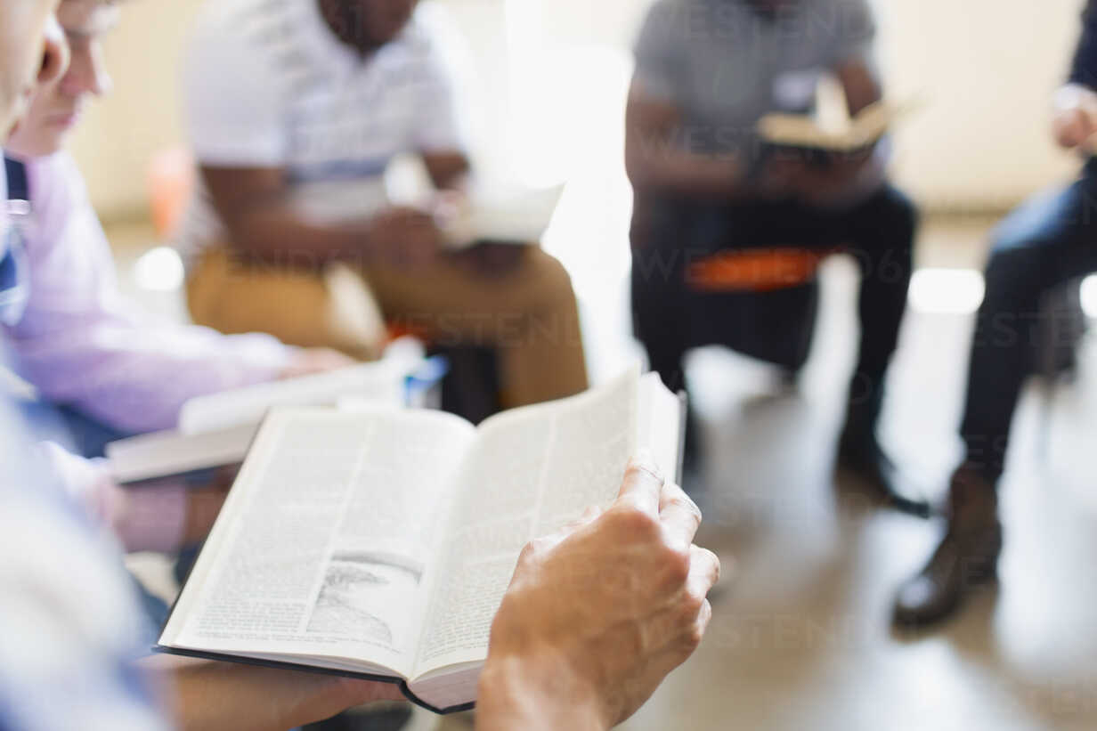


BELIEVER’S
Development
Programme
2024
Today: Sunday 9 Feb. 2025
19:30 – 20:30
Zoom Meeting ID: 795 674 627
"Know ye not that they which run in a race run all, but one receiveth the prize? So run, that ye may obtain." (1 Cor 9:24)

Slide 27
LESSON 991: Plea for deliverance from the enemy
STS STUDY FOR NEXT WEEK:
MEMORY VERSE: ……
“Deliver me, o my God out of the hand of the wicked: out of the hand of the unrighteous and cruel man”(Psalm 71:4).
TEXT: Psalms 69:1-6,7,9,13; Ps72:1-4

Slide 28


Isaiah 6:1–8

Slide 29
HYMN
GHS 124: CHRIST RECEIVETH SINFUL MEN

Slide 30
CHRIST RECEIVETH SINFUL MEN [GHS 124]
1.
Sinners Jesus will receive!
Sound this word of grace to all
Who the heav’nly pathway leave,
All who linger, all who fall!

Slide 31
Sing it o’er . . . and o’er again, . . . Christ receiv . . eth sinful men; . . .
Make the mes . . . sage clear and plain: . . Christ receiv . . . eth sinful men. . . .

Slide 32
CHRIST RECEIVETH SINFUL MEN [GHS 124]
2.
Come: and He will give you rest;
Trust Him; for His word is plain,
He will take the sinful-est;
Christ receiveth sinful men.

Slide 33
Sing it o’er . . . and o’er again, . . . Christ receiv . . eth sinful men; . . .
Make the mes . . . sage clear and plain: . . Christ receiv . . . eth sinful men. . . .

Slide 34
CHRIST RECEIVETH SINFUL MEN [GHS 124]
3.
Now my heart condemns me not,
Pure before the law I stand;
He who cleans’d me from all spot
Satisfied its last demand.

Slide 35
Sing it o’er . . . and o’er again, . . . Christ receiv . . eth sinful men; . . .
Make the mes . . . sage clear and plain: . . Christ receiv . . . eth sinful men. . . .

Slide 36
CHRIST RECEIVETH SINFUL MEN [GHS 124]
4.
Christ receiveth, sinful men;
Even me with all my sin;
Purg’d from ev’ry spot and stain,
Heav’n with Him I enter in.

Slide 37
Sing it o’er . . . and o’er again, . . . Christ receiv . . eth sinful men; . . .
Make the mes . . . sage clear and plain: . . Christ receiv . . . eth sinful men. . . .

Slide 38

CHOIR

Slide 39
TODAY’S SERMON
THE SINNER’S LOSTNESS IN THE EYES OF A HOLY GOD

Slide 40

TIME TO PRAY

