Slide 1

SUPER SUNDAY SERVICE
16-02-2025

Slide 2
HYMN
GHS 016: IF GOD BE FOR US

Slide 3
IF GOD BE FOR US [GHS 016]
1.
Rejoice in the Lord!
Oh, let His mercy cheer;
He sunders the bands that enthrall;
Redeem’d by His blood
Why should we ever fear
Since Jesus is our “all in all”?

Slide 4
If God be for us,
If God be for us,
If God be for us,
Who can be against us?
Who? Who? Who?
Who can be against us, against us?

Slide 5
IF GOD BE FOR US [GHS 016]
2.
Be strong in the Lord !
Rejoicing in His might,
Be loyal and true day by day;
When evils assail,
Be valiant for the right,
And He will be our strength and stay.

Slide 6
If God be for us,
If God be for us,
If God be for us,
Who can be against us?
Who? Who? Who?
Who can be against us, against us?

Slide 7
IF GOD BE FOR US [GHS 016]
3.
Confide in His word –
His promises so sure;
In Christ they are “ yea and amen;”
Though earth pass away,
They ever shall endure,
’Tis written o’er and o’er again.

Slide 8
If God be for us,
If God be for us,
If God be for us,
Who can be against us?
Who? Who? Who?
Who can be against us, against us?

Slide 9
IF GOD BE FOR US [GHS 016]
4.
Abide in the Lord:
Secure in His control,
’Tis life everlasting begun;
To pluck from His hand
The weakest, trembling soul
It never, never can be done!

Slide 10
If God be for us,
If God be for us,
If God be for us,
Who can be against us?
Who? Who? Who?
Who can be against us, against us?

Slide 11

SEARCH THE SCRIPTURES
16-02-2025

Slide 12
REVIEW OF OUR ASSIGNMENT OF LAST STUDY
Note one thing you have been praying and believing God for, then this week rather than making supplication concerning it, praise God for His power over that thing or situation.
Who wants to share his/her testimony on this assignment?
Exhortation to praise God

Slide 13
LESSON 991: Plea for deliverance from the enemy
MEMORY VERSE: ……
  “Deliver me, o my God out of the hand of the wicked: out of the hand of the unrighteous and cruel man” (Psalm 71:4).
TEXTS: Ps 69:1-6,7,9,13; Ps72:1-4
:

Slide 14
INTRODUCTION
In the preceding chapter, David praised God’s omnipotence and compassion to His people in times of affliction and distress. He also predicted the Messiah’s ascension and His future triumph. Today’s study focuses on David’s intense prayer for deliverance, his exhortation to praise God for the salvation of His people, prayer for Solomon for divine wisdom, justice and righteousness. This teaches us in trying times to shun complaint and murmuring and cultivate the attitude of praise and thanksgiving (Psalm 34:19).

Slide 15
Pls 69:1-29,71:14-24,72:1-20,Php4:6
KEY LESSONS IN THE STUDY OF TODAY
Mockery and reproaches are the lots of the righteous, but victory is assured by God’s intervention.
David and our Lord Jesus suffered reproaches and attack from friend and foe; so shall we.
In troublous times, we should depend on the proven weapon of praise and thanksgiving.
David prayed for Solomon for wisdom to lead God’s people aright. We should pray for leaders.
David’s prayer also predicted the millennial reign of Christ, which will bring peace and righteousness. Only the saved will participate.

Slide 16
QUESTION 1
What should be your attitude in times of distress?
Psalm 69:3; 34:19

Slide 17
QUESTION 2
State the similarities between the experiences of David and our Lord Jesus Christ. What lessons do you draw from them?

Slide 18
QUESTION 3
Why should believers praise God in times of adversity?
Phil 4:6,7; 1 Thes 5:18; Acts 16:23-26

Slide 19
QUESTION 4
From the specific prayer of David for Solomon, how can we shape the lives of our children through prayer?
Psalm 72:1,2

Slide 20
QUESTION 5
What do you understand by Christ’s millennial reign? How one can be part of it?
Rev 20:4-6; Pls 72:2-3

Slide 21
CONCLUSION
Godly living attracts persecution because the good works of the righteous condemn the ungodly. In all these, we should use the powerful weapon of praise and thanksgiving to bring down God’s power for our victory. We should also pray for our children for godliness and success in life. Moreover, we should be conscious that Christ’s millennial reign is at hand and only the righteous will be part of it.

Slide 22
ASSIGNMENT
You may not have direct control over all issues that affect or concern you personally, in the family, in the church, at work or in the nation. However, your prayer can change things.
Choose one such issue and spend time to pray earnestly about it throughout this week. Be ready to give testimony soon!

Slide 23


SEARCH THE SCRIPTURES SUMMARY

Slide 24

INTERCESSION

Slide 25
TITHES AND OFFERING
Kindly pay via one of the following options:
Your phone
Bank transfer to
Cash
IBAN: NL90ABNA0416385699
Remarks: Tithes (name of region)
“… God loves a cheerful giver”
- 2 Corinthians 9:7

Slide 26

WELCOME TO
DEEPER LIFE BIBLE CHURCH
A CHURCH ON THE MOVE…
“Come thou with us and we will do thee good: for the Lord hath spoken good concerning [us]”
– Numbers 10:29
GOD’S FAMILY
GOD’S FOOD
GLOWING FOLD
We are a family, God’s family:
Our Father: God
Our Saviour: Jesus
Our Comforter: The Holy Spirit
Our destination: Heaven
We feast on God’s pure Word. We:
Read it
Study it
Believe it
Apply it
We want you to be part of us – a growing and glowing family. Join us and you will soon discover what makes our identity unique.
For your time and eternal profit, this is the place to be!

Slide 27








COUNSELLING
SERVICE SCHEDULES
Service | Day | Timing | Remarks
Worship Service | Sunday | 09:45-12:00 | Physical/Online
Bible Study | Tuesday | 19:30-20:30 | Online
Revival Service | Friday | 19:30-21:00 | Online/Physical
Night Vigil | Friday | 19:30-23:30 | First Friday Monthly
If you have questions or need guidance on challenging issues, kindly request for counselling.
Our pastor is here for you.
CONTACT
+31 207 856 683
info@deeperlife.nl
LOCATION DETAILS
Location | Telephone # | ZOOM Meeting ID
Amsterdam | +31 686 093 624 | 795-674-627
Eindhoven | +31 643 678 896 | 912-749-784
Rotterdam | +31 642 133 520 | 237-801-783
The Hague | +31 685 076 861 | 818-6898-8436
dclmnetherlands
www.dclm-nl.org

Slide 28
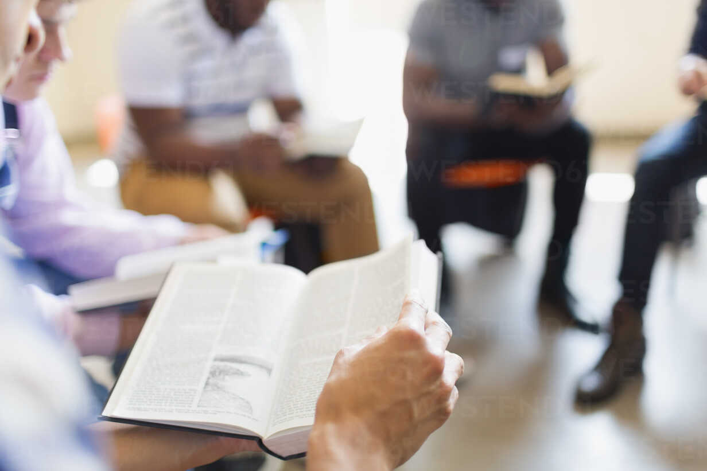


BELIEVER’S
Development
Programme
2024
Today: Sunday 16 Feb. 2025
19:30 – 20:30
Zoom Meeting ID: 795 674 627
"Know ye not that they which run in a race run all, but one receiveth the prize? So run, that ye may obtain." (1 Cor 9:24)

Slide 29


Slide 30
LESSON 992: The Justice of God
STS STUDY FOR NEXT WEEK:
MEMORY VERSE: ……
“Though hand join in hand, the wicked shall not be unpunished: but the seed of the righteous shall be delivered” (Proverbs 11:21).
TEXT: Psalm 73 to 78

Slide 31


1 John 5:1-13

Slide 32
HYMN
GHS 201: LOVE LIFTED ME

Slide 33
LOVE LIFTED ME [GHS 201]
1.
I was sinking deep in sin,
Far from the peaceful shore,
Very deeply stained within,
Sinking to rise no more;
But the Master of the sea
Heard my despairing cry,
From the waters lifted me,
Now safe am I.

Slide 34
Love lifted me! Love lifted me!
When nothing else could help, Love lifted me.
Love lifted me! Love lifted me!
When nothing else could help, Love lifted me.

Slide 35
LOVE LIFTED ME [GHS 201]
2.
All my heart to Him I give,
Ever to Him I’ll cling,
In His blessed presence live,
Ever His praises sing.
Love so mighty and so true
Merits my soul’s best songs;
Faithful, loving service, too,
To Him belongs.

Slide 36
Love lifted me! Love lifted me!
When nothing else could help, Love lifted me.
Love lifted me! Love lifted me!
When nothing else could help, Love lifted me.

Slide 37
LOVE LIFTED ME [GHS 201]
3.
Souls in danger, look above,
Jesus completely saves;
He will lift you by His love
Out of the angry waves.
He’s the Master of the sea,
Billows His will obey;
He your Saviour wants to be -
Be saved today.

Slide 38
Love lifted me! Love lifted me!
When nothing else could help, Love lifted me.
Love lifted me! Love lifted me!
When nothing else could help, Love lifted me.

Slide 39

CHOIR

Slide 40
TODAY’S SERMON
THE GATEWAY INTO GOD’S GRACIOUS SALVATION

Slide 41

TIME TO PRAY

