Slide 1

SUPER SUNDAY SERVICE
02-03-2025

Slide 2
HYMN
GHS 169: WHAT A FRIEND WE HAVE IN JESUS

Slide 3
WHAT A FRIEND WE HAVE IN JESUS [GHS 169]
1.
What a friend we have in Jesus,
All our sins and griefs to bear!
What a privilege to carry
Everything to God in prayer!
Oh, what peace we often forfeit,
Oh, what needless pain we bear -
All because we do not carry
Ev’rything to God in prayer!

Slide 4
WHAT A FRIEND WE HAVE IN JESUS [GHS 169]
2.
Have we trials and temptations?
Is there trouble anywhere?
We should never be discouraged,
Take it to the Lord in prayer.
Can we find a friend so faithful,
Who will all our sorrows share?
Jesus knows our every weakness;
Take it to the Lord in prayer.

Slide 5
WHAT A FRIEND WE HAVE IN JESUS [GHS 169]
3.
Are we weak and heavy-laden,
Cumbered with a load of care?
Precious Savior, still our refuge,
Take it to the Lord in prayer.
Do thy friends despise, forsake thee?
Take it to the Lord in prayer!
In His arms He’ll take and shield thee,
Thou wilt find a solace there.

Slide 6

SEARCH THE SCRIPTURES
02-03-2025

Slide 7
REVIEW OF THE ASSIGNMENT FROM LAST STUDY
Read Psalm 73 two or three times meditatively. Write down at least three lessons you learn from the experience of the Psalmist.
Share the lessons learnt from the assignment.
The Justice of God

Slide 8
REVIEW OF OUR ASSIGNMENT OF LAST STUDY
We should not be discouraged because of the evil in the world. God’s justice is sure and fair. Wickedness has an end; God’s judgment will be severe on evildoers. But His mercy and compassion are for those who fear Him. They will experience His deliverance, care and comfort on earth and inherit the Kingdom of God. We should find our consolation in God’s sanctuary by pondering on His word. Moreover, knowing the terror of God, we should persuade men!
The justice of God

Slide 9
LESSON 993: Prayer for National Deliverance and Revival
MEMORY VERSE: ……
  “Wilt thou not revive us again: that thy people may rejoice in thee? Shew us thy mercy, O LORD, and grant us thy salvation” (Psalm 85:6,7).
TEXTS: Psalms 79 – 85

Slide 10
INTRODUCTION
After Israel’s deliverance from Egyptian bondage and inheritance of the Promised Land, they repeatedly disobeyed God and served other gods. Their actions provoked God and attracted His wrath. As a result, they suffered oppression from enemy nations, and at other times were led into captivity. These fueled the Psalmist’s lamentation for mercy, deliverance and revival of the nation. God is good, gracious and merciful; but He is also holy, just and a jealous God. He is consistent in His dealings with man from generation to generation.

Slide 11
Psa. 79:1-4,8,10; 80:12,13; 81:16; 82:1-8; 84:11; 85:1-3,8-13
KEY LESSONS IN THE STUDY OF TODAY
When Israel did not heed divine instruction, they were exposed and ravaged by the enemy. Our eternal security is only found in abiding in Christ continually.
Intercession is necessary for revival. Like David, the evils in our society call for an urgent need to pray for deliverance from evil works and the revival of righteousness.
Our prayers must be passionate, persistent with specific promises of God in Scripture.
Great possibilities abound when we persevere in prayer for our nation. We should expect divine intervention.

Slide 12
QUESTION 1
Why did David pray for deliverance and revival?
Psa. 79:1,4,5; 80:4,5

Slide 13
QUESTION 2
From Israel’s example, what are some attributes of God, and why is it important to continue to obey Him? Psalm 81:6-12

Slide 14
QUESTION 3
Why is it dangerous to believe the doctrine of “once saved, forever saved”?
Heb. 10:26-30; Exo. 32:33; John 15:6

Slide 15
QUESTION 4
Describe the spiritual state of our nation that requires urgent divine intervention?
Rom. 3:11,12,14,18; Gal. 5:19-21a

Slide 16
QUESTION 5
What are the elements of effective intercession for spiritual revival?
Psa. 80:3,7,19; 84:2; 85:6,7

Slide 17
QUESTION 6
What are the benefits of praying for the nation?
Psa. 85:11-13; 2 Chron. 7:14

Slide 18
CONCLUSION
God is good, gracious and merciful, but He is also holy and just. Rejecting divine instruction provokes divine jealously. Our eternal security is only found in abiding in Christ continually. The state of our nation should drive us to pray passionately and persistently for the salvation of sinners, restoration of true worship, prosperity and peace in the land.

Slide 19
ASSIGNMENT
Spend 5mins each day this week to intercede for your neighborhood and the nation.

Slide 20


SEARCH THE SCRIPTURES SUMMARY

Slide 21

INTERCESSION

Slide 22
TITHES AND OFFERING
Kindly pay via one of the following options:
Your phone
Bank transfer to
Cash
IBAN: NL90ABNA0416385699
Remarks: Tithes (name of region)
“… God loves a cheerful giver”
- 2 Corinthians 9:7

Slide 23

WELCOME TO
DEEPER LIFE BIBLE CHURCH
A CHURCH ON THE MOVE…
“Come thou with us and we will do thee good: for the Lord hath spoken good concerning [us]”
– Numbers 10:29
GOD’S FAMILY
GOD’S FOOD
GLOWING FOLD
We are a family, God’s family:
Our Father: God
Our Saviour: Jesus
Our Comforter: The Holy Spirit
Our destination: Heaven
We feast on God’s pure Word. We:
Read it
Study it
Believe it
Apply it
We want you to be part of us – a growing and glowing family. Join us and you will soon discover what makes our identity unique.
For your time and eternal profit, this is the place to be!

Slide 24








COUNSELLING
SERVICE SCHEDULES
Service | Day | Timing | Remarks
Worship Service | Sunday | 09:45-12:00 | Physical/Online
Bible Study | Tuesday | 19:30-20:30 | Online
Revival Service | Friday | 19:30-21:00 | Online/Physical
Night Vigil | Friday | 19:30-23:30 | First Friday Monthly
If you have questions or need guidance on challenging issues, kindly request for counselling.
Our pastor is here for you.
CONTACT
+31 207 856 683
info@deeperlife.nl
LOCATION DETAILS
Location | Telephone # | ZOOM Meeting ID
Amsterdam | +31 686 093 624 | 795-674-627
Eindhoven | +31 643 678 896 | 912-749-784
Rotterdam | +31 642 133 520 | 237-801-783
The Hague | +31 685 076 861 | 818-6898-8436
dclmnetherlands
www.dclm-nl.org

Slide 25


Slide 26
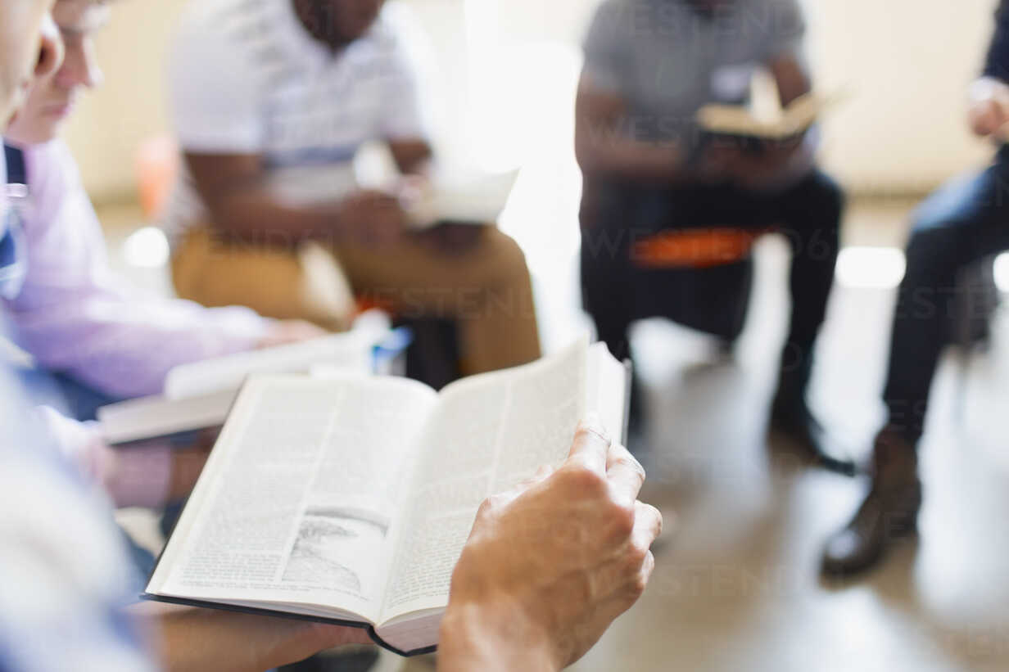


BELIEVER’S
Development
Programme
2024
Today: Sunday 02 Mar. 2025
19:30 – 20:30
Zoom Meeting ID: 795 674 627
"Know ye not that they which run in a race run all, but one receiveth the prize? So run, that ye may obtain." (1 Cor 9:24)

Slide 27
LESSON 994: War in heaven and wrath on earth
STS STUDY FOR NEXT WEEK:
MEMORY VERSE: ……
“Therefore rejoice, ye heavens, and ye that dwell in them. Woe to the inhabiters of the earth and of the sea! for the devil is come down unto you, having great wrath, because he knoweth that he hath but a short time” (Revelation 12:12).
TEXT: Revelation 12:1-17

Slide 28


Acts 8:36-39

Slide 29
HYMN
GHS 32: HEAVEN CAME DOWN

Slide 30
HEAVEN CAME DOWN [GHS 32]
1.
O what a wonderful, wonderful day,
Day I will never forget;
After I'd wandered in darkness away,
Jesus my Saviour I met.
O what a tender, compassionate friend,
He met the need of my heart;
Shadows dispelling, with joy I am telling,
He made all the darkness depart!

Slide 31
Heaven came down and glory filled my soul,
When at the cross the Saviour made me whole;
My sins were washed away
And my night was turned to day!
Heaven came down and glory filled my soul!

Slide 32
HEAVEN CAME DOWN [GHS 32]
2.
Born of the Spirit with life from above
Into God's family divine,
Justified fully thru Calvary's love,
O what a standing is mine!
And the transaction so quickly was made,
When as a sinner I came,
Took of the offer of grace He did proffer -
He saved me, O praise His dear name!

Slide 33
Heaven came down and glory filled my soul,
When at the cross the Saviour made me whole;
My sins were washed away
And my night was turned to day!
Heaven came down and glory filled my soul!

Slide 34
HEAVEN CAME DOWN [GHS 32]
3.
Now I've a hope that will surely endure
After the passing of time;
I have a future in heaven for sure
There in those mansions sublime.
And it's because of that wonderful day,
When at the cross I believed;
Riches eternal and blessings supernal,
From His precious hand I received.

Slide 35
Heaven came down and glory filled my soul,
When at the cross the Saviour made me whole;
My sins were washed away
And my night was turned to day!
Heaven came down and glory filled my soul!

Slide 36

CHOIR

Slide 37
TODAY’S SERMON
WATER BAPTISM AND THE LORD’S SUPPER

Slide 38

TIME TO PRAY

