Slide 1

SUPER SUNDAY SERVICE
16-03-2025

Slide 2
HYMN
GHS 207: THERE’S A GREAT DAY COMING

Slide 3
THERE’S A GREAT DAY COMING [GHS 207]
1.
There’s a great day coming
A great day coming
There’s a great day coming by and by
When the saints and the sinners shall be
Parted right and left
Are you ready for that day to come?

Slide 4
Are you ready? Are you ready?
Are you ready for the judgment day?
Are you ready? Are you ready?
For the judgment day?

Slide 5
THERE’S A GREAT DAY COMING [GHS 207]
2.
There’s a bright day coming
A bright day coming
There’s a bright day coming by and by;
But its brightness shall only come
To them that love the Lord,
Are you ready for that day to come?

Slide 6
Are you ready? Are you ready?
Are you ready for the judgment day?
Are you ready? Are you ready?
For the judgment day?

Slide 7
THERE’S A GREAT DAY COMING [GHS 207]
3.
There’s a sad day coming
A sad day coming
There’s a sad day coming by and by
When the sinner shall hear his doom
“Depart, I know ye not,”
Are you ready for that day to come?

Slide 8
Are you ready? Are you ready?
Are you ready for the judgment day?
Are you ready? Are you ready?
For the judgment day?

Slide 9

SEARCH THE SCRIPTURES
16-03-2025

Slide 10
REVIEW OF THE ASSIGNMENT FROM LAST STUDY
Throughout the week, we were encouraged to spend 5 minutes each day interceding for our neighbourhood and the nation.
Who would like to share their experience, or any insights received while praying for our community and nation? Did you notice any changes, personal burdens, or revelations during your intercession?
Prayer for National Deliverance and Revival

Slide 11
LESSON 994: War in Heaven and Wrath on Earth
MEMORY VERSE: ……
  “Therefore rejoice, ye heavens, and ye that dwell in them. Woe to the inhabitants of the earth and of the sea! for the devil is come down unto you, having great wrath, because he knoweth that he hath but a short time.” (Revelation 12:12).
TEXTS: Revelation 12:1-17

Slide 12
INTRODUCTION
The narrative in our text reveals five main characters in symbolic form. The Woman Clothed with the Sun represents Israel, God’s chosen nation; while the Man-Child symbolises Christ, the ruler of all nations. The Great Red Dragon represents Satan, the enemy of God’s people, and Michael the Archangel leads God’s army to defeat him. The Remnant of the Woman’s Seed refers to faithful believers in Christ. This passage highlights the War in Heaven, where Satan is cast out, the Wrath on Earth, as he unleashes his fury, and the Victory through Christ, as believers overcome by His blood and their testimony (Revelation 12:11)..

Slide 13
Revelation 12:1-6,15-16; Daniel 12:1; Ephesians 6:10-12
KEY LESSONS IN THE STUDY OF TODAY
The description of Israel as clothed with the sun, and crowned with the stars shows that she will shine forth in the future with glory, great brilliance and beauty.
As Satan could not stop the incarnation of Christ, so he will not be able to stop His exaltation and coronation.
Satan accuses believers before God, but victory is secured through Christ’s blood and steadfast faith.
Just as God provided refuge for the woman in the wilderness, believers must depend on Him for divine preservation.
Sinners must repent and live a holy life to escape God’s wrath.

Slide 14
QUESTION 1
Why is the woman in our text not a symbol of the Church of Christ?
2Corinthians 11:2; Revelation 19:7; Isaiah 54:5-6

Slide 15
QUESTION 2
Who is the Man-Child in our text, and why?
Revelation 12:5; Acts 1:9-11; Isaiah 66:7

Slide 16
QUESTION 3
What should believers do to defeat the accuser of the brethren?
Revelation 12:10-11; 1 John 2:1; Philippians 2:9-11

Slide 17
QUESTION 4
What should be the attitude of a believer as he engages in spiritual warfare?
Ephesians 6:10-12; Matthew 7:21; 1 John 3:8

Slide 18
QUESTION 5
What must sinners do to escape wrath and fury during the great tribulation?
Isaiah 55:6,7; Acts 17:30,31; Hebrews 3:15

Slide 19
CONCLUSION
The war in heaven marks a decisive battle, but Christ’s victory is certain. Satan’s wrath on earth is his last attempt to deceive and destroy, yet believers must stand firm in the faith, rely on Christ’s blood and Word, and remain faithful as they await His reign. For unbelievers, this is a call to repentance before it’s too late. Though the devil’s wrath is fierce, God’s mercy is still available to those who turn to Him. Are you ready for Christ’s return, or will you face the great tribulation?

Slide 20
ASSIGNMENT
Revelation 12:5 gives a panoramic or wide-ranging view on key events about Jesus Christ from His incarnation to the coronation, separated by a long period of time. Search the Scriptures to itemize the key events about Jesus Christ that are not mentioned in this text with supporting biblical references.

Slide 21


SEARCH THE SCRIPTURES SUMMARY

Slide 22

INTERCESSION

Slide 23
TITHES AND OFFERING
Kindly pay via one of the following options:
Your phone
Bank transfer to
Cash
IBAN: NL90ABNA0416385699
Remarks: Tithes (name of region)
“… God loves a cheerful giver”
- 2 Corinthians 9:7

Slide 24

WELCOME TO
DEEPER LIFE BIBLE CHURCH
A CHURCH ON THE MOVE…
“Come thou with us and we will do thee good: for the Lord hath spoken good concerning [us]”
– Numbers 10:29
GOD’S FAMILY
GOD’S FOOD
GLOWING FOLD
We are a family, God’s family:
Our Father: God
Our Saviour: Jesus
Our Comforter: The Holy Spirit
Our destination: Heaven
We feast on God’s pure Word. We:
Read it
Study it
Believe it
Apply it
We want you to be part of us – a growing and glowing family. Join us and you will soon discover what makes our identity unique.
For your time and eternal profit, this is the place to be!

Slide 25








COUNSELLING
SERVICE SCHEDULES
Service | Day | Timing | Remarks
Worship Service | Sunday | 09:45-12:00 | Physical/Online
Bible Study | Tuesday | 19:30-20:30 | Online
Revival Service | Friday | 19:30-21:00 | Online/Physical
Night Vigil | Friday | 19:30-23:30 | First Friday Monthly
If you have questions or need guidance on challenging issues, kindly request for counselling.
Our pastor is here for you.
CONTACT
+31 207 856 683
info@deeperlife.nl
LOCATION DETAILS
Location | Telephone # | ZOOM Meeting ID
Amsterdam | +31 686 093 624 | 795-674-627
Eindhoven | +31 643 678 896 | 912-749-784
Rotterdam | +31 642 133 520 | 237-801-783
The Hague | +31 685 076 861 | 818-6898-8436
dclmnetherlands
www.dclm-nl.org

Slide 26


Slide 27


Slide 28


Slide 29


Slide 30
LESSON 995: The Rise and Reign of the Antichrist
STS STUDY FOR NEXT WEEK:
MEMORY VERSE: ……
“And all that dwell upon the earth shall worship him whose names are not written in the book of life of the Lamb slained from the foundation of the world.” (Revelation 13:8).
TEXT: Revelation 13:1-18

Slide 31
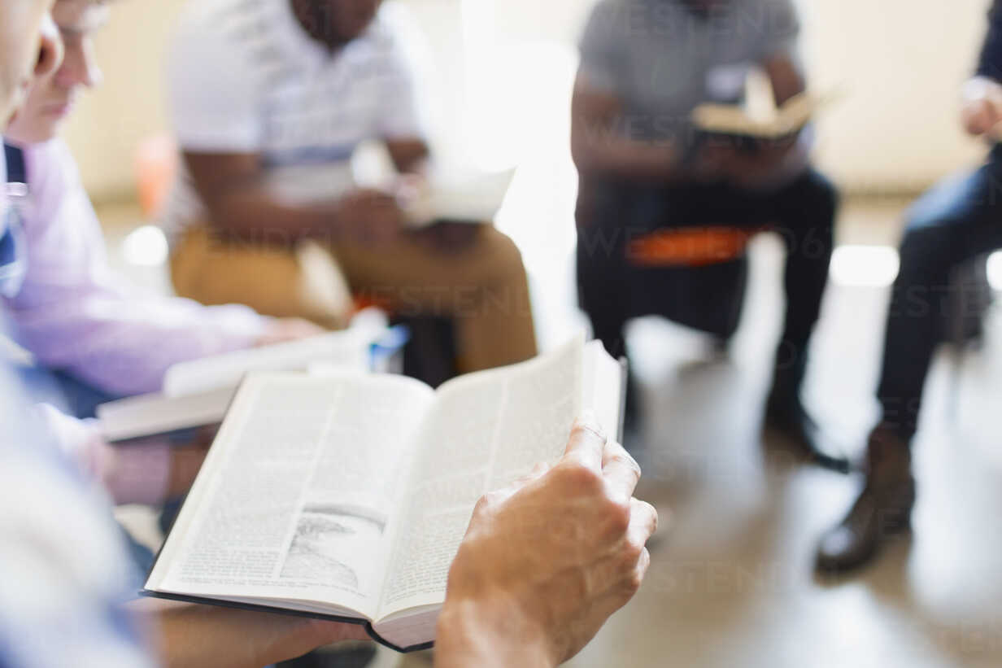


BELIEVER’S
Development
Programme
2024
Today: Sunday 16 Mar. 2025
19:30 – 20:30
Zoom Meeting ID: 795 674 627
"Know ye not that they which run in a race run all, but one receiveth the prize? So run, that ye may obtain." (1 Cor 9:24)

Slide 32


Galatians 3:10-14

Slide 33
HYMN
GHS 256: REDEEMED!

Slide 34
REDEEMED! [GHS 256]
1.
Redeemed—how I love to proclaim it!
Redeemed by the blood of the Lamb;
Redeemed through His infinite mercy,
His child, and forever, I am.

Slide 35
Redeemed, redeemed,
Redeemed by the blood of the Lamb;
Redeemed, redeemed,
His child, and forever, I am.

Slide 36
REDEEMED! [GHS 256]
2.
Redeemed and so happy in Jesus,
No language my rapture can tell;
I know that the light of His presence
With me doth continually dwell.

Slide 37
Redeemed, redeemed,
Redeemed by the blood of the Lamb;
Redeemed, redeemed,
His child, and forever, I am.

Slide 38
REDEEMED! [GHS 256]
3.
I think of my blessed Redeemer,
I think of Him all the day long;
I sing, for I cannot be silent;
His love is the theme of my song.

Slide 39
Redeemed, redeemed,
Redeemed by the blood of the Lamb;
Redeemed, redeemed,
His child, and forever, I am.

Slide 40
REDEEMED! [GHS 256]
4.
I know I shall see in His beauty
The King in whose way I delight;
Who lovingly guardeth my footsteps,
And giveth me songs in the night.

Slide 41
Redeemed, redeemed,
Redeemed by the blood of the Lamb;
Redeemed, redeemed,
His child, and forever, I am.

Slide 42
REDEEMED! [GHS 256]
5.
I know there’s crown that is waiting
In yonder bright mansion for me
And soon with the spirits made perfect
At home with the Lord I shall be.

Slide 43
Redeemed, redeemed,
Redeemed by the blood of the Lamb;
Redeemed, redeemed,
His child, and forever, I am.

Slide 44

CHOIR

Slide 45
TODAY’S SERMON
REDEEMED FROM THE CURSE OF THE LAW

Slide 46
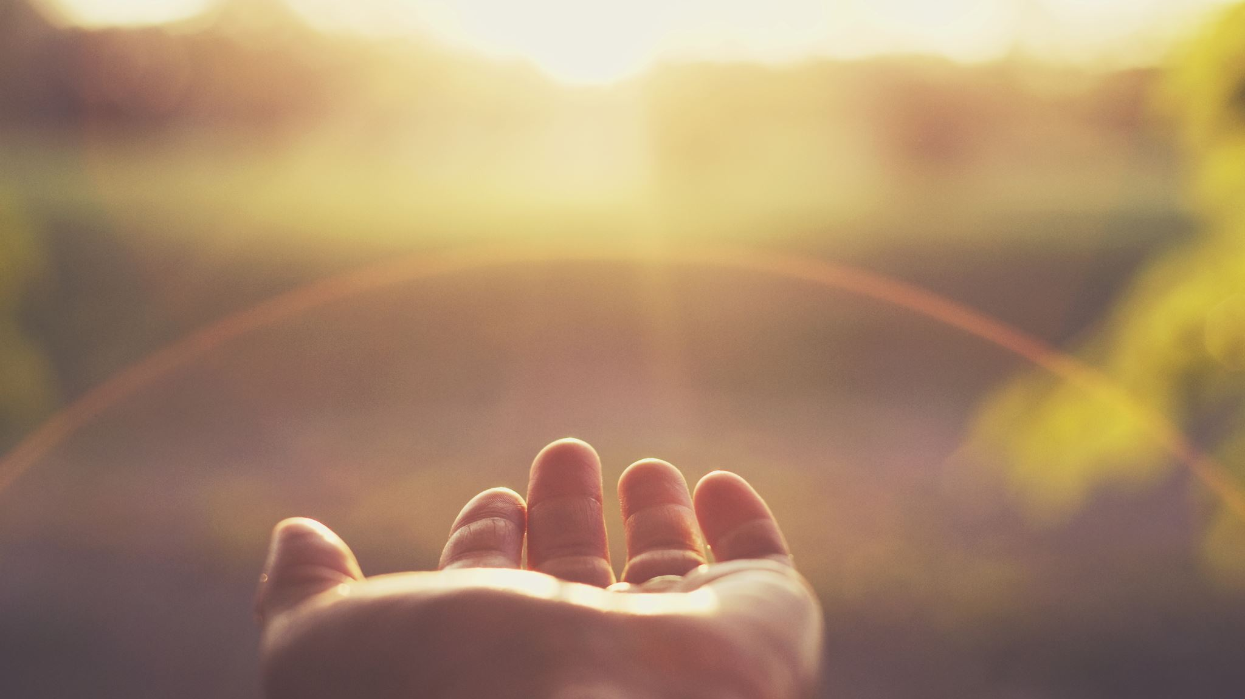
TIME TO PRAY

