Slide 1


Slide 2

FAMILY CONVOCATION
08-06-2025

Slide 3
HYMN
SEND THE FIRE!

Slide 4
SEND THE FIRE!
1.
Thou Christ of burning, cleansing flame,
Send the fire, send the fire send the fire!
Thy blood-bought gift today we claim,
Send the fire, send the fire send the fire;
Look down and see this waiting host,
Give us the promised Holy Ghost,
We want another Pentecost,
Send the fire, send the fire send the fire!

Slide 5
SEND THE FIRE!
2.
God of Elijah, hear our cry,
Send the fire, send the fire send the fire!
He'll make us fit to live or die,
Send the fire, send the fire send the fire;
To burn up every trace of sin,
To bring the light and glory in,
The revolution now begin,
Send the fire, send the fire send the fire!

Slide 6
SEND THE FIRE!
3.
'Tis fire we want, for fire we plead,
Send the fire, send the fire send the fire!
The fire will meet our every need,
Send the fire, send the fire send the fire;
For strength to ever do the right,
For grace to conquer in the fight,
For pow'r to walk the world in white,
Send the fire, send the fire send the fire!

Slide 7

FAMILY INSIGHT

Slide 8
UPHOLDING THE REGION

Slide 9
FAMILY SPECIALS

Slide 10
TITHES AND OFFERING
Kindly pay via one of the following options:
Your phone
Bank transfer to
Cash
IBAN: NL90ABNA0416385699
Remarks: Tithes (name of region)
“… God loves a cheerful giver”
- 2 Corinthians 9:7

Slide 11


Ezekiel 48:1-35;
Romans 8:1-39

Slide 12
HYMN
I’M A MILLIONAIRE

Slide 13
I’M A MILLIONAIRE
1.
I am now a child of God,
I’ve been washed in Jesus blood,
Making me an heir to wealth beyond compare;
So while here I press along,
Daily this shall me my song:
I’m a happy millionaire.

Slide 14
I’m a millionaire, I’m a millionaire;
My father is rich in houses and lands
And I’m His heir.
I’m a millionaire, I’m a millionaire;
I’m a happy millionaire.

Slide 15
I’M A MILLIONAIRE
2.
I had rather served my God,
Feast upon His holy word
Than to own this world with all its jewels rare;
By His Spirit I am led,
And on milk and honey fed,
I’m a happy millionaire.

Slide 16
I’m a millionaire, I’m a millionaire;
My father is rich in houses and lands
And I’m His heir.
I’m a millionaire, I’m a millionaire;
I’m a happy millionaire.

Slide 17
I’M A MILLIONAIRE
3.
Lord I’d rather worship Thee
With the people who are free
Than to pleasures of this world in seasons share;
For my Father is the King,
And His praise I’ll ever sing,
I’m a happy millionaire

Slide 18
I’m a millionaire, I’m a millionaire;
My father is rich in houses and lands
And I’m His heir.
I’m a millionaire, I’m a millionaire;
I’m a happy millionaire.

Slide 19
I’M A MILLIONAIRE
4.
Since salvation now is mine,
For the Lord I’ll shout and shine
Though I have to go through life on meager fare;
Rich in grace beyond recall
For my Father owns it all,
I’m a happy millionaire.

Slide 20
I’m a millionaire, I’m a millionaire;
My father is rich in houses and lands
And I’m His heir.
I’m a millionaire, I’m a millionaire;
I’m a happy millionaire.

Slide 21

CHOIR

Slide 22
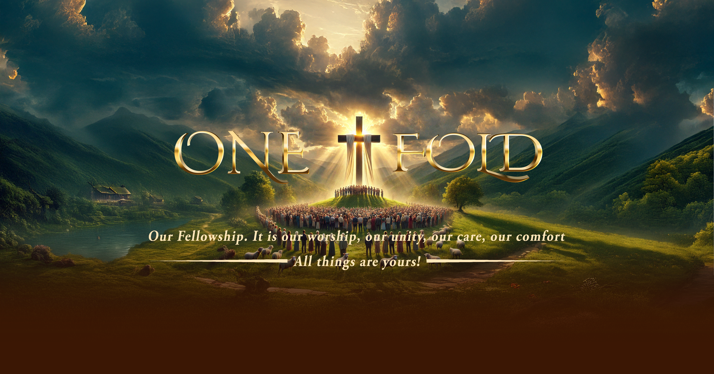
WORSHIP

Slide 23

Your name, your name, your name
Your name is exalted in the heavens
Exalted in the earth
Hallelujah
YOUR NAME IS EXALTED

Slide 24
Oh Lord
Your kingdom reigns forever
Your kingdom has no end
Hallelujah
YOUR NAME IS EXALTED

Slide 25
Your name is Alpha and Omega
Beginning and the end, halle-
Hallelujah
YOUR NAME IS EXALTED

Slide 26
Your name, your name, your name
Your name is exalted in the heavens
Exalted in the earth
Hallelujah
YOUR NAME IS EXALTED

Slide 27
I sing praises to your name
Oh Lord
Praises to your name Oh Lord
For your name is great and worthy to be praised
I SING PRAISES TO YOUR NAME

Slide 28
Through it all, through it all
I’ve learnt to trust in Jesus
I’ve learnt to trust in God
Through it all, through it all
I’ve learnt to depend upon his word
THROUGH IT ALL

Slide 29
So I thank God for the mountains
And I thank him for the valleys
And I thank him for the storms he brought me through
THROUGH IT ALL

Slide 30
For if I'd never had a problem
I'd never know that God could solve them
I'd never know what faith in his word could do
THROUGH IT ALL

Slide 31
CHOIR PIECE

Slide 32
1. I trust in God wherever I may be,
Upon the land, or on the rolling sea,
For come what may, from day to day,
My heav’nly Father watches over me.
My Father Watches Over Me

Slide 33
2. He makes the rose an object of His care,
He guides the eagle through the pathless air,
And surely He remembers me;
My heav’nly Father watches over me.
My Father Watches Over Me

Slide 34
I trust in God, I know He cares for me;
On mountain bleak or on the stormy sea;
Though billows roll, He keeps my soul;
My heav’nly Father watches over me.
My Father Watches Over Me

Slide 35
3. I trust in God, for, in the lion’s den,
On battlefield, or in the prison pen,
Through praise or blame, through flood or flame,
My heav’nly Father watches over me.
My Father Watches Over Me

Slide 36
4.The valley may be dark, the shadows deep,
But, oh, the Shepherd guards His lonely sheep;
And through the gloom He’ll lead me home,
My heav’nly Father watches over me.
My Father Watches Over Me

Slide 37
I trust in God, I know He cares for me;
On mountain bleak or on the stormy sea;
Though billows roll, He keeps my soul;
My heav’nly Father watches over me.
My Father Watches Over Me

Slide 38
Message & PRAYER

Slide 39

TIME TO PRAY

Slide 40
BREAKOUT INTO REGIONS
Welcome of Newcomers
&
Local Announcement

Slide 41

WELCOME TO
DEEPER LIFE BIBLE CHURCH
A CHURCH ON THE MOVE…
“Come thou with us and we will do thee good: for the Lord hath spoken good concerning [us]”
– Numbers 10:29
GOD’S FAMILY
GOD’S FOOD
GLOWING FOLD
We are a family, God’s family:
Our Father: God
Our Saviour: Jesus
Our Comforter: The Holy Spirit
Our destination: Heaven
We feast on God’s pure Word. We:
Read it
Study it
Believe it
Apply it
We want you to be part of us – a growing and glowing family. Join us and you will soon discover what makes our identity unique.
For your time and eternal profit, this is the place to be!

Slide 42








COUNSELLING
SERVICE SCHEDULES
Service | Day | Timing | Remarks
Worship Service | Sunday | 09:45-12:00 | Physical/Online
Bible Study | Tuesday | 19:30-20:30 | Online
Revival Service | Friday | 19:30-21:00 | Online/Physical
Night Vigil | Friday | 19:30-23:30 | First Friday Monthly
If you have questions or need guidance on challenging issues, kindly request for counselling.
Our pastor is here for you.
CONTACT
+31 207 856 683
info@deeperlife.nl
LOCATION DETAILS
Location | Telephone # | ZOOM Meeting ID
Amsterdam | +31 686 093 624 | 795-674-627
Eindhoven | +31 643 678 896 | 912-749-784
Rotterdam | +31 642 133 520 | 237-801-783
The Hague | +31 685 076 861 | 818-6898-8436
dclmnetherlands
www.dclm-nl.org

Slide 43
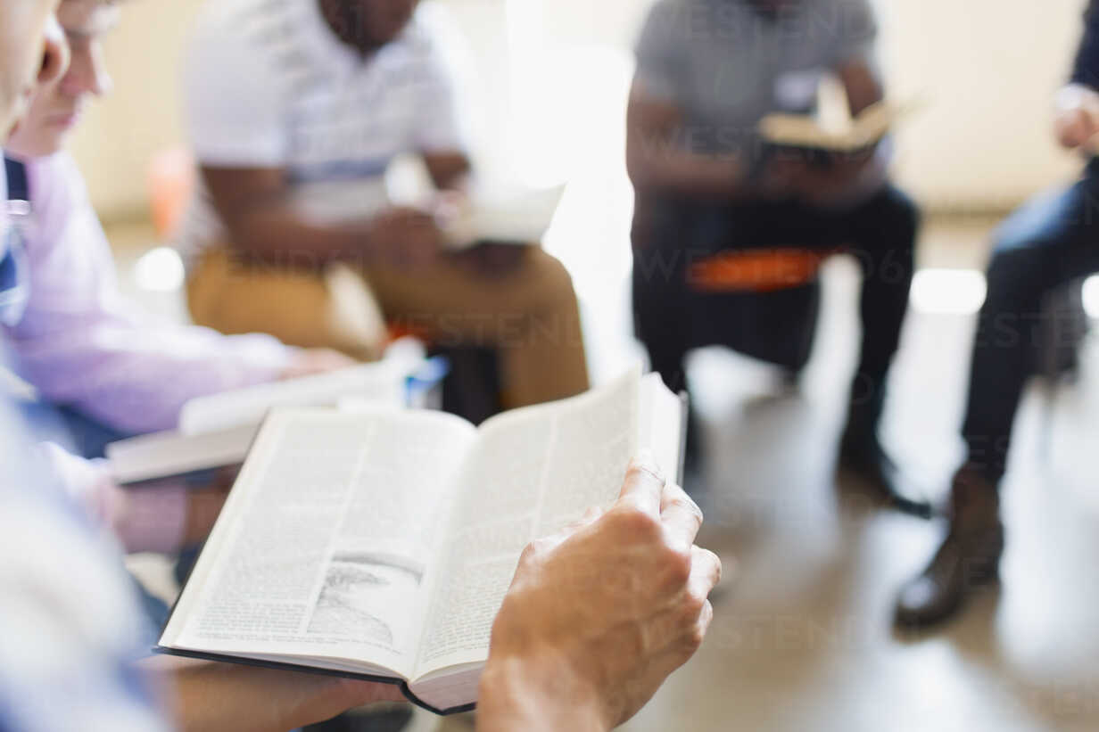

No BDP this evening
2024
"Know ye not that they which run in a race run all, but one receiveth the prize? So run, that ye may obtain." (1 Cor 9:24)

Slide 44
LESSON 1005: Praising God for His Faithfulness
STS STUDY FOR NEXT WEEK:
MEMORY VERSE: ……
  “Praise ye the Lord, O give thanks unto the Lord; for He is good: for His mercy endureth forever” (Psalm 106:1).
TEXT: Psalms 100 to 106

