Slide 1

SUPER SUNDAY SERVICE
06-07-2025

Slide 2
HYMN
GHS 205: HAVE YOU COUNTED THE COST?

Slide 3
HAVE YOU COUNTED THE COST? [GHS 205]
1.
There’s a line that is drawn
By rejecting our Lord,
Where the call of His Spirit is lost,
And you hurry along
With the pleasure-mad throng
Have you counted,
Have you counted the cost?

Slide 4
Have you counted the cost,
If your soul should be lost,
Tho’ you gained the whole world for your own? Even now it may be,
That the line you have crossed,
Have you counted,
Have you counted the cost?

Slide 5
HAVE YOU COUNTED THE COST? [GHS 205]
2.
You may barter your hope
Of eternity’s morn,
For a moment of joy at the most.
For the glitter of sin
And the things it will win –
Have you counted,
Have you counted the cost?

Slide 6
Have you counted the cost,
If your soul should be lost,
Tho’ you gained the whole world for your own? Even now it may be,
That the line you have crossed,
Have you counted,
Have you counted the cost?

Slide 7
HAVE YOU COUNTED THE COST? [GHS 205]
3.
While the door of His mercy is open to you,
Ere the depth of His love you exhaust,
Won’t you come and be healed,
Won’t you whisper, I yield
I have counted,
I have counted, the cost.

Slide 8
Have you counted the cost,
If your soul should be lost,
Tho’ you gained the whole world for your own? Even now it may be,
That the line you have crossed,
Have you counted,
Have you counted the cost?

Slide 9

SEARCH THE SCRIPTURES
06-07-2025

Slide 10
REVIEW OF THE ASSIGNMENT FROM LAST STUDY
Reflect on the influence of religious deception in the world today. Identify one false teaching or trend that compromises biblical truth and prepare a short explanation of how to confront it with Scripture.
Volunteers, please!
The mother of abomination

Slide 11
LESSON 1008: Lamentation over end-time Babylon
MEMORY VERSE: ……
  “And I heard another voice from heaven, saying, Come out of her, my people, that ye be not partakers of her sins, and that ye receive not of her plagues” (Revelation 18:4).
TEXTS: Revelation 18:1-24

Slide 12
INTRODUCTION
Our study today is a continuation of the seventh vial in Revelations 16:17-21. It focuses on the destruction of Babylon. While ancient Babylon is now desolate, all the things it represented are still present in our society today. The end-time Babylon in our text is a symbol of the evil systems and practices in our world. Before Christ’s second coming, it will be destroyed. Its fraudulent beneficiaries will lament over it. God rules over the affairs of this world. All the things in this world are temporary; live as a heavenly pilgrim.

Slide 13
Rev 18:1-24; 2 Peter 3:10-12; Mat 24:14-19; 2 Cor 6:14-18; Jer 51:47-49
KEY LESSONS IN THE STUDY OF TODAY
Babylon (from old Babel) represents confusion and rebellion against God. Flee worldliness!
This present world and all its glories will be destroyed. Possessions and pleasures will soon end. Do not idolize them. Godliness with contentment is great gain (1 Tim 6:6).
The kings and powerful men who commit sin in ‘Babylon’ will lament. Separate yourself from evil doers and live a life of holiness.
Christ’s enemies will be defeated. Persevere and serve God with joy. God will destroy those who persecute His servants (Rev 18:20).

Slide 14
QUESTION 1
What are the similarities between
ancient Babylon and end-time Babylon?
Rev 18:3, 23,24

Slide 15
QUESTION 2
Why are believers called out of end-time Babylon?
2 Cor 6:14-18; Gen 19:12,13; Col 3:1,2

Slide 16
QUESTION 3
What does the lamentation in our study remind us of as Christians with respect to worldly pursuits?
1 Tim 6:6-11; 1 John 2:15-17

Slide 17
QUESTION 4
How should a believer live in the light
of the imminent destruction coming on this world?
2 Pet 3:11,12; Mat 26:41; Jude 20-24

Slide 18
QUESTION 5
What eternal assurance do believers
have seeing the dominance of evil in this Satan-controlled world?
Jer 51:47-49,64; Rev 18:20-24

Slide 19
CONCLUSION
The pleasures and pride of the world are vanity. They will soon be destroyed. Keep yourself from idols (1 John 5:21). Guard your soul! Seek God and His righteousness (Mat 6:33).
Are you facing persecution, rejection or discrimination, do not avenge yourself. Trust God and persevere. God will judge all evil doers. He rules over the affairs of this world!

Slide 20
ASSIGNMENT
A brother/sister is frequently absent from church services because of (overtime) work. When you call or visit, he/she says, “I need to work to make enough money because things are expensive and one must help himself”. Give two scriptural references you would use to counsel him/her.

Slide 21


SEARCH THE SCRIPTURES SUMMARY

Slide 22

INTERCESSION

Slide 23
TITHES AND OFFERING
Kindly pay via one of the following options:
Your phone
Bank transfer to
Cash
IBAN: NL90ABNA0416385699
Remarks: Tithes (name of region)
“… God loves a cheerful giver”
- 2 Corinthians 9:7

Slide 24

WELCOME TO
DEEPER LIFE BIBLE CHURCH
A CHURCH ON THE MOVE…
“Come thou with us and we will do thee good: for the Lord hath spoken good concerning [us]”
– Numbers 10:29
GOD’S FAMILY
GOD’S FOOD
GLOWING FOLD
We are a family, God’s family:
Our Father: God
Our Saviour: Jesus
Our Comforter: The Holy Spirit
Our destination: Heaven
We feast on God’s pure Word. We:
Read it
Study it
Believe it
Apply it
We want you to be part of us – a growing and glowing family. Join us and you will soon discover what makes our identity unique.
For your time and eternal profit, this is the place to be!

Slide 25








COUNSELLING
SERVICE SCHEDULES
Service | Day | Timing | Remarks
Worship Service | Sunday | 09:45-12:00 | Physical/Online
Bible Study | Tuesday | 19:30-20:30 | Online
Revival Service | Friday | 19:30-21:00 | Online/Physical
Night Vigil | Friday | 19:30-23:30 | First Friday Monthly
If you have questions or need guidance on challenging issues, kindly request for counselling.
Our pastor is here for you.
CONTACT
+31 207 856 683
info@deeperlife.nl
LOCATION DETAILS
Location | Telephone # | ZOOM Meeting ID
Amsterdam | +31 686 093 624 | 795-674-627
Eindhoven | +31 643 678 896 | 912-749-784
Rotterdam | +31 642 133 520 | 237-801-783
The Hague | +31 685 076 861 | 818-6898-8436
dclmnetherlands
www.dclm-nl.org

Slide 26
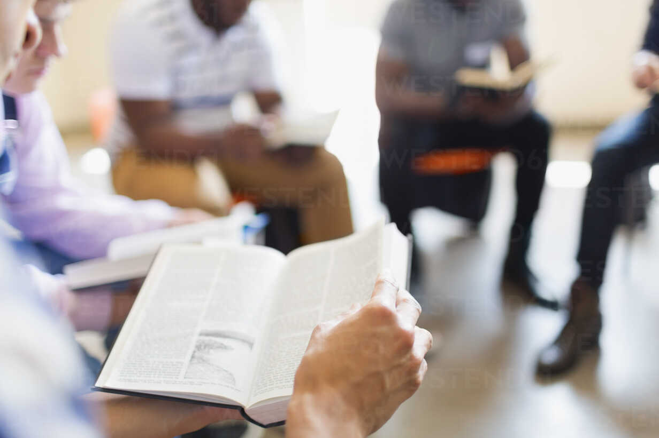


BELIEVER’S
Development
Programme
2024
Today: Sunday 06 July 2025
19:30 – 20:30
Zoom Meeting ID: 795 674 627
"Know ye not that they which run in a race run all, but one receiveth the prize? So run, that ye may obtain." (1 Cor 9:24)

Slide 27
LESSON 1009: The marriage supper of the Lamb
STS STUDY FOR NEXT WEEK:
MEMORY VERSE: ……
  “And He saith unto me, Write, blessed are they which are called unto the marriage supper of the Lamb. And He saith unto me, these are true sayings of God (Revelation 19:9).
TEXTS: Revelation 19:1-10

Slide 28


Acts 19:1-20

Slide 29
HYMN
GHS 115: LIFT HIM UP

Slide 30
LIFT HIM UP [GHS 115]
1.
How to reach the masses, men of every birth,
For an answer, Jesus gave the key:
“And I, if I be lifted up from the earth,
Will draw all men unto Me.”
Lift Him up, …. lift Him up, ….
Still He speaks from eternity:
“And I, if I be lifted up from the earth,
Will draw all men unto Me.”

Slide 31
LIFT HIM UP [GHS 115]
2.
Oh! the world is hungry for the Living Bread,
Lift the Savior up for them to see;
Trust Him, and do not doubt the words that He said, “I’ll draw all men unto Me.”
Lift Him up, …. lift Him up, ….
Still He speaks from eternity:
“And I, if I be lifted up from the earth,
Will draw all men unto Me.”

Slide 32
LIFT HIM UP [GHS 115]
3.
Don’t exalt the preacher, don’t exalt the pew,
Preach the Gospel simple, full, and free;
Prove Him and you will find that promise is true, “I’ll draw all men unto Me.”
Lift Him up, …. lift Him up, ….
Still He speaks from eternity:
“And I, if I be lifted up from the earth,
Will draw all men unto Me.”

Slide 33
LIFT HIM UP [GHS 115]
4.
Lift Him up by living as a Christian ought,
Let the world in you the Saviour see;
Then men will gladly follow Him who once taught, “I’ll draw all men unto Me.”
Lift Him up, …. lift Him up, ….
Still He speaks from eternity:
“And I, if I be lifted up from the earth,
Will draw all men unto Me.”

Slide 34

CHOIR

Slide 35

PRE-MESSAGE SONG
O Lord thy Word will endure

Slide 36
PRAYER & FASTING
“SO MIGHTILY GREW THE WORD OF GOD AND PREVAILED”

Slide 37

TIME TO PRAY

