Slide 1

SUPER SUNDAY SERVICE
13-07-2025

Slide 2
HYMN
GHS 137: HOW BEAUTIFUL HEAVEN MUST BE

Slide 3
HOW BEAUTIFUL HEAVEN MUST BE [GHS 137]
1.
We read of a beautiful heaven,
Prepared for the pure and the free;
These truths in God’s word He has given,
How beautiful heaven must be.

Slide 4
How beautiful heaven must be,
Sweet home of the happy and free;
Fair haven of rest for the weary,
How beautiful heaven must be.

Slide 5
HOW BEAUTIFUL HEAVEN MUST BE [GHS 137]
2.
In heaven, no drooping nor pining,
No wishing for elsewhere to be;
God’s light is forever there shining,
How beautiful heaven must be.

Slide 6
How beautiful heaven must be,
Sweet home of the happy and free;
Fair haven of rest for the weary,
How beautiful heaven must be.

Slide 7
HOW BEAUTIFUL HEAVEN MUST BE [GHS 137]
3.
I’m longing to go to fair heaven,
To be with the happy and free;
To spend the long ages in singing,
How beautiful heaven must be.

Slide 8
How beautiful heaven must be,
Sweet home of the happy and free;
Fair haven of rest for the weary,
How beautiful heaven must be.

Slide 9
HOW BEAUTIFUL HEAVEN MUST BE [GHS 137]
4.
The angels so sweetly are singing,
Up there by the beautiful sea;
Sweet chords from their gold harps are ringing,
How beautiful heaven must be.

Slide 10
How beautiful heaven must be,
Sweet home of the happy and free;
Fair haven of rest for the weary,
How beautiful heaven must be.

Slide 11

SEARCH THE SCRIPTURES
13-07-2025

Slide 12
REVIEW OF THE ASSIGNMENT FROM LAST STUDY
A brother/sister is frequently absent from church services because of (overtime) work. When you call or visit, he/she says, “I need to work to make enough money because things are expensive and one must help himself”. Give two scriptural references you would use to counsel him/her.
Volunteers, please!
Lamentation over end-time Babylon

Slide 13
LESSON 1009:
The marriage supper of the Lamb
MEMORY VERSE: ……
  “And He saith unto me, Write, blessed are they which are called unto the marriage supper of the Lamb. And He saith unto me, these are true sayings of God (Revelation 19:9).
TEXT: Revelation 19:1-10

Slide 14
INTRODUCTION
The marriage super of the Lamb will come after the rapture. It is the glorious consummation of Christ’s union with His church. The righteous will be translated to heaven. With a great voice of much people in heaven, saying Alleluia, the stage will be set for the long-awaited celebration of Christ the Bridegroom as He weds His church, the Bride (Eph 5:27). The Rapture ends the time of grace and the church age. It will be followed by the Great Tribulation when the Antichrist will greatly afflict those left behind. To partake at the marriage supper, you MUST be holy.

Slide 15
Rev. 19:1-13;
KEY LESSONS IN THE STUDY OF TODAY
God deserves our praise for our salvation, His love, justice, sovereignty and supremacy. He alone is to be worshipped.
For your praise to be acceptable to God on earth and in heaven, you must be born again.
The Bride of the Lamb are all believers who are chaste and holy; they are ‘virgins’, or undefiled. Israel lost this position due to idolatry.
Holiness is the major requirement for the holy union with the Lord at His marriage supper.
They are blessed that are called to the marriage supper of the Lamb.

Slide 16
QUESTION 1
What is the marriage supper of the Lamb?
Eph.5:27,32; Rev. 19:7-8

Slide 17
QUESTION 2
What are the reasons for the shout of hallelujah in the text?
Rev. 19:1,2,4,6

Slide 18
QUESTION 3
Who is the bride of Christ?
Acts 20:28; Eph. 5:30,32;
2 Cor. 11:2

Slide 19
QUESTION 4
How can one qualify for the marriage supper of the Lamb?
Rev. 19:7-8; Heb. 12:14

Slide 20
QUESTION 5
Explain the blessedness of being at the marriage supper of the Lamb.
Rev. 21:3-4; 1 Cor.15:58;
Matt. 25:34

Slide 21
CONCLUSION
Every believer should prepare for the marriage supper of the Lamb NOW by being rapture- ready. This readiness requires holiness, Christ-likeness and cross-bearing with constant self-examination, intake of God’s word, prayer, watchfulness and perseverance.
ARE YOU READY?

Slide 22
ASSIGNMENT
Reflect on the following questions prayerfully:
Do I excuse myself from the Lord’s supper? If so, why? Settle that with the Lord now.
Do I have any pending restitution to make? If so, why do I still delay? Seek help now.
If the trumpet would sound today, am I ready to go with the saints? If not, why not?
“For what shall it profit a man, if he shall gain the whole world, and lose his own soul? Or what shall a man give in exchange for his soul?”

Slide 23


SEARCH THE SCRIPTURES SUMMARY

Slide 24

INTERCESSION

Slide 25
TITHES AND OFFERING
Kindly pay via one of the following options:
Your phone
Bank transfer to
Cash
IBAN: NL90ABNA0416385699
Remarks: Tithes (name of region)
“… God loves a cheerful giver”
- 2 Corinthians 9:7

Slide 26

WELCOME TO
DEEPER LIFE BIBLE CHURCH
A CHURCH ON THE MOVE…
“Come thou with us and we will do thee good: for the Lord hath spoken good concerning [us]”
– Numbers 10:29
GOD’S FAMILY
GOD’S FOOD
GLOWING FOLD
We are a family, God’s family:
Our Father: God
Our Saviour: Jesus
Our Comforter: The Holy Spirit
Our destination: Heaven
We feast on God’s pure Word. We:
Read it
Study it
Believe it
Apply it
We want you to be part of us – a growing and glowing family. Join us and you will soon discover what makes our identity unique.
For your time and eternal profit, this is the place to be!

Slide 27








COUNSELLING
SERVICE SCHEDULES
Service | Day | Timing | Remarks
Worship Service | Sunday | 09:45-12:00 | Physical/Online
Bible Study | Tuesday | 19:30-20:30 | Online
Revival Service | Friday | 19:30-21:00 | Online/Physical
Night Vigil | Friday | 19:30-23:30 | First Friday Monthly
If you have questions or need guidance on challenging issues, kindly request for counselling.
Our pastor is here for you.
CONTACT
+31 207 856 683
info@deeperlife.nl
LOCATION DETAILS
Location | Telephone # | ZOOM Meeting ID
Amsterdam | +31 686 093 624 | 795-674-627
Eindhoven | +31 643 678 896 | 912-749-784
Rotterdam | +31 642 133 520 | 237-801-783
The Hague | +31 685 076 861 | 818-6898-8436
dclmnetherlands
www.dclm-nl.org

Slide 28




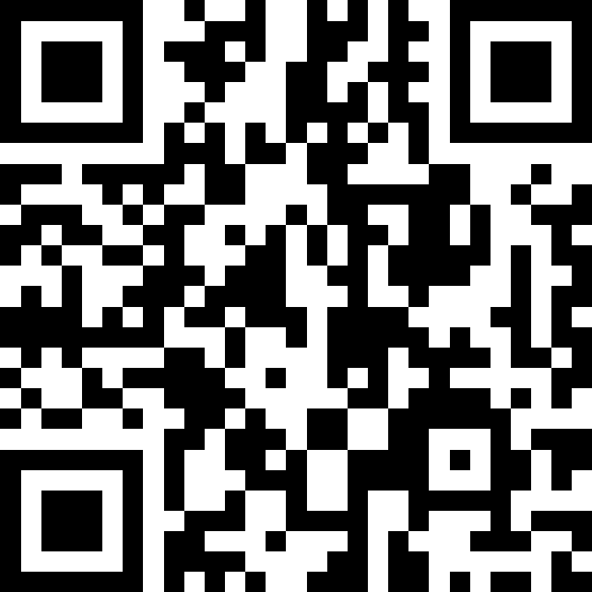

NATIONAL Workers’ training
This Workers’ Training is for both workers and aspiring workers
Saturday 02 August 2025
Latest by 30 July 2025, using the provided Slido QR code/ ID, please send in questions you may have on the theme “one-food”, the Bible.
09:30 – 16:00
Regional locations
www.slido.com
Code #: 100 000
Highlights:
Knowing and handling scriptures as a skilled worker
Doctrinal sessions on the Bible
Functional training on effective teaching of the Bible
Question and answer session on the Bible
Scriptural precepts on preserving the Word
Examples of questions:
The purpose of the Bible
What makes the Bible unique
How to get the best from the Bible
Specific questions on Bible doctrines
Erroneous false doctrine you need clarification on
The Bibles stands on business, marriage etc.

Slide 29
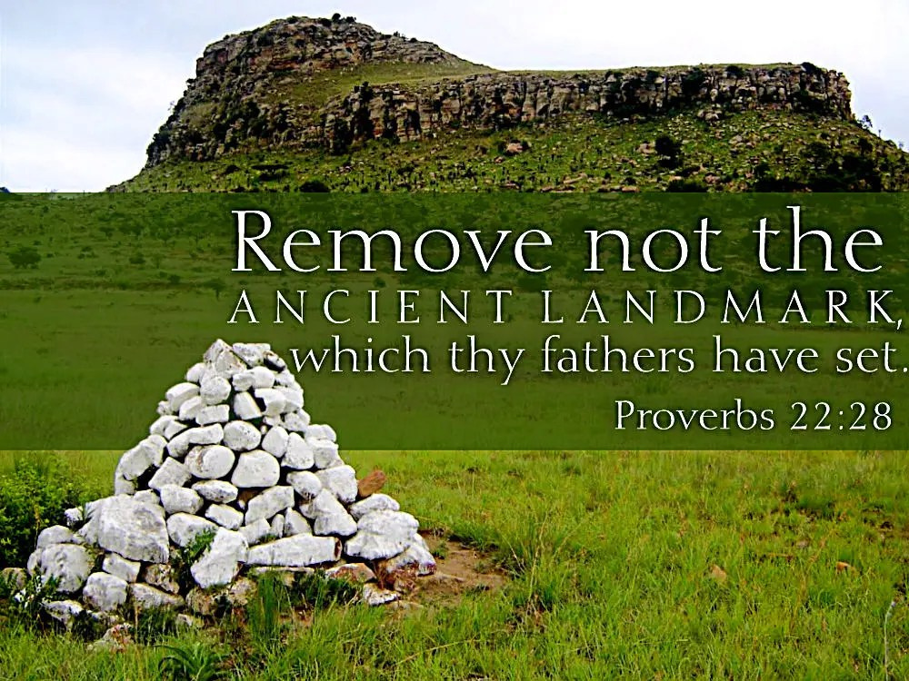
YOUTH SESSIONS ON
GOSPEL LANDMARKS
Date: 13th & 20th July 2025
The youth will breakout to their section during the message
Highlights:
13th July: Bible Doctrines 1 - 7
20th July: Bible Doctrines 8 - 12

Slide 30
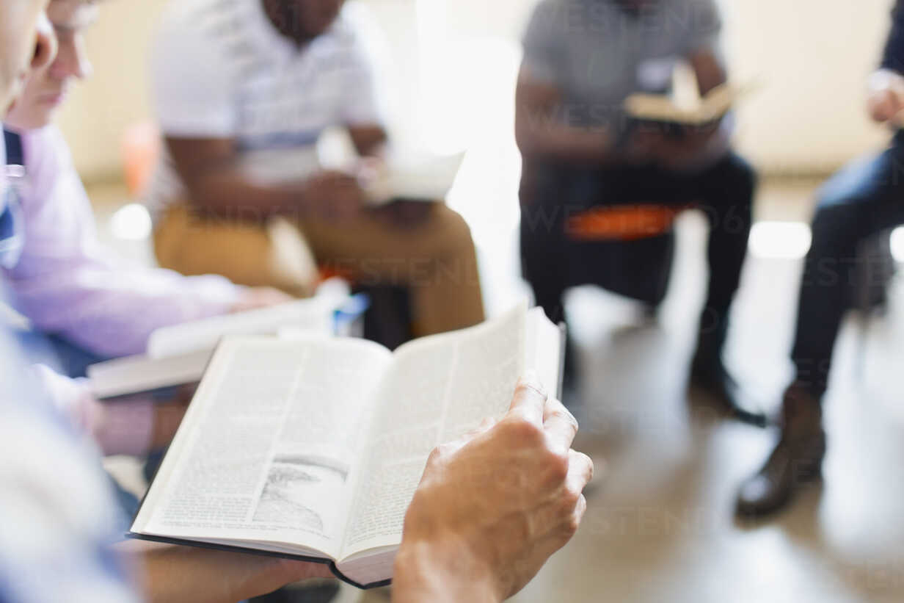

BELIEVER’S
Development
Programme
2024
Today: Sunday 13 July 2025
19:30 – 20:30
Zoom Meeting ID: 795 674 627
"Know ye not that they which run in a race run all, but one receiveth the prize? So run, that ye may obtain." (1 Cor 9:24)

Slide 31
LESSON 1010: Christ’s second coming and the battle of Armageddon
STS STUDY FOR NEXT WEEK:
MEMORY VERSE: ……
  “And I saw heaven opened, and behold a white horse; and he that sat upon him was called Faithful and True, and in righteousness he doth judge and make
  war” (Revelation 19:11).
TEXTS: Revelation 19:11-21

Slide 32


Psalm 19:1-14

Slide 33
HYMN
THE BIBLE STANDS

Slide 34
THE BIBLE STANDS
1.
The Bible stands like a rock undaunted
’Mid the raging storms of time;
Its pages burn with the truth eternal,
And they glow with a light sublime.

Slide 35
The Bible stands tho’ the hills may tumble,
It will firmly stand when the earth shall crumble;
I will plant my feet on its firm foundation,
For the Bible stands.

Slide 36
THE BIBLE STANDS
2.
The Bible stands like a mountain tow’ring
Far above the works of men;
Its truth by none ever was refuted,
And destroy it they never can.

Slide 37
The Bible stands tho’ the hills may tumble,
It will firmly stand when the earth shall crumble;
I will plant my feet on its firm foundation,
For the Bible stands.

Slide 38
THE BIBLE STANDS
3.
The Bible stands and it will for ever,
When the world has passed away;
By inspiration it has been given,
All its precepts I will obey.

Slide 39
The Bible stands tho’ the hills may tumble,
It will firmly stand when the earth shall crumble;
I will plant my feet on its firm foundation,
For the Bible stands.

Slide 40
THE BIBLE STANDS
4.
The Bible stands ev’ry test we give it,
For its Author is divine;
By grace alone I expect to live it,
And to prove it and make it mine.

Slide 41
The Bible stands tho’ the hills may tumble,
It will firmly stand when the earth shall crumble;
I will plant my feet on its firm foundation,
For the Bible stands.

Slide 42

CHOIR

Slide 43
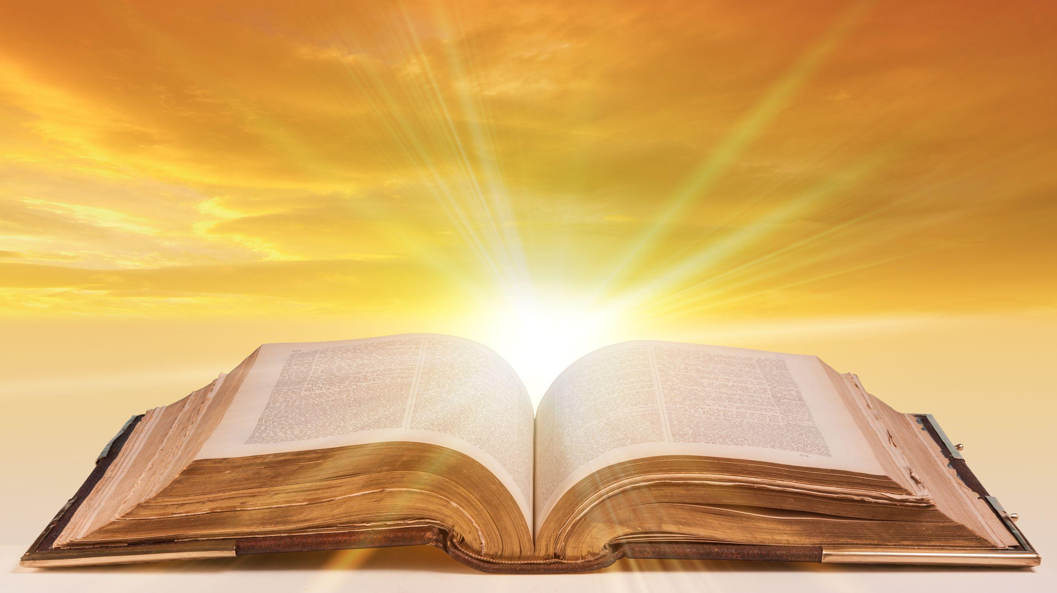
PRE-MESSAGE SONG
O Lord thy Word will endure

Slide 44
TODAY’S SERMON
GOSPEL LANDMARKS
SESSION 1: DOCTRINES #01-#07

Slide 45
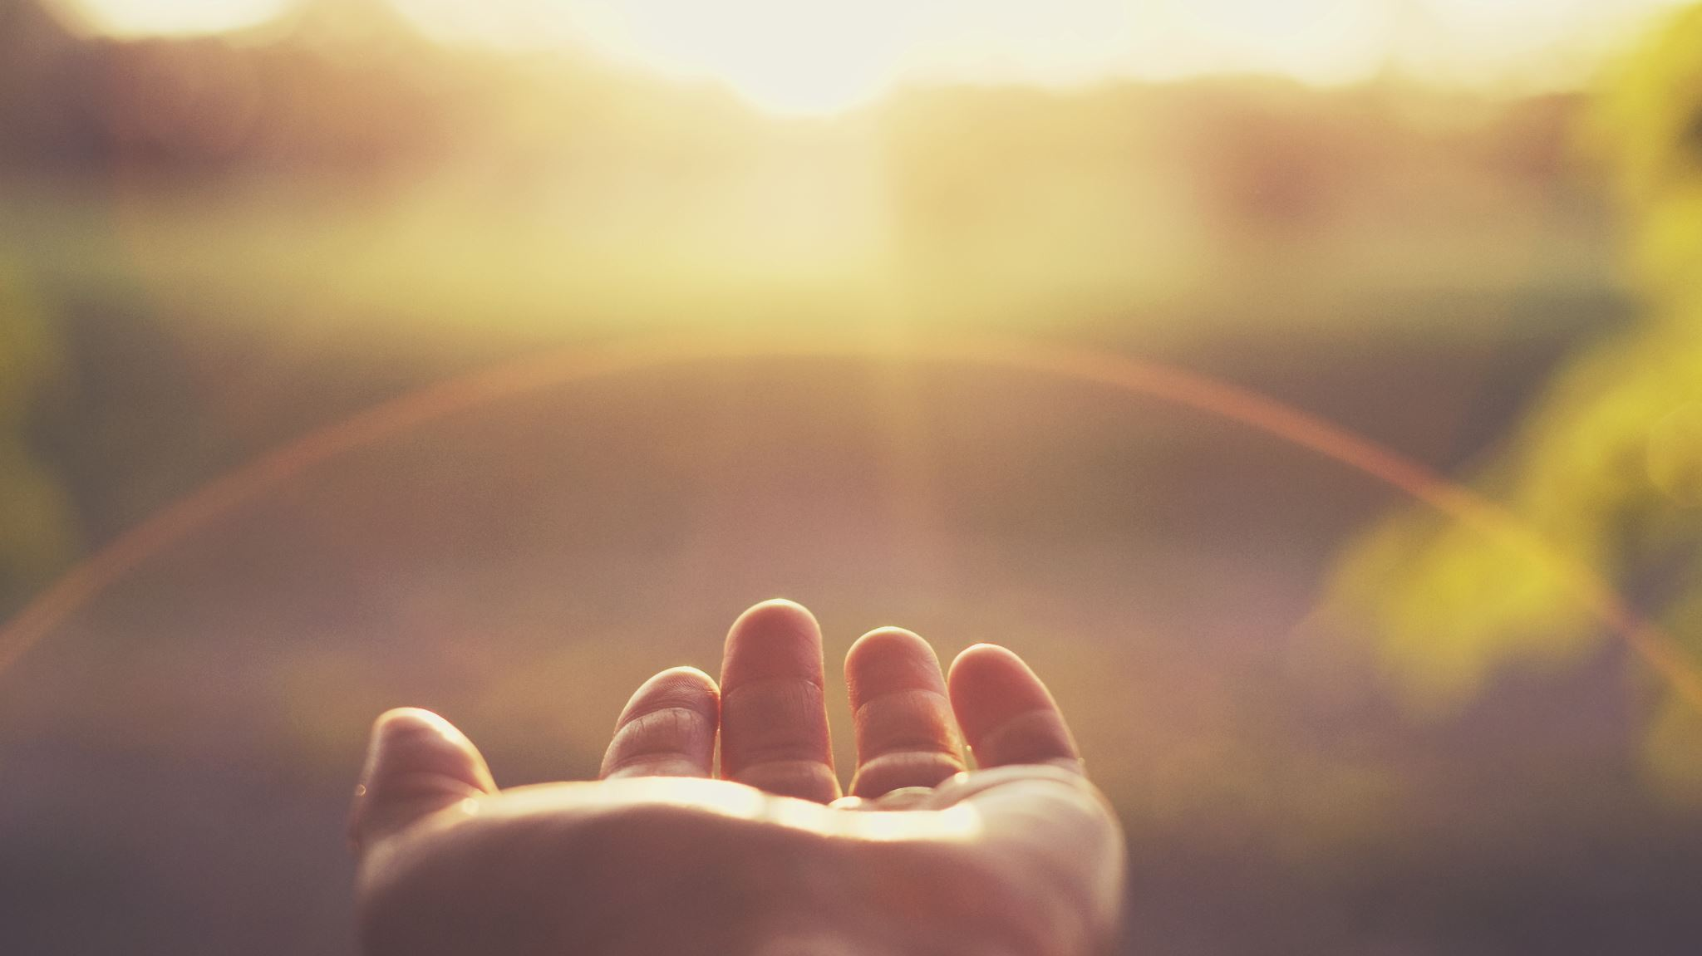
TIME TO PRAY

