Slide 1

SUPER SUNDAY SERVICE
20-07-2025

Slide 2
HYMN
GHS 176: CHRIST RETURNETH

Slide 3
CHRIST RETURNETH [GHS 176]
1.
It may be at morn, when the day is awaking,
When sunlight thro’ darkness and shadow is breaking,
That Jesus will come in the fulness of glory,
To receive from the world “His own.”

Slide 4
O Lord Jesus, how long, how long,
Ere we shout the glad song,
Christ returneth!
Hallelujah! hallelujah! Amen,
Hallelujah! Amen

Slide 5
CHRIST RETURNETH [GHS 176]
2.
It may be at mid-day, it may be at twilight,
It may be, per chance, that the blackness of midnight
Will burst into light in the blaze of His glory,
When Jesus receives “His own.”

Slide 6
O Lord Jesus, how long, how long,
Ere we shout the glad song,
Christ returneth!
Hallelujah! hallelujah! Amen,
Hallelujah! Amen

Slide 7
CHRIST RETURNETH [GHS 176]
3.
While its hosts cry Hosanna, from heaven descending,
With glorified saints and the angels attending,
With grace on His brow, like a halo of glory,
Will Jesus receive “His own.”

Slide 8
O Lord Jesus, how long, how long,
Ere we shout the glad song,
Christ returneth!
Hallelujah! hallelujah! Amen,
Hallelujah! Amen

Slide 9
CHRIST RETURNETH [GHS 176]
4.
Oh, joy! oh, delight! should we go without dying,
No sickness, no sadness, no dread and no crying,
Caught up thro’ the clouds with our Lord into glory,
When Jesus receives “His own.”

Slide 10
O Lord Jesus, how long, how long,
Ere we shout the glad song,
Christ returneth!
Hallelujah! hallelujah! Amen,
Hallelujah! Amen

Slide 11

SEARCH THE SCRIPTURES
20-07-2025

Slide 12
LESSON 1010:
Christ’s second coming and the battle of Armageddon
MEMORY VERSE: ……
“And I saw heaven opened, and behold a white horse; and he that sat upon him was called Faithful and True, and in righteousness he doth judge and make war” (Revelation 19:11).
TEXT: Revelation 19:11-21

Slide 13
INTRODUCTION
The second coming of Christ and the battle of Armageddon are the two events that will wind up the great tribulation. He came the first time as the Lamb of God; His second coming is as the Lion of the tribe of Judah. He, with all His saints will execute judgment against the antichrist and his armies and establish a glorious reign as King of kings.
God desires that people repent and trust His Son as Saviour. He is a God of justice. Hence, sinners must repent and come to Christ before it is too late while the Church should be ready, prayerful and busy preaching His word until He comes.

Slide 14
Rev. 19:11-21
KEY LESSONS IN THE STUDY OF TODAY
The second coming of Christ is different from the rapture. It will be as real as His post-resurrection ascension to heaven. He will fulfill all the promises He has made to His Church.
Christ’s second coming is to end the reign of the Antichrist and establish peace on earth for 1000 years.
God has no pleasure in punishing people. He is a God of love who desires that sinners repent and trust His son as Saviour.
Just as God is indiscriminate in His offer of salvation, so will He exercise His judgment without discrimination.

Slide 15
QUESTION 1
Differentiate between the rapture and the second coming of Christ.
1 Thess 4:16,17; Zech 14:1,4; Jude 1:14,15

Slide 16
QUESTION 2
Describe the attributes of Christ as revealed in the chapter.
Revelation 19:11-13

Slide 17
QUESTION 3
What is the difference between the two kinds of supper mentioned in the passage? Revelation 19:9,17

Slide 18
QUESTION 4
What would be the fate of those who reject God’s offer of salvation and what steps must sinners take to be reconciled with God? Rev 19:20; Isaiah 55:6,7

Slide 19
QUESTION 5
What necessary preparations should sinners and believers make in readiness for Christ’s second coming?
Heb 12:14; 2 Tim 4:1,2; 1 Jn 3:2,3.

Slide 20
CONCLUSION
Sinners and backsliders have the same eternal destination as the antichrist and his team. They are admonished to repent and come to Christ before the day of the Lord.
To reign with Christ on His second coming, the Church should be ready through holiness, watchfulness, prayers and being occupied with preaching His word until He comes.
          BE A READY BRIDE!

Slide 21
ASSIGNMENT
A friend comes to you and says that he is no longer sure that Christ will return again. In the light of today’s study, what are the dangers he faces? And how will you counsel him?
Prepare scriptural verses to back up your response and share them with the church next week.

Slide 22


SEARCH THE SCRIPTURES SUMMARY

Slide 23

INTERCESSION

Slide 24
TITHES AND OFFERING
Kindly pay via one of the following options:
Your phone
Bank transfer to
Cash
IBAN: NL90ABNA0416385699
Remarks: Tithes (name of region)
“… God loves a cheerful giver”
- 2 Corinthians 9:7

Slide 25

WELCOME TO
DEEPER LIFE BIBLE CHURCH
A CHURCH ON THE MOVE…
“Come thou with us and we will do thee good: for the Lord hath spoken good concerning [us]”
– Numbers 10:29
GOD’S FAMILY
GOD’S FOOD
GLOWING FOLD
We are a family, God’s family:
Our Father: God
Our Saviour: Jesus
Our Comforter: The Holy Spirit
Our destination: Heaven
We feast on God’s pure Word. We:
Read it
Study it
Believe it
Apply it
We want you to be part of us – a growing and glowing family. Join us and you will soon discover what makes our identity unique.
For your time and eternal profit, this is the place to be!

Slide 26








COUNSELLING
SERVICE SCHEDULES
Service | Day | Timing | Remarks
Worship Service | Sunday | 09:45-12:00 | Physical/Online
Bible Study | Tuesday | 19:30-20:30 | Online
Revival Service | Friday | 19:30-21:00 | Online/Physical
Night Vigil | Friday | 19:30-23:30 | First Friday Monthly
If you have questions or need guidance on challenging issues, kindly request for counselling.
Our pastor is here for you.
CONTACT
+31 207 856 683
info@deeperlife.nl
LOCATION DETAILS
Location | Telephone # | ZOOM Meeting ID
Amsterdam | +31 686 093 624 | 795-674-627
Eindhoven | +31 643 678 896 | 912-749-784
Rotterdam | +31 642 133 520 | 237-801-783
The Hague | +31 685 076 861 | 818-6898-8436
dclmnetherlands
www.dclm-nl.org

Slide 27
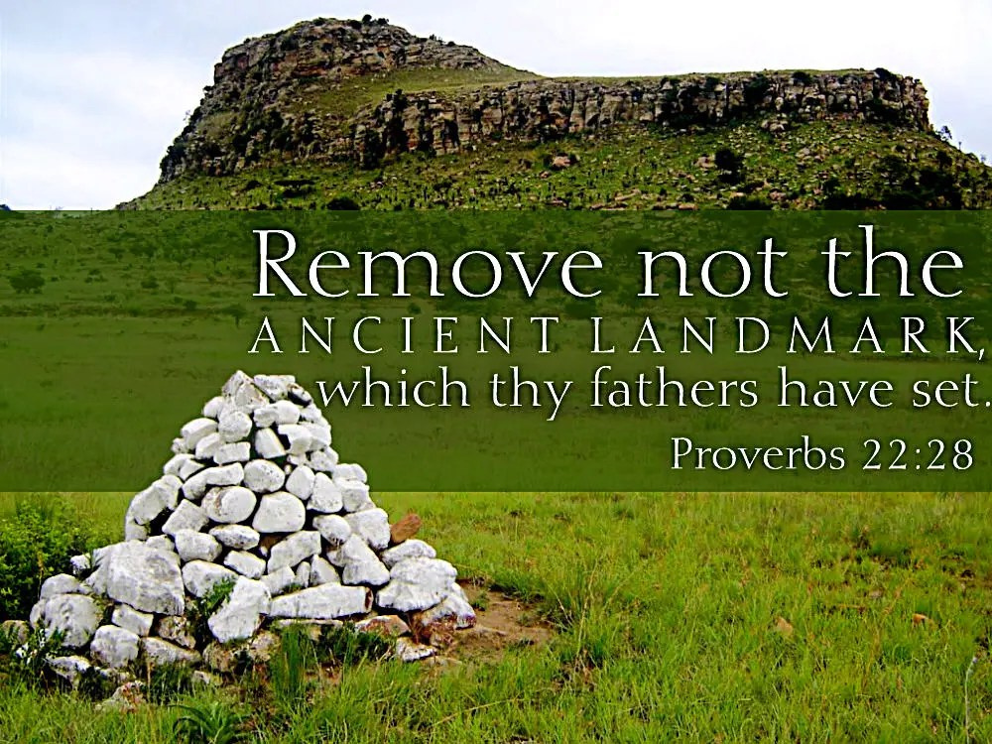
YOUTH SESSION ON
GOSPEL LANDMARKS
Date: Today, 20th July 2025
The youth will breakout to their section during the message
Highlights:
20th July: Bible Doctrines 8 - 12

Slide 28



BELIEVER’S
Development
Programme
2024
Today: Sunday 20 July 2025
19:30 – 20:30
Zoom Meeting ID: 795 674 627
"Know ye not that they which run in a race run all, but one receiveth the prize? So run, that ye may obtain." (1 Cor 9:24)

Slide 29


Slide 30


Slide 31


Slide 32
LESSON 1011: The Millennial reign of Christ
STS STUDY FOR NEXT WEEK:
MEMORY VERSE: ……
  "Blessed and holy is he that hath part in the first resurrection: on such the second death hath no power, but they shall be priests of God and of Christ, and shall reign with him a thousand years" (Revelation 20:6).
TEXTS: Revelation 20:1-10

Slide 33



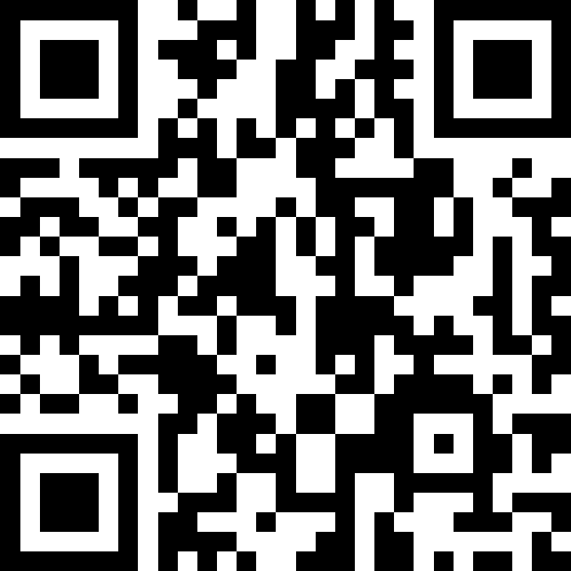

NATIONAL Workers’ training
This Workers’ Training is for both workers and aspiring workers
Saturday 02 August 2025
Latest by 30 July 2025, using the provided Slido QR code/ ID, please send in questions you may have on the theme “one-food”, the Bible.
09:30 – 16:00
Regional locations
www.slido.com
Code #: 100 000
Highlights:
Knowing and handling scriptures as a skilled worker
Doctrinal sessions on the Bible
Functional training on effective teaching of the Bible
Question and answer session on the Bible
Scriptural precepts on preserving the Word
Examples of questions:
The purpose of the Bible
What makes the Bible unique
How to get the best from the Bible
Specific questions on Bible doctrines
Erroneous false doctrine you need clarification on
The Bibles stands on business, marriage etc.

Slide 34


Slide 35


Psalm 19:1-14

Slide 36
HYMN
GHS 73: JESUS ONLY IS OUR MESSAGE

Slide 37
JESUS ONLY IS OUR MESSAGE (GHS 73)​
1.
Jesus only is our Message, ​
Jesus all our theme shall be; ​
We will lift up Jesus ever ​
Jesus only will we see.​
Jesus only, Jesus ever,
Jesus all in all we sing;
Saviour, Sanctifier, Healer,
Baptizer and coming King.

Slide 38
JESUS ONLY IS OUR MESSAGE (GHS 73)​
2.
Jesus only is our Saviour, ​
All our guilt He bore away; ​
All our righteousness He gives us, ​
All our strength from day to day.​
Jesus only, Jesus ever,
Jesus all in all we sing;
Saviour, Sanctifier, Healer,
Baptizer and coming King.

Slide 39
JESUS ONLY IS OUR MESSAGE (GHS 73)​
3.
Jesus is our Sanctifier, ​
Cleansing us from self and sin; ​
And with all His Spirit’s fulness, ​
Filling all our hearts within. ​
Jesus only, Jesus ever,
Jesus all in all we sing;
Saviour, Sanctifier, Healer,
Baptizer and coming King.

Slide 40
JESUS ONLY IS OUR MESSAGE (GHS 73)​
4.
Jesus only is our Healer, ​
All our sicknesses He bare; ​
And His risen life and fulness, ​
All His members still may share.​
Jesus only, Jesus ever,
Jesus all in all we sing;
Saviour, Sanctifier, Healer,
Baptizer and coming King.

Slide 41
JESUS ONLY IS OUR MESSAGE (GHS 73)​
5.
Jesus only is our Power,​
His the gift of Pentecost;​
Jesus, breathe Thy power upon us,​
Fill us with the Holy Ghost. ​
Jesus only, Jesus ever,
Jesus all in all we sing;
Saviour, Sanctifier, Healer,
Baptizer and coming King.

Slide 42
JESUS ONLY IS OUR MESSAGE (GHS 73)​
6.
And for Jesus we are waiting,​
Listening for the trumpet’s sound;​
Then it will be us and Jesus,​
Living ever with our God​
Jesus only, Jesus ever,
Jesus all in all we sing;
Saviour, Sanctifier, Healer,
Baptizer and coming King.

Slide 43
Christ Jesus hath the pow’r,
The pow’r of God He wields!
Christ Jesus hath the pow’r,
My heart surrender yields!
Christ Jesus hath the pow’r,
I trust Him evermore!.
Christ Jesus hath the pow’r,
I worship and adore!

Slide 44

CHOIR

Slide 45

PRE-MESSAGE SONG
O Lord thy Word will endure

Slide 46
TODAY’S SERMON
GOSPEL LANDMARKS
SESSION 2: DOCTRINES #08-#12

Slide 47

TIME TO PRAY

