Slide 1


Slide 2

GLOBAL WORSHIP SERVICE
31-08-2025

Slide 3
HYMN
THE BIBLE STANDS

Slide 4
THE BIBLE STANDS
1.
The Bible stands like a rock undaunted
’Mid the raging storms of time;
Its pages burn with the truth eternal,
And they glow with a light sublime.

Slide 5
The Bible stands tho’ the hills may tumble,
It will firmly stand when the earth shall crumble;
I will plant my feet on its firm foundation,
For the Bible stands.

Slide 6
THE BIBLE STANDS
2.
The Bible stands like a mountain tow’ring
Far above the works of men;
Its truth by none ever was refuted,
And destroy it they never can.

Slide 7
The Bible stands tho’ the hills may tumble,
It will firmly stand when the earth shall crumble;
I will plant my feet on its firm foundation,
For the Bible stands.

Slide 8
THE BIBLE STANDS
3.
The Bible stands and it will for ever,
When the world has passed away;
By inspiration it has been given,
All its precepts I will obey.

Slide 9
The Bible stands tho’ the hills may tumble,
It will firmly stand when the earth shall crumble;
I will plant my feet on its firm foundation,
For the Bible stands.

Slide 10
THE BIBLE STANDS
4.
The Bible stands ev’ry test we give it,
For its Author is divine;
By grace alone I expect to live it,
And to prove it and make it mine.

Slide 11
The Bible stands tho’ the hills may tumble,
It will firmly stand when the earth shall crumble;
I will plant my feet on its firm foundation,
For the Bible stands.

Slide 12

SEARCH THE SCRIPTURES
31-08-2025

Slide 13
REVIEW OF THE ASSIGNMENT FROM LAST STUDY
Study Exodus 15:1-18 and outline the key points in this song of deliverance.
Volunteers, please!
Songs of deliverance and thanksgiving

Slide 14
LESSON 1016:
Pre-eminence of God’s law
MEMORY VERSE: ……
  “Thy word is true from the beginning: and every one of thy righteous judgments endureth for ever.”
  (Psalm 119:160).
TEXT: Psalm 119:1-16

Slide 15
INTRODUCTION
This chapter highlights the pre-eminence of God’s law, His Word, in the life our lives. The psalmist expresses profound love and reverence for God’s commandments, describing Scripture as his delight, counsellor, and invaluable treasure (Psalm 119:24,111). Rich intake of God’s Word nourishes the soul and produces abundant spiritual growth and fruitfulness. For this reason, believers in every generation have found God’s Word indispensable for doctrine, guidance, comfort, and instruction in righteous living.

Slide 16
KEY LESSONS IN THE STUDY OF TODAY
The unique qualities of God’s Word – divine inspiration, living power, absolute truth, and eternal relevance – make it the foundation and ultimate authority for faith and life.
We can maximise profit from God’s Word by internalising it, cherishing it with love and delight, and obeying it in our daily life.
To fully benefit from the scripture, we must avoid the snare of unbelief, mere religious formality and worldly preoccupations.
We should esteem God’s Word above all else (Job 23:12); by so doing, we will experience the manifold profits of keeping His precepts.

Slide 17
QUESTION 1
What life-changing power does God’s Word hold?
Jer 23:29; John 17:17

Slide 18
QUESTION 2
Why is meditating on God’s Word essential to long-term spiritual growth?
Psalm 1:2,3; 1 Timothy 4:15

Slide 19
QUESTION 3
How does God’s Word protect believers from spiritual deception and moral failure?
Psalm 119:98; Ephesians 6:17

Slide 20
QUESTION 4
In times of affliction or discouragement, how can the Word of God bring comfort and renewal to the soul?
Psalm 119:50; Lam. 3:22–23

Slide 21
QUESTION 5
What is the connection between a person’s love for God’s Word and their level of peace in life?
Philippians 4:6,7; Proverbs 3:1,2

Slide 22
QUESTION 6
What deliberate actions must a person take to transition from a sinful path to a life blessed by obedience to God’s Word?
James 1:21 ; Acts 3:19

Slide 23
CONCLUSION
God’s Word must hold the place of highest pre-eminence in our lives. It is true, valuable, and life-giving; therefore, we too should esteem every divine precept as right. We should treasure the Scriptures, trust every promise, and obey every command. It is in this that we will find wisdom, comfort, and “great peace”.

Slide 24
ASSIGNMENT
Read Psalm 119:1–40 slowly over the course of the week (8 verses per day). For each day, write briefly:
  One quality of God’s Word mentioned in the passage.
  One way you can apply it to your personal life.

Slide 25


SEARCH THE SCRIPTURES SUMMARY

Slide 26

INTERCESSION

Slide 27
TITHES AND OFFERING
Kindly pay via one of the following options:
Your phone
Bank transfer to
Cash
IBAN: NL90ABNA0416385699
Remarks: Tithes (name of region)
“… God loves a cheerful giver”
- 2 Corinthians 9:7

Slide 28

WELCOME TO
DEEPER LIFE BIBLE CHURCH
A CHURCH ON THE MOVE…
“Come thou with us and we will do thee good: for the Lord hath spoken good concerning [us]”
– Numbers 10:29
GOD’S FAMILY
GOD’S FOOD
GLOWING FOLD
We are a family, God’s family:
Our Father: God
Our Saviour: Jesus
Our Comforter: The Holy Spirit
Our destination: Heaven
We feast on God’s pure Word. We:
Read it
Study it
Believe it
Apply it
We want you to be part of us – a growing and glowing family. Join us and you will soon discover what makes our identity unique.
For your time and eternal profit, this is the place to be!

Slide 29








COUNSELLING
SERVICE SCHEDULES
Service | Day | Timing | Remarks
Worship Service | Sunday | 09:45-12:00 | Physical/Online
Bible Study | Tuesday | 19:30-20:30 | Online
Revival Service | Friday | 19:30-21:00 | Online/Physical
Night Vigil | Friday | 19:30-23:30 | First Friday Monthly
If you have questions or need guidance on challenging issues, kindly request for counselling.
Our pastor is here for you.
CONTACT
+31 207 856 683
info@deeperlife.nl
LOCATION DETAILS
Location | Telephone # | ZOOM Meeting ID
Amsterdam | +31 686 093 624 | 795-674-627
Eindhoven | +31 643 678 896 | 912-749-784
Rotterdam | +31 642 133 520 | 237-801-783
The Hague | +31 685 076 861 | 818-6898-8436
dclmnetherlands
www.dclm-nl.org

Slide 31
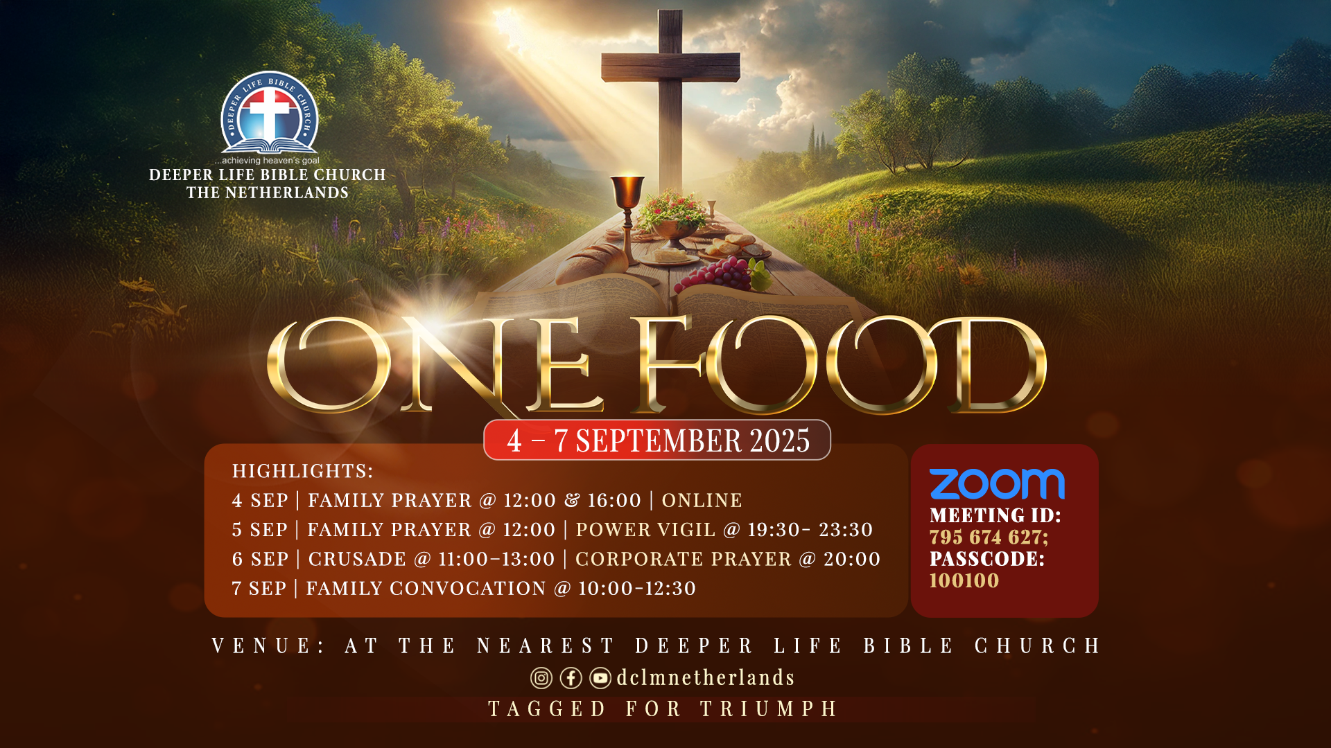

Slide 32
FAMILY CONVOCATION
NO
STS STUDY FOR NEXT WEEK:
SPECIAL SEMINAR

Slide 33

CHOIR

Slide 34
CONNECTION TO GCK

Slide 35

TIME TO PRAY

