Slide 1

SUPER SUNDAY SERVICE
21-09-2025

Slide 2
HYMN
GHS 047: JUST OBEY

Slide 3
JUST OBEY [GHS 047]
1.
Just as God who reigns on high,
Spake to men in days gone by;
So the Lord is calling men today;
And, my brother, this is true,
Whatso’er He says to you,
There is but one thing to do –
Just obey.

Slide 4
Just obey . . . , Just obey . . . ,
Is the way . . . , God’s way . . . ,
When His message comes to you,
There is but one thing to do:
Just obey . . . , Just obey .

Slide 5
JUST OBEY [GHS 047]
2.
If you’re in the Saviour’s hands,
You must do as He commands,
For there is no other gospel way;
Never put the message by,
Never stop to reason “why”,
When the Saviour speaks to you –
Just obey.

Slide 6
Just obey . . . , Just obey . . . ,
Is the way . . . , God’s way . . . ,
When His message comes to you,
There is but one thing to do:
Just obey . . . , Just obey .

Slide 7
JUST OBEY [GHS 047]
3.
If for mansions fair you sigh,
In that land beyond the sky,
After time with you has passed away;
Tho’ the way no may not see,
Christ is calling, “follow me,”
Faith and duty both will cry –
Just obey.

Slide 8
Just obey . . . , Just obey . . . ,
Is the way . . . , God’s way . . . ,
When His message comes to you,
There is but one thing to do:
Just obey . . . , Just obey .

Slide 9

SEARCH THE SCRIPTURES
21-09-2025

Slide 10
REVIEW OF THE ASSIGNMENT FROM LAST STUDY
A brother/sister confides in you that he/she is not sure of continuing to follow the Lord, because the temptations are becoming too much for him/her.
How would you counsel him/her in this condition? Support your approach with relevant scriptures.
Volunteers, please!
Security of God’s people

Slide 11
LESSON 1018:
Blessedness of Obedience and Unity
MEMORY VERSE: ……
  “Blessed is everyone that feareth the LORD; that walketh in his ways. For thou shalt eat the labour of thine hands: happy shalt thou be, and it shall be well with you.”
  (Psalm 128:1,2).
TEXT: Psalms 126 to 133

Slide 12
INTRODUCTION
Psalms 126 to 133 are songs of praise and worship that the Israelites sang on their journey to Jerusalem for religious feasts. These texts recount their redemption, victories, and God's mercy and faithfulness toward them. “When the Lord turned again the captivity of Zion, we were like them that dream. Then was our mouth filled with laughter,...” (Psalm 126:1,2). We learn that constant praise and worship help believers focus on God rather than on people. Assurance of God's constant help, His abiding presence, and our fruitfulness require complete devotion to God and unity among believers.

Slide 13
Isaiah 49:24-26; 2 Corinthians 2:14; Psalms 103:1-3; Ephesians 4:3; Deuteronomy 28;1-13
KEY LESSONS IN THE STUDY OF TODAY
God has the power to deliver individuals from captivity. Sinners can call upon Him for deliverance from sin
Believers should constantly praise God for all their blessings
Human efforts are futile unless they involve God.
Obedience to God’s word guarantees blessings for believers.
Believers must maintain unity within the church and avoid anything that causes division. Unity is fruit of sanctification, not mere sentiment
Prophetic blessings for fruitfulness in the family.

Slide 14
QUESTION 1
Why might anyone be in captivity?
Psalm 119:67; 1 John 3:8: John 5:14

Slide 15
QUESTION 2
How can sinners and backsliders be freed from captivity of sin and maintain their freedom?
Acts 3:19; John 8:32,35; 5:14

Slide 16
QUESTION 3
What can believers learn from the Israelites during their captivity and after their deliverance?
Psalm 130:1-5; 126:1,2; Phillipians 4:6

Slide 17
QUESTION 4
Mention some causes of disunity in the church and how to avoid them.
1Tim. 6:3-5; Acts 6: 1; 1 Corinthians 3:4-6; 1 Thessalonians 4:6

Slide 18
QUESTION 5
List conditions for God’s blessings. Psalm 133:1-3; 1 John 5:14,15

Slide 19
CONCLUSION
God will deliver believers from captivity, just as He delivered the Israelites. It is essential for all believers to express gratitude for the countless blessings they receive. When we live in unity and unwavering obedience to His word, God will undoubtedly command His blessings upon us. Sanctified unity is where the Lord commands the blessing

Slide 20
ASSIGNMENT
List practical actions that promote unity among brethren, supporting your answers with Bible references.
Provide five promises in the Bible along with their attached conditions.

Slide 21


SEARCH THE SCRIPTURES SUMMARY

Slide 22

INTERCESSION

Slide 23
TITHES AND OFFERING
Kindly pay via one of the following options:
Your phone
Bank transfer to
Cash
IBAN: NL90ABNA0416385699
Remarks: Tithes (name of region)
“… God loves a cheerful giver”
- 2 Corinthians 9:7

Slide 24

WELCOME TO
DEEPER LIFE BIBLE CHURCH
A CHURCH ON THE MOVE…
“Come thou with us and we will do thee good: for the Lord hath spoken good concerning [us]”
– Numbers 10:29
GOD’S FAMILY
GOD’S FOOD
GLOWING FOLD
We are a family, God’s family:
Our Father: God
Our Saviour: Jesus
Our Comforter: The Holy Spirit
Our destination: Heaven
We feast on God’s pure Word. We:
Read it
Study it
Believe it
Apply it
We want you to be part of us – a growing and glowing family. Join us and you will soon discover what makes our identity unique.
For your time and eternal profit, this is the place to be!

Slide 25








COUNSELLING
SERVICE SCHEDULES
Service | Day | Timing | Remarks
Worship Service | Sunday | 09:45-12:00 | Physical/Online
Bible Study | Tuesday | 19:30-20:30 | Online
Revival Service | Friday | 19:30-21:00 | Online/Physical
Night Vigil | Friday | 19:30-23:30 | First Friday Monthly
If you have questions or need guidance on challenging issues, kindly request for counselling.
Our pastor is here for you.
CONTACT
+31 207 856 683
info@deeperlife.nl
LOCATION DETAILS
Location | Telephone # | ZOOM Meeting ID
Amsterdam | +31 686 093 624 | 795-674-627
Eindhoven | +31 643 678 896 | 912-749-784
Rotterdam | +31 642 133 520 | 237-801-783
The Hague | +31 685 076 861 | 818-6898-8436
dclmnetherlands
www.dclm-nl.org

Slide 26


Slide 27
LESSON 1019: The Practice of Praise
STS STUDY FOR NEXT WEEK:
MEMORY VERSE: ……
“I will worship toward thy holy temple, and praise thy name for thy lovingkindness and for thy truth: for thou hast magnified thy word above all thy name” (Psalm 138:2).
TEXTS: Psalms 134 to 139

Slide 28


Slide 29


Slide 30


Revelation 3:7-12

Slide 31
HYMN
GHS 229: HOLD THE FORT

Slide 32
HOLD THE FORT [GHS 229]
1.
Ho, my comrades! See the signal
Waving in the sky!
Reinforcements now appearing
Victory is nigh.

Slide 33
“Hold the fort, for I am coming,”
Jesus signals still;
Wave the answer back to heaven,
“By Thy grace we will.”

Slide 34
HOLD THE FORT [GHS 229]
2.
See the mighty host advancing
Satan leading on:
Mighty men around us falling,
Courage almost gone!

Slide 35
“Hold the fort, for I am coming,”
Jesus signals still;
Wave the answer back to heaven,
“By Thy grace we will.”

Slide 36
HOLD THE FORT [GHS 229]
3.
See the glorious banner waving!
Hear the trumpet blow!
In our Leader’s name we’ll triumph
Over every foe!

Slide 37
“Hold the fort, for I am coming,”
Jesus signals still;
Wave the answer back to heaven,
“By Thy grace we will.”

Slide 38
HOLD THE FORT [GHS 229]
4.
Fierce and long the battle rages
But our help is near:
Onward comes our great Commander,
Cheer, my comrades, cheer!

Slide 39
“Hold the fort, for I am coming,”
Jesus signals still;
Wave the answer back to heaven,
“By Thy grace we will.”

Slide 40

CHOIR

Slide 41
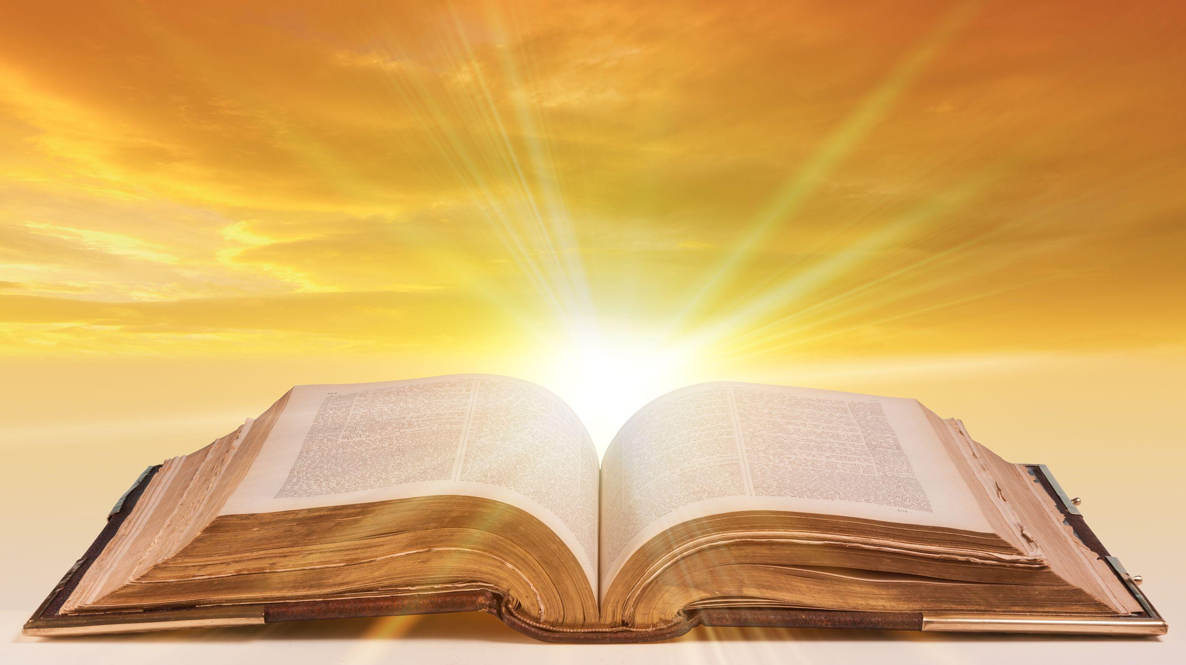
PRE-MESSAGE SONG
O Lord thy Word will endure

Slide 42
TODAY’S SERMON
HOLDING THE TRUTH FAST TILL JESUS COMES

Slide 43

TIME TO PRAY

