Slide 1

SUPER SUNDAY SERVICE
28-09-2025

Slide 2
HYMN
GHS 014: HOW GREAT THOU ART

Slide 3
HOW GREAT THOU ART [GHS 014]
1.
O Lord my God! When I in awesome wonder,
Consider all the works Thy hands hath made,
I see the stars, I hear the rolling thunder,
Thy pow’r thro’ out the universe displayed,

Slide 4
Then sings my soul, my Saviour God to Thee;
How great Thou art, how great Thou art!
Then sings my soul, my Saviour God to Thee;
How great Thou art, how great Thou art!

Slide 5
HOW GREAT THOU ART [GHS 014]
2.
When through the woods and forest glades I wander,
And hear the birds sing sweetly in the trees;
When I look down from lofty mountain grandeur,
And hear the brook and feel the gentle breeze;

Slide 6
Then sings my soul, my Saviour God to Thee;
How great Thou art, how great Thou art!
Then sings my soul, my Saviour God to Thee;
How great Thou art, how great Thou art!

Slide 7
HOW GREAT THOU ART [GHS 014]
3.
And when I think that God, His Son not sparing,
Sent Him to die, I scarce can take it in;
That on the cross, my burden gladly bearing,
He bled and died to take away my sin;

Slide 8
Then sings my soul, my Saviour God to Thee;
How great Thou art, how great Thou art!
Then sings my soul, my Saviour God to Thee;
How great Thou art, how great Thou art!

Slide 9
HOW GREAT THOU ART [GHS 014]
4.
When Christ shall come with shout of acclamation,
And take me home, what joy shall fill my heart!
Then I shall bow in humble adoration,
And there proclaim, my God, how great Thou art!

Slide 10
Then sings my soul, my Saviour God to Thee;
How great Thou art, how great Thou art!
Then sings my soul, my Saviour God to Thee;
How great Thou art, how great Thou art!

Slide 11

SEARCH THE SCRIPTURES
28-09-2025

Slide 12
REVIEW OF THE ASSIGNMENT FROM LAST STUDY
Provide five promises in the Bible along with their attached conditions.
List practical actions that promote unity among brethren, supporting your answers with Bible references.
Volunteers, please!
Blessedness of Obedience and Unity

Slide 13
LESSON 1019:
The Practice of Praise
MEMORY VERSE: ……
“I will worship toward thy holy temple, and praise thy name for thy lovingkindness and for thy truth: for thou hast magnified thy word above all thy name”
(Psalm 138:2).
TEXT: Psalms 134 to 139

Slide 14
INTRODUCTION
Praise is an expression of gratitude to God for His great deeds and manifold blessings. It enriches and deepens our fellowship with God. We are exhorted to cultivate praise as a lifestyle regardless of the circumstances in which we find ourselves. We are to praise God in recognition of our divine ownership, redemption, covenant relationship, favour and blessings made available to us in Christ. Indeed, if we truly consider these, we cannot help but be overwhelmed with gratitude and join the sweet psalmist of Israel in exclaiming, ‘Praise ye the LORD. Praise ye the name of the LORD; praise him, O ye servants of the LORD’ (Psalm 135:1).

Slide 15
The Practice of Praise
KEY LESSONS IN THE STUDY OF TODAY
Our understanding and fixation on God’s supremacy, sovereignty, and mercy are crucial to a lifestyle of praise.
We should praise God because He deserves, expects, inhabits and does wonders through it.
We praise God with our lives foremost. Sinners praise God by repenting, and not just words. Believers praise God with the aroma of holiness.
God has magnified His word above all His name. We can trust its promises and prophecies.
God is omnipresent! This ought to be a source of comfort and caution to believers. For sinners, it’s a call to repentance.

Slide 16
QUESTION 1
How can believers cultivate a lifestyle of praising God?
Psalm 8:3,4; 136:1;139:17

Slide 17
QUESTION 2
What ingredients constitute an acceptable praise to God?
2 Chronicles 20:21; Psalm 119:7;138:1

Slide 18
QUESTION 3
What does it mean that God has magnified His word above all His name?
Matthew 24:35; Luke 16:17; Numbers 23:19

Slide 19
QUESTION 4
What should God’s omnipresence mean to believers and sinners?
Isaiah 43:2; Psalm 139:9-11; Hebrews 4:13

Slide 20
QUESTION 5
What is the power of praise in a believer’s life?
2 Chronicles 20:22; Psalm 22:3

Slide 21
CONCLUSION
We are encouraged to praise God at all times and in every situation. This becomes more natural when we focus on God's supremacy over our circumstances rather than on the circumstances themselves. Living in holiness makes our praises acceptable to God and releases their power in our lives and situations.

Slide 22
ASSIGNMENT
Choose a specific challenging situation in your life, whether it is related to your family or your local church. Each day this week, take time to praise God for His supremacy over that situation. Next Sunday, share your testimony in church about what happened regarding that situation or how it impacted you in relation to it.

Slide 23


SEARCH THE SCRIPTURES SUMMARY

Slide 24

INTERCESSION

Slide 25
TITHES AND OFFERING
Kindly pay via one of the following options:
Your phone
Bank transfer to
Cash
IBAN: NL90ABNA0416385699
Remarks: Tithes (name of region)
“… God loves a cheerful giver”
- 2 Corinthians 9:7

Slide 26

WELCOME TO
DEEPER LIFE BIBLE CHURCH
A CHURCH ON THE MOVE…
“Come thou with us and we will do thee good: for the Lord hath spoken good concerning [us]”
– Numbers 10:29
GOD’S FAMILY
GOD’S FOOD
GLOWING FOLD
We are a family, God’s family:
Our Father: God
Our Saviour: Jesus
Our Comforter: The Holy Spirit
Our destination: Heaven
We feast on God’s pure Word. We:
Read it
Study it
Believe it
Apply it
We want you to be part of us – a growing and glowing family. Join us and you will soon discover what makes our identity unique.
For your time and eternal profit, this is the place to be!

Slide 27








COUNSELLING
SERVICE SCHEDULES
Service | Day | Timing | Remarks
Worship Service | Sunday | 09:45-12:00 | Physical/Online
Bible Study | Tuesday | 19:30-20:30 | Online
Revival Service | Friday | 19:30-21:00 | Online/Physical
Night Vigil | Friday | 19:30-23:30 | First Friday Monthly
If you have questions or need guidance on challenging issues, kindly request for counselling.
Our pastor is here for you.
CONTACT
+31 207 856 683
info@deeperlife.nl
LOCATION DETAILS
Location | Telephone # | ZOOM Meeting ID
Amsterdam | +31 686 093 624 | 795-674-627
Eindhoven | +31 643 678 896 | 912-749-784
Rotterdam | +31 642 133 520 | 237-801-783
The Hague | +31 685 076 861 | 818-6898-8436
dclmnetherlands
www.dclm-nl.org

Slide 28
LESSON 1020: The cry for deliverance
STS STUDY FOR NEXT WEEK:
MEMORY VERSE: ……
Cause me to hear thy lovingkindness in the morning; for in thee do I trust; cause me to know the way wherein I should walk; for I lift up my soul unto thee
(Psalm 143:8).
TEXTS: Psalms 140 to 144

Slide 29
HYMN
GHS 177: SEARCH ME O GOD

Slide 30
SEARCH ME O GOD [GHS 177]
1.
Search me, O God, and know my heart today,​
Try me, O Lord, and know my thoughts I pray;​
See if there be some wicked way in me;​
Cleanse me from every sin, and set me free.​

Slide 31
SEARCH ME O GOD [GHS 177]
2.
I praise Thee, Lord, for cleansing me from sin;​
Fulfill Thy Word, and make me pure within;​
Fill me with fire, where once I burned with shame;​
Grant my desire to magnify Thy name.

Slide 32
SEARCH ME O GOD [GHS 177]
3.
Lord, take my life, and make it wholly Thine;​
Fill my poor heart with Thy great love divine;​
Take all my will, my passion, self and pride;​
I now surrender, Lord, in me abide.​

Slide 33
SEARCH ME O GOD [GHS 177]
4.
O Holy Ghost, revival comes from Thee;​
Send a revival, start the work in me;​
Thy Word declares Thou wilt supply our need;​
For blessings now, O Lord, I humbly plead.​

Slide 34


2 Kings 22:1-20

Slide 35

CHOIR

Slide 36
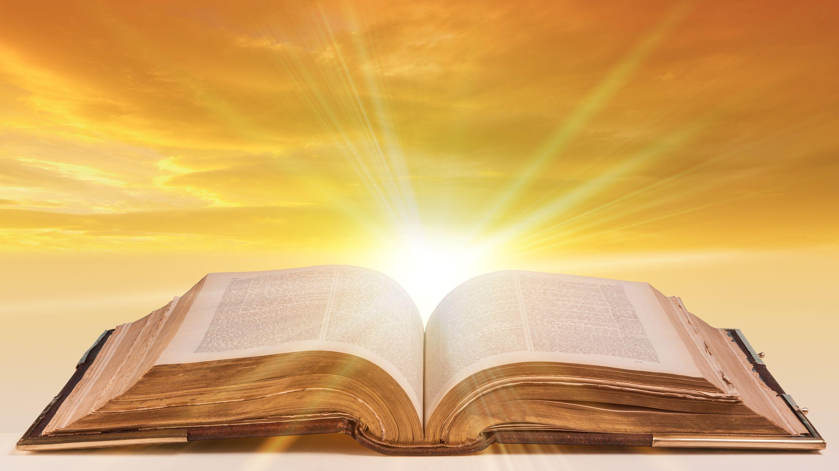
PRE-MESSAGE SONG
O Lord thy Word will endure

Slide 37
TODAY’S SERMON
THE PROFIT OF A TENDER HEART

Slide 38

TIME TO PRAY

