Slide 1

SUPER SUNDAY SERVICE
23-11-2025

Slide 2
HYMN
GHS 258: O TO BE LIKE THEE

Slide 3
O! TO BE LIKE THEE [GHS 258]
1.
O! to be like Thee, blessed Redeemer,
This is my constant longing and prayer;
Gladly I’ll forfeit all of earth’s treasures,
Jesus, Thy perfect likeness to wear.

Slide 4
O! to be like Thee,
O! to be like Thee,
Blessed Redeemer,
Pure as Thou art;
Come in Thy sweetness,
come in Thy fulness;
Stamp Thine own image
Deep on my heart.

Slide 5
O! TO BE LIKE THEE [GHS 258]
2.
O! to be like Thee, full of compassion,
Loving, forgiving, tender and kind,
Helping the helpless, cheering the fainting,
Seeking the wand’ring sinner to find.

Slide 6
O! to be like Thee,
O! to be like Thee,
Blessed Redeemer,
Pure as Thou art;
Come in Thy sweetness,
come in Thy fulness;
Stamp Thine own image
Deep on my heart.

Slide 7
O! TO BE LIKE THEE [GHS 258]
3.
O! to be like Thee, lowly in spirit,
Holy and harmless, patient and brave;
Meekly enduring cruel reproaches,
Willing to suffer, others to save.

Slide 8
O! to be like Thee,
O! to be like Thee,
Blessed Redeemer,
Pure as Thou art;
Come in Thy sweetness,
come in Thy fulness;
Stamp Thine own image
Deep on my heart.

Slide 9
O! TO BE LIKE THEE [GHS 258]
4.
O! to be like Thee, Lord, I am coming,
Now to receive th’ anointing divine,
All that I am and have I am bringing,
Lord, from this moment all shall be Thine.

Slide 10
O! to be like Thee,
O! to be like Thee,
Blessed Redeemer,
Pure as Thou art;
Come in Thy sweetness,
come in Thy fulness;
Stamp Thine own image
Deep on my heart.

Slide 11
O! TO BE LIKE THEE [GHS 258]
5.
O! to be like Thee, while I am pleading,
Pour out Thy Spirit, fill with Thy love,
Make me a temple meet for Thy dwelling,
Fit me for life and heaven above.

Slide 12
O! to be like Thee,
O! to be like Thee,
Blessed Redeemer,
Pure as Thou art;
Come in Thy sweetness,
come in Thy fulness;
Stamp Thine own image
Deep on my heart.

Slide 13

SEARCH THE SCRIPTURES
23-11-2025

Slide 14
REVIEW OF THE ASSIGNMENT FROM LAST STUDY
Write down two specific Christian virtues you would like to grow in and the promises in the Bible about the virtues. Pray about them and come and prepare to share your testimony next week.
Volunteers, please!
Growing in Christian Virtues

Slide 15
LESSON 1027: Consecration and submission in the church
MEMORY VERSE: ……
  “ And the Lord thy God will circumcise thine heart, and the heart of thy seed, to love the Lord thy God with all thine heart, and with all thy soul, that thou mayest live” (Deuteronomy 30:6)
TEXTS: Num 6:1-9; 1 Peter 2:9; Acts 4:32-37; 1 Thess 5:12,13; Hebrews 13:7
1 Thessalonians 5:12,13; Hebrews 13:7

Slide 16
INTRODUCTION
Orderliness, peace, and progress abound where there is submission, but confusion and crisis prevail where self-will dominates. The Church, as the body of Christ, is a fellowship of those called out of darkness into the light of the gospel. It is a gathering of believers united for worship, edification, and service. The strength and success of the Church depend largely on the consecration and submission of its members, just as the early Church thrived through unity, humility, and devotion to God’s purpose. This is the standard God requires of every believer both young and old.

Slide 17
Num 6:13-21; Mark 10:42-45; 1 Tim 1:16; James 1:22; Gal 5:16
KEY LESSONS IN THE STUDY OF TODAY
A consecrated and submissive church grows in unity, holiness, and strength through the commitment of its members and leaders.
God’s Word calls believers to humility and obedience to spiritual leadership, warning that rebellion, and pride hinders divine blessing.
A consecrated life is one which puts Christ first, others second but both ahead of oneself.
Early church believers were fully consecrated. That standard has not changed in God’s eyes.
Submission and obedience attract God’s blessings, bring unity, strength, and God’s favor.

Slide 18
QUESTION 1
Kindly define the church according to today’s study.

Slide 19
QUESTION 2
Mention two essential traits which made the early church successful and why?
Acts 4:32-34; Col 3:22-23

Slide 20
QUESTION 3
Mention Bible references that enjoin believers to honour, obey and respect church leadership, and how we can apply them in the church?

Slide 21
QUESTION 4
In what ways are the vow and consecration of the Nazarite similar to that of new testament believers?
Num 6:1-4; Rom 12:1-2
Notes:
2

Slide 22
QUESTION 5
What is the reward for obeying and cooperating with our spiritual leaders?
Matt 10:40-41; Heb 13:17
Notes:
2

Slide 23
CONCLUSION
God calls all believers to a life of consecration and submission. God’s standard for consecration and submission has not changed. It requires total surrender and yielding to him. Our obedience to His expectation will enhance the unity and growth of the church and result in the advancement of the gospel frontiers to hitherto unreached people and lands. So, more souls will be won and God will be glorified.

Slide 24
ASSIGNMENT
Reflect on your Christian life and write down 2 things which were very difficult for you to totally abandon even though those things are not sinful but are not edifying. It may be a friend, a hobby, a job or even an object. However, by the grace of God and through consecration you have abandoned those things which were not spiritually edifying. Please be ready to share your experience next week.

Slide 25


SEARCH THE SCRIPTURES SUMMARY

Slide 26

INTERCESSION

Slide 27
TITHES AND OFFERING
Kindly pay via one of the following options:
Your phone
Bank transfer to
Cash
IBAN: NL90ABNA0416385699
Remarks: Tithes (name of region)
“… God loves a cheerful giver”
- 2 Corinthians 9:7

Slide 28

WELCOME TO
DEEPER LIFE BIBLE CHURCH
A CHURCH ON THE MOVE…
“Come thou with us and we will do thee good: for the Lord hath spoken good concerning [us]”
– Numbers 10:29
GOD’S FAMILY
GOD’S FOOD
GLOWING FOLD
We are a family, God’s family:
Our Father: God
Our Saviour: Jesus
Our Comforter: The Holy Spirit
Our destination: Heaven
We feast on God’s pure Word. We:
Read it
Study it
Believe it
Apply it
We want you to be part of us – a growing and glowing family. Join us and you will soon discover what makes our identity unique.
For your time and eternal profit, this is the place to be!

Slide 29








COUNSELLING
SERVICE SCHEDULES
Service | Day | Timing | Remarks
Worship Service | Sunday | 09:45-12:00 | Physical/Online
Bible Study | Tuesday | 19:30-20:30 | Online
Revival Service | Friday | 19:30-21:00 | Online/Physical
Night Vigil | Friday | 19:30-23:30 | First Friday Monthly
If you have questions or need guidance on challenging issues, kindly request for counselling.
Our pastor is here for you.
CONTACT
+31 207 856 683
info@deeperlife.nl
LOCATION DETAILS
Location | Telephone # | ZOOM Meeting ID
Amsterdam | +31 686 093 624 | 795-674-627
Eindhoven | +31 643 678 896 | 912-749-784
Rotterdam | +31 642 133 520 | 237-801-783
The Hague | +31 685 076 861 | 818-6898-8436
dclmnetherlands
www.dclm-nl.org

Slide 30


Slide 31


Slide 32


Slide 33
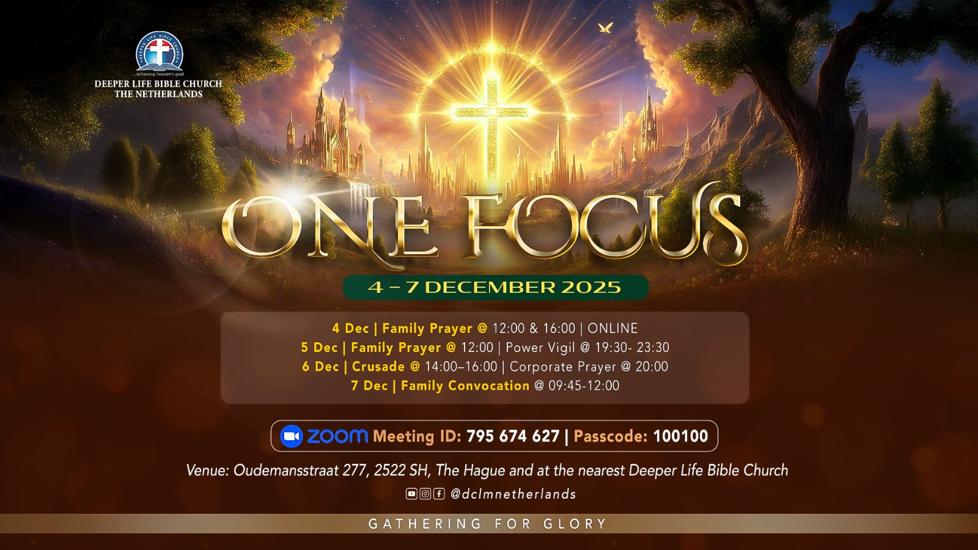

Slide 34
LESSON 1028: Daily Christian Service
STS STUDY FOR NEXT WEEK:
MEMORY VERSE: ……
“I beseech you therefore by the mercies of God that ye present your bodies a living sacrifice, holy and acceptable unto God which is your reasonable service” (Romans 12:1).
TEXTS: Romans 12:1-12

Slide 35


Matthew 6:19-34
Notes:
s

Slide 36
HYMN
GHS 063: WILL THERE BE ANY STARS?

Slide 37
WILL THERE BE ANY STARS? [GHS 63]
1.
I am thinking today of that beautiful land
I shall reach when the sun goeth down;
When thro’ wonderful grace by my Saviour I stand,
Will there be any stars in my crown?

Slide 38
Will there be any stars,
any stars in my crown,
When at evening the sun goeth down?
When I wake with be blest,
in the mansions of rest,
Will there be any stars in my crown?

Slide 39
WILL THERE BE ANY STARS? [GHS 63]
2.
In the strength of the Lord let me labour and pray,
Let me watch as a winner of souls;
That bright stars may be mine in the glorious day,
When His praise like the sea billows roll.

Slide 40
Will there be any stars,
any stars in my crown,
When at evening the sun goeth down?
When I wake with be blest,
in the mansions of rest,
Will there be any stars in my crown?

Slide 41
WILL THERE BE ANY STARS? [GHS 63]
3.
O what joy will it be when His face I behold,
Living gems at His feet to lay down;
It would sweeten my bliss in the city of gold,
Should there be any stars in my crown?

Slide 42
Will there be any stars,
any stars in my crown,
When at evening the sun goeth down?
When I wake with be blest,
in the mansions of rest,
Will there be any stars in my crown?

Slide 43

CHOIR

Slide 44
TODAY’S SERMON
HOW TO LAY YOUR TREASURE IN HEAVEN

Slide 45

TIME TO PRAY

