Slide 1


Slide 2

GLOBAL WORSHIP SERVICE
30-11-2025

Slide 3
HYMN
GHS 085: GIVE OF YOUR BEST TO THE MASTER

Slide 4
GIVE OF YOUR BEST TO THE MASTER [GHS 085]
1.
Give of your best to the Master;
Give of the strength of your youth.
Throw your soul’s fresh, glowing ardor
Into the battle for truth.
Jesus has set the example;
Dauntless was He, young and brave;
Give Him your loyal devotion,
Give Him the best that you have.

Slide 5
Give of your best to the Master:
Give of the strength of your youth.
Clad in salvation’s full armour,
Join in the battle for truth.

Slide 6
GIVE OF YOUR BEST TO THE MASTER [GHS 085]
2.
Give of your best to the Master;
Give Him first place in your heart;
Give Him first place in your service,
Consecrate every part.
Give, and to you will be given
God His beloved Son gave;
Gratefully seeking to serve Him,
Give Him the best that you have.

Slide 7
Give of your best to the Master:
Give of the strength of your youth.
Clad in salvation’s full armour,
Join in the battle for truth.

Slide 8
GIVE OF YOUR BEST TO THE MASTER [GHS 085]
3.
Give of your best to the Master;
Naught else is worthy His love;
He gave Himself for your ransom,
Gave up His glory above:
Laid down His life without murmur,
You from sin’s ruin to save.
Give Him your heart’s adoration;
Give Him the best that you have.

Slide 9
Give of your best to the Master:
Give of the strength of your youth.
Clad in salvation’s full armour,
Join in the battle for truth.

Slide 10

SEARCH THE SCRIPTURES
30-11-2025

Slide 11
REVIEW OF THE ASSIGNMENT FROM LAST STUDY
Reflect on your Christian life and write down 2 things which were very difficult for you to totally abandon even though those things are not sinful but are not edifying. It may be a friend, a hobby, a job or even an object. However, by the grace of God and through consecration you have abandoned those things which were not spiritually edifying. Please be ready to share your experience next week.
Consecration and Submission in the church

Slide 12
LESSON 1028: Daily Christian Service
MEMORY VERSE: ……
  “I beseech you therefore by the mercies of God that ye present your bodies a living sacrifice, holy and acceptable unto God which is your reasonable service” (Romans 12:1).
TEXTS: Romans 12:1-12

Slide 13
INTRODUCTION
Christian service should follow salvation experience. Consecration, submission and service are significant attributes of our Christian calling. Submission entails complete surrender and yieldedness to God and His Word. In this age when people, including so-called believers, are obsessed with selfish and inordinate ambition, it becomes essential to examine rendering service that has eternal value. Believers should prioritize serving the Lord above all other things. We should give our best to the service of the Lord as our labour shall be rewarded both in time and in eternity.

Slide 14
Romans 12:1-21; Matthew 28:18-20; Luke 19:13; 1Corinthians 15:58
KEY LESSONS IN THE STUDY OF TODAY
Christian service can be categorized into four areas: service to God, service to ourselves, service to the brethren, service to the world. The most compelling of our daily service is the preaching of the gospel.
There are different areas in church where we can utilize our God given gifts such as caring and visitation, praying, teaching, singing etc.
Conditions to be met before Christian service include clear conversion, holy living, sobriety, fervor and zeal, love, prayer, and Spirit’s power.
There are both temporal and eternal promises for Christian service.

Slide 15
QUESTION 1
Why is the subject of daily Christian service important? Romans 12:1,2; John 15:16

Slide 16
QUESTION 2
Mention the four broad areas we may categorise Christian service
Romans 12:1,2,3-8, 9-11, 17-19

Slide 17
QUESTION 3
Mention some forms of service we can daily engage in as Christians?
Romans 12:7,8, 10, 12,13

Slide 18
QUESTION 4
What is the first and most important condition Christian servants must fulfil?
2 Tim 2:6
Notes:
2

Slide 19
QUESTION 5
What principles should be upheld by Christian servants?
2 Tim 2:21; Rom 12:11; John 15:3
Notes:
2

Slide 20
QUESTION 6
What are the promises to Christian servants?
John 12:26; Mark 10:29,30
Notes:
2

Slide 21
CONCLUSION
Christian service should come naturally after salvation. Believers are expected to submit, yield and serve God before they go to heaven. The most compelling of our daily service is the preaching of the gospel. If we follow the principle of Christian service, we will be rewarded here on earth and in eternity.

Slide 22
ASSIGNMENT
Reflect on your walk with God and your Christian service. In which areas of service can you do better? Itemize steps to take to improve in the areas of Christian service you have identified.

Slide 23


SEARCH THE SCRIPTURES SUMMARY

Slide 24

INTERCESSION

Slide 25
TITHES AND OFFERING
Kindly pay via one of the following options:
Your phone
Bank transfer to
Cash
IBAN: NL90ABNA0416385699
Remarks: Tithes (name of region)
“… God loves a cheerful giver”
- 2 Corinthians 9:7

Slide 26

WELCOME TO
DEEPER LIFE BIBLE CHURCH
A CHURCH ON THE MOVE…
“Come thou with us and we will do thee good: for the Lord hath spoken good concerning [us]”
– Numbers 10:29
GOD’S FAMILY
GOD’S FOOD
GLOWING FOLD
We are a family, God’s family:
Our Father: God
Our Saviour: Jesus
Our Comforter: The Holy Spirit
Our destination: Heaven
We feast on God’s pure Word. We:
Read it
Study it
Believe it
Apply it
We want you to be part of us – a growing and glowing family. Join us and you will soon discover what makes our identity unique.
For your time and eternal profit, this is the place to be!

Slide 27








COUNSELLING
SERVICE SCHEDULES
Service | Day | Timing | Remarks
Worship Service | Sunday | 09:45-12:00 | Physical/Online
Bible Study | Tuesday | 19:30-20:30 | Online
Revival Service | Friday | 19:30-21:00 | Online/Physical
Night Vigil | Friday | 19:30-23:30 | First Friday Monthly
If you have questions or need guidance on challenging issues, kindly request for counselling.
Our pastor is here for you.
CONTACT
+31 207 856 683
info@deeperlife.nl
LOCATION DETAILS
Location | Telephone # | ZOOM Meeting ID
Amsterdam | +31 686 093 624 | 795-674-627
Eindhoven | +31 643 678 896 | 912-749-784
Rotterdam | +31 642 133 520 | 237-801-783
The Hague | +31 685 076 861 | 818-6898-8436
dclmnetherlands
www.dclm-nl.org

Slide 29


Slide 30



BDP
DIPLOMA
CEREMONY
Brethren who went through the BDP should get ready for this ceremony coming Sunday
2024
Date: Sunday 7 December
"Know ye not that they which run in a race run all, but one receiveth the prize? So run, that ye may obtain." (1 Cor 9:24)

Slide 31
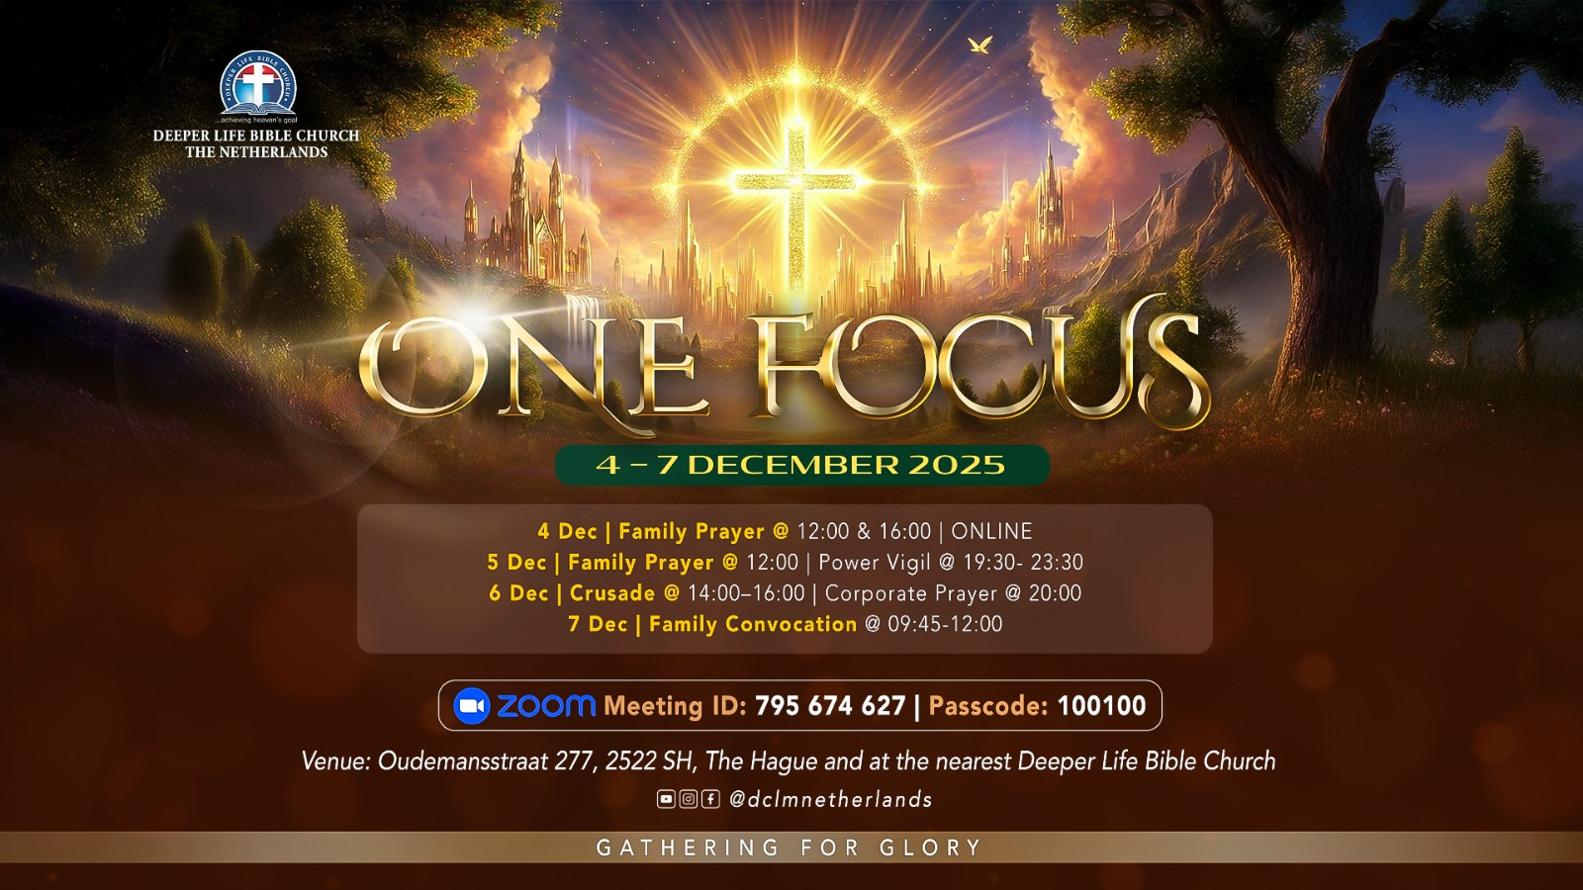

Slide 32
FAMILY CONVOCATION
NO
STS STUDY FOR NEXT WEEK:
SPECIAL SEMINAR

Slide 33

CHOIR

Slide 34
CONNECTION TO GCK

Slide 35

TIME TO PRAY

