Slide 1

PRACTICAL SUBMISSION IN A HEAVEN-BOUND CONGREGATION
- James 4:7,8; Hebrews 13:17
ONE FOCUS FAMILY CONVOCATION
DCLM, THE NETHERLANDS
7 DEC 2025

Slide 2
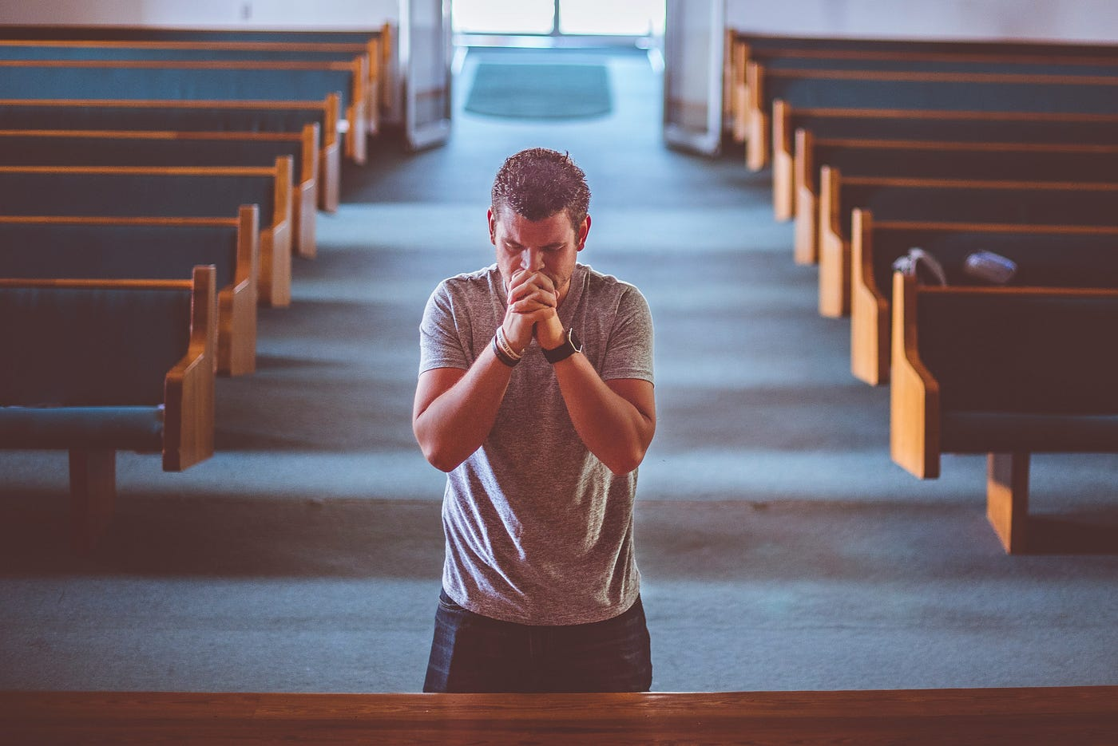
INTRODUCTION
We are on a journey together to our eternal home – our ONE FOCUS. Like the journey of the Israelites of old to Canaan, humble, practical submission is required of every pilgrim (Acts 3:22,23). While submission may not be a popular word in today’s world that values self-will, God still demands it and He blesses a submissive people.
“the action of accepting or yielding to a superior force or to the will or authority of another person.”
Notes:
“the action of accepting or yielding to a superior force or to the will or authority of another person.”

Slide 3


WHY SUBMISSION?
Reasons for submission in God’s household
God commands it – Heb 13:17; Eph 5:21
Jesus exemplified it – Phil 2:5-9; Lk 22:41,42
It brings faster progress – Num 12:1,2,14,15
  Effort is devoted to productive ventures rather than resolving issues in the congregation
It enables leaders do their work without grief – Heb 13:17; 2 Sam 3:39
God rewards it – Phil 2:5-10

Slide 4
SUBMISSION EXPLAINED
Practical meaning of submission in God’s household
1.
2.
3.
4.
5.
Obedience without argument – Phil 2:14
Following instructions without resistance – Exo 19:8
Cooperating without murmuring – Num 14:1,2,14,15
Voicing concerns without confrontation – Num 27:1-7
Contribution without contradiction – Exo 18:14-24

Slide 5
SUBMISSION EXPRESSED
Practice of submission in a heaven-bound congregation:
Submission to God: James 4:7; Eph 5:24.
Submission to church authority: Heb 13:17.
Submission to one another: Ep 5:21; 1 Pet 5:5; Rom 12:10.
Submission in the family: Eph 5:22-24; 6:1-3; Col 3:18.

Slide 6
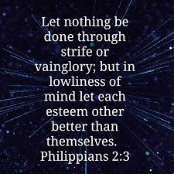
SUBMISSION ENJOYED
Things to do to enjoy the blessings of submission in the congregation
Give your heart to God – Deut. 30:6; Pro 23:26.
Let your will be broken – Jn 12:24; 6:38.
Leave the camp of pride or the proud – Rom 16:17; Ps 1:1.
Esteem others better than yourself – Phil 2:3.
See your leaders as God’s representative – Heb 13:17.
Be watchful and prayerful – Mk 14:38; Ep 6:18.

Slide 7
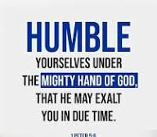

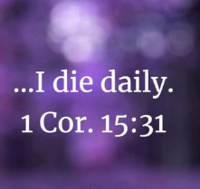

CONCLUSIONS
Submission is practical. It flows from a heart that has been purged of pride and self-will. It attracts divine blessings to believers, families and the church. May our response always be “Lord, not my will, but thine be done.”

Slide 8

LT US PRAY

