Slide 1
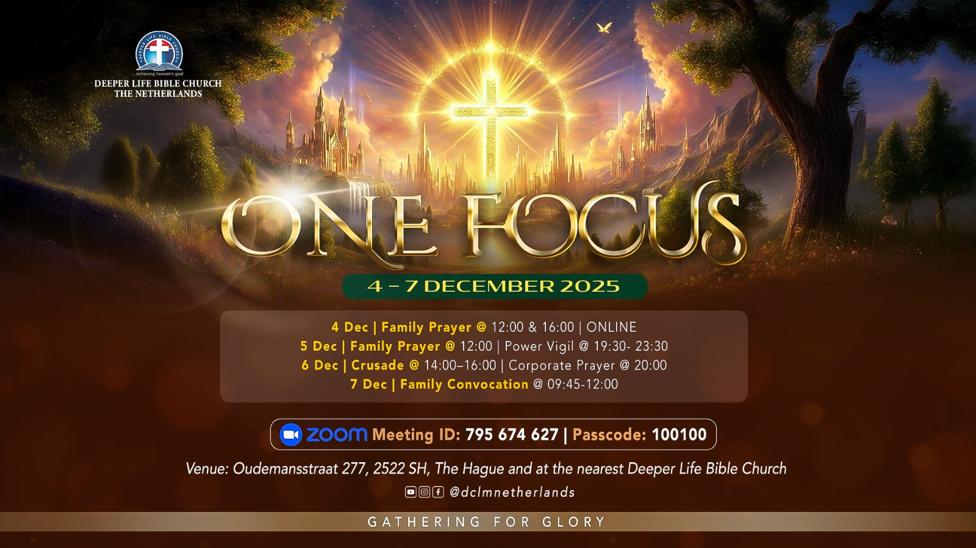

Slide 2

FAMILY CONVOCATION
07-12-2025

Slide 3
HYMN
GHS 047: JUST OBEY

Slide 4
JUST OBEY [GHS 047]
1.
Just as God who reigns on high,
Spake to men in days gone by;
So the Lord is calling men today;
And, my brother, this is true,
Whatso’er He says to you,
There is but one thing to do –
Just obey.

Slide 5
Just obey . . . , Just obey . . . ,
Is the way . . . , God’s way . . . ,
When His message comes to you,
There is but one thing to do:
Just obey . . . , Just obey .

Slide 6
JUST OBEY [GHS 047]
2.
If you’re in the Saviour’s hands,
You must do as He commands,
For there is no other gospel way;
Never put the message by,
Never stop to reason “why”,
When the Saviour speaks to you –
Just obey.

Slide 7
Just obey . . . , Just obey . . . ,
Is the way . . . , God’s way . . . ,
When His message comes to you,
There is but one thing to do:
Just obey . . . , Just obey .

Slide 8
JUST OBEY [GHS 047]
3.
If for mansions fair you sigh,
In that land beyond the sky,
After time with you has passed away;
Tho’ the way no may not see,
Christ is calling, “follow me,”
Faith and duty both will cry –
Just obey.

Slide 9
Just obey . . . , Just obey . . . ,
Is the way . . . , God’s way . . . ,
When His message comes to you,
There is but one thing to do:
Just obey . . . , Just obey .

Slide 10

FAMILY INSIGHT

Slide 11
UPHOLDING THE REGION

Slide 12



BDP
DIPLOMA
CEREMONY
2024
"Know ye not that they which run in a race run all, but one receiveth the prize? So run, that ye may obtain." (1 Cor 9:24)

Slide 13
TITHES AND OFFERING
Kindly pay via one of the following options:
Your phone
Bank transfer to
Cash
IBAN: NL90ABNA0416385699
Remarks: Tithes (name of region)
“… God loves a cheerful giver”
- 2 Corinthians 9:7

Slide 14


Luke 12:22-40; Revelation 3:1-13

Slide 15
HYMN
HIS EYE IS ON THE SPARROW

Slide 16
HIS EYE IS ON THE SPARROW
1.
Why should I be discouraged?
Why should the shadows come?
Why should my heart be lonely
And long for heaven and home
When Jesus is my Portion?
My constant Friend is He:

Slide 17
His eye is on the sparrow,
And I know He watches me.
His eye is on the sparrow,
And I know He watches me.
I sing because I’m happy;
I sing because I’m free.
For His eye is on the sparrow,
And I know He watches me.

Slide 18
HIS EYE IS ON THE SPARROW
2.
“Let not your heart be troubled,”
His tender words I hear;
And trusting on His goodness,
I lose my doubt and fear.
Tho’ by the path He leadeth
But one step I may see:

Slide 19
His eye is on the sparrow,
And I know He watches me.
His eye is on the sparrow,
And I know He watches me.
I sing because I’m happy;
I sing because I’m free.
For His eye is on the sparrow,
And I know He watches me.

Slide 20
HIS EYE IS ON THE SPARROW
3.
Whenever I am tempted,
Whenever doubts arise,
When songs give place to sighing,
And hope within me dies,
I draw the closer to Him;
From care He sets me free.

Slide 21
His eye is on the sparrow,
And I know He watches me.
His eye is on the sparrow,
And I know He watches me.
I sing because I’m happy;
I sing because I’m free.
For His eye is on the sparrow,
And I know He watches me.

Slide 22

CHOIR

Slide 23
Message & PRAYER

Slide 24

TIME TO PRAY

Slide 25
BREAKOUT INTO REGIONS
Welcome of Newcomers
&
Local Announcement

Slide 26

WELCOME TO
DEEPER LIFE BIBLE CHURCH
A CHURCH ON THE MOVE…
“Come thou with us and we will do thee good: for the Lord hath spoken good concerning [us]”
– Numbers 10:29
GOD’S FAMILY
GOD’S FOOD
GLOWING FOLD
We are a family, God’s family:
Our Father: God
Our Saviour: Jesus
Our Comforter: The Holy Spirit
Our destination: Heaven
We feast on God’s pure Word. We:
Read it
Study it
Believe it
Apply it
We want you to be part of us – a growing and glowing family. Join us and you will soon discover what makes our identity unique.
For your time and eternal profit, this is the place to be!

Slide 27








COUNSELLING
SERVICE SCHEDULES
Service | Day | Timing | Remarks
Worship Service | Sunday | 09:45-12:00 | Physical/Online
Bible Study | Tuesday | 19:30-20:30 | Online
Revival Service | Friday | 19:30-21:00 | Online/Physical
Night Vigil | Friday | 19:30-23:30 | First Friday Monthly
If you have questions or need guidance on challenging issues, kindly request for counselling.
Our pastor is here for you.
CONTACT
+31 207 856 683
info@deeperlife.nl
LOCATION DETAILS
Location | Telephone # | ZOOM Meeting ID
Amsterdam | +31 686 093 624 | 795-674-627
Eindhoven | +31 643 678 896 | 912-749-784
Rotterdam | +31 642 133 520 | 237-801-783
The Hague | +31 685 076 861 | 818-6898-8436
dclmnetherlands
www.dclm-nl.org

Slide 28
LESSON 1029: Rediscovering the forgotten path to blessing
STS STUDY FOR NEXT WEEK:
MEMORY VERSE: ……
  “But seek ye first the kingdom of God, and his righteousness; and all these things shall be added unto you”
  (Matthew 6:33)
TEXT: Eze. 36:11,25-27,37; Matt. 6:33

Slide 29


