Slide 1

SUPER SUNDAY SERVICE
21-12-2025

Slide 2
HYMN
GHS 112: WIN THEM ONE BY ONE

Slide 3
WIN THEM ONE BY ONE [GHS 112]
1.
If to Christ our only king
Men redeemed we strive to bring,
Just one way this may be done —
We must win them one by one.

Slide 4
So you bring the one next to you,
And I’ll bring the one next to me;
In all kinds of weather, we’ll all work together,
And see what can be done;
If you’ll bring the one next to you,
And I bring the one next to me,
In no time at all we’ll have them all,
So win them, win them, one by one.

Slide 5
WIN THEM ONE BY ONE [GHS 112]
2.
Side by side we stand each day,
Saved are we, but lost are they;
They will come if we but dare
Speak a word backed up by prayer.

Slide 6
So you bring the one next to you,
And I’ll bring the one next to me;
In all kinds of weather, we’ll all work together,
And see what can be done;
If you’ll bring the one next to you,
And I bring the one next to me,
In no time at all we’ll have them all,
So win them, win them, one by one.

Slide 7
WIN THEM ONE BY ONE [GHS 112]
3.
Only cowards dare refuse,
Dare this gift of God misuse;
Ere some friend goes to his grave,
Speak a word his soul to save.

Slide 8
So you bring the one next to you,
And I’ll bring the one next to me;
In all kinds of weather, we’ll all work together,
And see what can be done;
If you’ll bring the one next to you,
And I bring the one next to me,
In no time at all we’ll have them all,
So win them, win them, one by one.

Slide 9
WIN THEM ONE BY ONE [GHS 112]
4.
Not for hope of great reward
Turn men’s hearts unto the Lord;
Just to see a saved man smile
Makes the effort well worth while.

Slide 10
So you bring the one next to you,
And I’ll bring the one next to me;
In all kinds of weather, we’ll all work together,
And see what can be done;
If you’ll bring the one next to you,
And I bring the one next to me,
In no time at all we’ll have them all,
So win them, win them, one by one.

Slide 11

SEARCH THE SCRIPTURES
21-12-2025

Slide 12
REVIEW OF OUR ASSIGNMENT OF LAST STUDY
Identify areas in your life where you may have misplaced priorities and how this has affected your spiritual growth or blessings. Then develop an action plan to reorder your priorities to align with seeking first God’s kingdom and His righteousness.
Please prepare to share your action plan next week.
Volunteers please!
Rediscovering
the forgotten
path to blessing

Slide 13
LESSON 1030: The Act of Soul-winning
MEMORY VERSE: ……
  “The Lord gave the word: great was the company of those that published it” (Psalm 68:11).
TEXTS: Acts 16:1-10
Notes:
MEMORY VERSE: “My covenant will
I not break, nor alter the thing that is
gone out of my lips” (Psalm 89:34).

Slide 14
INTRODUCTION
Jesus spent His life on earth doing good, healing all that were oppressed and preaching the gospel of the Kingdom of God. At the end of His earthly ministry, He committed the Great Commission to His disciples. This is our God-given responsibility to go into the world and preach the gospel to every creature. Our service to God is incomplete without this. The Acts of the Apostles captures numerous evangelistic exploits by the early disciples. Like them, soul-winning must be our primary activity.
Notes:
Christ’s life and ministry on earth encompassed doing good, healing all that were oppressed and preaching the gospel of the kingdom of God. At the end of His earthly ministry, Jesus committed the task of the Great Commission into the hands of His disciples. The Great Commision is is the believers God-given responsibility to go into the world and preach the gospel to every creature. Whatever service we render to God is imcomplete without the preaching of the gospel of repentance and salvation from sin. Similar to the early church, evangelism must be our central/sole activity.

Slide 15
Acts 10:38; Matt 28:19, 20; Mark 16:15,16; Lk 24:46-48; 1Thess 2:17; Lk 19:5-10;2 Tim 3:16,17; 4:1-5
KEY LESSONS IN THE STUDY OF TODAY
The Great Commission is central, not optional to the Church. It is every believer’s responsibility.
Passion for souls drives evangelism. This kind of passion is not merely an emotion but a moral attribute of God.
Evangelism should be done lovingly and enthusiastically.
The Great Commission is universal. The gospel is for all sinners, without discrimination.
We should preach the total gospel of repentance and remission of sin by grace through faith in Jesus Christ alone.

Slide 16
QUESTION 1
What is the central task Jesus gave to the Church and the consequences of neglecting it? Mark 16:15; Ezek. 3:18

Slide 17
QUESTION 2
What is the place of passion in reaching sinners with the gospel?
Matt. 9:36;14:14

Slide 18
QUESTION 3
What necessary precautions must we take in order to save more people?
Matt.10:16; 1Cor. 9:19-22

Slide 19
QUESTION 4
Why are sinners not permitted to preach the gospel?
Isaiah 52:11; Psalm 50:16.

Slide 20
QUESTION 5
State the role of the Holy Ghost in choosing who and where we may preach the gospel
Acts 16:9, 10; 19:10.

Slide 21
CONCLUSION
Effective evangelism requires preaching the full doctrines of Christ to grow the church. The Holy Ghost guides when and where to share the gospel, as not everyone is ready at the same time. True evangelism involves the right passion, focused on the right people, by the right workers, under divine guidance.

Slide 22
ASSIGNMENT
Passion for souls drives evangelism. Throughout this week, pray everyday that God will fill you with passion and compassion for souls. Armed with this confidence, preach to at least 1 person with the aim of winning them to the Lord. Come with the readiness to share your experience and testimony next week.

Slide 23


SEARCH THE SCRIPTURES SUMMARY

Slide 24

INTERCESSION

Slide 25
TITHES AND OFFERING
Kindly pay via one of the following options:
Your phone
Bank transfer to
Cash
IBAN: NL90ABNA0416385699
Remarks: Tithes (name of region)
“… God loves a cheerful giver”
- 2 Corinthians 9:7

Slide 26

WELCOME TO
DEEPER LIFE BIBLE CHURCH
A CHURCH ON THE MOVE…
“Come thou with us and we will do thee good: for the Lord hath spoken good concerning [us]”
– Numbers 10:29
GOD’S FAMILY
GOD’S FOOD
GLOWING FOLD
We are a family, God’s family:
Our Father: God
Our Saviour: Jesus
Our Comforter: The Holy Spirit
Our destination: Heaven
We feast on God’s pure Word. We:
Read it
Study it
Believe it
Apply it
We want you to be part of us – a growing and glowing family. Join us and you will soon discover what makes our identity unique.
For your time and eternal profit, this is the place to be!

Slide 27








COUNSELLING
SERVICE SCHEDULES
Service | Day | Timing | Remarks
Worship Service | Sunday | 09:45-12:00 | Physical/Online
Bible Study | Tuesday | 19:30-20:30 | Online
Revival Service | Friday | 19:30-21:00 | Online/Physical
Night Vigil | Friday | 19:30-23:30 | First Friday Monthly
If you have questions or need guidance on challenging issues, kindly request for counselling.
Our pastor is here for you.
CONTACT
+31 207 856 683
info@deeperlife.nl
LOCATION DETAILS
Location | Telephone # | ZOOM Meeting ID
Amsterdam | +31 686 093 624 | 795-674-627
Eindhoven | +31 643 678 896 | 912-749-784
Rotterdam | +31 642 133 520 | 237-801-783
The Hague | +31 685 076 861 | 818-6898-8436
dclmnetherlands
www.dclm-nl.org

Slide 28
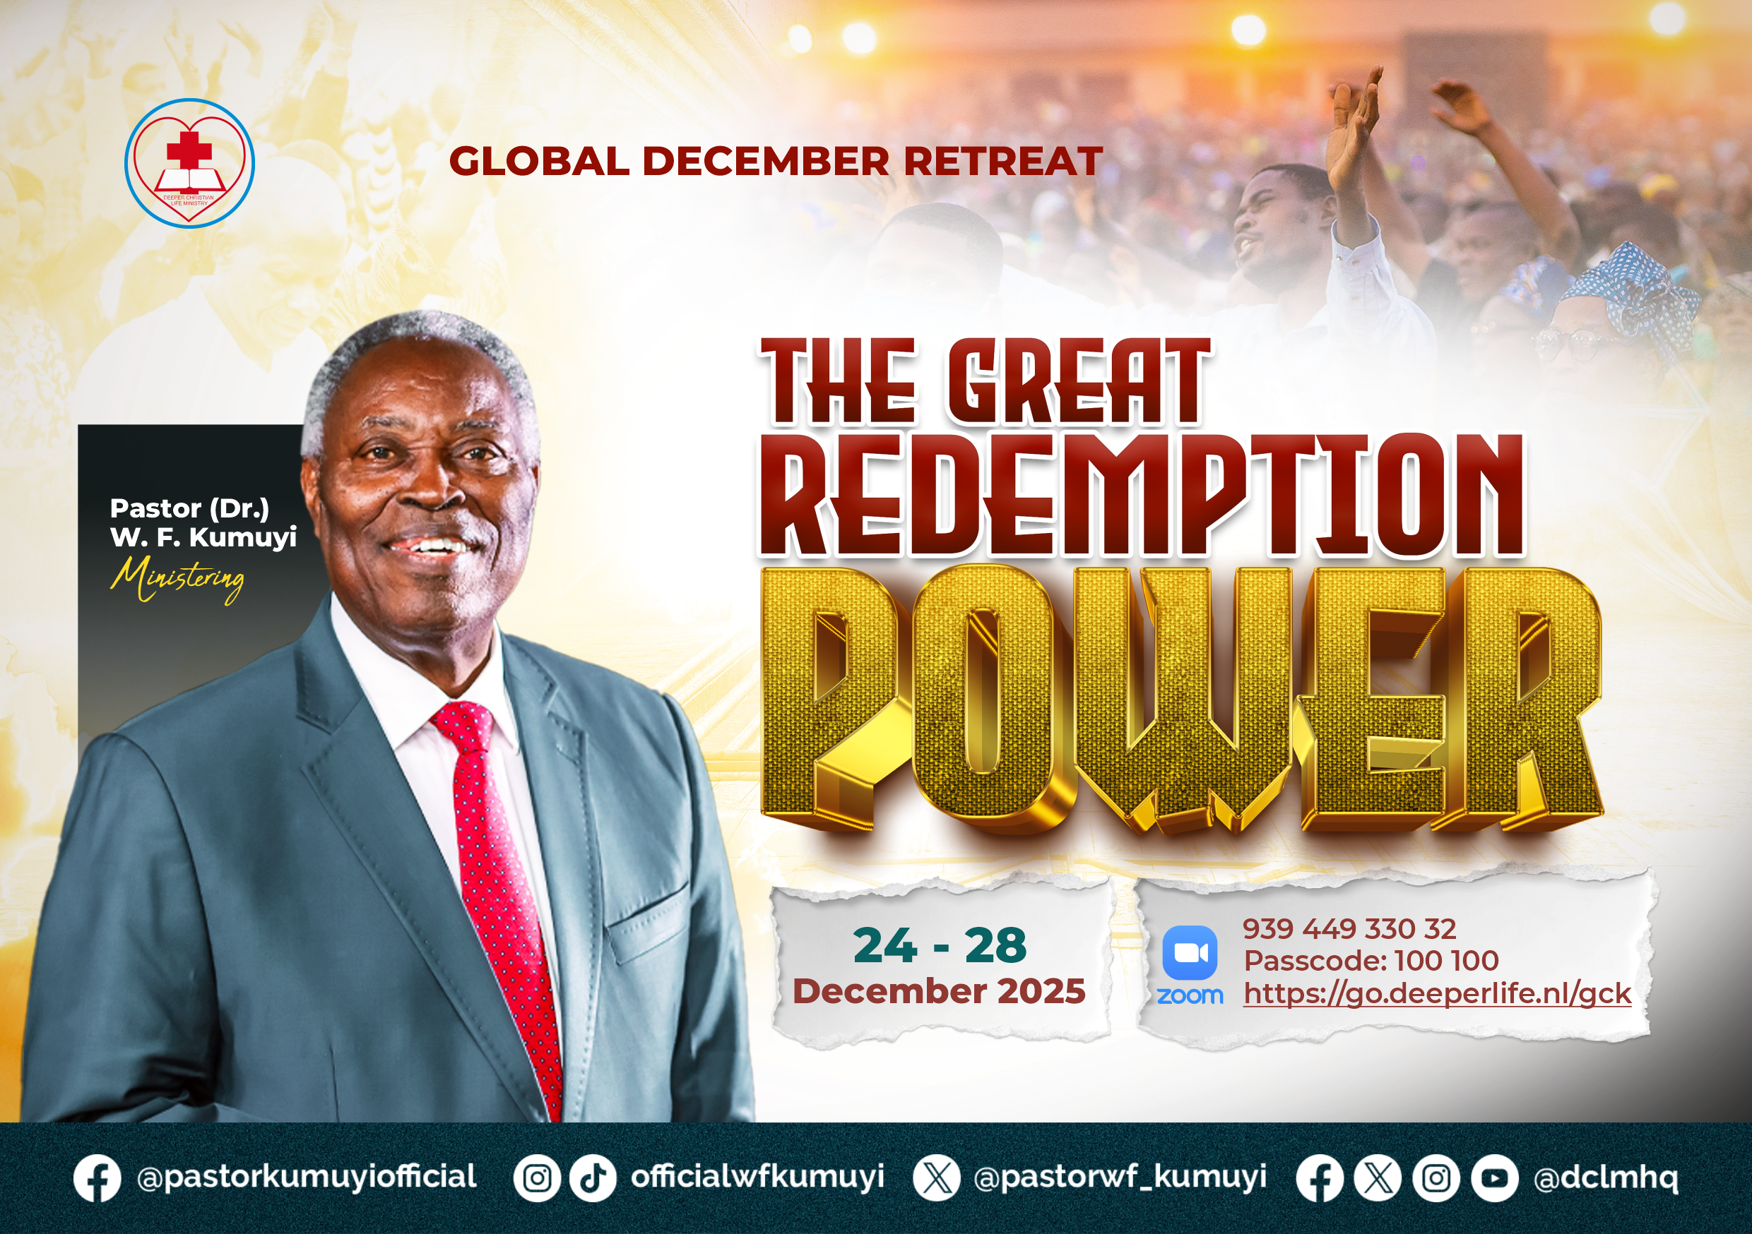

Slide 29
2025 DECEMBER RETREAT PLAN FRI & SAT: 13:00-14:30: Lunch break
 | 09:30-13:00 | 14:30-17:30 | 14:30-16:00 | 16:00-17:30
THU 25 DEC |  |  |  | National Zoom
FRI 26 DEC | National Zoom ID: 795-674-627 Passcode: 100 100 http://go.deeperlife.nl/zoom
SAT 27 DEC
SUN 28 DEC | Regional (Physical in church)
National
Regional

Slide 30
GLOBAL DECEMBER RETREAT
NO
STS STUDY FOR NEXT WEEK:
GLOBAL DECEMBER RETREAT

Slide 31


Numbers 10:1-36
Notes:
s

Slide 32
HYMN
WE’RE MARCHING TO ZION

Slide 33
WE’RE MARCHING TO ZION
1.
Come, we that love the Lord,
And let our joys be known;
Join in a song with sweet accord,
Join in a song with sweet accord
And thus surround the throne,
And thus surround the throne.

Slide 34
We’re marching to Zion,
Beautiful, beautiful Zion;
We’re marching upward to Zion,
The beautiful city of God.

Slide 35
WE’RE MARCHING TO ZION
2.
Let those refuse to sing
Who never knew our God;
But children of the heav’nly King,
But children of the heav’nly King,
May speak their joys abroad,
May speak their joys abroad.

Slide 36
We’re marching to Zion,
Beautiful, beautiful Zion;
We’re marching upward to Zion,
The beautiful city of God.

Slide 37
WE’RE MARCHING TO ZION
3.
The hill of Zion yields,
A thousand sacred sweets
Before we reach the heav’nly field,
Before we reach the heav’nly field
Or walk the golden streets,
Or walk the golden streets.

Slide 38
We’re marching to Zion,
Beautiful, beautiful Zion;
We’re marching upward to Zion,
The beautiful city of God.

Slide 39
WE’RE MARCHING TO ZION
4.
Then let our songs abound,
And every tear be dry;
We’re marching thro’ Immanuel’s ground,
We’re marching thro’ Immanuel’s ground,
To fairer worlds on high,
To fairer worlds on high.

Slide 40
We’re marching to Zion,
Beautiful, beautiful Zion;
We’re marching upward to Zion,
The beautiful city of God.

Slide 41

CHOIR

Slide 42
TODAY’S SERMON
MARCHING JOYFULLY TO THE HEAVENLY CITY

Slide 43

TIME TO PRAY

