Slide 1

SUPER SUNDAY SERVICE
18-01-2026

Slide 2
HYMN
GHS 205: HAVE YOU COUNTED THE COST?

Slide 3
HAVE YOU COUNTED THE COST? [GHS 205]
1.
There’s a line that is drawn
By rejecting our Lord,
Where the call of His Spirit is lost,
And you hurry along
With the pleasure-mad throng
Have you counted,
Have you counted the cost?

Slide 4
Have you counted the cost,
If your soul should be lost,
Tho’ you gained the whole world for your own? Even now it may be,
That the line you have crossed,
Have you counted,
Have you counted the cost?

Slide 5
HAVE YOU COUNTED THE COST? [GHS 205]
2.
You may barter your hope
Of eternity’s morn,
For a moment of joy at the most.
For the glitter of sin
And the things it will win –
Have you counted,
Have you counted the cost?

Slide 6
Have you counted the cost,
If your soul should be lost,
Tho’ you gained the whole world for your own? Even now it may be,
That the line you have crossed,
Have you counted,
Have you counted the cost?

Slide 7
HAVE YOU COUNTED THE COST? [GHS 205]
3.
While the door of His mercy is open to you,
Ere the depth of His love you exhaust,
Won’t you come and be healed,
Won’t you whisper, I yield
I have counted,
I have counted, the cost.

Slide 8
Have you counted the cost,
If your soul should be lost,
Tho’ you gained the whole world for your own? Even now it may be,
That the line you have crossed,
Have you counted,
Have you counted the cost?

Slide 9

SEARCH THE SCRIPTURES
18-01-2026

Slide 10
REVIEW OF THE ASSIGNMENT FROM LAST STUDY
Study Genesis 3:6-8 and 1 John 2:15-17. How do they connect and what can we learn from them in relation to today’s study? Prepare to share your findings next week.
Volunteer please!
The fall of man

Slide 11
LESSON 3:
The flood and its aftermath
MEMORY VERSE: ……
  “And the LORD said, I will destroy man whom I have created from the face of the earth; both man, and beast, and the creeping thing, and the fowls of the air; for it repenteth me that I have made them. But Noah found grace in the eyes of the LORD”
  (Genesis 6:7,8).
TEXT: Genesis 6 – 11

Slide 12
INTRODUCTION
The great wickedness of man in Noah’s day came to a point where God decided to destroy the earth. However, He found Noah righteous person in his generation. He made a covenant with him, instructed him to build and Ark for the salvation of his household and instructed him on fruitfulness, multiplication, eating and capital punishment. Thereafter, man disobeyed God’s command to fill the earth and the Lord divided and dispersed them upon the face of the earth.

Slide 13
The flood and its aftermath
KEY LESSONS IN THE STUDY OF TODAY
Sinners and backsliders should not take the forbearance of God for granted.
The believer can be preserved and kept pure no matter the corruption in the society.
Our continued security as Christians is for as long as we abide in the Lord Jesus Christ.
God is faithful to His Word. The command to multiply does not require large numbers.
If any believer is overtaken in a fault, others should join hands to ensure restoration.
We should unite in prayer, evangelism, defence of the truth and against error.

Slide 14
QUESTION 1
Why did God decide to destroy man with a flood?
Gen. 6:5-7,11-13

Slide 15
QUESTION 2
How can believers walk close to God and keep hearing from Him in this corrupt generation?
Psa. 16:11; 1 Thess. 5:17; John 5:39; Rom. 12:2; Heb. 10:25

Slide 16
QUESTION 3
In the face of looming destruction awaiting the unrepentant, what should backsliders and sinners do?
Heb. 3:7,8; Acts 3:19; 1 John 1:9

Slide 17
QUESTION 4
What is the condition for benefitting from God’s covenant?
Gen. 6:22; Heb. 11:1,6; Gen. 8:20-22

Slide 18
QUESTION 5
What virtue can we learn from the unity of the men who attempted to build the Tower of Babel?
Gen. 11:1-8; Matt. 18:19,20; Ecc. 4:9-12; Rom. 15:5,6

Slide 19
CONCLUSION
The conditions of the world before Christ’s coming are like the conditions of the world before the flood: exploding population, sexual perversion, constant evil in the heart of man and widespread corruption. Believers should not be discouraged because God preserves and keeps pure no matter the prevalence of corruption in the society. God is at work in all things to restore fallen humanity to Himself.

Slide 20
ASSIGNMENT
What lessons can you draw out from Noah’s story that are relevant to the life of the believer and how can you live them out daily?
Please prepare to share your action plan next week.

Slide 21


SEARCH THE SCRIPTURES SUMMARY

Slide 22

INTERCESSION

Slide 23
TITHES AND OFFERING
Kindly pay via one of the following options:
Your phone
Bank transfer to
Cash
IBAN: NL90ABNA0416385699
Remarks: Tithes (name of region)
“… God loves a cheerful giver”
- 2 Corinthians 9:7

Slide 24


Slide 25








COUNSELLING
SERVICE SCHEDULES
Service | Day | Timing | Remarks
Worship Service | Sunday | 09:45-12:00 | Physical/Online
Bible Study | Tuesday | 19:30-20:30 | Online
Revival Service | Friday | 19:30-21:00 | Online/Physical
Night Vigil | Friday | 19:30-23:30 | First Friday Monthly
If you have questions or need guidance on challenging issues, kindly request for counselling.
Our pastor is here for you.
CONTACT
+31 207 856 683
info@deeperlife.nl
LOCATION DETAILS
Location | Telephone # | ZOOM Meeting ID
Amsterdam | +31 686 093 624 | 795-674-627
Eindhoven | +31 643 678 896 | 912-749-784
Rotterdam | +31 642 133 520 | 237-801-783
The Hague | +31 685 076 861 | 818-6898-8436
dclmnetherlands
www.dclm-nl.org

Slide 26
LESSON 4: God's call and covenant with Abraham
STS STUDY FOR NEXT WEEK:
MEMORY VERSE: ……
  “Now the LORD had said unto Abram, Get thee out of thy country, and from thy kindred, and from thy father’s house, unto a land that I will shew thee: And I will make of thee a great nation, and I will bless thee, and make thy name great; and thou shalt be a blessing” (Genesis 12:1,2).
TEXT: Genesis 12 - 17

Slide 27
NATIONAL PRAYER & FASTING
Next Sunday 25th January 2026 is Prayer and Fasting
Please come to church fasting with readiness to pray
…..”The effectual fervent prayer of a righteous man availeth much”(James 5:16)

Slide 28
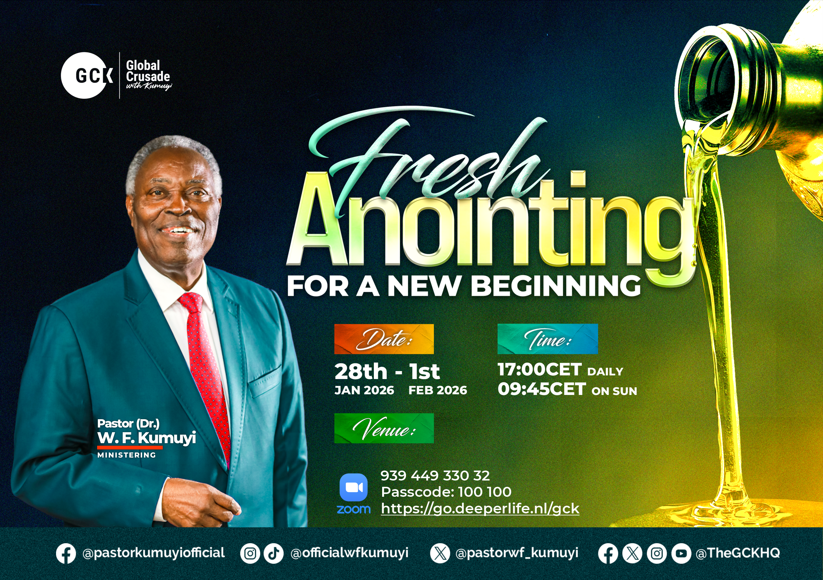

Slide 29


Slide 30


Slide 31


Acts 2:1-42
Notes:
s

Slide 32
HYMN
GHS 154: GIVE ME A DOUBLE PORTION

Slide 33
GIVE ME A DOUBLE PORTION [GHS 154]
1.
Long ago in days of old,
Stood a man of God we’re told,
As he talked to Elijah that day;
His request he did repeat,
Standing at Elijah’s feet,
“A double portion” I can hear him say.

Slide 34
Give me, Lord, a double portion,
Pour Thy Spirit on me,
Through eyes of faith Thy wondrous works I can see;
But I need Thy helping hand,
In this troubled, sinful land,
Give me, Lord, a double portion from Thee.

Slide 35
GIVE ME A DOUBLE PORTION [GHS 154]
2.
As Elijah stood that day,
To Elisha he did say,
“Ask me what I shall do unto thee”
And Elisha then replied,
Walking at Elijah’s side,
“A double portion, let it fall on me.”

Slide 36
Give me, Lord, a double portion,
Pour Thy Spirit on me,
Through eyes of faith Thy wondrous works I can see;
But I need Thy helping hand,
In this troubled, sinful land,
Give me, Lord, a double portion from Thee.

Slide 37
GIVE ME A DOUBLE PORTION [GHS 154]
3.
Lord, I always to Thee pray,
Just for strength from day to day,
But I see there’s so much to be done,
That I have to kneel a new,
And this favour ask of You,
A double portion this fight must be won.

Slide 38
Give me, Lord, a double portion,
Pour Thy Spirit on me,
Through eyes of faith Thy wondrous works I can see;
But I need Thy helping hand,
In this troubled, sinful land,
Give me, Lord, a double portion from Thee.

Slide 39

CHOIR

Slide 40
TODAY’S SERMON
PLEA FOR THE OUTPOURING OF THE SPIRIT

Slide 41

TIME TO PRAY

