Slide 1

SUPER SUNDAY SERVICE
25-01-2026

Slide 2
HYMN
GHS 029: I KNOW WHO HOLDS TOMORROW

Slide 3
I KNOW WHO HOLDS TOMORROW [GHS 029]
1.
I don’t know about tomorrow,
I just live from day to day;
I don’t borrow from it’s sunshine,
For it’s skies may turn to gray;
I don’t worry o’er the future,
For I know what Jesus said,
And today I’ll walk beside Him,
For He knows what is ahead.

Slide 4
Many things about tomorrow
I don’t seem to understand;
But I know who holds tomorrow,
And I know who holds my hand.

Slide 5
I KNOW WHO HOLDS TOMORROW [GHS 029]
2.
Ev’ry step is getting brighter
As the golden stairs I climb;
Ev’ry burden’s getting lighter,
Ev’ry cloud is silver lined;
There the sun is always shining,
There no tear will dim the eye;
At the ending of the rainbow,
Where the mountains touch the sky.

Slide 6
Many things about tomorrow
I don’t seem to understand;
But I know who holds tomorrow,
And I know who holds my hand.

Slide 7
I KNOW WHO HOLDS TOMORROW [GHS 029]
3.
I don’t know about tomorrow,
It may bring me poverty;
But the One who feeds the sparrow
Is the One who stands by me;
And the path that be my portion,
May be through the flame or flood,
But His presence goes before me,
And I’m covered with His blood.

Slide 8
Many things about tomorrow
I don’t seem to understand;
But I know who holds tomorrow,
And I know who holds my hand.

Slide 9

SEARCH THE SCRIPTURES
25-01-2026

Slide 10
REVIEW OF THE ASSIGNMENT FROM LAST STUDY
What lessons can you draw from Noah’s story that are relevant to your Christian life and how can you live them out daily?
Volunteer please!
The flood and its aftermath

Slide 11
LESSON 4:
God’s call and covenant with Abraham
MEMORY VERSE: ……
  “Now the LORD had said unto Abram, Get thee out of thy country, and from thy kindred, and from thy father’s house, unto a land that I will shew thee: And I will make of thee a great nation, and I will bless thee, and make thy name great; and thou shalt be a blessing”
  (Genesis 12:1,2).
TEXT: Genesis 12 – 17

Slide 12
INTRODUCTION
God would form a nation through which the Messiah would come. He called Abraham out of idolatrous Ur to begin this redemptive phase. His response demanded faith, separation, obedience, and courage. God entered into covenant with him, promising a land, descendants, and blessing to all nations. Though tested by famine, conflict, fear, and delay, Abraham grew in faith and God accounted his faith as righteousness. The Abrahamic covenant remains foundational to the understanding of justification, sanctification, and God’s redemptive plan.

Slide 13
God’s call and covenant with Abraham
KEY LESSONS IN THE STUDY OF TODAY
God’s call demands separation from sinful ties and obedience, leaving and trusting His leading.
Faith responds even when details are hidden. Abraham did not know where God was leading him. Faith walks into divine uncertainty.
Trials and weaknesses do not cancel God’s promises. Abraham was tested, yet God upheld His covenant with him.
Justification is by faith, not by works. Abraham believed God; he was justified by that faith.
To remain in covenant with God, we must be holy. God demanded perfection from Abraham.

Slide 14
QUESTION 1
What call did God give Abraham and what blessings followed his obedience?
Gen 12:1-3; Heb 11:8

Slide 15
QUESTION 2
In what areas must believers avoid following Abraham’s wrong steps?
Prov 3:5-7; Gal 6:7-8

Slide 16
QUESTION 3
Why should believers settle misunderstandings amicably?
Rom 12:18; Matt 5:9

Slide 17
QUESTION 4
Why should Christians give tithes and offerings?
Gen 14:18-20; Mal 3:10

Slide 18
QUESTION 5
What does it mean to be justified by faith?
Rom 4:3-5; Gal 3:6-9

Slide 19
QUESTION 6
What does God require from believers to fulfil His promises in their lives?
Gen 17:1; 1 Thess 4:3

Slide 20
QUESTION 7
How can we answer God’s call today?
Luk 9:23; Rom 12:1-2

Slide 21
CONCLUSION
Abraham stands as the “father of faith” and a covenant example to all believers. His life teaches that God calls people out of sin into covenant relationship, justifies them by faith, sanctifies them unto perfection, and fulfills His promises in His time. Those who obey God’s call, walk in holiness, and trust His covenant will become channels of blessing to their generation.

Slide 22
ASSIGNMENT
Identify one area where Abraham obeyed God and one area where he struggled. How can these two examples guide your personal walk with God? Prepare to share next study.

Slide 23


SEARCH THE SCRIPTURES SUMMARY

Slide 24

INTERCESSION

Slide 25
TITHES AND OFFERING
Kindly pay via one of the following options:
Your phone
Bank transfer to
Cash
IBAN: NL90ABNA0416385699
Remarks: Tithes (name of region)
“… God loves a cheerful giver”
- 2 Corinthians 9:7

Slide 26


Slide 27








COUNSELLING
SERVICE SCHEDULES
Service | Day | Timing | Remarks
Worship Service | Sunday | 09:45-12:00 | Physical/Online
Bible Study | Tuesday | 19:30-20:30 | Online
Revival Service | Friday | 19:30-21:00 | Online/Physical
Night Vigil | Friday | 19:30-23:30 | First Friday Monthly
If you have questions or need guidance on challenging issues, kindly request for counselling.
Our pastor is here for you.
CONTACT
+31 207 856 683
info@deeperlife.nl
LOCATION DETAILS
Location | Telephone # | ZOOM Meeting ID
Amsterdam | +31 686 093 624 | 795-674-627
Eindhoven | +31 643 678 896 | 912-749-784
Rotterdam | +31 642 133 520 | 237-801-783
The Hague | +31 685 076 861 | 818-6898-8436
dclmnetherlands
www.dclm-nl.org

Slide 28
LESSON 5: The Destruction of Sodom and Gomorrah
STS STUDY FOR NEXT WEEK:
MEMORY VERSE: ……
  “Then the LORD rained upon Sodom and upon Gomorrah brimstone and fire from the LORD out of heaven; And he overthrew those cities, and all the plain, and all the inhabitants of the cities, and that which grew upon the ground.” (Genesis 19:24,25).
TEXT: Genesis 18:1-33; 19:1-38

Slide 29
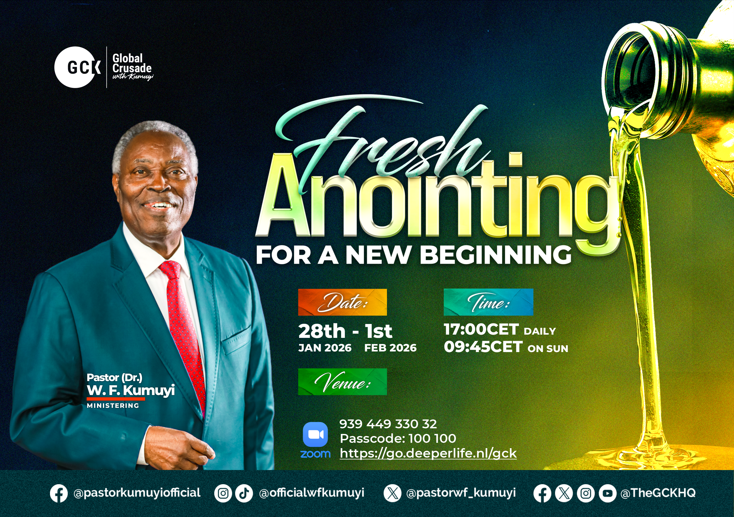

Slide 30


Slide 31


Slide 32


Deuteronomy 28:1-13
Notes:
s

Slide 33
HYMN
GHS 151: THERE SHALL BE SHOWERS OF BLESSING

Slide 34
THERE SHALL BE SHOWERS OF BLESSING [GHS 151]
1.
“There shall be showers of blessing:”
This is the promise of love;
There shall be seasons refreshing,
Sent from the Saviour above.

Slide 35
Showers of blessing,
Showers of blessing we need;
Mercy drops round us are falling,
But for the showers we plead.

Slide 36
THERE SHALL BE SHOWERS OF BLESSING [GHS 151]
2.
“There shall be showers of blessing:”
Precious reviving again;
Over the hills and the valleys,
Sound of abundance of rain.

Slide 37
Showers of blessing,
Showers of blessing we need;
Mercy drops round us are falling,
But for the showers we plead.

Slide 38
THERE SHALL BE SHOWERS OF BLESSING [GHS 151]
3.
“There shall be showers of blessing:”
Send them upon us, O Lord!
Grant to us now a refreshing;
Come, and now honour Thy Word.

Slide 39
Showers of blessing,
Showers of blessing we need;
Mercy drops round us are falling,
But for the showers we plead.

Slide 40
THERE SHALL BE SHOWERS OF BLESSING [GHS 151]
4.
“There shall be showers of blessing:”
Oh, that today they might fall,
Now, as to God we’re confessing,
Now as on Jesus we call!

Slide 41
Showers of blessing,
Showers of blessing we need;
Mercy drops round us are falling,
But for the showers we plead.

Slide 42
THERE SHALL BE SHOWERS OF BLESSING [GHS 151]
5.
“There shall be showers of blessing:”
If we but trust and obey
There shall be seasons refreshing,
If we let God have His way.

Slide 43
Showers of blessing,
Showers of blessing we need;
Mercy drops round us are falling,
But for the showers we plead.

Slide 44

CHOIR

Slide 45
TODAY’S SERMON
PLEA FOR GOD’S BLESSING ON THE YEAR

Slide 46

TIME TO PRAY

