Slide 1
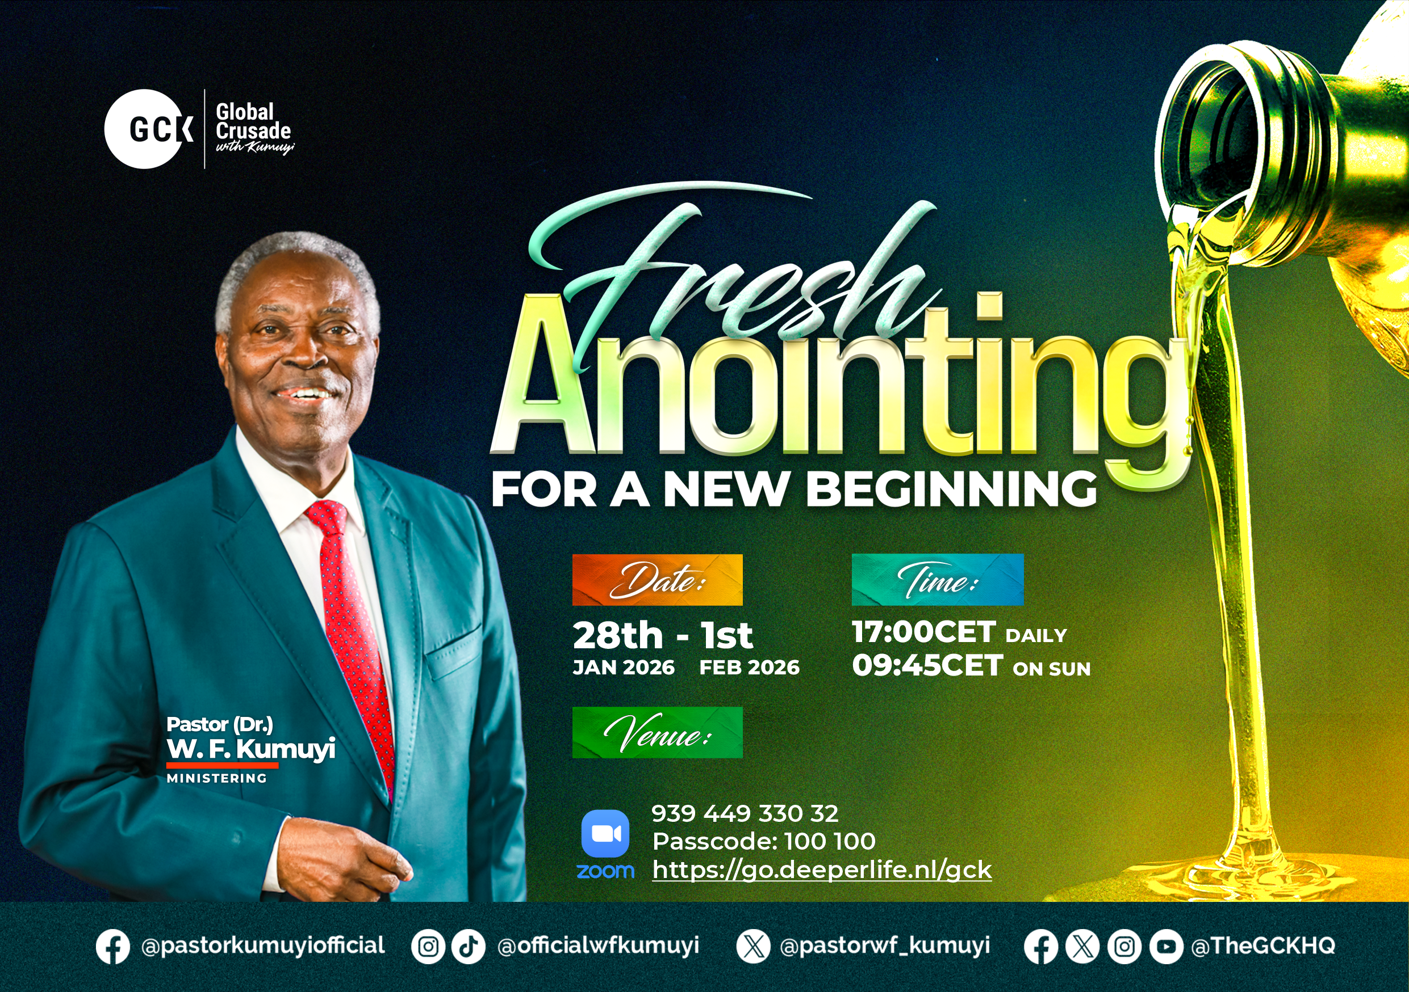

Slide 2

GLOBAL WORSHIP SERVICE
01-02-2026

Slide 3
HYMN
GHS 207: THERE’S A GREAT DAY COMING

Slide 4
THERE’S A GREAT DAY COMING [GHS 207]
1.
There’s a great day coming
A great day coming
There’s a great day coming by and by
When the saints and the sinners shall be
Parted right and left
Are you ready for that day to come?

Slide 5
Are you ready? Are you ready?
Are you ready for the judgment day?
Are you ready? Are you ready?
For the judgment day?

Slide 6
THERE’S A GREAT DAY COMING [GHS 207]
2.
There’s a bright day coming
A bright day coming
There’s a bright day coming by and by;
But its brightness shall only come
To them that love the Lord,
Are you ready for that day to come?

Slide 7
Are you ready? Are you ready?
Are you ready for the judgment day?
Are you ready? Are you ready?
For the judgment day?

Slide 8
THERE’S A GREAT DAY COMING [GHS 207]
3.
There’s a sad day coming
A sad day coming
There’s a sad day coming by and by
When the sinner shall hear his doom
“Depart, I know ye not,”
Are you ready for that day to come?

Slide 9
Are you ready? Are you ready?
Are you ready for the judgment day?
Are you ready? Are you ready?
For the judgment day?

Slide 10

SEARCH THE SCRIPTURES
01-02-2026

Slide 11
REVIEW OF OUR ASSIGNMENT OF LAST STUDY
Identify one area where Abraham obeyed God and one area where he struggled. How can these two examples guide your personal walk with God? Prepare to share next study.
Volunteers please!
God’s call and covenant with Abraham

Slide 12
LESSON 5:
The Destruction of Sodom and Gomorrah
MEMORY VERSE: ……
  “Then the LORD rained upon Sodom and upon Gomorrah brimstone and fire from the LORD out of heaven; And he overthrew those cities, and all the plain, and all the inhabitants of the cities, and that which grew upon the ground.” (Genesis 19:24,25).
TEXTS: Genesis 18:1-33; 19:1-38

Slide 13
INTRODUCTION
God appeared again to Abraham, accompanied by two angels in human form, in the plains of Mamre. Abraham demonstrated remarkable hospitality to the visitors, setting an example for believers. As a friend of God who enjoyed close communion with Him (Genesis 18:17, 20–21), Abraham learned of God’s plan to judge Sodom and Gomorrah for their wickedness and responded by interceding earnestly for the cities. However, their sin had reached a point where judgment was unavoidable (Genesis 13:13). The destruction of these cities stands as a warning to all who take God’s laws lightly.

Slide 14
Gen 18:1-10; 1Timothy 5:10; Gen19:1,24-26;John9:4;1Cor 15:33;
Hospitality reflects godly character and invites divine blessing.
Intercessory prayer is a duty of believers and a means through which God shows mercy.
Worldliness or compromise weakens faith and damages families.
Continuing in sin hardens the heart and leads to inevitable judgement.
Evangelism is a God-given responsibility to every believer; neglecting it results in lost souls.
Incomplete separation from the world brings tragic consequences, even for the righteous.
KEY LESSONS IN THE STUDY OF TODAY

Slide 15
QUESTION 1
What is the spiritual significance of Sodom and Gomorrah to believers today? Proverbs 14:12; Luke 17:32

Slide 16
QUESTION 2
Why was there a severe judgment on Sodom and Gomorrah? Gen 18:20: Jude 1:7; Prov 29:1

Slide 17
QUESTION 3
Why is it necessary to intercede for others? Gen 18:23; Ezekiel 22:30; Romans 10:1

Slide 18
QUESTION 4
Enumerate the dangers of exposing our families to ungodly influence. Gen 19:14, 36-38; Proverb 14:12 ; 1 Cor 15:33

Slide 19
QUESTION 5
What should be our evangelistic motto? John 9:4

Slide 20
QUESTION 6
What can we learn from the destruction of Sodom and Gomorrah and the fate of Lot’s wife? Gen 19:24,26; Luke 17:32

Slide 21
QUESTION 7
How can we remain unspotted in a corrupt society? 1 John 2:15; Proverb 4:23; 1 Peter 1:15-16; 2 Cor 6:17; Psalm 101:3

Slide 22
CONCLUSION
The account of Abraham, Lot, and Sodom reveals God’s holiness, mercy, and justice.
Believers are called to practise hospitality, intercession, urgent evangelism, and holy living while resisting worldly compromise.
Lot’s losses and his wife’s fate warn that half-hearted obedience leads to ruin, but faithfulness brings deliverance.

Slide 23
ASSIGNMENT
Bro Jacob was a fervent believer. He relocated 18 months ago from Lagos to Prague for study. But now, he has become inconsistent in fellowship, engages in elaborate outings, keeps unhealthy company and sinful practices so he could fit into the society. He has stopped speaking openly about his faith. Where did Bro Jacob’s problem begin? What are the dangers if it continues? How can he recover?
List two practical steps a believer should take to avoid Bro Jacob’s experience and remain faithful and unspotted in this environment.

Slide 24


SEARCH THE SCRIPTURES SUMMARY

Slide 25

INTERCESSION

Slide 26
TITHES AND OFFERING
Kindly pay via one of the following options:
Your phone
Bank transfer to
Cash
IBAN: NL90ABNA0416385699
Remarks: Tithes (name of region)
“… God loves a cheerful giver”
- 2 Corinthians 9:7

Slide 27


Slide 28








COUNSELLING
SERVICE SCHEDULES
Service | Day | Timing | Remarks
Worship Service | Sunday | 09:45-12:00 | Physical/Online
Bible Study | Tuesday | 19:30-20:30 | Online
Revival Service | Friday | 19:30-21:00 | Online/Physical
Night Vigil | Friday | 19:30-23:30 | First Friday Monthly
If you have questions or need guidance on challenging issues, kindly request for counselling.
Our pastor is here for you.
CONTACT
+31 207 856 683
info@deeperlife.nl
LOCATION DETAILS
Location | Telephone # | ZOOM Meeting ID
Amsterdam | +31 686 093 624 | 795-674-627
Eindhoven | +31 643 678 896 | 912-749-784
Rotterdam | +31 642 133 520 | 237-801-783
The Hague | +31 685 076 861 | 818-6898-8436
dclmnetherlands
www.dclm-nl.org

Slide 29


Slide 30
LESSON 6: Abimelech
Restores
Abraham’s Wife
STS STUDY FOR NEXT WEEK:
MEMORY VERSE: ……
  “And Abimelech took sheep, and oxen, and menservants, and women servants, and gave them unto Abraham, and restored him Sarah his wife” (Genesis 20:14).
TEXT: Genesis 20:1 – 18

Slide 32

CHOIR

Slide 33
CONNECTION TO GCK

Slide 34

TIME TO PRAY

