Slide 1

SUPER SUNDAY SERVICE
15-02-2026

Slide 2
HYMN
GHS 009: GREAT IS THY FAITHFULNESS

Slide 3
GREAT IS THY FAITHFULNESS [GHS 009]
1.
“Great is thy faithfulness,”
O God my Father!
There is no shadow of turning with Thee;
Thou changest not,
Thy compassions, they fail not
As Thou hast been
Thou forever wilt be.

Slide 4
“Great is Thy faithfulness!
Great is Thy faithfulness!”
Morning by morning new mercies I see;
All I have needed
Thy hand hath provided –
“Great is Thy faithfulness,”
Lord unto me!

Slide 5
GREAT IS THY FAITHFULNESS [GHS 009]
2.
Summer and winter, and spring time and harvest,
Sun, moon and stars in their courses above,
Join with all nature in manifold witness,
To Thy great faithfulness, mercy and love.

Slide 6
“Great is Thy faithfulness!
Great is Thy faithfulness!”
Morning by morning new mercies I see;
All I have needed
Thy hand hath provided –
“Great is Thy faithfulness,”
Lord unto me!

Slide 7
GREAT IS THY FAITHFULNESS [GHS 009]
3.
Pardon for sin and a peace that endureth,
Thine own dear presence to cheer and to guide;
Strength for today and bright hope for tomorrow,
Blessings all mine, with ten thousands beside!

Slide 8
“Great is Thy faithfulness!
Great is Thy faithfulness!”
Morning by morning new mercies I see;
All I have needed
Thy hand hath provided –
“Great is Thy faithfulness,”
Lord unto me!

Slide 9

SEARCH THE SCRIPTURES
15-02-2026

Slide 10
REVIEW OF THE ASSIGNMENT FROM LAST STUDY
Sister Sandra has just come from Lesotho with a visiting visa, but she intends to work. A friend offers her her passport so she could use it to work with her name, telling her it is common practice here. How would you counsel Sister Sandra in this case?
Volunteer please!
Abimelech restores Abraham’s wife

Slide 11
LESSON 7:
The birth of Isaac, heir of promise
MEMORY VERSE: ……
  “And the LORD visited Sarah as he had said, and the LORD did unto Sarah as he had spoken. For Sarah conceived, and bare Abraham a son in his old age, at the set time of which God had spoken to him”
  (Genesis 21:1,2).
TEXT: Genesis 21:1-34

Slide 12
INTRODUCTION
When God called Abraham to serve Him, He promised to raise a great nation out of Him. He said, “In thee shall all families of the earth be blessed” (Genesis 12:3).
To fulfil God’s promise, Abraham needed to have a
son. But Sarah, his wife, was barren and aged. However, God assured Abraham that Sarah would give birth to a son. It eventually happened.
No matter how long it takes for God to fulfil His promise, in due time, it will be fulfilled if you remain faithful to Him and obey His word.

Slide 13
The birth of Isaac, heir of promise
KEY LESSONS IN THE STUDY OF TODAY
God was faithful to the promises He made to Abraham. Delays are steppingstones to your testimony. Hold on to God’s promises.
Abraham sent Ishmael away to fulfil God’s promise concerning Isaac’s heirship. Obey God’s command promptly even when it is unpleasant.
Although Ishmael was not Abraham’s heir, God took care of Him. God cares for all men. He wants them to repent and not perish (2 Pet 3:9).
Like Abraham, let others see God’s presence in your life. Live peaceably with all men.

Slide 14
QUESTION 1
What should be a believer’s attitude to different
suggestions in time of pressing needs and problems?
Psalm 118:8,9; Psalm 37:5; Rom 4:19-21.

Slide 15
QUESTION 2
What can a Christian learn from the fulfilment of the promised son to Abraham?
Gen 21:1,2; Num 23:19; Heb 10:36-38

Slide 16
QUESTION 3
What can we learn from Abraham’s obedience to send Ishmael away though it was grievous to him?
1 John 5:2-4; 1 Sam 15:22; John 5:30

Slide 17
QUESTION 4
What should be our role as brethren in the church when there is strife or misunderstanding?
Gen 13:8,9; Mat 18:15-17

Slide 18
QUESTION 5
What can believers learn from the covenant between Abraham and Abimelech?
Heb 12:14 ; Gen 21:23-24,32-33

Slide 19
CONCLUSION
God’s promises are infallible. He will surely fulfil them, no matter the delay. Do not yield to temptation. Reject ungodly counsel of men.
Sarah opted for an alternative option - Ishmael. She eventually regretted it and rejected Ishmael.
Make God and His word your singular option. Wait on Him. “He will come and save you”.

Slide 20
ASSIGNMENT
One of our brethren has been trusting God for ten years for his residence permit to be issued. Someone advised him to change his story and lie.
What would be your advice to this person? What bible passages would you share with him/her?

Slide 21


SEARCH THE SCRIPTURES SUMMARY

Slide 22

INTERCESSION

Slide 23
TITHES AND OFFERING
Kindly pay via one of the following options:
Your phone
Bank transfer to
Cash
IBAN: NL90ABNA0416385699
Remarks: Tithes (name of region)
“… God loves a cheerful giver”
- 2 Corinthians 9:7

Slide 24


Slide 25








COUNSELLING
SERVICE SCHEDULES
Service | Day | Timing | Remarks
Worship Service | Sunday | 09:45-12:00 | Physical/Online
Bible Study | Tuesday | 19:30-20:30 | Online
Revival Service | Friday | 19:30-21:00 | Online/Physical
Night Vigil | Friday | 19:30-23:30 | First Friday Monthly
If you have questions or need guidance on challenging issues, kindly request for counselling.
Our pastor is here for you.
CONTACT
+31 207 856 683
info@deeperlife.nl
LOCATION DETAILS
Location | Telephone # | ZOOM Meeting ID
Amsterdam | +31 686 093 624 | 795-674-627
Eindhoven | +31 643 678 896 | 912-749-784
Rotterdam | +31 642 133 520 | 237-801-783
The Hague | +31 685 076 861 | 818-6898-8436
dclmnetherlands
www.dclm-nl.org

Slide 26
LESSON 8:
Genealogy and birth of Christ
STS STUDY FOR NEXT WEEK:
MEMORY VERSE: ……
  “Behold, a virgin shall be with child, and shall bring forth a son, and they shall call his name Emmanuel, which being interpreted is, God with us”
  (Matthew 1:23)
TEXT: Matthew 1:1-25; 2:1-23; Luke 3:23-38

Slide 27


Ephesians 3:1-21
Notes:
s

Slide 28
HYMN
GHS 019: CHRIST JESUS HATH THE POWER

Slide 29
CHRIST JESUS HATH THE POWER [GHS 019]
1.
Christ Jesus hath the pow’r,
The power to forgive,
The pow’r to quicken whom He will,
And make the sinner live.
Christ Jesus hath the pow’r,
O tell it far and near!
O bring to Him your guilty heart,
And grace shall banish fear!

Slide 30
Christ Jesus hath the pow’r,
The pow’r of God He wields!
Christ Jesus hath the pow’r,
My heart surrender yields!
Christ Jesus hath the pow’r,
I trust Him evermore!.
Christ Jesus hath the pow’r,
I worship and adore!

Slide 31
CHRIST JESUS HATH THE POWER [GHS 019]
2.
Christ Jesus hath the pow’r,
The power to renew,
The pow’r to cleanse your heart from sin,
And make you wholly true.
Christ Jesus hath the pow’r,
For evermore to keep;
O none can pluck you from His hand,
Or rob Him of His sheep!

Slide 32
Christ Jesus hath the pow’r,
The pow’r of God He wields!
Christ Jesus hath the pow’r,
My heart surrender yields!
Christ Jesus hath the pow’r,
I trust Him evermore!.
Christ Jesus hath the pow’r,
I worship and adore!

Slide 33
CHRIST JESUS HATH THE POWER [GHS 019]
3.
Christ Jesus hath the pow’r,
The power to console,
The pow’r to carry all your care—
On Him your burdens roll.
Christ Jesus hath the pow’r,
To wipe the tear away;
O place in Him your confidence!
O trust Him, and obey!

Slide 34
Christ Jesus hath the pow’r,
The pow’r of God He wields!
Christ Jesus hath the pow’r,
My heart surrender yields!
Christ Jesus hath the pow’r,
I trust Him evermore!.
Christ Jesus hath the pow’r,
I worship and adore!

Slide 35
CHRIST JESUS HATH THE POWER [GHS 019]
4.
Christ Jesus hath the pow’r,
The power to destroy,
The pow’r to bruise your enemy
Who would your soul annoy.
Christ Jesus hath the pow’r,
When on your dying bed,
To give your soul the victory,
The pow’r to raise the dead!.

Slide 36
Christ Jesus hath the pow’r,
The pow’r of God He wields!
Christ Jesus hath the pow’r,
My heart surrender yields!
Christ Jesus hath the pow’r,
I trust Him evermore!.
Christ Jesus hath the pow’r,
I worship and adore!

Slide 37

CHOIR

Slide 38
TODAY’S SERMON
THE POWERFUL CHRIST LIVING IN YOU!

Slide 39
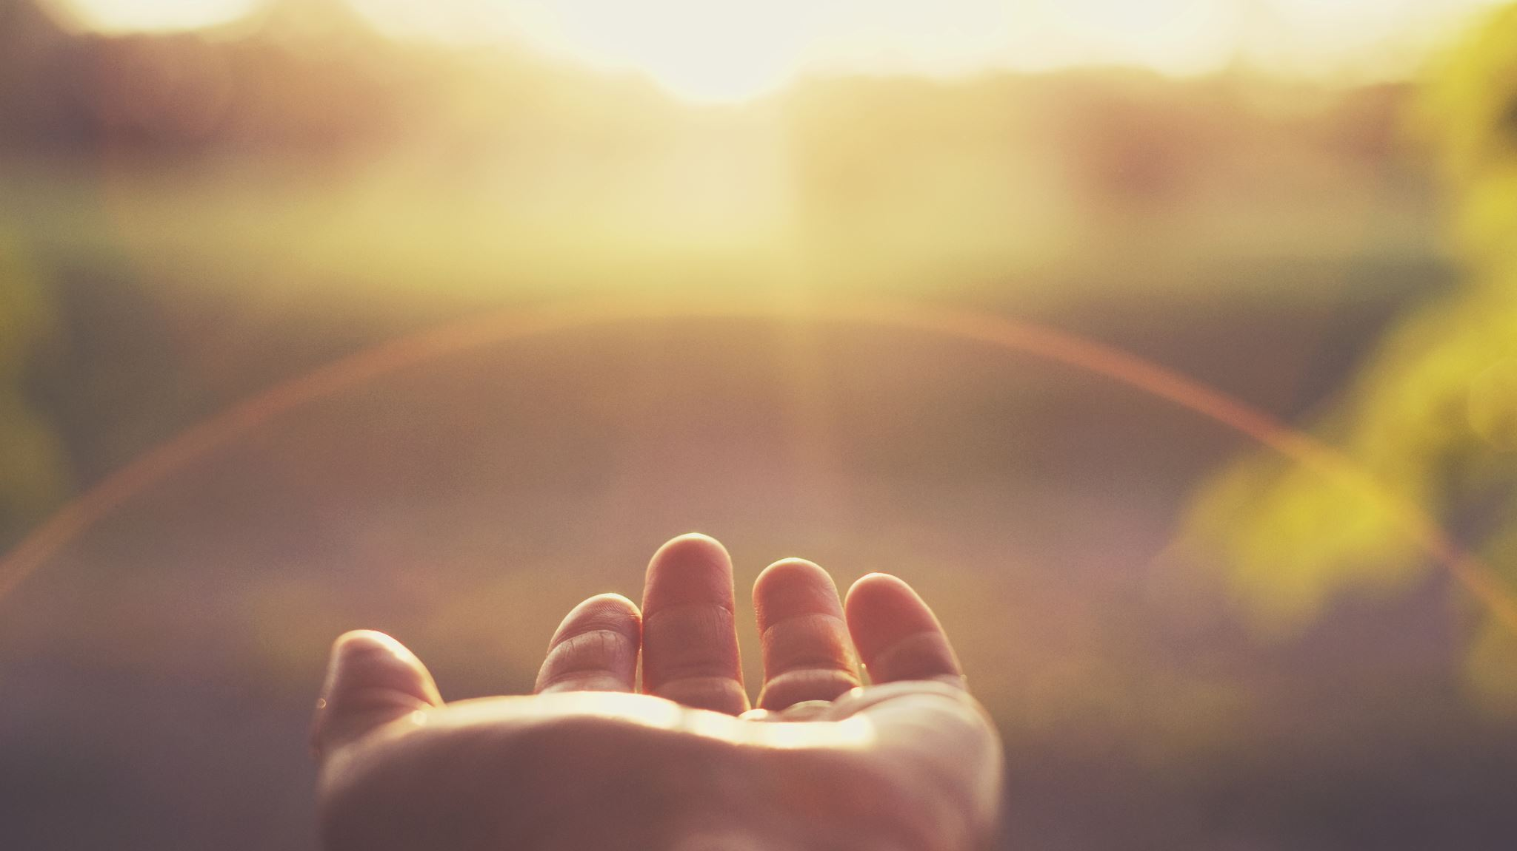
TIME TO PRAY

