Slide 1

SUPER SUNDAY SERVICE
12-04-2026

Slide 2
HYMN
GHS 021: WILL YOUR ANCHOR HOLD?

Slide 3
WILL YOUR ANCHOR HOLD? [GHS 021]
1.
Will your anchor hold in the storms of life?
When the clouds unfold their wings of strife;
When the strong tides lift, and the cables strain,
Will your anchor drift, or firm remain?

Slide 4
We have an anchor that keeps the soul
Stedfast and sure while the billows roll:
Fasten’d to the Rock which cannot move,
Grounded firm and deep in the Saviour’s love!

Slide 5
WILL YOUR ANCHOR HOLD? [GHS 021]
2.
It is safely moored ’twill the storm withstand,
For ’tis well secured by the Saviour’s hand;
And the cables passed from His heart to mine,
Can defy the blast, through strength divine.

Slide 6
We have an anchor that keeps the soul
Stedfast and sure while the billows roll:
Fasten’d to the Rock which cannot move,
Grounded firm and deep in the Saviour’s love!

Slide 7
WILL YOUR ANCHOR HOLD? [GHS 021]
3.
It will firmly hold in the straits of fear,
When the breakers have told the reef is near;
Though the tempest rave and the wild winds blow,
Not an angry wave shall our bark o’erflow.

Slide 8
We have an anchor that keeps the soul
Stedfast and sure while the billows roll:
Fasten’d to the Rock which cannot move,
Grounded firm and deep in the Saviour’s love!

Slide 9
WILL YOUR ANCHOR HOLD? [GHS 021]
4.
It will surely hold in the floods of death,
When the waters cold, chill our latest breath,
On the rising tide it can never fail,
While our hopes abide within the veil!

Slide 10
We have an anchor that keeps the soul
Stedfast and sure while the billows roll:
Fasten’d to the Rock which cannot move,
Grounded firm and deep in the Saviour’s love!

Slide 11
WILL YOUR ANCHOR HOLD? [GHS 021]
5.
When our eyes behold, through the gathering night
The city of gold, our harbor bright
We shall anchor fast by the heavenly shore,
While the storms all past for evermore.

Slide 12
We have an anchor that keeps the soul
Stedfast and sure while the billows roll:
Fasten’d to the Rock which cannot move,
Grounded firm and deep in the Saviour’s love!

Slide 13

SEARCH THE SCRIPTURES
12-04-2026

Slide 14
REVIEW OF THE ASSIGNMENT FROM LAST STUDY
You are a Christian on a six-month probation at work. Your manager asks you to falsify the figures in a report so the team can hit the target, and hints that your renewal may depend on it. As a disciple of Christ, what should you do? Support your answer with Scripture.
Volunteer please!
The Cost of
Discipleship

Slide 15
LESSON 14:
God Tests Abraham
MEMORY VERSE: ……
  “And he said, Take now thy son, thine only son Isaac, whom thou lovest, and get thee into the land of Moriah; and offer him there for a burnt offering upon one of the mountains which I will tell thee of”
  (Genesis 22:2).
TEXT: Genesis 22:1-24; 23:1-20

Slide 16
INTRODUCTION
Tests and trials are instruments God uses to prove the strength and genuineness of faith (Deuteronomy 8:2; James 1:2-3). Throughout Scripture, He has used them to reveal heart condition, obedience, truthfulness, and commitment to His will. In Abraham’s case, God did not test him to lead him into sin, but to reveal the quality of his love and faith. Since God gives man freedom of choice, each believer is responsible for obeying Him when tested.

Slide 17
God Tests Abraham
KEY LESSONS IN THE STUDY OF TODAY
God’s tests reveal faith, not because He is ignorant, but because He wants to prove what is in the heart.
Abraham obeyed without argument, delay, or retreat, even when the command touched his dearest possession.
Believers must never allow the gifts to replace the Giver.
God rewards obedient faith.
Abraham’s offering of Isaac points forward to the Father’s gift of His only Son.
Sarah’s death also reminds us that life is short, death is certain, and eternity must be prepared for now.

Slide 18
QUESTION 1
Why does God test His people?
Genesis 22:1; Deuteronomy 8:2-3; James 1:2-3

Slide 19
QUESTION 2
How did Abraham respond when God tested him?
Genesis 22:3-10; Hebrews 11:17-19

Slide 20
QUESTION 3
What proves the fear of God in a believer?
Genesis 22:12; Proverbs 8:13; Ecclesiastes 12:13

Slide 21
QUESTION 4
What rewards followed Abraham’s obedience?
Genesis 22:16-18; James 2:21-23

Slide 22
QUESTION 5
How did Abraham handle Sarah’s death, and what does it teach about death and eternity?
Genesis 23:2,4,19; Hebrews 9:27; John 5:28–29

Slide 23
CONCLUSION
Trials are not meant to destroy the believer, but to refine faith and deepen obedience. The right response is prompt submission to God, trust in His provision, and daily readiness for eternity through repentance, faith in Christ, and holy living.
Life is short, and judgment is certain.
Prepare for eternity by repenting of sin, trusting in Christ as Saviour, and living a holy life.

Slide 24
ASSIGNMENT
A believer has prayed for an opportunity or a job for years. When the opportunity comes, the process requires lying about some personal details or using a false document. What should the believer do, and why? Support your answer with Scripture.

Slide 25


SEARCH THE SCRIPTURES SUMMARY

Slide 26

INTERCESSION

Slide 27
TITHES AND OFFERING
Kindly pay via one of the following options:
Your phone
Bank transfer to
Cash
IBAN: NL90ABNA0416385699
Remarks: Tithes (name of region)
“… God loves a cheerful giver”
- 2 Corinthians 9:7

Slide 28


Slide 29








COUNSELLING
SERVICE SCHEDULES
Service | Day | Timing | Remarks
Worship Service | Sunday | 09:45-12:00 | Physical/Online
Bible Study | Tuesday | 19:30-20:30 | Online
Revival Service | Friday | 19:30-21:00 | Online/Physical
Night Vigil | Friday | 19:30-23:30 | First Friday Monthly
If you have questions or need guidance on challenging issues, kindly request for counselling.
Our pastor is here for you.
CONTACT
+31 207 856 683
info@deeperlife.nl
LOCATION DETAILS
Location | Telephone # | ZOOM Meeting ID
Amsterdam | +31 686 093 624 | 795-674-627
Eindhoven | +31 643 678 896 | 912-749-784
Rotterdam | +31 642 133 520 | 237-801-783
The Hague | +31 685 076 861 | 818-6898-8436
dclmnetherlands
www.dclm-nl.org

Slide 30


Slide 31


Slide 32
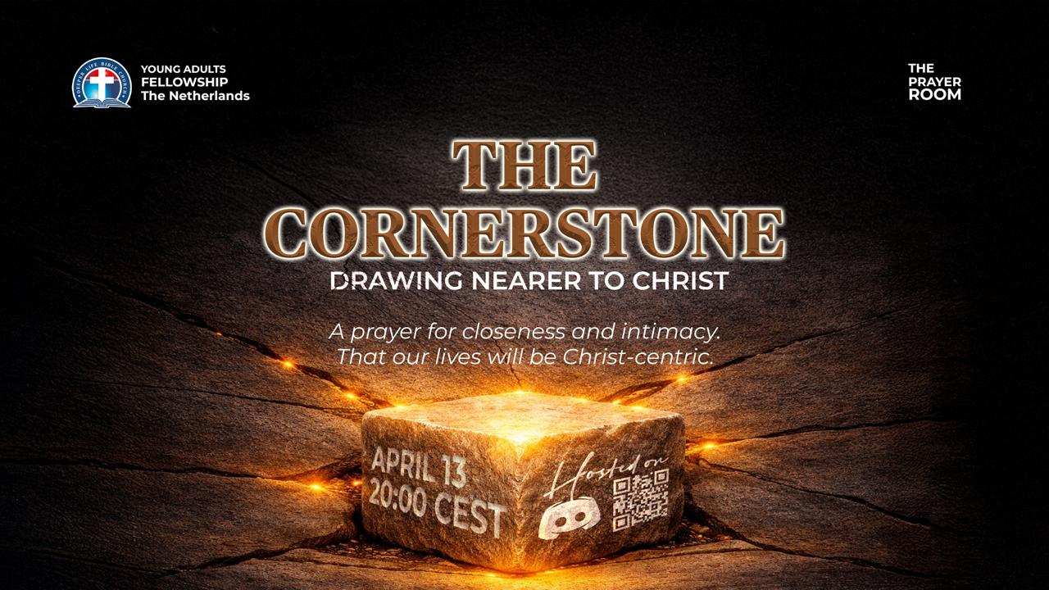

Slide 33
LESSON 15:
Isaac marries Rebekah
STS STUDY FOR NEXT WEEK:
MEMORY VERSE: ……
  “And Isaac brought her into his mother Sarah’s tent, and took Rebekah, and she became his wife; and he loved her: and Isaac was comforted after his mother’s death” (Genesis 24:67).
TEXT: Genesis 24:1-67

Slide 34


Philippians 3:1-11
Notes:
s

Slide 35
HYMN
GHS 019: CHRIST JESUS HATH THE POWER

Slide 36
CHRIST JESUS HATH THE POWER [GHS 019]
1.
Christ Jesus hath the pow’r,
The power to forgive,
The pow’r to quicken whom He will,
And make the sinner live.
Christ Jesus hath the pow’r,
O tell it far and near!
O bring to Him your guilty heart,
And grace shall banish fear!

Slide 37
Christ Jesus hath the pow’r,
The pow’r of God He wields!
Christ Jesus hath the pow’r,
My heart surrender yields!
Christ Jesus hath the pow’r,
I trust Him evermore!.
Christ Jesus hath the pow’r,
I worship and adore!

Slide 38
CHRIST JESUS HATH THE POWER [GHS 019]
2.
Christ Jesus hath the pow’r,
The power to renew,
The pow’r to cleanse your heart from sin,
And make you wholly true.
Christ Jesus hath the pow’r,
For evermore to keep;
O none can pluck you from His hand,
Or rob Him of His sheep!

Slide 39
Christ Jesus hath the pow’r,
The pow’r of God He wields!
Christ Jesus hath the pow’r,
My heart surrender yields!
Christ Jesus hath the pow’r,
I trust Him evermore!.
Christ Jesus hath the pow’r,
I worship and adore!

Slide 40
CHRIST JESUS HATH THE POWER [GHS 019]
3.
Christ Jesus hath the pow’r,
The power to console,
The pow’r to carry all your care—
On Him your burdens roll.
Christ Jesus hath the pow’r,
To wipe the tear away;
O place in Him your confidence!
O trust Him, and obey!

Slide 41
Christ Jesus hath the pow’r,
The pow’r of God He wields!
Christ Jesus hath the pow’r,
My heart surrender yields!
Christ Jesus hath the pow’r,
I trust Him evermore!.
Christ Jesus hath the pow’r,
I worship and adore!

Slide 42
CHRIST JESUS HATH THE POWER [GHS 019]
4.
Christ Jesus hath the pow’r,
The power to destroy,
The pow’r to bruise your enemy
Who would your soul annoy.
Christ Jesus hath the pow’r,
When on your dying bed,
To give your soul the victory,
The pow’r to raise the dead!.

Slide 43
Christ Jesus hath the pow’r,
The pow’r of God He wields!
Christ Jesus hath the pow’r,
My heart surrender yields!
Christ Jesus hath the pow’r,
I trust Him evermore!.
Christ Jesus hath the pow’r,
I worship and adore!

Slide 44

CHOIR

Slide 45
TODAY’S SERMON
ENJOYING THE FULLNESS OF THE RESURRECTION POWER

Slide 46
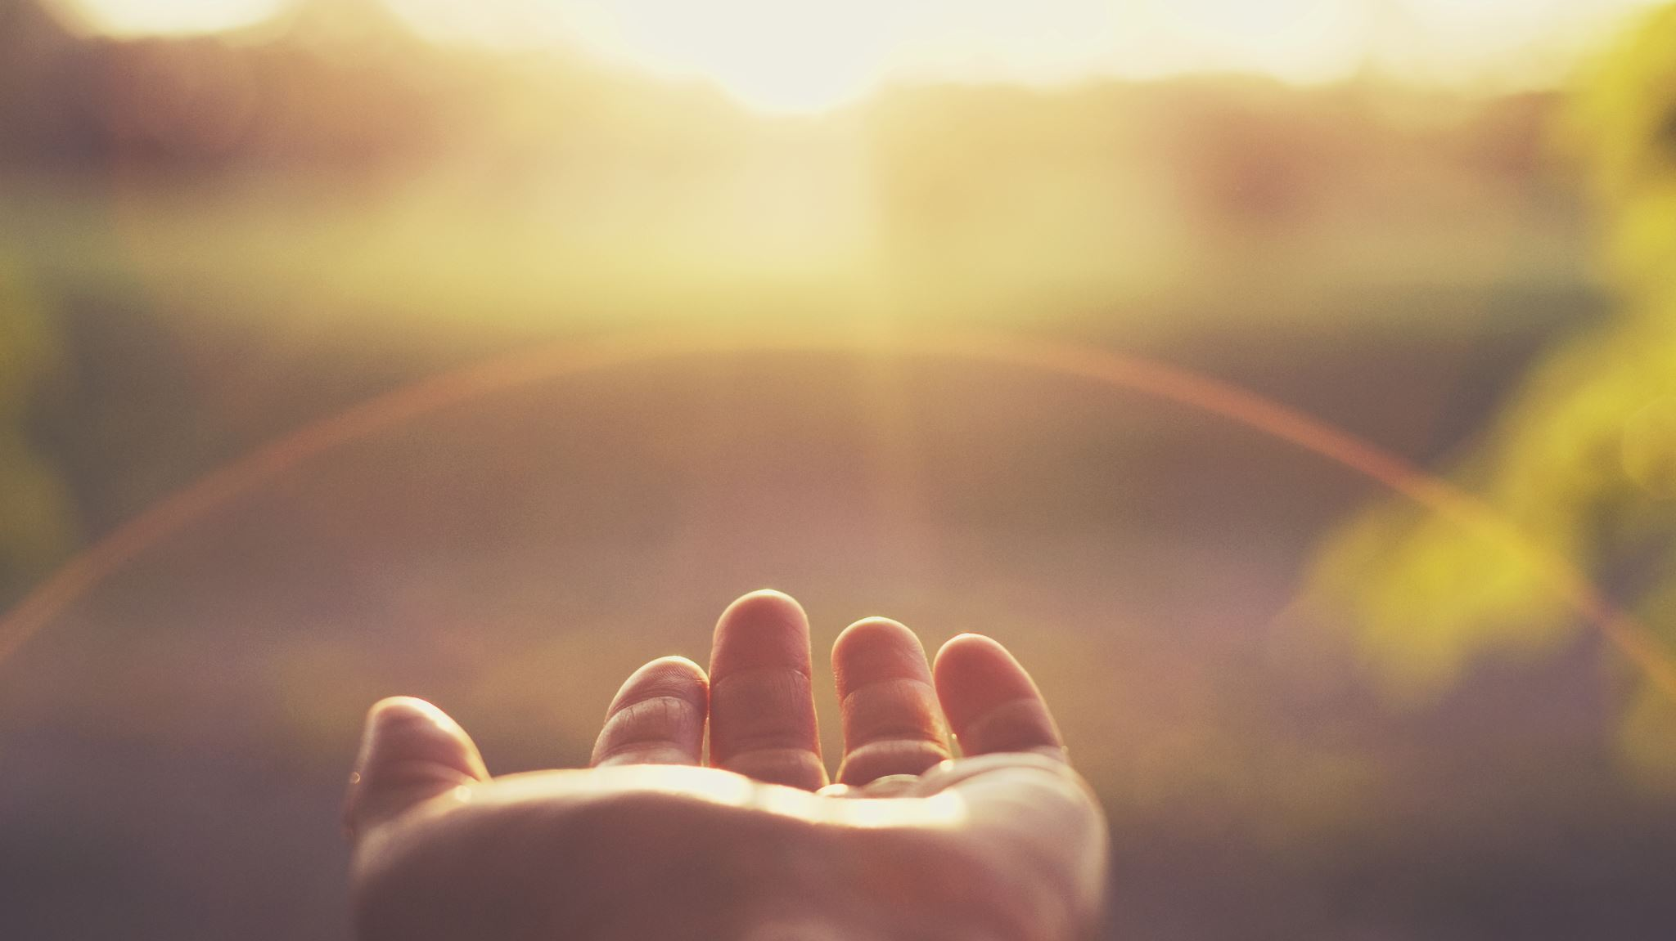
TIME TO PRAY

