Slide 1


Slide 2

GLOBAL WORSHIP SERVICE
31-05-2026

Slide 3
HYMN
GHS 153: WITH SIGNS FOLLOWING

Slide 4
WITH SIGNS FOLLOWING [GHS 153]
1.
When first the risen Lord of pow’r
His chosen ones sent forth,
A charge He gave, that solemn hour,
To preach His saving worth.
“Go ye,” said He, “to all mankind;
Declare My Word, and ye shall find:
These signs shall surely follow them
Who on My Name believe.”

Slide 5
WITH SIGNS FOLLOWING [GHS 153]
2.
“No demons shall before them stand,
No poison do them harm;
Nor subtle serpent in their hand
Cause pain or dread alarm.”
For Satan’s kingdom He o’ercame,
To give His people right to claim:
“These signs shall surely follow them
Who on My Name believe.”

Slide 6
WITH SIGNS FOLLOWING [GHS 153]
3.
“They shall with other tongues declare
The wonders of their God:
The sick beneath their hands, by prayer,
Shall rise, to prove My Word,”
So let it be! Firm as His Throne
Stands this clear promise to His own:
“These signs shall surely follow them
Who on My Name believe.”

Slide 7
WITH SIGNS FOLLOWING [GHS 153]
4.
Crowned with the flame of Pentecost,
A faithful, fearless band
Proclaimed His Name: a ransomed host
Arose from every land.
The Lord worked with them from on High,
His proven Word could none deny:
“These signs shall surely follow them
Who on My Name believe.”

Slide 8
WITH SIGNS FOLLOWING [GHS 153]
5.
No word of Thine is void of power;
No Promise, Lord, is vain.
Be this a Pentecostal hour –
Confirm Thy Word again!
Nor can’st Thou fail! Thou art the same
As when of old Thou did’st proclaim
“These signs shall surely follow them
Who on My Name believe.”

Slide 9

SEARCH THE SCRIPTURES
31-05-2026

Slide 10
REVIEW OF THE ASSIGNMENT FROM LAST STUDY
Commit to pray daily for seven days for a specific burden or problem. To help your prayer, develop a prayer plan, that is prayer points and time. Record your experience during the week and testimony of answer to prayer. Be ready to share your testimony the following week.
Volunteers please!
Jacob prevails at Jabbok

Slide 11
LESSON 21:
Jesus sends out the twelve
MEMORY VERSE: ……
  “And as ye go, preach, saying, The kingdom of heaven is at hand. Heal the sick, cleanse the lepers, raise the dead, cast out devils: freely ye have received, freely give” (Matthew 10:7,8).
TEXT: Matthew 10:1-42; Luke 9:1-10; 12:1-12

Slide 12
INTRODUCTION
The divine objective of rescuing perishing souls remained the driving force and focus of Christ’s earthly ministry from the beginning to the end. In today’s text, Christ sent out the twelve to further train them in the art of ‘soul-fishing’. His instructions to them reveal the content of the message and empowerment of the disciples for effective and fruitful soul-winning. Every believer is saved to win souls. There should be no idle hand in the Kingdom. Like Christ, believers should embark on evangelism and endeavor to mentor new believers to do same.

Slide 13
Matthew 10:1-42; Luke 9:1-10; 12:1-12
KEY LESSONS IN THE STUDY OF TODAY
Christ taught and commissioned his disciples to preach the gospel of the kingdom.
The Great Commission is the final command of Christ to all believers to spread the gospel.
Christ always associated the preaching of His gospel with the demonstration of God’s supernatural power.
Emphasis of the gospel should be repentance and faith in Christ.
We should show sympathy and patience in preaching despite possible rejection or hostility.
A life that is wholly yielded to the work of soul-winning is worthy, well-spent and profitable.

Slide 14
QUESTION 1
What was the focus of Christ’s ministry on earth?
Luke 19:10; Mark 3:14; Matthew 4:19

Slide 15
QUESTION 2
How does the Great Commission compare to the first mission Jesus gave to the Twelve?
Matthew 28:18,19; Acts 1:8; Matthew 10:5,6

Slide 16
QUESTION 3
What purpose do miracles and signs serve in the preaching of the gospel?
John 10:37,38; John 4:48; Mark 16:20

Slide 17
QUESTION 4
Explain the content and emphasis of a true gospel message
Mark 1:15; Acts 3:19; Galatians 1:8

Slide 18
QUESTION 5
What should be a believer’s attitude in the face of hostility and why?
John 16:1-3; Matthew 10:28,30,31; Luke 12:4

Slide 19
QUESTION 6
What are the rewards of faithful disciples in life and eternity?
Daniel 12:3; 2 Timothy 4:8; John 15:16

Slide 20
CONCLUSION
The preaching of the gospel turns people from sin unto righteousness and from eternal damnation to everlasting life. Every believer is called to “Go ye into all the world, and preach the gospel to every creature.” Those who preach the gospel to sinners always have the joy of turning many to righteousness.
Harvest time is here! Let us endeavor to work the fields and reap the fruits before this season slips away.

Slide 21
ASSIGNMENT
Pray, prepare and preach the gospel to at least someone new this week, and share your experience with the congregation next week

Slide 22


SEARCH THE SCRIPTURES SUMMARY

Slide 23

INTERCESSION

Slide 24
TITHES AND OFFERING
Kindly pay via one of the following options:
Your phone
Bank transfer to
Cash
IBAN: NL90ABNA0416385699
Remarks: Tithes (name of region)
“… God loves a cheerful giver”
- 2 Corinthians 9:7

Slide 25


Slide 26





COUNSELLING
SERVICE SCHEDULES
Service | Day | Timing | Remarks
Worship Service | Sunday | 09:45-12:00 | Physical/Online
Bible Study | Tuesday | 19:30-20:30 | Online
Revival Service | Friday | 19:30-21:00 | Online/Physical
Night Vigil | Friday | 19:30-23:30 | First Friday Monthly
If you have questions or need guidance on challenging issues, kindly request for counselling.
Our pastor is here for you.
CONTACT
+31 207 856 683
info@deeperlife.nl
LOCATION DETAILS
Location | Telephone # | ZOOM Meeting ID
Amsterdam | +31 686 093 624 | 795-674-627
Eindhoven | +31 643 678 896 | 912-749-784
Rotterdam | +31 642 133 520 | 237-801-783
The Hague | +31 685 076 861 | 818-6898-8436
dclmnetherlands
www.dclm-nl.org

Slide 27
LESSON 22:
Christ’s testimony of
John the Baptist
STS STUDY FOR NEXT WEEK:
MEMORY VERSE: ……
  “Verily I say unto you,
  Among them that are born of women there hath not risen a greater than John the Baptist: notwithstanding he that is least in the kingdom of heaven is greater than he”
  (Matthew 11:11).
TEXT: Matthew 11:1-30; Luke 7:18-35

Slide 28
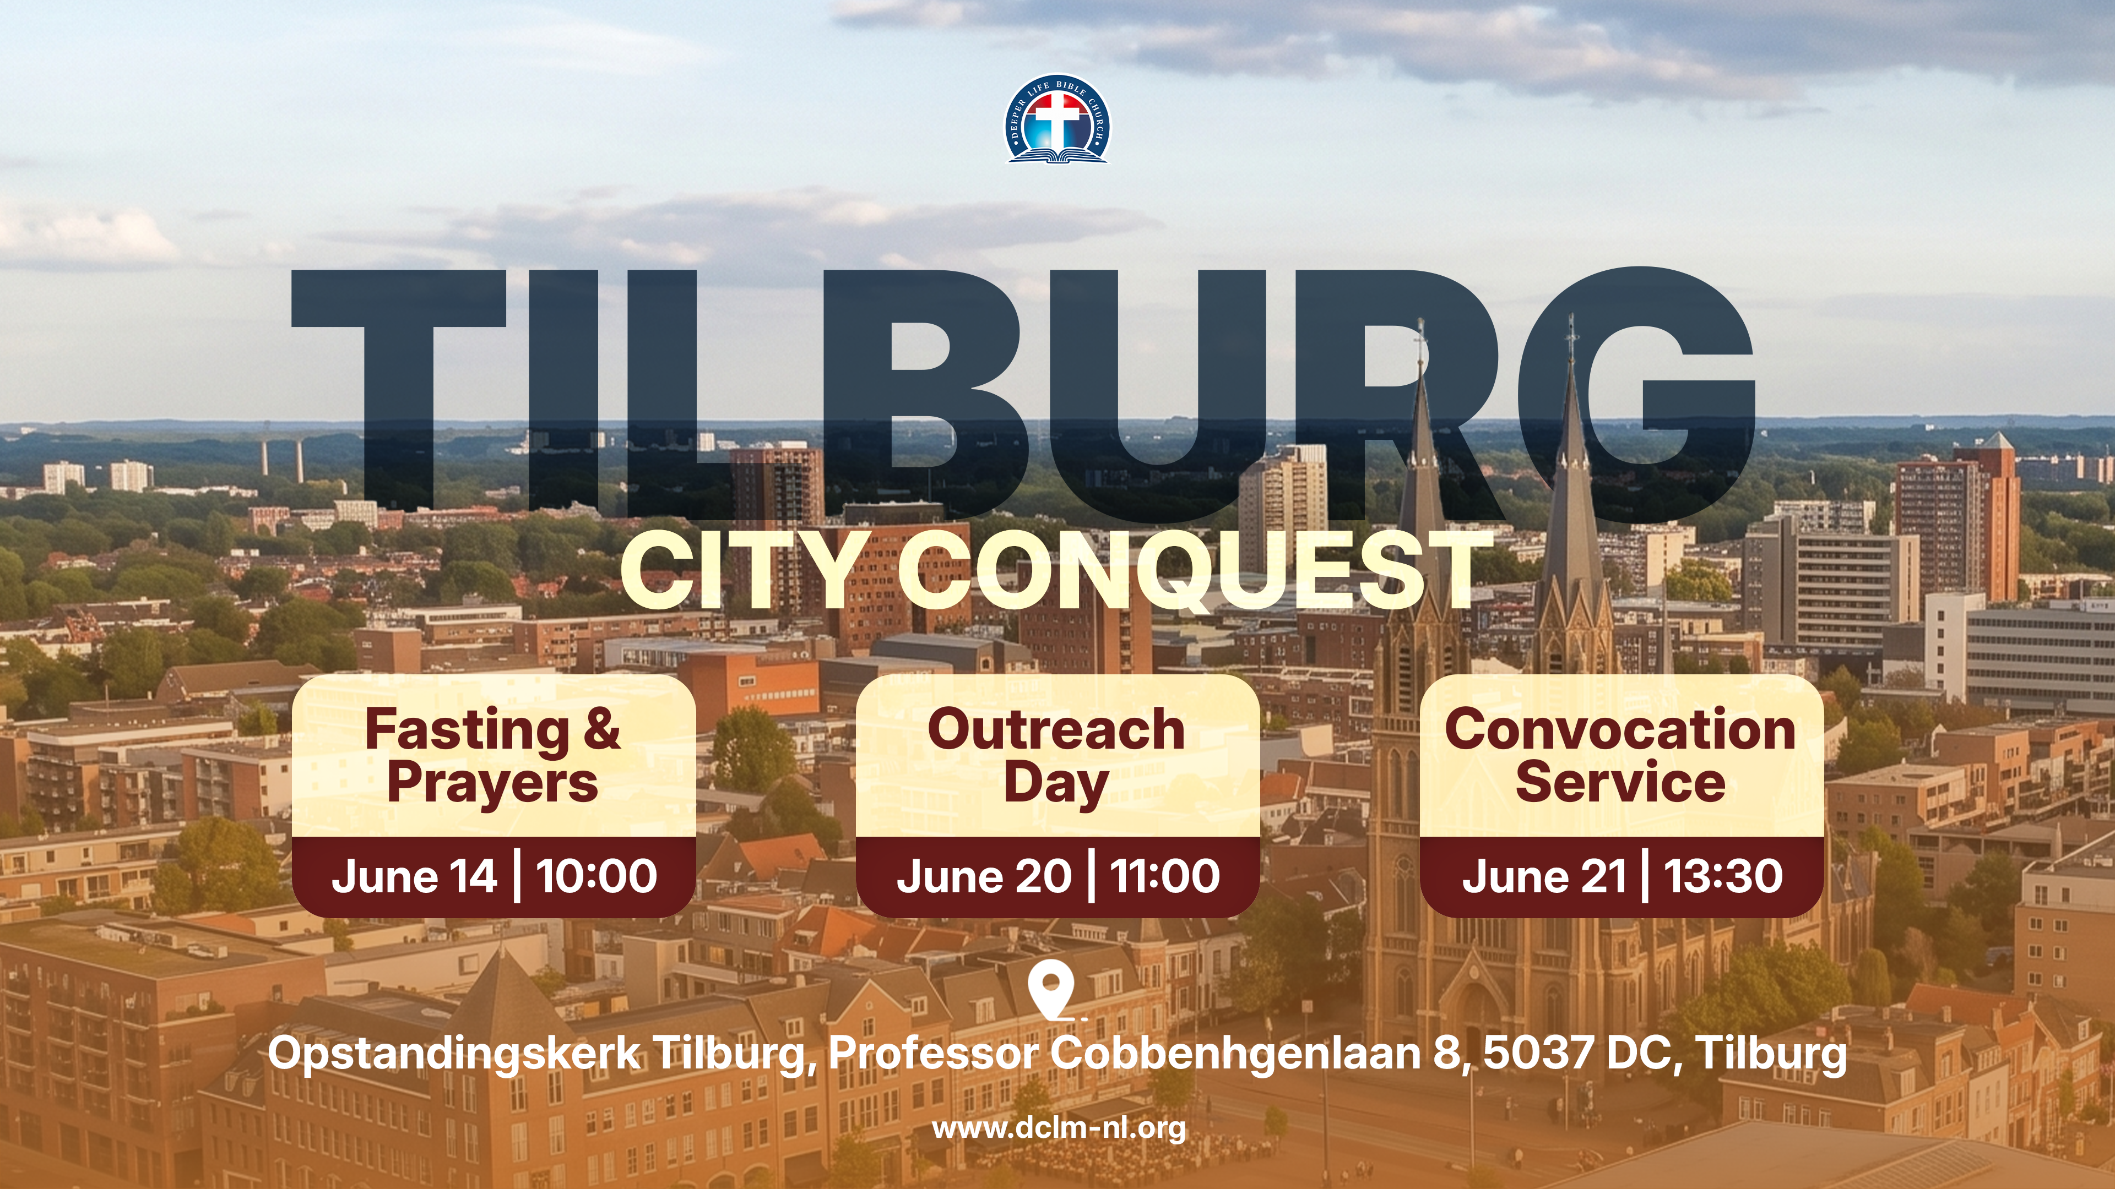

Slide 29


Slide 30


Slide 32

CHOIR

Slide 33
CONNECTION TO GCK

Slide 34

TIME TO PRAY

