Slide 1
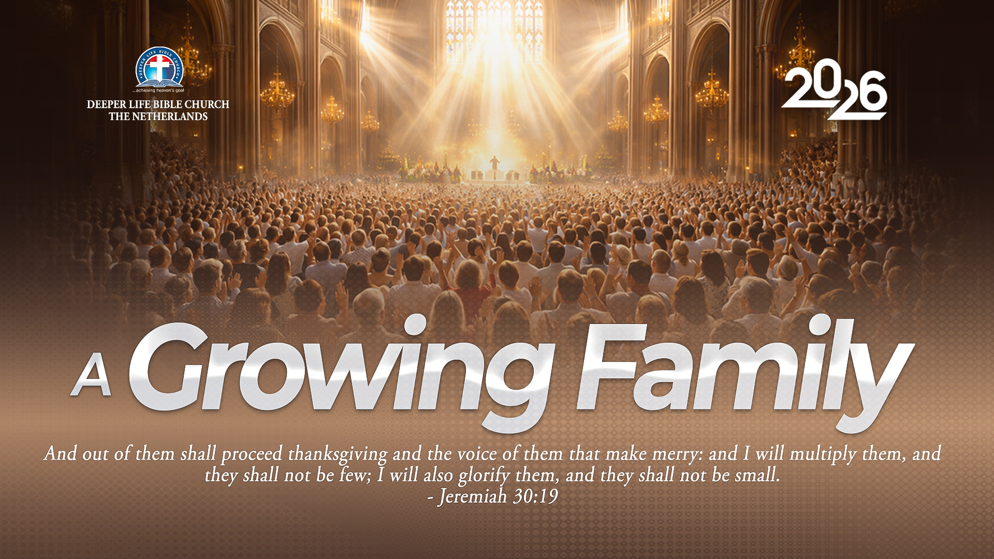
SUPER SUNDAY SERVICE
19-07-2026

Slide 2
HYMN
GHS 040: WASH ME, O LAMB OF GOD

Slide 3
WASH ME, O LAMB OF GOD [GHS 040]
1.
Wash me, O Lamb of God,
Wash me from sin!
By Thine atoning blood,
Oh, make me clean!
Purge me from ev’ry stain,
Let me Thine image gain,
In love and mercy reign,
O’er all within.

Slide 4
WASH ME, O LAMB OF GOD [GHS 040]
2.
Wash me, O Lamb of God,
Wash me from sin!
I long to be like Thee -
All pure within.
Now let the crimson tide,
Shed from Thy wounded side,
Be to my heart applied,
And make me clean.

Slide 5
WASH ME, O LAMB OF GOD [GHS 040]
3.
Wash me, O Lamb of God,
Wash me from sin!
I will not, cannot, rest
Till pure within.
All human skill is vain,
But Thou canst cleanse each stain
Till not a spot remain -
Made wholly clean.

Slide 6
WASH ME, O LAMB OF GOD [GHS 040]
4.
Wash me, O Lamb of God,
Wash me from sin!
By faith Thy cleansing blood
Now makes me clean.
So near art Thou to me,
So sweet my rest in Thee -
Oh, blessed purity,
Saved, saved from sin!

Slide 7
WASH ME, O LAMB OF GOD [GHS 040]
5.
Wash me, O Lamb of God,
Wash me from sin!
Thou, while I trust in Thee,
Wilt keep me clean.
Each day to Thee I bring
Heart, life - yea, everything;
Saved, while to Thee I cling,
Saved from all sin!

Slide 8

SEARCH THE SCRIPTURES
19-07-2026

Slide 9
REVIEW OF THE ASSIGNMENT FROM LAST STUDY
A young Christian sister has become emotionally involved with an unbeliever who later pressures her into compromising her Christian values.
What warning signs should the young sister have noticed?
How could she have prevented this problem and is there a way out for her?
Be ready to share your reflection with Bible references.
Volunteers please!
Dinah’s Defilement Avenged

Slide 10
LESSON 28: Jacob returns to Bethel
MEMORY VERSE: ……
  “And God said unto Jacob, Arise, go up to Bethel, and dwell there: and make there an altar unto God, that appeared unto thee when thou fleddest from the face of Esau thy brother”
  (Genesis 35:1).
TEXT: Genesis 35:1-29; 36:1-43

Slide 11
INTRODUCTION
Bethel signified a place to meet with God. The command to return there was a solemn rebuke to Jacob for delay in fulfilling his vow. It was also a call to spiritual renewal and restoration to first love, fervency, devotion and faithfulness (Gen 31:13). Jacob prepared his household for this important meeting. He commanded them to put away their “strange gods”. If we want spiritual revival or reformation, we must separate from sinful objects and sinful people. In return, God protected Jacob and his household as they journeyed to Bethel. Jacob built an altar of worship unto the Lord when he arrived safely.

Slide 12
Jacob returns to Bethel
KEY LESSONS IN THE STUDY OF TODAY
We must not delay in fulfilling our vows to the Lord to avoid distress and affliction (Jonah 2:9,10).
It is important to set our hearts and house in order before appearing before God. Jacob knew that righteousness and holiness pleased God. He exhorted his household to put away “strange gods” (Gen 35:2).
We are to renew our consecration and commitment to live in holiness, obedience, and service to God.
Death and loss of loved ones is a common experience of all humans.

Slide 13
QUESTION 1
What danger does material prosperity pose to our commitment to God?
Deu. 6:10-12; 1 Tim. 6:9,10

Slide 14
QUESTION 2
How should believers respond to God’s call to spiritual restoration and consecration?
Rev. 2:4,5; 3:15-19; 2 Chron. 7:14

Slide 15
QUESTION 3
What is incest and how can we prevent it in our family?
Lev. 18:6-9; Deu. 6:6,7; 1 Cor. 6:18-20

Slide 16
QUESTION 4
In the light of the certainty of death, how should saints lead their daily lives?
Col. 3:2,5,8-10,12-17

Slide 17
QUESTION 5
What were the exemplary actions of Jacob towards his parents (Gen. 35:27) and Deborah (Gen. 35:8)?
Exo. 20:12; Col. 4:1

Slide 18
QUESTION 6
What do we learn about the choice of Esau and its toll on his descendants?
Gen. 25:39-34; Mal. 1:3,4

Slide 19
QUESTION 7
Why is Esau not a good example to a follower of Christ?
Heb. 12:16,17

Slide 20
CONCLUSION
The command to return to Bethel is a call to spiritual renewal and restoration to first love, fervency, devotion and faithfulness. God is holy; therefore, we must always appear before Him clean and pure. Just as Jacob built an altar of worship to the Lord, we should always appreciate God for His past mercies and His promises of continual blessing and protection.

Slide 21
ASSIGNMENT
Describe one person in the Bible who allowed material prosperity to affect his commitment to God and another one who did not. What made the difference? What do you learn from them?
Be ready to share your reflection next Sunday with Bible references.

Slide 22


SEARCH THE SCRIPTURES SUMMARY

Slide 23
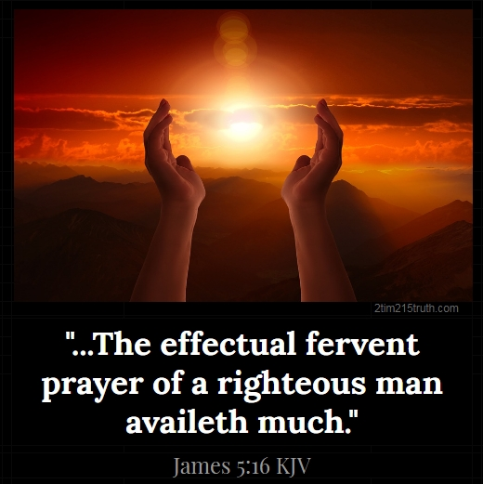
INTERCESSION

Slide 24
TITHES AND OFFERING
Kindly pay via one of the following options:
Your phone
Bank transfer to
Cash
IBAN: NL90ABNA0416385699
Remarks: Tithes (name of region)
“… God loves a cheerful giver”
- 2 Corinthians 9:7

Slide 25


Slide 26





COUNSELLING
SERVICE SCHEDULES
Service | Day | Timing | Remarks
Worship Service | Sunday | 09:45-12:00 | Physical/Online
Bible Study | Tuesday | 19:30-20:30 | Online
Revival Service | Friday | 19:30-21:00 | Online/Physical
Night Vigil | Friday | 19:30-23:30 | First Friday Monthly
If you have questions or need guidance on challenging issues, kindly request for counselling.
Our pastor is here for you.
CONTACT
+31 207 856 683
info@deeperlife.nl
LOCATION DETAILS
Location | Telephone # | ZOOM Meeting ID
Amsterdam | +31 686 093 624 | 795-674-627
Eindhoven | +31 643 678 896 | 912-749-784
The Hague | +31 685 076 861 | 818-6898-8436
dclmnetherlands
www.dclm-nl.org

Slide 27
LESSON 29:
The Plot Against Joseph
STS STUDY FOR NEXT WEEK:
MEMORY VERSE: ……
  “Yea, and all that will live godly in Christ Jesus shall suffer persecution”
  (2 Timothy 3:12).
TEXT: Genesis 37:1-36; 39:1-23

Slide 28


Slide 29


Slide 30


Numbers 14:1-10
Notes:
s

Slide 31
HYMN
VICTORY ALL THE TIME

Slide 32
VICTORY ALL THE TIME
1.
They who know the Savior shall in Him be strong,
Mighty in the conflict of the right ’gainst wrong;
This the blessed promise given in God’s Word,
Doing wondrous exploits, they who know the Lord.

Slide 33
Victory! victory! Blessed, blood-bought victory!
Victory! victory! Vict’ry all the time!
As Jehovah liveth, strength divine He giveth
Unto those who know Him—vict’ry all the time!

Slide 34
VICTORY ALL THE TIME
2.
In the midst of battle be thou not dismayed,
Though the pow’rs of darkness ’gainst thee are arrayed;
God, thy Strength, is with thee, causing thee to stand,
Heaven’s allied armies wait at thy command.

Slide 35
Victory! victory! Blessed, blood-bought victory!
Victory! victory! Vict’ry all the time!
As Jehovah liveth, strength divine He giveth
Unto those who know Him—vict’ry all the time!

Slide 36
VICTORY ALL THE TIME
3.
Brave to bear life’s testing, strong the foe to meet,
Walking like a hero midst the furnace heat,
Doing wondrous exploits with the Spirit’s sword,
Winning souls for Jesus, praise, oh, praise the Lord!

Slide 37
Victory! victory! Blessed, blood-bought victory!
Victory! victory! Vict’ry all the time!
As Jehovah liveth, strength divine He giveth
Unto those who know Him—vict’ry all the time!

Slide 38

CHOIR

Slide 39
TODAY’S SERMON
THE SPIRIT OF CONQUEST

Slide 40

TIME TO PRAY

