Slide 1

SUPER SUNDAY SERVICE
26-07-2026

Slide 2
HYMN
GHS 016: IF GOD BE FOR US

Slide 3
IF GOD BE FOR US [GHS 016]
1.
Rejoice in the Lord!
Oh, let His mercy cheer;
He sunders the bands that enthrall;
Redeem’d by His blood
Why should we ever fear
Since Jesus is our “all in all”?

Slide 4
If God be for us,
If God be for us,
If God be for us,
Who can be against us?
Who? Who? Who?
Who can be against us, against us?

Slide 5
IF GOD BE FOR US [GHS 016]
2.
Be strong in the Lord !
Rejoicing in His might,
Be loyal and true day by day;
When evils assail,
Be valiant for the right,
And He will be our strength and stay.

Slide 6
If God be for us,
If God be for us,
If God be for us,
Who can be against us?
Who? Who? Who?
Who can be against us, against us?

Slide 7
IF GOD BE FOR US [GHS 016]
3.
Confide in His word –
His promises so sure;
In Christ they are “ yea and amen;”
Though earth pass away,
They ever shall endure,
’Tis written o’er and o’er again.

Slide 8
If God be for us,
If God be for us,
If God be for us,
Who can be against us?
Who? Who? Who?
Who can be against us, against us?

Slide 9
IF GOD BE FOR US [GHS 016]
4.
Abide in the Lord:
Secure in His control,
’Tis life everlasting begun;
To pluck from His hand
The weakest, trembling soul
It never, never can be done!

Slide 10
If God be for us,
If God be for us,
If God be for us,
Who can be against us?
Who? Who? Who?
Who can be against us, against us?

Slide 11

SEARCH THE SCRIPTURES
26-07-2026

Slide 12
REVIEW OF THE ASSIGNMENT FROM LAST STUDY
Describe one person in the Bible who allowed material prosperity to affect his commitment to God and another one who did not. What made the difference? What do you learn from them?
Be ready to share your reflection next Sunday with Bible references.
Volunteers please!
Jacob returns to Bethel

Slide 13
LESSON 29:
The Plot Against Joseph
MEMORY VERSE: ……
  “Yea, and all that will live godly in Christ Jesus shall suffer persecution” (2 Timothy 3:12).
TEXT: Genesis 37:1-36; 39:1-23

Slide 14
INTRODUCTION
Joseph feared God and obeyed his father, but his brothers were driven by envy, hatred, and deceit. Joseph suffered betrayal, slavery, temptation, false accusation, and imprisonment. But God remained with him and fulfilled His purpose for his life (Psa 34:19; Rom 8:28).
This study warns against envy, immorality, and revenge and encourages us to live in obedience, purity, patience, and unwavering faith. Like Joseph, we must remain faithful through every trial, knowing that God’s purpose cannot be frustrated.

Slide 15
The Plot Against Joseph
KEY LESSONS IN THE STUDY OF TODAY
Envy and hatred destroy relationships, but love and contentment preserve unity.
God honours obedience, diligence, and integrity, even in times of suffering.
No opposition can frustrate God’s purpose for those who trust and obey Him.
Believers must flee sexual immorality and live holy lives that honour God.
God’s presence is our greatest blessing, bringing protection, favour, and victory.
Notes:
Envy, hatred and favouritism destroy families, relationships and spiritual fellowship. Believers must cultivate love, contentment and impartiality (Genesis 37:3-11; Proverbs 14:30).
Obedience, diligence and faithfulness to God remain the pathway to divine favour and fulfilment of God's purpose, even in difficult circumstances (Genesis 37:13-17; Colossians 3:23-24).
No trial, persecution or opposition can frustrate God's plan for a righteous believer who continues to trust and obey Him (Genesis 39:2-5,21-23; Romans 8:28).
Fornication and adultery are great wickedness against God. Believers must flee every form of sexual immorality and maintain holiness (Genesis 39:7-12; 1 Corinthians 6:18-20).
The presence of God is the believer's greatest possession. Those who walk in righteousness will enjoy His guidance, protection, favour and ultimate victory (Genesis 39:2,21; Psalm 34:19).

Slide 16
QUESTION 1
What do you learn from the envy and hatred Joseph’s brothers showed towards him? How can you avoid these attitudes today?
Genesis 37:4, 11; Proverbs 14:30; James 3:16

Slide 17
QUESTION 2
Give biblical examples that show the destructive effects of envy. What lessons can you learn from them?
Notes:
Envy can lead to: Hatred and broken relationships; Violence and injustice; Bitterness and unforgiveness; Opposition to God's purpose; Spiritual and moral downfall.
Cain envied Abel and murdered him (Genesis 4:3–8).
Saul envied David and repeatedly sought to kill him (1 Samuel 18:7–11).
The Jewish leaders envied Jesus and delivered Him to be crucified (Mark 15:10).
Believers should rejoice in God's blessings upon others, avoid comparison, and cultivate love, humility, and contentment.

Slide 18
QUESTION 3
What can parents, church leaders, and believers do to prevent envy and hatred in the family and the church?
2 Genesis 37:3,4; Philippians 2:3,4; John 13:34,35
Notes:
Envy grows where comparison is encouraged, but love grows where people are valued, treated fairly, and taught to rejoice in one another's blessings. Parents and leaders should model impartiality, encourage unity, and address jealousy before it develops into bitterness or conflict.

Slide 19
QUESTION 4
What does Joseph’s obedience and diligence in carrying out his father’s instruction teach you about your responsibility in fulfilling the Great Commission? Genesis 37:13–14; Luke 9:23; 2 Timothy 4:2
Notes:
Like Joseph, believers should obey Christ's command to preach the gospel with a willing heart, faithfully carrying out the Great Commission regardless of inconvenience, rejection, or hardship, knowing that God honours obedient servants.

Slide 20
QUESTION 5
How did Joseph’s life demonstrate that salvation and God’s presence are life’s greatest possessions? Genesis 39:2, 21, 23; Psalm 73:25–26
Notes:
elievers should value their salvation above wealth, comfort, popularity, or position. Like Joseph, we must be willing to suffer loss rather than compromise our relationship with God, knowing that His presence is our greatest possession both in this life and in eternity.

Slide 21
QUESTION 6
Why are fornication and adultery described in Scripture as great sins against God? What are their consequences in this life and in eternity? Isaiah 59:1,2; Proverbs 6:32,33; 1 Corinthians 6:9,10
Notes:
Loss of fellowship with God (Isaiah 59:1–2).Broken marriages and families (Proverbs 6:32–33).Shame, guilt, and damaged reputation (Proverbs 5:8–11).Emotional, physical, and spiritual consequences, including loss of peace and trust.Loss of God's favour, testimony, and usefulness, as seen in the lives of David and Samson after their moral failures (2 Samuel 12:9–14; Judges 16:20–21).

Slide 22
QUESTION 7
What can you learn from the way God’s invisible hand preserved and guided Joseph through every danger he faced? Genesis 39:2, 21; 50:20; Psalm 34:19

Slide 23
CONCLUSION
Sin hinders God’s purpose and bring painful consequences. Joseph’s life teaches that those who fear God, flee temptation, remain obedient, and trust His providence will enjoy His presence, protection, and ultimate victory despite trials and opposition.
No circumstance can frustrate God’s plan for those who walk in righteousness. Sinners should repent and receive Christ, for salvation and fellowship with God are life’s greatest possessions both now and in eternity.

Slide 24
ASSIGNMENT
A faithful Christian is falsely accused and denied a promotion because of a jealous colleague.
How should he/she respond according to Joseph’s example?
What practical lessons can be learned from Joseph’s life?
Support your answer with relevant Bible references.

Slide 25


SEARCH THE SCRIPTURES SUMMARY

Slide 26
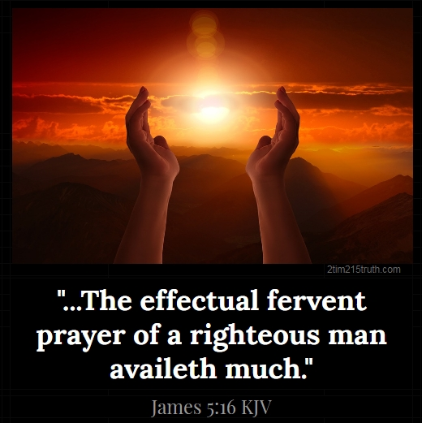
INTERCESSION

Slide 27
TITHES AND OFFERING
Kindly pay via one of the following options:
Your phone
Bank transfer to
Cash
IBAN: NL90ABNA0416385699
Remarks: Tithes (name of region)
“… God loves a cheerful giver”
- 2 Corinthians 9:7

Slide 28
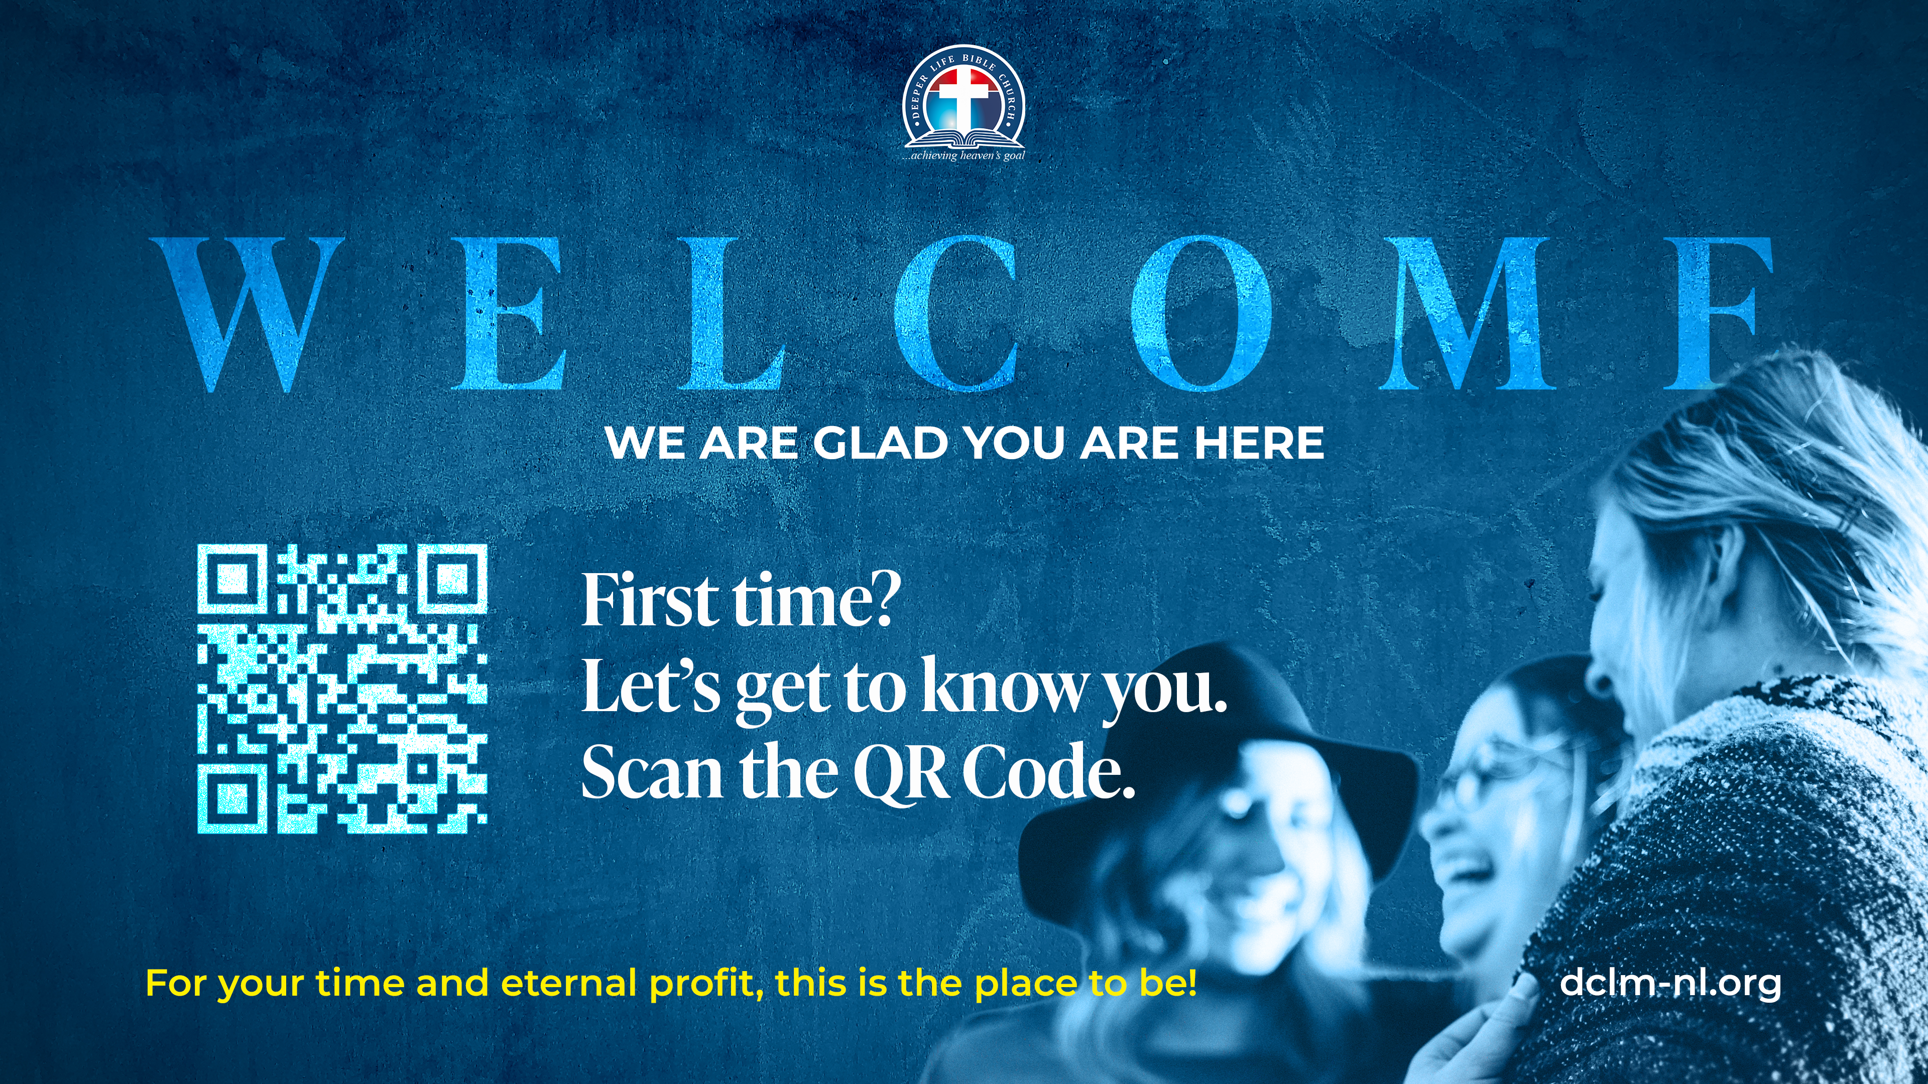

Slide 29





COUNSELLING
SERVICE SCHEDULES
Service | Day | Timing | Remarks
Worship Service | Sunday | 09:45-12:00 | Physical/Online
Bible Study | Tuesday | 19:30-20:30 | Online
Revival Service | Friday | 19:30-21:00 | Online/Physical
Night Vigil | Friday | 19:30-23:30 | First Friday Monthly
If you have questions or need guidance on challenging issues, kindly request for counselling.
Our pastor is here for you.
CONTACT
+31 207 856 683
info@deeperlife.nl
LOCATION DETAILS
Location | Telephone # | ZOOM Meeting ID
Amsterdam | +31 686 093 624 | 795-674-627
Eindhoven | +31 643 678 896 | 912-749-784
The Hague | +31 685 076 861 | 818-6898-8436
dclmnetherlands
www.dclm-nl.org

Slide 30
LESSON 30:
Judah’s moral slip
STS STUDY FOR NEXT WEEK:
MEMORY VERSE: ……
  "And Judah acknowledged them, and said, She hath been more righteous than I; because that I gave her not to Shelah my son. And he knew her again no more” (Genesis 38:26).
TEXT: Genesis Chapter 38

Slide 31


Slide 32


Slide 33


Slide 34


Matthew 5:1-16
Notes:
s

Slide 35
HYMN
GHS 117: SHOW A LITTLE BIT OF LOVE AND KINDNESS

Slide 36
SHOW A LITTLE BIT OF LOVE AND KINDNESS [GHS 117]
1.
Sing a song, spread some cheer,
There are sad and lonely people everywhere;
Be a friend, show some love
It will lift them from the dungeons of despair.

Slide 37
Show a little bit of love and kindness,
Never go along with hatred's blindness
Take a little time to reach for joy and wear a happy face;
Sing a little bit when the days are dreary,
Give a little help to a friend who's weary-
That's the way to make the world a happy place!

Slide 38
SHOW A LITTLE BIT OF LOVE AND KINDNESS [GHS 117]
2.
Offer help, bring some hope
To the fainting and discouraged on life’s road;
See a need, lend a hand,
There are many who are crushed beneath their load.

Slide 39
Show a little bit of love and kindness,
Never go along with hatred's blindness
Take a little time to reach for joy and wear a happy face;
Sing a little bit when the days are dreary,
Give a little help to a friend who's weary-
That's the way to make the world a happy place!

Slide 40
SHOW A LITTLE BIT OF LOVE AND KINDNESS [GHS 117]
3.
Be a light, show the way,
Be a light within the night for those astray;
Speak a word, loving word,
That will bring them back to walk the narrow way.

Slide 41
Show a little bit of love and kindness,
Never go along with hatred's blindness
Take a little time to reach for joy and wear a happy face;
Sing a little bit when the days are dreary,
Give a little help to a friend who's weary-
That's the way to make the world a happy place!

Slide 42

CHOIR

Slide 43
TODAY’S SERMON
YOUR DUTY IN GROWING THE FAMILY

Slide 44

TIME TO PRAY

