Slide 1


Slide 2

GLOBAL WORSHIP SERVICE
02-08-2026

Slide 3
HYMN
GHS 006: YIELD NOT TO TEMPTATION

Slide 4
YIELD NOT TO TEMPTATION [GHS 006]
1.
Yield not to temptation, for yielding is sin;
Each vict’ry will help you some other to win;
Fight manfully onward, dark passions subdue;
Look ever to Jesus, He’ll carry you through.

Slide 5
Ask the Savior to help you,
Comfort, strengthen, and keep you;
He is willing to aid you,
He will carry you through.

Slide 6
YIELD NOT TO TEMPTATION [GHS 006]
2.
Shun evil companions, bad language disdain,
God’s name hold in rev’rence, nor take it in vain;
Be thoughtful and earnest, kindhearted and true;
Look ever to Jesus, He’ll carry you through.

Slide 7
Ask the Savior to help you,
Comfort, strengthen, and keep you;
He is willing to aid you,
He will carry you through.

Slide 8
YIELD NOT TO TEMPTATION [GHS 006]
3.
To him that o’ercometh, God giveth a crown,
Through faith we will conquer,
Though often cast down;
He who is our Savior, our strength will renew;
Look ever to Jesus, He’ll carry you through.

Slide 9
Ask the Savior to help you,
Comfort, strengthen, and keep you;
He is willing to aid you,
He will carry you through.

Slide 10

SEARCH THE SCRIPTURES
02-08-2026

Slide 11
REVIEW OF THE ASSIGNMENT FROM LAST STUDY
A faithful Christian is falsely accused and denied a promotion because of a jealous colleague.
How should he/she respond according to Joseph’s example?
What practical lessons can be learned from Joseph’s life?
Support your answer with relevant Bible references.
Volunteers please!
The plot against Joseph

Slide 12
LESSON 30: Judah’s moral slip
MEMORY VERSE: ……
  "And Judah acknowledged them, and said, She hath been more righteous than I; because that I gave her not to Shelah my son. And he knew her again no more” (Genesis 38:26).
TEXT: Genesis Chapter 38

Slide 13
INTRODUCTION
Judah’s moral failure contrasts sharply to Joseph’s godly character. His friendship with the world, wrong marital choices and indulgence in fleshly lusts brought shame upon himself, defilement, deception and even death to some members of his family. Yet this chapter also reveals the triumph of God’s grace. When Judah acknowledged his sin, he found mercy and restoration and was even chosen as a royal pathway to our Lord Jesus Christ. The study teaches believers to avoid worldliness, maintain moral purity, respond to God's correction with genuine repentance, and trust His grace to restore every sincere penitent.

Slide 14
Judah’s moral slip
KEY LESSONS IN THE STUDY OF TODAY
1. Friendship with the world and unequal yokes lead to spiritual decline. Seek God’s will before marriage and other major decisions.
2. Selfishness, broken promises and fleshly lust always bring shame and painful consequences.
3. There is no excuse for adultery or fornication. Guard your heart, eyes and conduct, and flee every temptation.
4. When God exposes your sins, respond with sincere repentance, not excuses or denial.
5. God is faithful to forgive, restore and use those who genuinely repent and return to Him.

Slide 15
QUESTION 1
What lessons can we learn from Judah’s friendship with the world and his choice of marriage partner?
Gen 26:34,35; 2 Cor 6:14-18; James 4:4.

Slide 16
QUESTION 2
What excuses do people give to indulge in adultery and fornication?
Gen 38:15-16; Prov 7:21-22;
Rom 6:1-2

Slide 17
QUESTION 3
What dangers are associated with unfulfilled promises, fleshly lust and sexual immorality?
1 Cor 10:8; 1 Thess 4:3-8; Hebrews 13:4; 1 Cor 6:18-20.

Slide 18
QUESTION 4
How should believers respond when God exposes their sins?
Gen 38:24-26; Prov 28:13; 2 Sam 12:13.

Slide 19
QUESTION 5
What can sinners and backsliders learn from God’s mercy and grace shown to Judah?
Gen 38:27-30; Isaiah 55:6,7; 1 John 1:8-9

Slide 20
QUESTION 6
What is your personal take-home from today’s study?
Rom 15:4; 1 Tim 3:16-17

Slide 21
CONCLUSION
Judah’s life warns us against unequal yokes, worldly friendship, hypocrisy and immorality. Hidden sins will eventually be exposed, but sincere confession and repentance always attract God's mercy. God’s grace is able to transform the vilest sinner into a vessel of honour. Therefore, we should walk in holiness, seek God’s will in marriage and relationships, and remain faithful to the end.

Slide 22
ASSIGNMENT
A sister in your church has been in a relationship with an unbeliever for several years and now wants to marry him because he is loving, responsible and promises to attend church after the wedding. Using the Scriptures, counsel her on God’s standard for marriage.

Slide 23
ALTERNATIVE
ASSIGNMENT
A Christian who fell into sexual immorality believes God can never forgive or use him again. Using the examples of Judah and David, explain what the Bible teaches about genuine repentance, forgiveness and restoration.

Slide 24


SEARCH THE SCRIPTURES SUMMARY

Slide 25
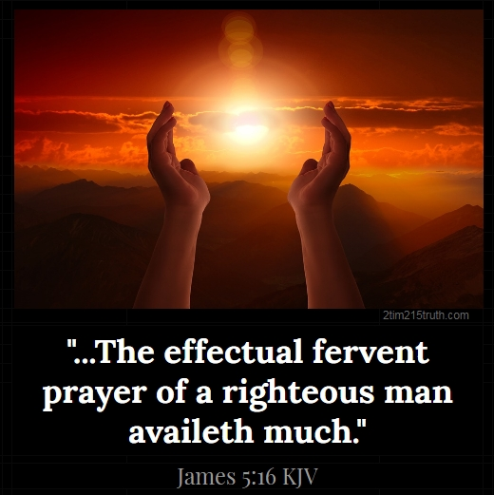
INTERCESSION

Slide 26
TITHES AND OFFERING
Kindly pay via one of the following options:
Your phone
Bank transfer to
Cash
IBAN: NL90ABNA0416385699
Remarks: Tithes (name of region)
“… God loves a cheerful giver”
- 2 Corinthians 9:7

Slide 27


Slide 28





COUNSELLING
SERVICE SCHEDULES
Service | Day | Timing | Remarks
Worship Service | Sunday | 09:45-12:00 | Physical/Online
Bible Study | Tuesday | 19:30-20:30 | Online
Revival Service | Friday | 19:30-21:00 | Online/Physical
Night Vigil | Friday | 19:30-23:30 | First Friday Monthly
If you have questions or need guidance on challenging issues, kindly request for counselling.
Our pastor is here for you.
CONTACT
+31 207 856 683
info@deeperlife.nl
LOCATION DETAILS
Location | Telephone # | ZOOM Meeting ID
Amsterdam | +31 686 093 624 | 795-674-627
Eindhoven | +31 643 678 896 | 912-749-784
The Hague | +31 685 076 861 | 818-6898-8436
dclmnetherlands
www.dclm-nl.org

Slide 29
LESSON 31:
Joseph’s Interpretation of Dreams and His Elevation
STS STUDY FOR NEXT WEEK:
MEMORY VERSE: ……
  “And Pharaoh said unto Joseph, Forasmuch as God hath shewed thee all this, there is none so discreet and wise as thou art: Thou shalt be over my house, and according unto thy word shall all my people be ruled: only in the throne will I be greater than thou” (Genesis 41:39,40).
TEXT: Genesis 40:1-23; 41:1-57

Slide 30


Slide 32


Slide 33


Slide 34

CHOIR

Slide 35

CONNECTION TO GCK

Slide 36

TIME TO PRAY

