Slide 1
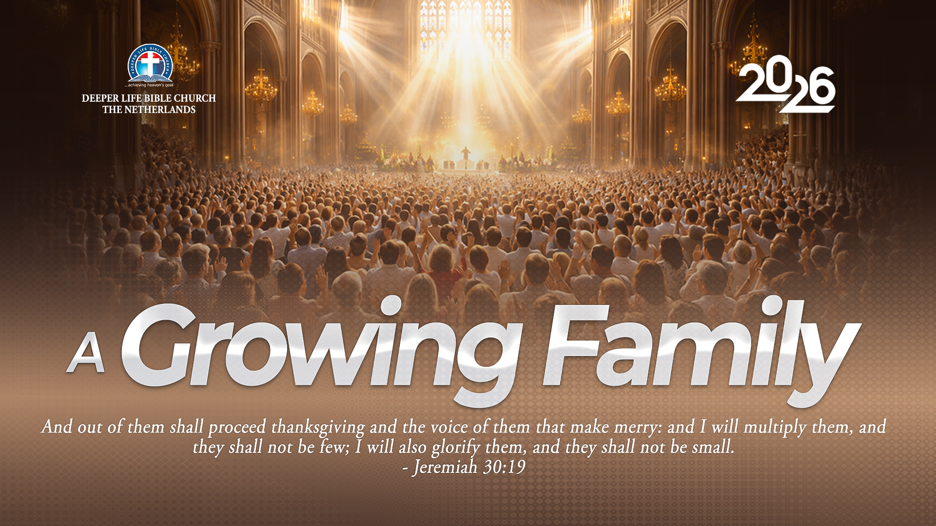
SUPER SUNDAY SERVICE
09-08-2026

Slide 2
HYMN
GHS 179: HIGHER GROUND

Slide 3
HIGHER GROUND [GHS 179]
1.
I’m pressing on the upward way,
New heights I’m gaining everyday;
Still praying as I onward bound,
Lord, plant my feet on higher ground.

Slide 4
Lord, lift me up, and let me stand
By faith on heaven’s table land;
A higher plane than I have found,
Lord, plant my feet on higher ground.

Slide 5
HIGHER GROUND [GHS 179]
2.
My heart has no desire to stay
Where doubts arise, and fears dismay;
Tho’ some may dwell where these abound,
My pray’r my aim is higher ground.

Slide 6
Lord, lift me up, and let me stand
By faith on heaven’s table land;
A higher plane than I have found,
Lord, plant my feet on higher ground.

Slide 7
HIGHER GROUND [GHS 179]
3.
I want to live above the world,
Though Satan’s darts at me are hurled
But still I’ll pray till heav’n I’ve found:
“Lord, lead me on to higher ground.”

Slide 8
Lord, lift me up, and let me stand
By faith on heaven’s table land;
A higher plane than I have found,
Lord, plant my feet on higher ground.

Slide 9
HIGHER GROUND [GHS 179]
4.
I want to scale the utmost height,
And catch a gleam of glory bright;
For faith has caught the joyful sound,
The song of saints on higher ground.

Slide 10
Lord, lift me up, and let me stand
By faith on heaven’s table land;
A higher plane than I have found,
Lord, plant my feet on higher ground.

Slide 11

SEARCH THE SCRIPTURES
09-08-2026

Slide 12
REVIEW OF THE ASSIGNMENT FROM LAST STUDY
A sister in your church has been in a relationship with an unbeliever for several years and now wants to marry him because he is loving, responsible and promises to attend church after the wedding. Using the Scriptures, counsel her on God’s standard for marriage.
Volunteers please!
Judah’s Moral Slip

Slide 13
REVIEW OF THE ASSIGNMENT FROM LAST STUDY – Option 2
A Christian who fell into sexual immorality believes God can never forgive or use him again. Using the examples of Judah and David, explain what the Bible teaches about genuine repentance, forgiveness and restoration.
Volunteers please!
Judah’s Moral Slip

Slide 14
LESSON 31: Joseph’s Interpretation of Dreams and His Elevation
MEMORY VERSE: ……
  “And Pharaoh said unto Joseph, Forasmuch as God hath shewed thee all this, there is none so discreet and wise as thou art: Thou shalt be over my house, and according unto thy word shall all my people be ruled: only in the throne will I be greater than thou” (Genesis 41:39,40).
TEXT: Genesis 40:1-23; 41:1-57

Slide 15
INTRODUCTION
Today’s lesson focuses on the story of Joseph, who, though imprisoned for a crime he did not commit, maintained his integrity and faithfulness. His exemplary character earned him the trust of the prison authorities, and he was put in charge of other inmates. Joseph interpreted dreams for Pharaoh’s chief butler and baker, correctly predicting their fates. Later, when Pharaoh was troubled by dreams, the butler remembered Joseph, who was summoned to interpret them. Joseph’s insightful interpretation and wise counsel impressed Pharaoh, leading to Joseph’s promotion and empowerment in Egypt.

Slide 16
Joseph’s Interpretation of Dreams and His Elevation
KEY LESSONS IN THE STUDY OF TODAY
We should remain faithful in difficult situations.
Serve the Lord faithfully wherever He places you.
Interpretation of dreams comes from God, so all glory must be given to Him. We should maintain a humble disposition like Joseph did.
God sometimes uses waiting and adversity to prepare His people.
Your God-given gifts can open doors for greater opportunities.
Use today’s opportunities to prepare for tomorrow’s needs.
Notes:
Joseph was imprisoned despite his innocence, yet he maintained his integrity.

Slide 17
QUESTION 1
What should be the attitude of a believer in times of adversity?
James 1:2-3; 1 Peter 5:7; Psalm 46:1

Slide 18
QUESTION 2
What should be our attitude to dreams, and what caution should we exercise about them?
Ecclesiastes 5:3,7; Isaiah 8:20

Slide 19
QUESTION 3
Why does God speak through dreams, especially to the heathen?
Job 33:14-17,23,24

Slide 20
QUESTION 4
Mention the three essentials in Joseph’s interpretation and counsel.
Genesis 41:25,29,30,33,35

Slide 21
QUESTION 5
What is the similarity between Pharaoh’s dream and the current state of the world?
Matthew 24:21; 28:18,19

Slide 22
QUESTION 6
Mention some success qualities in Joseph and how you can apply them to the task of soul-winning.
Genesis 45:7; Genesis 41:33-35, 37

Slide 23
QUESTION 7
How did Joseph overcome his adversaries?
Gen 50:20; Gen 45:4,5,7; Gen 39:7-9

Slide 24
CONCLUSION
Joseph’s interpretation of Pharaoh’s dream, guided by God’s Spirit, led to his appointment as Egypt’s second ruler. Pharaoh’s dream reflects our current state, where we are in a period of grace empowered by the Holy Spirit to win souls for the Kingdom. With a time of tribulation approaching, it is crucial to seize every opportunity to save sinners, much like visionary individuals such as Joseph.

Slide 25
ASSIGNMENT
i) Reading about the life of Joseph from prison to Prime Minister, how can you encourage a believer going through a tough time? Support your answer with scriptures.
ii) How can you use your God-given gift(s) for the salvation of souls and the expansion of God’s kingdom? Give a recent incident.

Slide 26


SEARCH THE SCRIPTURES SUMMARY

Slide 27
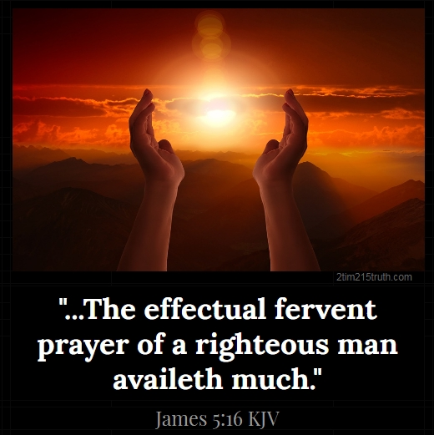
INTERCESSION

Slide 28
TITHES AND OFFERING
Kindly pay via one of the following options:
Your phone
Bank transfer to
Cash
IBAN: NL90ABNA0416385699
Remarks: Tithes (name of region)
“… God loves a cheerful giver”
- 2 Corinthians 9:7

Slide 29
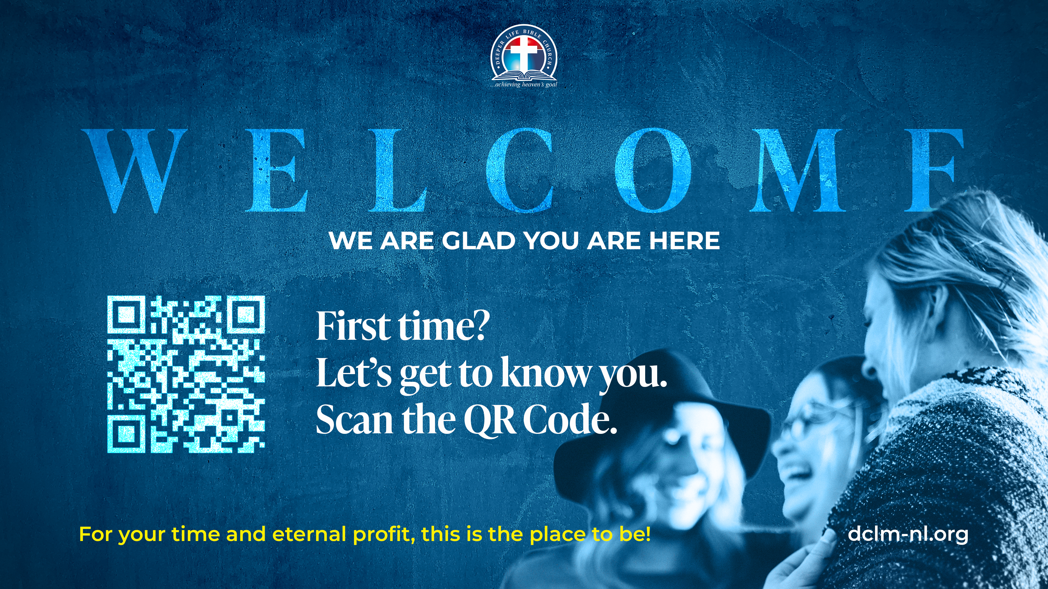

Slide 30





COUNSELLING
SERVICE SCHEDULES
Service | Day | Timing | Remarks
Worship Service | Sunday | 09:45-12:00 | Physical/Online
Bible Study | Tuesday | 19:30-20:30 | Online
Revival Service | Friday | 19:30-21:00 | Online/Physical
Night Vigil | Friday | 19:30-23:30 | First Friday Monthly
If you have questions or need guidance on challenging issues, kindly request for counselling.
Our pastor is here for you.
CONTACT
+31 207 856 683
info@deeperlife.nl
LOCATION DETAILS
Location | Telephone # | ZOOM Meeting ID
Amsterdam | +31 686 093 624 | 795-674-627
Eindhoven | +31 643 678 896 | 912-749-784
The Hague | +31 685 076 861 | 818-6898-8436
dclmnetherlands
www.dclm-nl.org

Slide 31


Slide 32
LESSON 32:
Joseph’s Encounter with His Brethren
STS STUDY FOR NEXT WEEK:
MEMORY VERSE: ……
  “And Joseph said unto his brethren... I am Joseph your brother, whom ye sold into Egypt. Now therefore be not grieved, nor angry with yourselves, that ye sold me hither: for God did send me before you to preserve life” (Genesis 45:4,5)
TEXT: Genesis chapters 42 to 45

Slide 33


Slide 34

NH Conference Centre Koningshof, Locht 113a Veldhoven

Slide 35

NOTE:
Regular registration
closes on 15 September; after this date, a surcharge of €75 per participant from 12 years up and €50 per child from 3-11 will apply.

Slide 36


2 Peter 3:18
Notes:
s

Slide 37
HYMN
GHS 216: MORE ABOUT JESUS WOULD I KNOW

Slide 38
MORE ABOUT JESUS WOULD I KNOW [GHS 216]
1.
More about Jesus would I know,
More of His grace to others show;
More of His saving fulness see,
More of His love who died for me.

Slide 39
More, more about Jesus,
More, more about Jesus:
More of His saving fulness see,
More of His love who died for me.

Slide 40
MORE ABOUT JESUS WOULD I KNOW [GHS 216]
2.
More about Jesus let me learn,
More of His holy will discern;
Spirit of God, my Teacher be,
Showing the things of Christ to me.

Slide 41
More, more about Jesus,
More, more about Jesus:
More of His saving fulness see,
More of His love who died for me.

Slide 42
MORE ABOUT JESUS WOULD I KNOW [GHS 216]
3.
More about Jesus, in His Word,
Holding communion with my Lord;
Hearing His voice in every line,
Making each faithful saying mine.

Slide 43
More, more about Jesus,
More, more about Jesus:
More of His saving fulness see,
More of His love who died for me.

Slide 44
MORE ABOUT JESUS WOULD I KNOW [GHS 216]
4.
More about Jesus on His throne,
Riches in glory all His own;
More of His kingdom’s sure increase;
More of His coming, Prince of Peace.

Slide 45
More, more about Jesus,
More, more about Jesus:
More of His saving fulness see,
More of His love who died for me.

Slide 46

CHOIR

Slide 47
TODAY’S SERMON
PREPARATION FOR SPIRITUAL GROWTH

Slide 48

TIME TO PRAY

