Slide 1
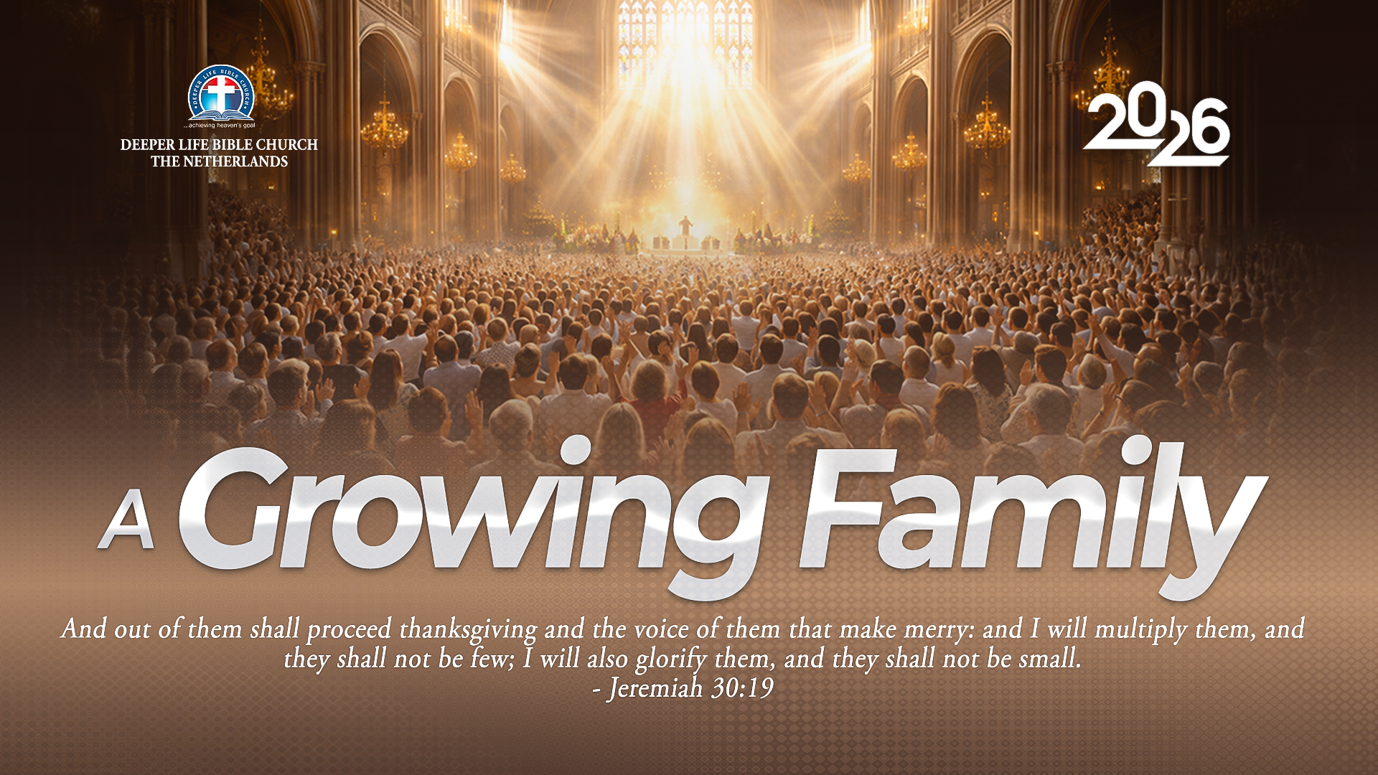
SUPER SUDAY SERVICE
23-08-2026

Slide 2
HYMN
GHS 022: SIMPLY TRUSTING EVERYDAY

Slide 3
SIMPLY TRUSTING EVERYDAY [GHS 022]
1.
Simply trusting ev’ry day,
Trusting through a stormy way;
Even when my faith is small,
Trusting Jesus, that is all.
Trusting as the moments fly,
Trusting as the days go by;
Trusting Him whate’er befall,
Trusting Jesus, that is all.

Slide 4
SIMPLY TRUSTING EVERYDAY [GHS 022]
2.
Brightly doth His Spirit shine
Into this poor heart of mine;
While He leads I cannot fall;
Trusting Jesus, that is all.
Trusting as the moments fly,
Trusting as the days go by;
Trusting Him whate’er befall,
Trusting Jesus, that is all.

Slide 5
SIMPLY TRUSTING EVERYDAY [GHS 022]
3.
Singing if my way be clear;
Praying if the path be drear;
If in danger, for Him call;
Trusting Jesus, that is all.
Trusting as the moments fly,
Trusting as the days go by;
Trusting Him whate’er befall,
Trusting Jesus, that is all.

Slide 6
SIMPLY TRUSTING EVERYDAY [GHS 022]
4.
Trusting Him while life shall last,
Trusting Him till earth be past;
Till within the jasper wall:
Trusting Jesus, that is all.
Trusting as the moments fly,
Trusting as the days go by;
Trusting Him whate’er befall,
Trusting Jesus, that is all.

Slide 7

SEARCH THE SCRIPTURES
23-08-2026

Slide 8
REVIEW OF OUR ASSIGNMENT OF LAST STUDY
You have been informed that a so-called brother whom you work together with reported you to the church leadership for what you know you did not do. Now, this same brother has come to you for urgent financial assistance to resolve a pressing need. How will you handle the situation in the light of today’s study? Prepare to share your answers next week.
Joseph’s Encounter With His Brethren

Slide 9
LESSON 33: JACOB MOVES TO EGYPT
MEMORY VERSE: ……
  “I will go down with thee into Egypt; and I will also surely bring thee up again: and Joseph shall put his hand upon thine eyes.” (Gen 46:4).
TEXTS: Genesis 46:1-34; Genesis 47:1-31

Slide 10
INTRODUCTION
In the previous lesson, Joseph revealed himself to his brethren and invited his father Jacob and his household to come to Egypt because of the famine (Genesis 45:5-15). Before continuing the journey, Jacob worshipped God at Beersheba, and God assured him of His presence and promise to make him a great nation (Genesis 46:3-4). Jacob and his family then moved to Egypt and settled in Goshen according to God's plan. This study teaches believers to seek God's guidance, trust His promises and remain faithful in every circumstance.

Slide 11
Gen 46:1-7; Gen 47:11-26-31; Isaiah 60:22; Jerem 30:19; Acts:16:31-34
KEY LESSONS IN THE STUDY OF TODAY
God remains faithful to His covenant and fulfils His promises despite difficult circumstances.
God guides and assures His children who seek His will before making important decisions.
Believers should maintain family worship and complete obedience to God's direction.
God blesses and preserves His people when they trust and follow His divine plan.
Wisdom, integrity and faithful stewardship bring blessing to both God's people and society.
Believers should live by faith, remembering God's promises until the end of life.

Slide 12
QUESTION 1
Why should believers seek the face of God in any life’s decision?
Gen 46:1-4; Prov 3:5-6; James 1:5

Slide 13
QUESTION 2
What historical significance has Beersheba in the Bible?
Gen 21:14-19, 32-34; Gen 26:23-25

Slide 14
QUESTION 3
What encouragement can believers derive from Israel’s multiplication from a small number to a mighty nation? Gen 46:27; Isaiah 60:22; Jerem 30:19

Slide 15
QUESTION 4
What can believers learn from the way Joseph heartily forgave his wicked brethren? Gen 45:3-5; Gen 47:11-12; Matt 6:14-15

Slide 16
QUESTION 5
Mention four attributes of faithfulness believers can emulate in Joseph’s handling of the Egyptian crisis?
Gen 47:13-14,22, 26; Prov 11:26; Luke 16:10

Slide 17
QUESTION 6
How should believers carry out their business and relate with people generally, including our persecutors? Gen 47:14-17; Rom 12:17-21;Gal 6:10

Slide 18
QUESTION 7
How was Joseph able to overcome his temptations and trials?
Gen 39:7-12; Acts 7:9; James 1:12

Slide 19
CONCLUSION
God fulfilled His promise by leading Jacob safely to Egypt and preserving his household according to His covenant. Jacob sought God's guidance before taking a major decision, while Joseph demonstrated forgiveness, wisdom, faithfulness and integrity in leadership. Believers should always seek God's direction, trust His promises, forgive others, remain faithful in stewardship and keep their focus on the eternal inheritance rather than earthly prosperity.

Slide 20
ASSIGNMENT
1.Mention some attributes of Joseph that every believer should emulate, giving relevant Bible references and its application in our Christian journey.
2. Explain three lessons believer should learn from Jacob's journey to Egypt and Joseph's management of the famine, support your answers with relevant Bible references.

Slide 21


SEARCH THE SCRIPTURES SUMMARY

Slide 22
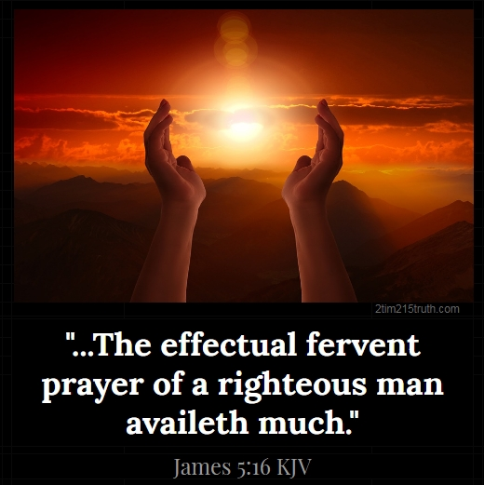
INTERCESSION

Slide 23
TITHES AND OFFERING
Kindly pay via one of the following options:
Your phone
Bank transfer to
Cash
IBAN: NL90ABNA0416385699
Remarks: Tithes (name of region)
“… God loves a cheerful giver”
- 2 Corinthians 9:7

Slide 24


Slide 25





COUNSELLING
SERVICE SCHEDULES
Service | Day | Timing | Remarks
Worship Service | Sunday | 09:45-12:00 | Physical/Online
Bible Study | Tuesday | 19:30-20:30 | Online
Revival Service | Friday | 19:30-21:00 | Online/Physical
Night Vigil | Friday | 19:30-23:30 | First Friday Monthly
If you have questions or need guidance on challenging issues, kindly request for counselling.
Our pastor is here for you.
CONTACT
+31 207 856 683
info@deeperlife.nl
LOCATION DETAILS
Location | Telephone # | ZOOM Meeting ID
Amsterdam | +31 686 093 624 | 795-674-627
Eindhoven | +31 643 678 896 | 912-749-784
The Hague | +31 685 076 861 | 818-6898-8436
dclmnetherlands
www.dclm-nl.org

Slide 26


Slide 27
LESSON 34:
Christ Feeds the Multitudes
STS STUDY FOR NEXT WEEK:
MEMORY VERSE: ……
  “And they did all eat, and were filled: and they took up of the fragments that remained twelve baskets full” (Matthew 14:20)
TEXT: Matthew 14: 14-21; Luke 9:11-17; Mark 8: 1

Slide 28


Slide 29

NH Conference Centre Koningshof, Locht 113a Veldhoven

Slide 30

NOTE:
Regular registration
closes on 15 September; after this date, a surcharge of €75 per participant from 12 years up and €50 per child from 3-11 will apply.

Slide 31
CONNECTION
TO NATIONAL COMBINED SERVICE
@ 10:45am today

Slide 32
NATIONAL PRAYER SESSION

Slide 33


Numbers 10:1-36
Notes:
s

Slide 34
HYMN
WE’RE MARCHING TO ZION

Slide 35
WE’RE MARCHING TO ZION
1.
Come, we that love the Lord,
And let our joys be known;
Join in a song with sweet accord,
Join in a song with sweet accord
And thus surround the throne,
And thus surround the throne.

Slide 36
We’re marching to Zion,
Beautiful, beautiful Zion;
We’re marching upward to Zion,
The beautiful city of God.

Slide 37
WE’RE MARCHING TO ZION
2.
Let those refuse to sing
Who never knew our God;
But children of the heav’nly King,
But children of the heav’nly King,
May speak their joys abroad,
May speak their joys abroad.

Slide 38
We’re marching to Zion,
Beautiful, beautiful Zion;
We’re marching upward to Zion,
The beautiful city of God.

Slide 39
WE’RE MARCHING TO ZION
3.
The hill of Zion yields,
A thousand sacred sweets
Before we reach the heav’nly field,
Before we reach the heav’nly field
Or walk the golden streets,
Or walk the golden streets.

Slide 40
We’re marching to Zion,
Beautiful, beautiful Zion;
We’re marching upward to Zion,
The beautiful city of God.

Slide 41
WE’RE MARCHING TO ZION
4.
Then let our songs abound,
And every tear be dry;
We’re marching thro’ Immanuel’s ground,
We’re marching thro’ Immanuel’s ground,
To fairer worlds on high,
To fairer worlds on high.

Slide 42
We’re marching to Zion,
Beautiful, beautiful Zion;
We’re marching upward to Zion,
The beautiful city of God.

Slide 43

CHOIR

Slide 44
MESSAGE

Slide 45

TIME TO PRAY

