Slide 1
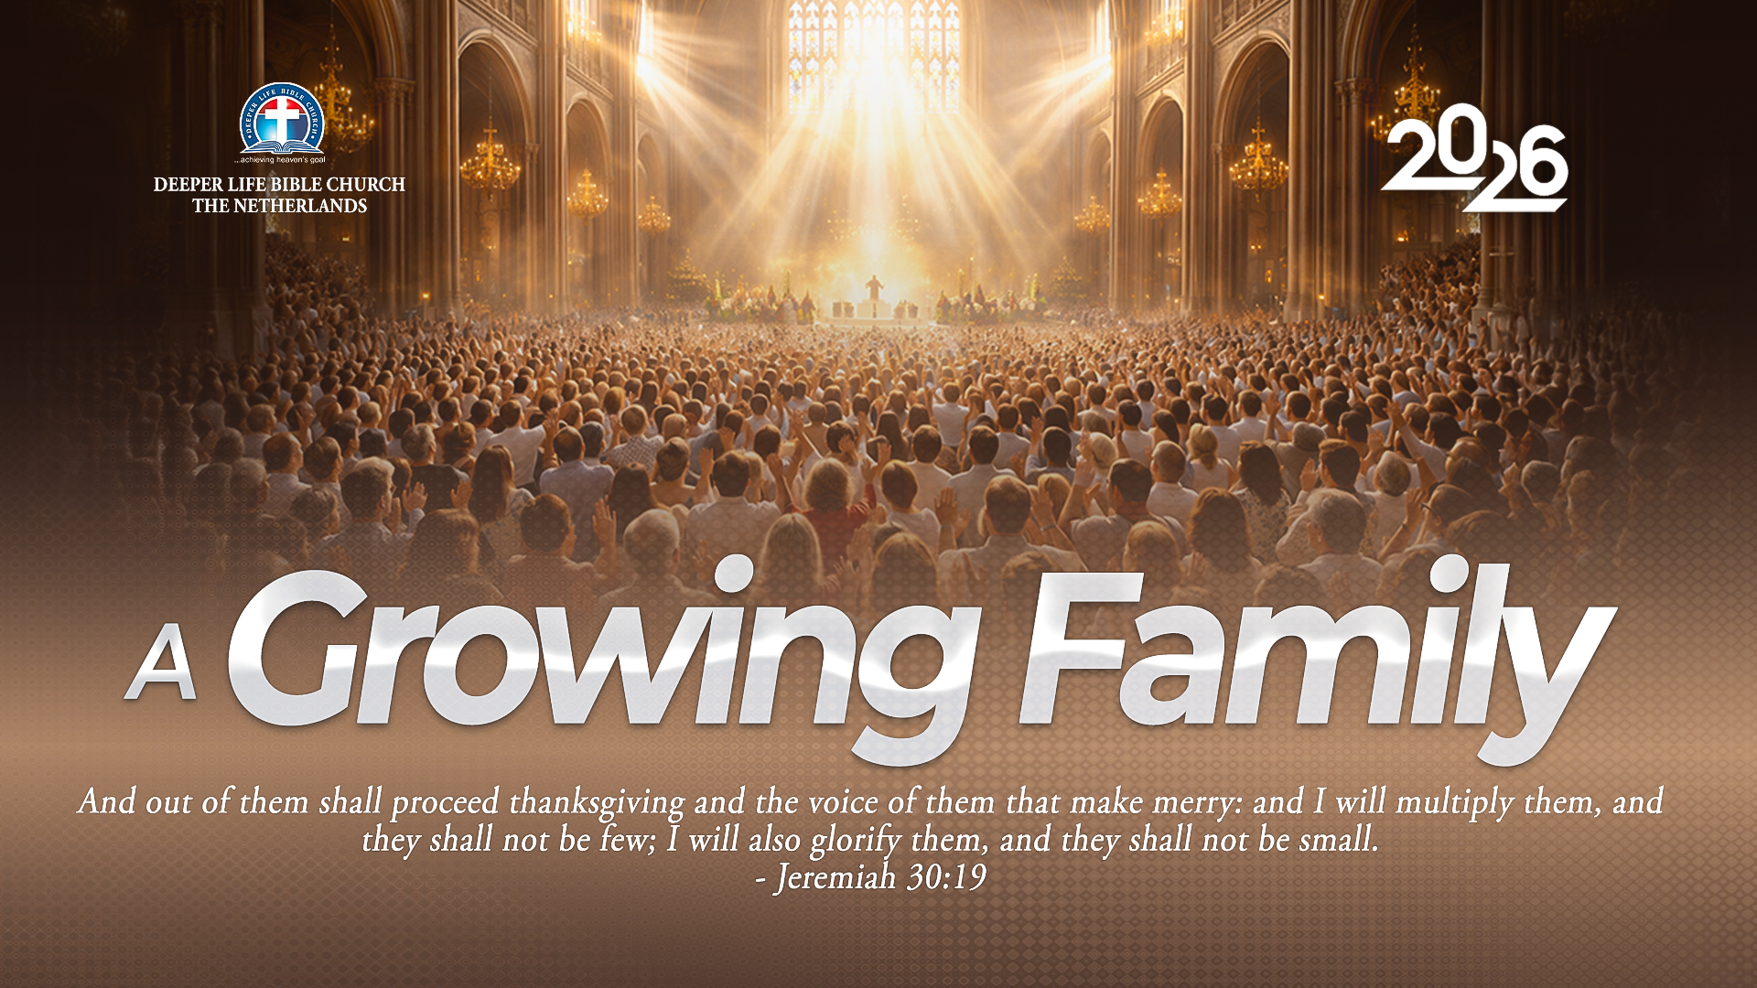
SUPER SUNDAY SERVICE
13-09-2026

Slide 2
HYMN
GHS 078: FAITH OF OUR FATHERS

Slide 3
FAITH OF OUR FATHERS [GHS 078]
1.
Faith of our fathers! living still
In spite of dungeon, fire and sword,
O how our hearts beat high with joy
Whene’er we hear that glorious word!
Faith of our fathers, holy faith!
We will be true to Thee till death.

Slide 4
FAITH OF OUR FATHERS [GHS 078]
2.
Faith of our fathers! we will strive
To win all nations unto Thee;
And through the truth that comes from God
Mankind shall then be truly free;
Faith of our fathers, holy faith!
We will be true to Thee till death.

Slide 5
FAITH OF OUR FATHERS [GHS 078]
3.
Faith of our fathers! we will love
Both friend and foe in all our strife,
And preach Thee, too, as love knows how
By kindly words and virtuous life.
Faith of our fathers, holy faith!
We will be true to Thee till death.

Slide 6

SEARCH THE SCRIPTURES
13-09-2026

Slide 7
REVIEW OF THE ASSIGNMENT FROM LAST STUDY
In what ways can you help a fellow Christian who is currently going through a storm (it could be a sudden health crisis, broken relationship or financial challenge)? Use the Scriptures and Scriptural principles to support your answer.
Christ’s Power over Nature

Slide 8
LESSON 36:
Christ exalts God’s commandments over traditions
MEMORY VERSE: ……
  “This people draweth nigh unto me with their mouth, and honoureth me with their lips; but their heart is far from me. But in vain they do worship me, teaching for doctrines the commandments of men.”
  (Matthew 15:8–9).
TEXT: Matthew 15:1–39

Slide 9
INTRODUCTION
Today’s study focuses on the scribes and Pharisees corrupt habit of misrepresenting and substituting God’s word with their ideas, ceremonial traditions and preferences. Jesus exposed their error: they placed human rules above God’s commandments and used religion observances to avoid genuine obedience. Christ taught that defilement comes from a sinful heart, not outward practices.
Those who approached Christ with humility and faith received mercy, healing and provision. This lesson affirms that Scripture is supreme over culture, tradition, practices of human institution and personal opinion (Mat 15:3–9; Col 2:8; 2 Tim 3:16–17).

Slide 10
Christ exalts God’s commandments over traditions
KEY LESSONS IN THE STUDY OF TODAY
God’s Word is the final authority; every tradition and practice must agree with Scripture.
Outward religion is empty without inward repentance, holiness and sincere obedience
Sin begins in the heart; therefore, everyone needs salvation and spiritual cleansing through Christ.
Believers must honour their parents and receive biblical correction with humility.
Humble faith receives divine mercy, while true Christian ministry combines sound teaching, compassion and practical care.

Slide 11
QUESTION 1
Who were the scribes and Pharisees?
Matthew 15:1–9; Ezra 7:6, 10; Matthew 23:2–7; Luke 11:43–46
Notes:
The scribes were teachers and interpreters of the Law, while the Pharisees were a strict religious group devoted to the Law and the traditions of the elders.
Many became hypocritical by placing human traditions above God’s commandments and outward religion above inward holiness.

Slide 12
QUESTION 2
Why are believers forbidden from adding to or subtracting from Scripture?
Deuteronomy 4:2; Proverbs 30:5–6; Revelation 22:18–19; 2 Timothy 3:16–17
Notes:
God’s Word is complete and authoritative; adding human rules or removing its commands corrupts the truth.
Believers may explain Scripture, but every teaching must remain faithful to its full meaning.

Slide 13
QUESTION 3
What are the characteristics of present-day Pharisees?
Matthew 23:25–28; Luke 18:9–14; Matthew 7:3–5; 2 Timothy 3:5
Notes:
Present-day Pharisees emphasise outward religion, condemn others while excusing themselves, elevate personal traditions above Scripture, and seek human praise rather than God’s approval.
They resist correction, lack humility and compassion, and perform religious duties without genuine love for God; therefore, believers must examine themselves honestly.

Slide 14
QUESTION 4
What lessons can believers learn from the way Jesus rebuked the Pharisees? Matthew 15:3–9; Galatians 6:1; 2 Timothy 2:24–26; Titus 1:9–13
Notes:
Jesus corrected their error directly from Scripture, exposing traditions that contradicted God’s commandment and misled others.
Believers should likewise correct error with truth, humility and love, seeking restoration rather than humiliation.

Slide 15
QUESTION 5
According to Christ’s teaching, what actually defiles a person? Matthew 15:18–20; Proverbs 4:23
Mark 7:20–23; Ezekiel 36:25–27
Notes:
True defilement comes from a sinful heart, not from failure to observe outward ceremonies.
Only repentance, faith in Christ, and holy living can cleanse the heart, while believers must still avoid harmful and sinful practices.

Slide 16
QUESTION 6
Mention some traditions of men which believers must avoid.
Matthew 15:3–9; Colossians 2:8
Titus 1:14; 1 Peter 1:18–19
Notes:
Believers must reject traditions involving superstition, idolatry, immorality, injustice, discrimination, neglect of duty, or teachings that place human authority above Scripture.
A tradition becomes unacceptable when it contradicts God’s Word, promotes sin, or imposes rules where Scripture gives liberty.

Slide 17
QUESTION 7
What can believers learn from the recipients of miracles in the text? Matthew 15:21–28; 15:29–31; 15:32–38; Hebrews 11:6
Notes:
The Canaanite woman persevered in humble faith until Christ answered her, while the multitudes remained to hear His Word and witnessed His healing power.
Their examples teach us to seek Christ sincerely, pray persistently, trust His compassion, and glorify God for both spiritual and physical help.

Slide 18
CONCLUSION
God’s Word is above every human tradition, cultural expectation and religious preference. Traditions must never replace or contradict Scripture.
True worship requires sincere obedience, humility and inward holiness; not merely outward religion. We must test every belief and practice by God’s Word, reject customs that promote sin or hypocrisy, and seek Christ with faith and perseverance to receive His mercy and transforming grace.

Slide 19
ASSIGNMENT
A Christian family observes a long-standing cultural tradition that conflicts with a clear biblical command. Family members insist that refusing the practice would dishonour their parents and community.
How should the believer respond to this with truth, humility and love? Explain how to distinguish between an acceptable cultural custom and an unscriptural tradition.
Be ready to share your answer with Bible references.

Slide 20


SEARCH THE SCRIPTURES SUMMARY

Slide 21
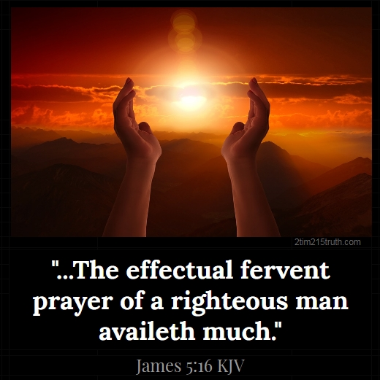
INTERCESSION

Slide 22
TITHES AND OFFERING
Kindly pay via one of the following options:
Your phone
Bank transfer to
Cash
IBAN: NL90ABNA0416385699
Remarks: Tithes (name of region)
“… God loves a cheerful giver”
- 2 Corinthians 9:7

Slide 23
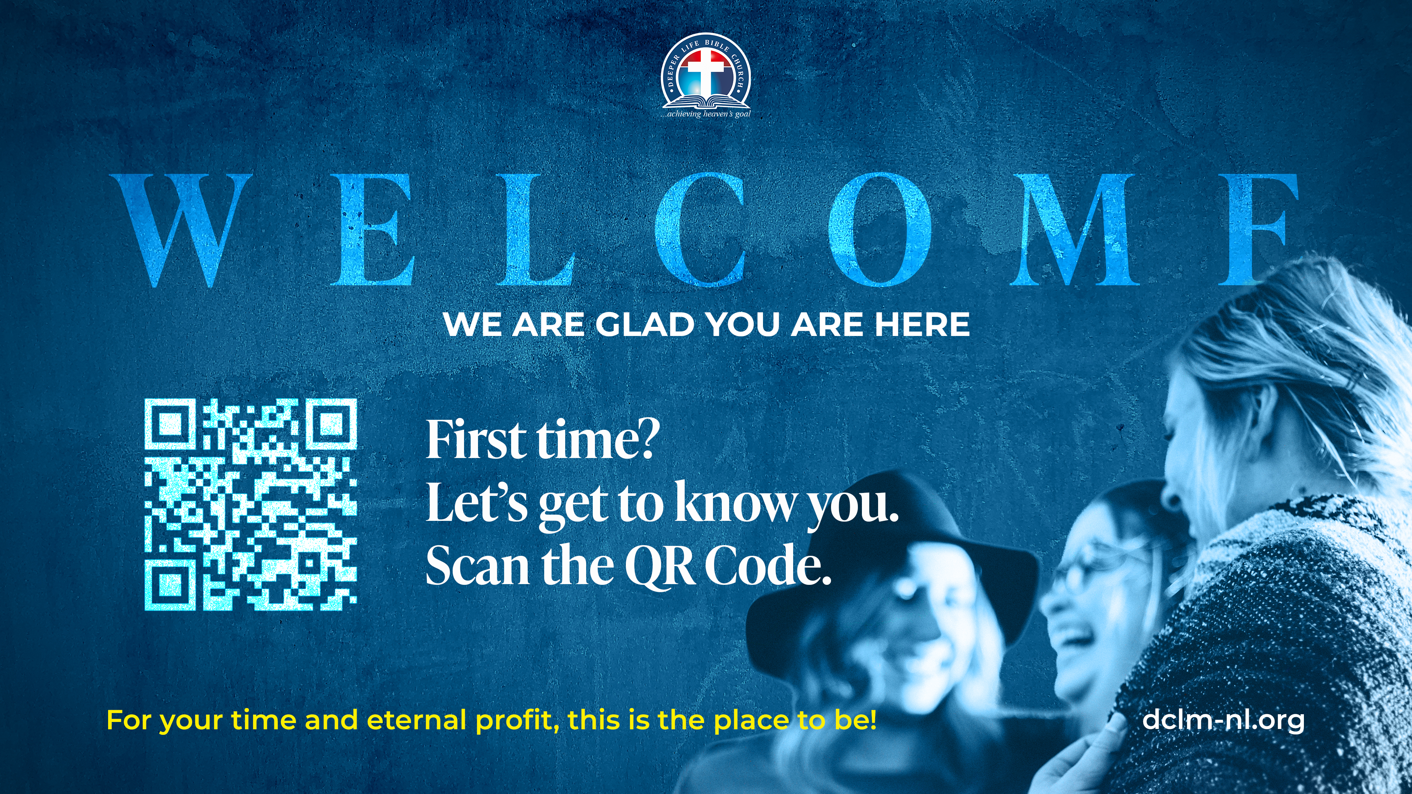

Slide 24





COUNSELLING
SERVICE SCHEDULES
Service | Day | Timing | Remarks
Worship Service | Sunday | 09:45-12:00 | Physical/Online
Bible Study | Tuesday | 19:30-20:30 | Online
Revival Service | Friday | 19:30-21:00 | Online/Physical
Night Vigil | Friday | 19:30-23:30 | First Friday Monthly
If you have questions or need guidance on challenging issues, kindly request for counselling.
Our pastor is here for you.
CONTACT
+31 207 856 683
info@deeperlife.nl
LOCATION DETAILS
Location | Telephone # | ZOOM Meeting ID
Amsterdam | +31 686 093 624 | 795-674-627
Eindhoven | +31 643 678 896 | 912-749-784
The Hague | +31 685 076 861 | 818-6898-8436
dclmnetherlands
www.dclm-nl.org

Slide 25
LESSON 37:
Peter Confesses Christ
STS STUDY FOR NEXT WEEK:
MEMORY VERSE: ……
  And Simon Peter answered and said, Thou art the Christ, the Son of the living God.”
  (Matthew 16:16).
TEXT: Matthew 16:1–28; Mark 8:27–30; Luke 9:18–27; 18:31–34

Slide 26

NH Conference Centre Koningshof, Locht 113a Veldhoven

Slide 27


Slide 28


1 Timothy 5:1-25
Notes:
s

Slide 29
HYMN
GHS 258: O TO BE LIKE THEE

Slide 30
O! TO BE LIKE THEE [GHS 258]
1.
O! to be like Thee, blessed Redeemer,
This is my constant longing and prayer;
Gladly I’ll forfeit all of earth’s treasures,
Jesus, Thy perfect likeness to wear.

Slide 31
O! to be like Thee,
O! to be like Thee,
Blessed Redeemer,
Pure as Thou art;
Come in Thy sweetness,
come in Thy fulness;
Stamp Thine own image
Deep on my heart.

Slide 32
O! TO BE LIKE THEE [GHS 258]
2.
O! to be like Thee, full of compassion,
Loving, forgiving, tender and kind,
Helping the helpless, cheering the fainting,
Seeking the wand’ring sinner to find.

Slide 33
O! to be like Thee,
O! to be like Thee,
Blessed Redeemer,
Pure as Thou art;
Come in Thy sweetness,
come in Thy fulness;
Stamp Thine own image
Deep on my heart.

Slide 34
O! TO BE LIKE THEE [GHS 258]
3.
O! to be like Thee, lowly in spirit,
Holy and harmless, patient and brave;
Meekly enduring cruel reproaches,
Willing to suffer, others to save.

Slide 35
O! to be like Thee,
O! to be like Thee,
Blessed Redeemer,
Pure as Thou art;
Come in Thy sweetness,
come in Thy fulness;
Stamp Thine own image
Deep on my heart.

Slide 36
O! TO BE LIKE THEE [GHS 258]
4.
O! to be like Thee, Lord, I am coming,
Now to receive th’ anointing divine,
All that I am and have I am bringing,
Lord, from this moment all shall be Thine.

Slide 37
O! to be like Thee,
O! to be like Thee,
Blessed Redeemer,
Pure as Thou art;
Come in Thy sweetness,
come in Thy fulness;
Stamp Thine own image
Deep on my heart.

Slide 38
O! TO BE LIKE THEE [GHS 258]
5.
O! to be like Thee, while I am pleading,
Pour out Thy Spirit, fill with Thy love,
Make me a temple meet for Thy dwelling,
Fit me for life and heaven above.

Slide 39
O! to be like Thee,
O! to be like Thee,
Blessed Redeemer,
Pure as Thou art;
Come in Thy sweetness,
come in Thy fulness;
Stamp Thine own image
Deep on my heart.

Slide 40

CHOIR

Slide 41
TODAY’S SERMON
RULE OF COURTESY IN THE HOUSEHOLD OF GOD

Slide 42

TIME TO PRAY

