Slide 1
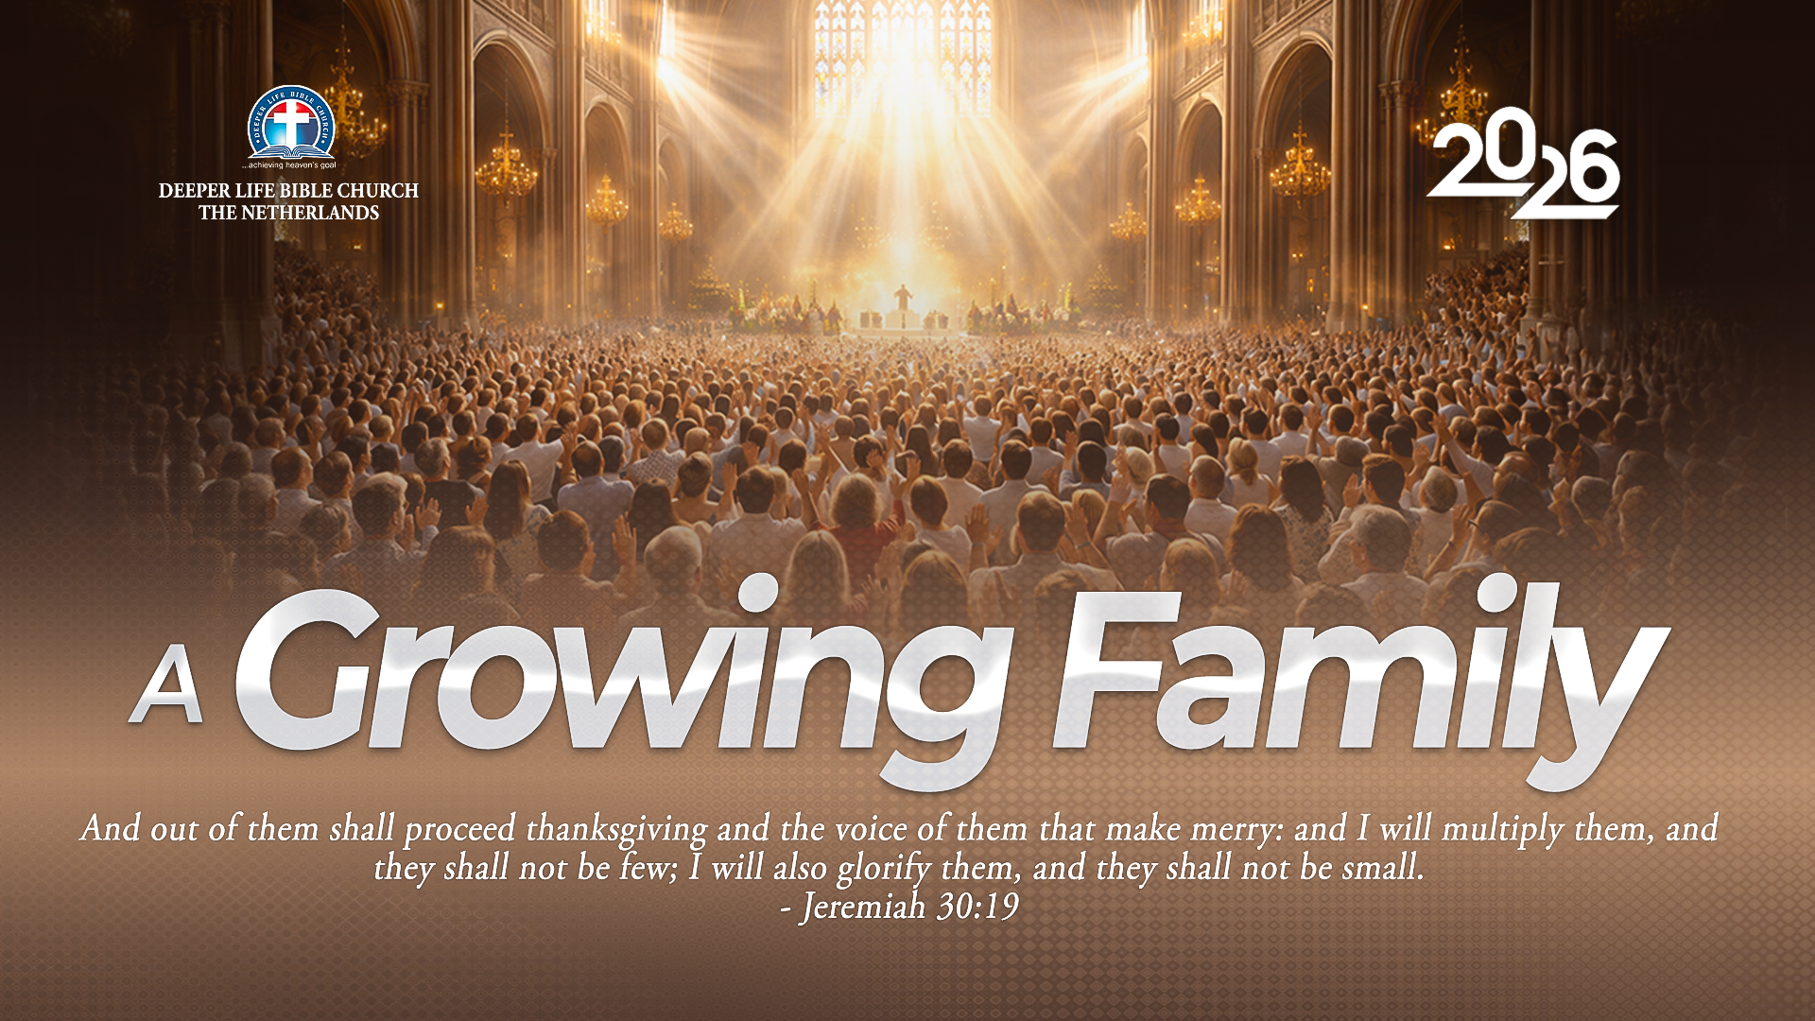
SUPER SUNDAY SERVICE
01-11-2026

Slide 2
HYMN
GHS 207: THERE’S A GREAT DAY COMING

Slide 3
THERE’S A GREAT DAY COMING [GHS 207]
1.
There’s a great day coming
A great day coming
There’s a great day coming by and by
When the saints and the sinners shall be
Parted right and left
Are you ready for that day to come?

Slide 4
Are you ready? Are you ready?
Are you ready for the judgment day?
Are you ready? Are you ready?
For the judgment day?

Slide 5
THERE’S A GREAT DAY COMING [GHS 207]
2.
There’s a bright day coming
A bright day coming
There’s a bright day coming by and by;
But its brightness shall only come
To them that love the Lord,
Are you ready for that day to come?

Slide 6
Are you ready? Are you ready?
Are you ready for the judgment day?
Are you ready? Are you ready?
For the judgment day?

Slide 7
THERE’S A GREAT DAY COMING [GHS 207]
3.
There’s a sad day coming
A sad day coming
There’s a sad day coming by and by
When the sinner shall hear his doom
“Depart, I know ye not,”
Are you ready for that day to come?

Slide 8
Are you ready? Are you ready?
Are you ready for the judgment day?
Are you ready? Are you ready?
For the judgment day?

Slide 9

SEARCH THE SCRIPTURES
01-11-2026

Slide 10
REVIEW OF THE ASSIGNMENT FROM LAST STUDY
You have just prayed through to the will of God in marriage. To your dismay, the person has a visible physical disability. You are absolutely persuaded in your mind that this is God’s choice. You are now confused. Learning from Moses’ parents’ response to Pharaoh’s edict, what would you do?
Volunteers please!
The birth, Call and Commission of Moses

Slide 11
LESSON 43:
Divine Judgment on Egypt
MEMORY VERSE: ……
  “And the Lord said unto Moses, Yet will I bring one plague more upon Pharaoh, and upon Egypt; afterwards he will let you go hence: when he shall let you go, he shall surely thrust you out hence altogether.”
  (Genesis 11:1).
TEXT: Exodus 7 - 11

Slide 12
INTRODUCTION
In the text under consideration, we read of the beginning of God’s mighty deliverance of the Israelites from their captivity in Egypt.
God displayed His mighty power as the Redeemer through the plagues He put upon Egypt. We learn of the authority and boldness of Moses, the humiliation of Pharoah and the judgment of the gods of Egypt.
All these show us that God both love as well as a God of justice; He will not spare those who harden themselves against His purposes.

Slide 13
Divine Judgment on Egypt
KEY LESSONS IN THE STUDY OF TODAY
Like Moses, believers are God’s ambassadors, endued with authority to execute His counsel.
We should preach the unchanging message of the gospel: repentance toward God and faith to our Lord Jesus Christ.
Our earthly and eternal destinies are largely products of our choices, and not a matter of fate or predestination.
True repentance produces a change of heart and action and the desire to do God’s biddings.
God’s wrath will eventually be visited upon the unrepentant as seen in the plagues in Egypt.

Slide 14
QUESTION 1
How can believers live daily as true ambassadors of God?
Exodus 7:1-2,6; 2 Corinth. 5:20

Slide 15
QUESTION 2
How are we to understand the phrase “I will harden Pharoah’s heart?”
Exod. 10:3; 1 Timothy 2:4-6, Romans 1:21,28

Slide 16
QUESTION 3
What is God’s wish for every sinner and backslider?
2 Peter 3:9; Ezekiel 33:11

Slide 17
QUESTION 4
What are the vital marks of sincere repentance?
John 8:11; Psalms 42:1,2

Slide 18
QUESTION 5
How can one avoid the impending judgement on the unrepentant here and hereafter?
Acts 17:30,31; Acts 3:19

Slide 19
CONCLUSION
God is not willing that any sinner should perish; yet sin will inevitably be punished.
God sends warnings and chastises us in order to bring us to submission, to save and deliver those held in bondage. If the sinner repents, God shows mercy, otherwise the sinner will not escape the final judgement.

Slide 20
ASSIGNMENT
You went out for evangelism and met a person who believes in the idea of PREDETERMINATION; with scriptural references, how will you explain to such person the falsehood of that ideology?
Be ready to discuss your answer with
Bible references.

Slide 21


SEARCH THE SCRIPTURES SUMMARY

Slide 22
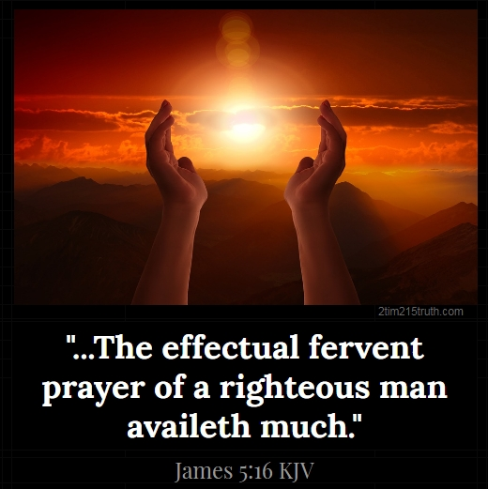
INTERCESSION

Slide 23
TITHES AND OFFERING
Kindly pay via one of the following options:
Your phone
Bank transfer to
Cash
IBAN: NL90ABNA0416385699
Remarks: Tithes (name of region)
“… God loves a cheerful giver”
- 2 Corinthians 9:7

Slide 24
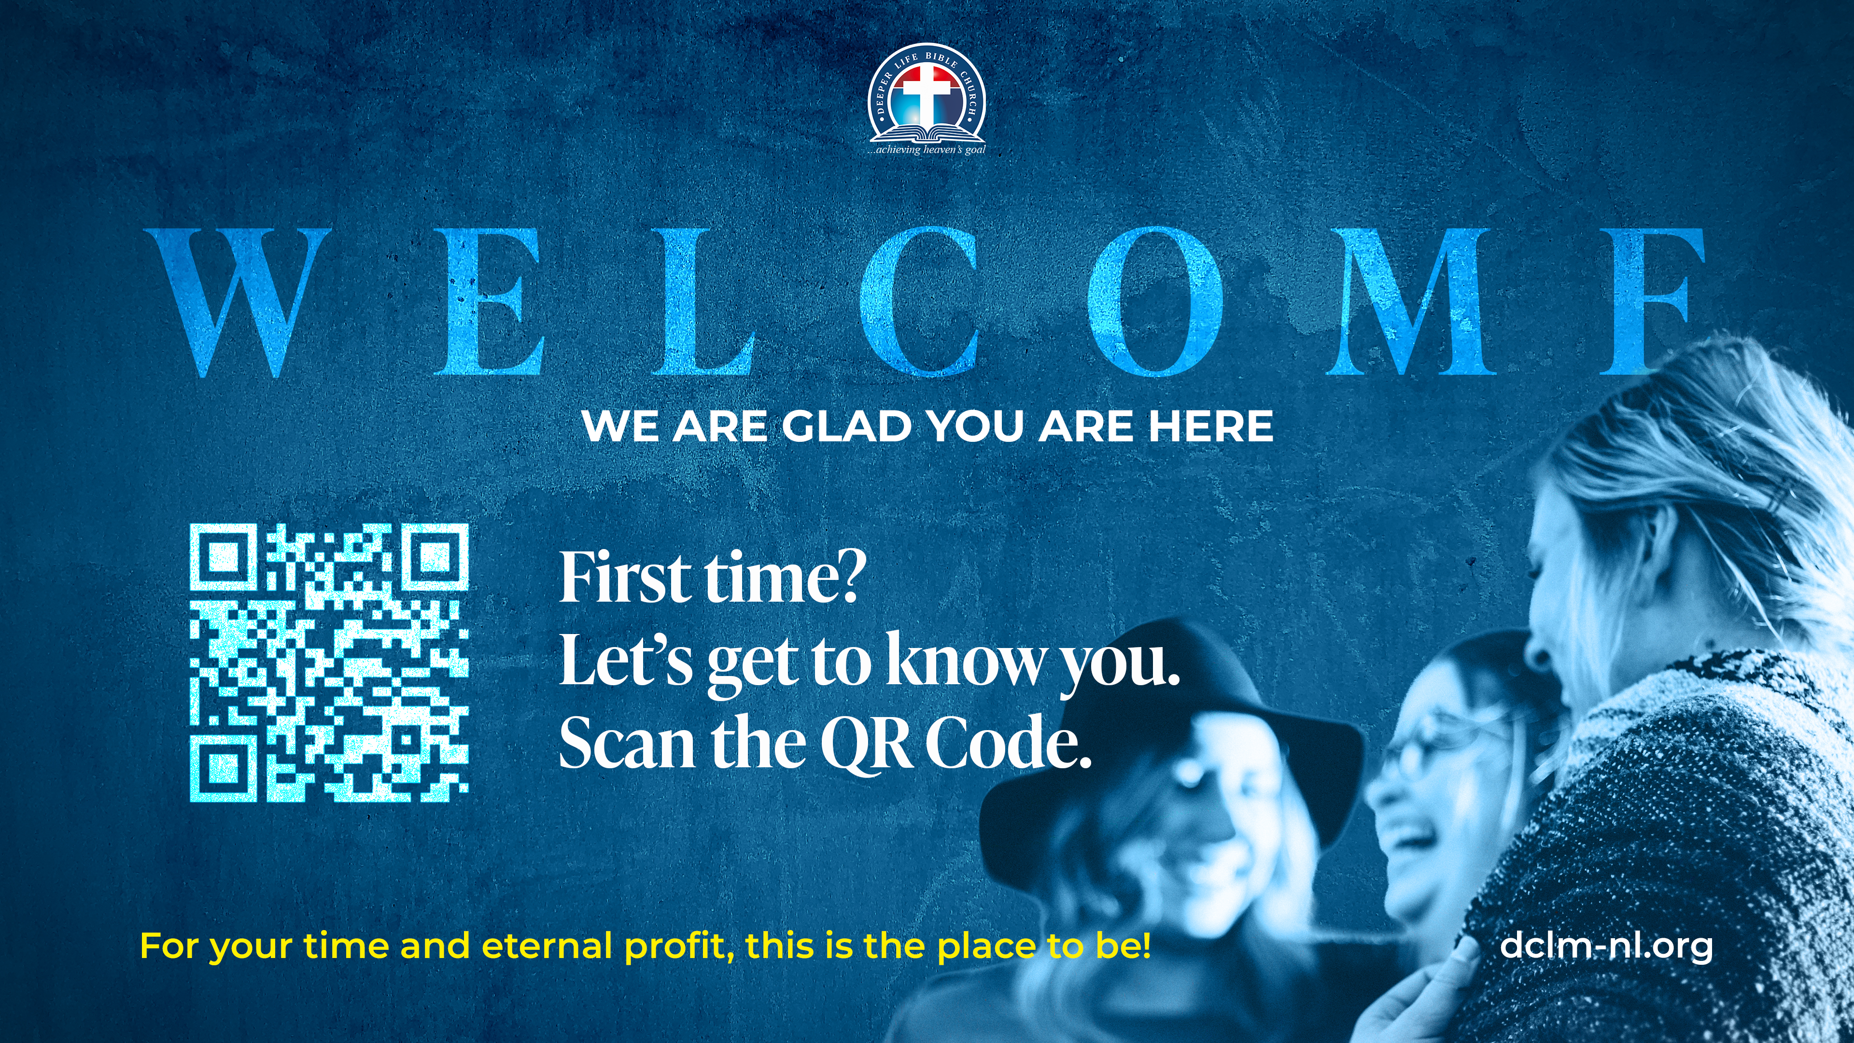

Slide 25





COUNSELLING
SERVICE SCHEDULES
Service | Day | Timing | Remarks
Worship Service | Sunday | 09:45-12:00 | Physical/Online
Bible Study | Tuesday | 19:30-20:30 | Online
Revival Service | Friday | 19:30-21:00 | Online/Physical
Night Vigil | Friday | 19:30-23:30 | First Friday Monthly
If you have questions or need guidance on challenging issues, kindly request for counselling.
Our pastor is here for you.
CONTACT
+31 207 856 683
info@deeperlife.nl
LOCATION DETAILS
Location | Telephone # | ZOOM Meeting ID
Amsterdam | +31 686 093 624 | 795-674-627
Eindhoven | +31 643 678 896 | 912-749-784
The Hague | +31 685 076 861 | 818-6898-8436
dclmnetherlands
www.dclm-nl.org

Slide 26


Slide 27
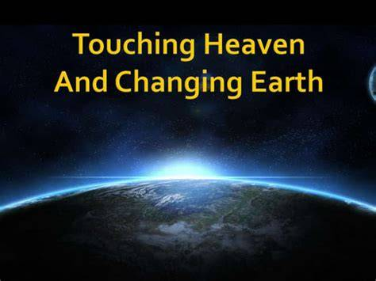
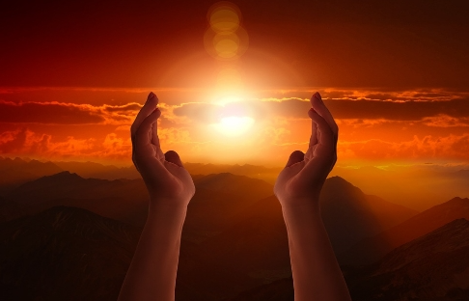
Night Vigil
This Friday:
6th November
@ 19:30

Slide 28
LESSON 44:
The Passover and Israel’s Exodus
STS STUDY FOR NEXT WEEK:
MEMORY VERSE: ……
  “It is a night to be much observed unto the LORD for bringing them out from the land of Egypt: this is that night of the LORD to be observed of all the children of Israel in their generations”
  (Exodus 12:42).
TEXT: Exodus 12:1-51; 13:1-22

Slide 29


Exodus 33:1-23;
34:1-35

Slide 30
HYMN
GHS 035: A NEW NAME IN GLORY

Slide 31
A NEW NAME IN GLORY [GHS 035]
1.
I was once a sinner, but I came
Pardon to receive from my Lord:
This was freely given, and I found
That He always kept His word.

Slide 32
There’s a new name written down in glory,
And it’s mine, O yes, it’s mine !
And the white-robed angels sing the story
“A sinner has come home.”
For there’s a new name written down in glory,
And it’s mine, O yes, it’s mine;
With my sins forgiven I am bound for heaven,
Never more to roam.

Slide 33
A NEW NAME IN GLORY [GHS 035]
2.
I was humbly kneeling at the cross,
Fearing naught but God’s angry frown;
When the heavens opened and I saw
That my name was written down.

Slide 34
There’s a new name written down in glory,
And it’s mine, O yes, it’s mine !
And the white-robed angels sing the story
“A sinner has come home.”
For there’s a new name written down in glory,
And it’s mine, O yes, it’s mine;
With my sins forgiven I am bound for heaven,
Never more to roam.

Slide 35
A NEW NAME IN GLORY [GHS 035]
3.
In the Book ’tis written, “Saved by Grace,”
O the joy that came to my soul!
Now I am forgiven, and I know
By the blood I am made whole.

Slide 36
There’s a new name written down in glory,
And it’s mine, O yes, it’s mine !
And the white-robed angels sing the story
“A sinner has come home.”
For there’s a new name written down in glory,
And it’s mine, O yes, it’s mine;
With my sins forgiven I am bound for heaven,
Never more to roam.

Slide 37

CHOIR

Slide 38
TODAY’S SERMON
TRANSFIGURED FOR LIFE

Slide 39

TIME TO PRAY

