Slide 1
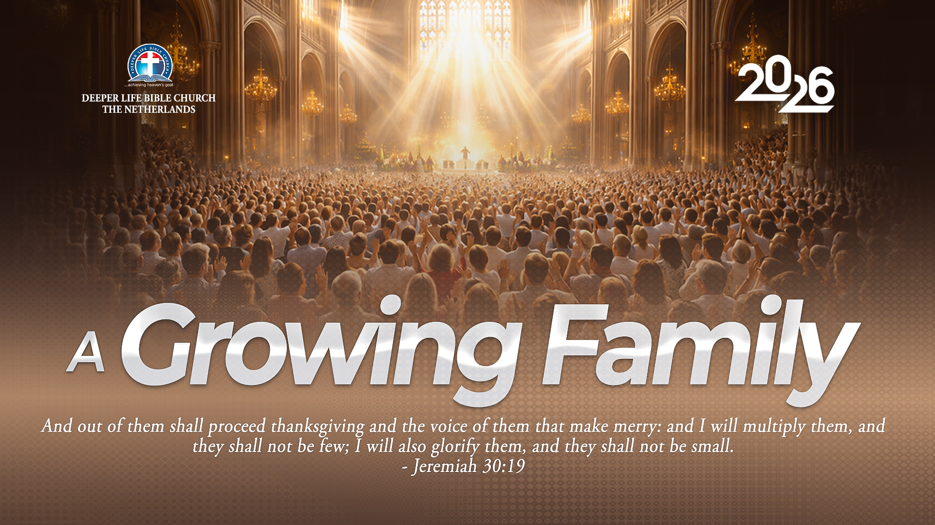
SUPER SUNDAY SERVICE
11-10-2026

Slide 2
HYMN
GHS 251: ONLY REMEMBERED

Slide 3
ONLY REMEMBERED [GHS 251]
1.
Fading away like the stars of the morning,
Losing their light in the glorious sun-
Thus would we pass from the earth and its toiling,
Only remembered by what we have done.

Slide 4
Only remembered, only remembered,
Only remembered by what we have done;
Thus would we pass from the earth and its toiling,
Only remembered by what we have done.

Slide 5
ONLY REMEMBERED [GHS 251]
2.
Shall we be missed, tho' by others succeeded,
Reaping the fields we in spring time have sown?
Yes, but the sowers must pass from their labours,
Ever remembered by what they have done.

Slide 6
Only remembered, only remembered,
Only remembered by what we have done;
Thus would we pass from the earth and its toiling,
Only remembered by what we have done.

Slide 7
ONLY REMEMBERED [GHS 251]
3.
Only the truth that in life we have spoken,
Only the seed that on earth we have sown;
These shall pass onward when we are forgotten,
Fruits of the harvest and what we have done.

Slide 8
Only remembered, only remembered,
Only remembered by what we have done;
Thus would we pass from the earth and its toiling,
Only remembered by what we have done.

Slide 9
ONLY REMEMBERED [GHS 251]
4.
Oh, when the saviour shall make up His jewels,
When the bright crowns of rejoicing are won,
Then shall His weary and faithful disciples
All be remembered by what they have done.

Slide 10
Only remembered, only remembered,
Only remembered by what we have done;
Thus would we pass from the earth and its toiling,
Only remembered by what we have done.

Slide 11

SEARCH THE SCRIPTURES
11-10-2026

Slide 12
REVIEW OF THE ASSIGNMENT FROM LAST STUDY
Think of a disagreement you have not settled. Ask God for grace to forgive from the heart. This week, take one step towards peace, such as speaking privately and respectfully with the person or apologising for your own wrong. If you need support, speak with your pastor or leader.
Volunteer please!
Christ teaches on forgiveness

Slide 13
LESSON 40:
Jacob’s last days on earth
MEMORY VERSE: ……
  “And he charged them, and said unto them, I am to be gathered unto my people: bury me with my fathers in the cave that is in the field of Ephron the Hittite.”
  (Genesis 49:29).
TEXT: Genesis 48: 1-22; 49:1-33;
50:1-26

Slide 14
INTRODUCTION
Jacob’s last days reveal his faith in God’s promises and his concern for his family. Though weak in body, he adopted Joseph’s two sons, blessed his family and requested burial in Canaan. Reuben lost his birthright because of sexual sin, showing that our conduct has lasting consequences.
After Jacob’s death, Joseph reassured his brothers of his forgiveness and provided for them. He later died trusting God to bring Israel out of Egypt into the promised land. Life is brief. We must repent of sin, forgive others, fulfil our duties and remain faithful to God, ready to meet Him.

Slide 15
Jacob’s Last Days on Earth
KEY LESSONS IN THE STUDY OF TODAY
God chooses in wisdom and saves by grace. We must trust His promises and obey His word.
Our character and conduct matter to God. Sin can cost us blessings; we must repent and put wrongs right.
We must honour God in our family duties and ceremonies, comfort those who mourn and obey His commands
Joseph forgave his brothers and cared for them. We must reject revenge and show kindness.
Life is brief, but God’s promises are sure. We must live wisely and be ready to meet Him.

Slide 16
QUESTION 1
What do Jacob’s final blessings teach us about God’s promises and choices?
Genesis 48:14–21; Hebrews 11:21; Romans 9:15–16.

Slide 17
QUESTION 2
What can we learn from Reuben’s sin and its consequences?
Genesis 49:3-4; 1 Chronicles 5:1-2; Proverbs 28:13

Slide 18
QUESTION 3
How should believers conduct themselves during mourning, burials and other family ceremonies?
Genesis 50:12-14; Romans 12:15; 1 Corinthians 10:31; Philippians 4:5

Slide 19
QUESTION 4
Why were Joseph’s brothers afraid, and what can we learn from his response?
Genesis 50:15-21; Proverbs 28:1; Romans 12:17-21

Slide 20
QUESTION 5
How should God’s promises help us live and prepare for death? Genesis 50:24-25; Joshua 24:32; Psalm 90:12; Luke 12:40.

Slide 21
CONCLUSION
Jacob and Joseph died trusting God’s promises. Their example calls us to use our time wisely and remain faithful to Him.
We must repent of sin, fulfil our responsibilities and forgive those who wrong us. Let us set things right where we can today and live ready to meet God.

Slide 22
ASSIGNMENT
While sharing the gospel, you meet someone who is afraid because his father cursed him after he disobeyed. Search the Scriptures for three passages you would use to guide and encourage him. Explain how each passage applies to his situation and what steps he should take. Be ready to share your findings next week.

Slide 23


SEARCH THE SCRIPTURES SUMMARY

Slide 24
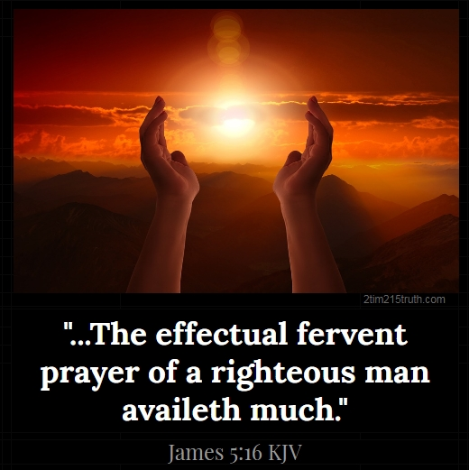
INTERCESSION

Slide 25
TITHES AND OFFERING
Kindly pay via one of the following options:
Your phone
Bank transfer to
Cash
IBAN: NL90ABNA0416385699
Remarks: Tithes (name of region)
“… God loves a cheerful giver”
- 2 Corinthians 9:7

Slide 26


Slide 27





COUNSELLING
SERVICE SCHEDULES
Service | Day | Timing | Remarks
Worship Service | Sunday | 09:45-12:00 | Physical/Online
Bible Study | Tuesday | 19:30-20:30 | Online
Revival Service | Friday | 19:30-21:00 | Online/Physical
Night Vigil | Friday | 19:30-23:30 | First Friday Monthly
If you have questions or need guidance on challenging issues, kindly request for counselling.
Our pastor is here for you.
CONTACT
+31 207 856 683
info@deeperlife.nl
LOCATION DETAILS
Location | Telephone # | ZOOM Meeting ID
Amsterdam | +31 686 093 624 | 795-674-627
Eindhoven | +31 643 678 896 | 912-749-784
The Hague | +31 685 076 861 | 818-6898-8436
dclmnetherlands
www.dclm-nl.org

Slide 28
FASTING & PRAYER FOR THE NATIONAL CONFERENCE
DATE: October 1 – 21, 2026
HIGHLIGHTS
Corporate Prayer:
    Daily: 12:00 – 13:00(except Sunday)
    On Saturday 17 October: 10:00AM – 13:00
    Join via National Zoom ID: 795 674 627|| PC: 100100
Personal Prayer:
    On Sundays (11th, and 18th October)
    There will be prayer bulletin for each Sunday

Slide 29
LESSON 41:
Israel’s multiplication and oppression in Egypt
STS STUDY FOR NEXT WEEK:
MEMORY VERSE: ……
  “But the more they afflicted them, the more they multiplied and grew. And they were grieved because of the children of Israel” (Exodus 1:12).
TEXT: Exodus 1:1-22

Slide 30
NATIONAL COMBINED SERVICE
Date: Next Sunday, 18 October 2026
Date: 9:40am
Aim: Mobilisation for the Divine Redesign Conference
Come thou with us, and the Lord will do you good !
Notes:
s

Slide 31

NH Conference Centre Koningshof, Locht 113a Veldhoven

Slide 32


Slide 33


2 Peter 1:1-10

Slide 34
HYMN
GHS 179: HIGHER GROUND

Slide 35
HIGHER GROUND [GHS 179]
1.
I’m pressing on the upward way,
New heights I’m gaining everyday;
Still praying as I onward bound,
Lord, plant my feet on higher ground.

Slide 36
Lord, lift me up, and let me stand
By faith on heaven’s table land;
A higher plane than I have found,
Lord, plant my feet on higher ground.

Slide 37
HIGHER GROUND [GHS 179]
2.
My heart has no desire to stay
Where doubts arise, and fears dismay;
Tho’ some may dwell where these abound,
My pray’r my aim is higher ground.

Slide 38
Lord, lift me up, and let me stand
By faith on heaven’s table land;
A higher plane than I have found,
Lord, plant my feet on higher ground.

Slide 39
HIGHER GROUND [GHS 179]
3.
I want to live above the world,
Though Satan’s darts at me are hurled
But still I’ll pray till heav’n I’ve found:
“Lord, lead me on to higher ground.”

Slide 40
Lord, lift me up, and let me stand
By faith on heaven’s table land;
A higher plane than I have found,
Lord, plant my feet on higher ground.

Slide 41
HIGHER GROUND [GHS 179]
4.
I want to scale the utmost height,
And catch a gleam of glory bright;
For faith has caught the joyful sound,
The song of saints on higher ground.

Slide 42
Lord, lift me up, and let me stand
By faith on heaven’s table land;
A higher plane than I have found,
Lord, plant my feet on higher ground.

Slide 43

CHOIR

Slide 44
TODAY’S SERMON
MEASURING GROWTH AND MAKING IMPACT

Slide 45

TIME TO PRAY

