Slide 1


Slide 2
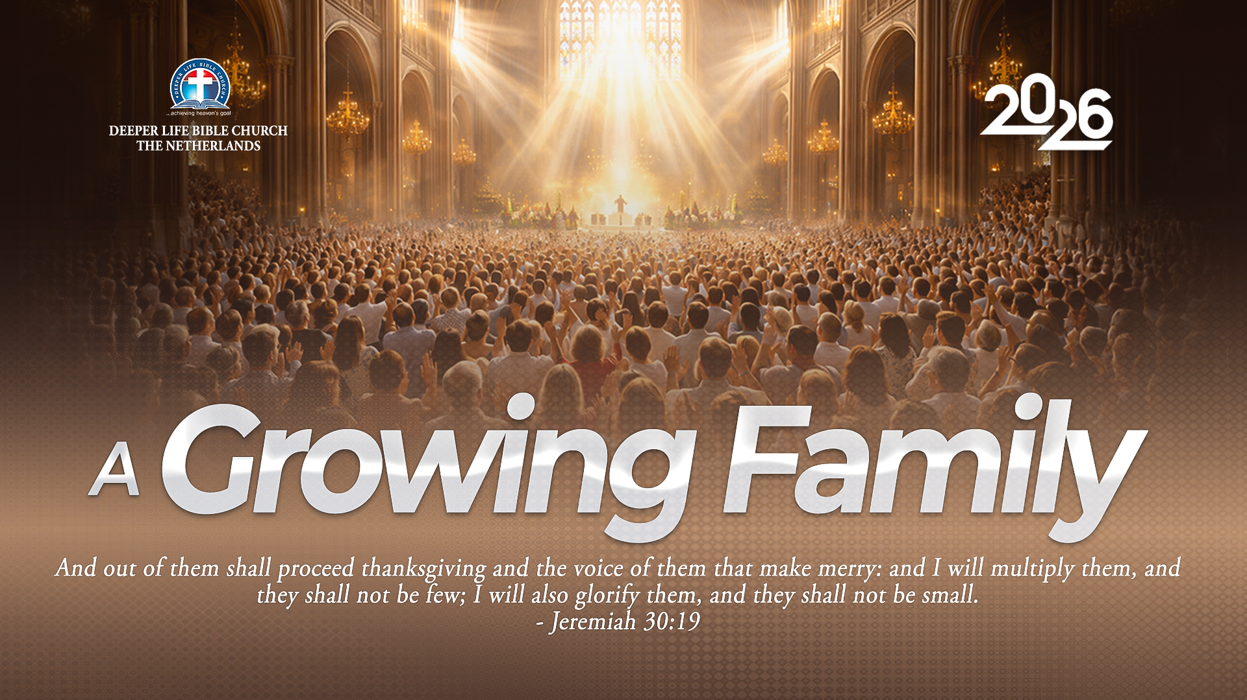
GLOBAL WORSHIP SERVICE
30-08-2026

Slide 3
HYMN
GHS 196: DOES JESUS CARE?

Slide 4
DOES JESUS CARE? [GHS 196]
1.
Does Jesus care when my heart is pained
Too deeply for mirth or song;
As the burdens press, and the cares distress,
And the way grows weary and long?

Slide 5
O yes, He cares, I know He cares,
His heart is touched with my grief;
When the days are weary,
The long night dreary,
I know my Saviour cares.

Slide 6
DOES JESUS CARE? [GHS 196]
2.
Does Jesus care when my way is dark
With a nameless dread and fear?
As the daylight fades into deep night shades,
Does He care enough to be near?

Slide 7
O yes, He cares, I know He cares,
His heart is touched with my grief;
When the days are weary,
The long night dreary,
I know my Saviour cares.

Slide 8
DOES JESUS CARE? [GHS 196]
3.
Does Jesus care when I’ve tried and failed
To resist some temptation strong;
When for my deep grief there is no relief,
Though my tears flow all the night long?

Slide 9
O yes, He cares, I know He cares,
His heart is touched with my grief;
When the days are weary,
The long night dreary,
I know my Saviour cares.

Slide 10
DOES JESUS CARE? [GHS 196]
4.
Does Jesus care when I’ve said goodbye
To the dearest on earth to me,
And my sad heart aches till it nearly breaks,
Is it aught to Him? Does He care?

Slide 11
O yes, He cares, I know He cares,
His heart is touched with my grief;
When the days are weary,
The long night dreary,
I know my Saviour cares.

Slide 12

SEARCH THE SCRIPTURES
30-08-2026

Slide 13
REVIEW OF THE ASSIGNMENT FROM LAST STUDY
1.Mention some attributes of Joseph that every believer should emulate, giving relevant Bible references and its application in our Christian journey.
2. Explain three lessons believer should learn from Jacob's journey to Egypt and Joseph's management of the famine, support your answers with relevant Bible references.
Jacob moves to Egypt

Slide 14
LESSON 34: Christ Feeds the Multitudes
MEMORY VERSE: ……
  “And they did all eat, and were filled: and they took up of the fragments that remained twelve baskets full” (Matthew 14:20)
TEXT: Matthew 14: 14-21; Luke 9:11-17; Mark 8: 1

Slide 15
INTRODUCTION
Christ heard of the demise of John, yet he resolved to minister to the multitude who were eager to hear him preach. While Christians are not forbidden to sympathize with the bereaved, we should exercise restraint in our moments of grief. Death is a price that must be paid by mortal beings. Before death comes, Christians should ensure their Christian experiences are intact and also get others prepared (Ecclesiastes 9:10). Today’s study focuses on the people’s resolve to hear the gospel, Christ’s compassion and His supernatural provision.
Christ Feeds the Multitudes

Slide 16
Christ Feeds the Multitudes
KEY LESSONS IN THE STUDY OF TODAY
The field of harvest consists of different categories of people.
Believers must be prepared, compassionate and be willing to forfeit their convenience to win the lost.
To maintain an intimate walk with God, believers must avoid pride and be ready to obey Christ and His faithful ministers.
God is a great Provider and there is no limit to what He can do if we obey Him.
True followers of Christ must be prudent in the management of human and material resources.

Slide 17
QUESTION 1
a) How did Jesus respond to the yearnings of the multitudes in our text? Luke 9:11
b) How should a believer, entrusted with the seed of life dispense it? 1 Corinthians 9:16; Acts 8:4

Slide 18
QUESTION 2
a) How would you define Christlike compassion? Matthew 14:14-16; Mark 8:1-3
b) How can it be demonstrated today? Jude 22,23; Galatians 6:2

Slide 19
QUESTION 3
What lessons can we draw from Christ’s feeding of the multitude? Matthew 14:19-20;
Matthew 6:31–33

Slide 20
QUESTION 4
What should a believer do in time of want? Hebrews 4:16; Psalm 46:1

Slide 21
QUESTION 5
Why should believers be prudent in the management of the resources in their care? 1 Corinthians 4:2; Luke 16:10-12

Slide 22
QUESTION 6
In what ways can a believer show compassion to those in need? 1 John 3:17–18; Matthew 25:35–36

Slide 23
QUESTION 7
Explain how believers can be like Christ? John 9:4; Colossians 3:12–14; Proverbs 11:24

Slide 24
CONCLUSION
Jesus remained committed to ministering to the people. His response teaches believers not to dwell excessively on loss but to remain faithful in God’s work. Jesus compassionately taught, healed, and cared for the crowd. True compassion goes beyond sympathy and leads to action in reaching the lost. Christ’s miraculous feeding of the multitude demonstrated God’s power, provision, and concern for both spiritual and physical needs.

Slide 25
ASSIGNMENT
A. Look around your home, church or workplace. Identify one situation this week where you can demonstrate Christlike compassion, and describe the action you will take.
B. Identify an area of your life where you need to place greater trust in God's provision, and commit to praying earnestly about it this week.
Prepare to share your answers next week.

Slide 26


SEARCH THE SCRIPTURES SUMMARY

Slide 27
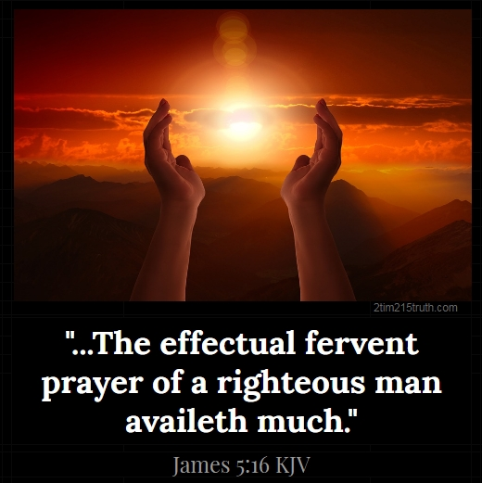
INTERCESSION

Slide 28
TITHES AND OFFERING
Kindly pay via one of the following options:
Your phone
Bank transfer to
Cash
IBAN: NL90ABNA0416385699
Remarks: Tithes (name of region)
“… God loves a cheerful giver”
- 2 Corinthians 9:7

Slide 29


Slide 30





COUNSELLING
SERVICE SCHEDULES
Service | Day | Timing | Remarks
Worship Service | Sunday | 09:45-12:00 | Physical/Online
Bible Study | Tuesday | 19:30-20:30 | Online
Revival Service | Friday | 19:30-21:00 | Online/Physical
Night Vigil | Friday | 19:30-23:30 | First Friday Monthly
If you have questions or need guidance on challenging issues, kindly request for counselling.
Our pastor is here for you.
CONTACT
+31 207 856 683
info@deeperlife.nl
LOCATION DETAILS
Location | Telephone # | ZOOM Meeting ID
Amsterdam | +31 686 093 624 | 795-674-627
Eindhoven | +31 643 678 896 | 912-749-784
The Hague | +31 685 076 861 | 818-6898-8436
dclmnetherlands
www.dclm-nl.org

Slide 32
LESSON 35:
Christ’s Power over Nature
STS STUDY FOR NEXT WEEK:
MEMORY VERSE: ……
  “And they came to him, and awoke him, saying, Master, master, we perish. Then he arose, and rebuked the wind and the raging of the water: and they ceased, and there was a calm”
  (Luke 8:24).
TEXT: Matthew 14:22-36; Luke 8:22-25

Slide 33


Slide 34


Slide 35

NH Conference Centre Koningshof, Locht 113a Veldhoven

Slide 36


Slide 37

CHOIR

Slide 38
CONNECTION TO GCK

Slide 39

TIME TO PRAY

