Slide 1
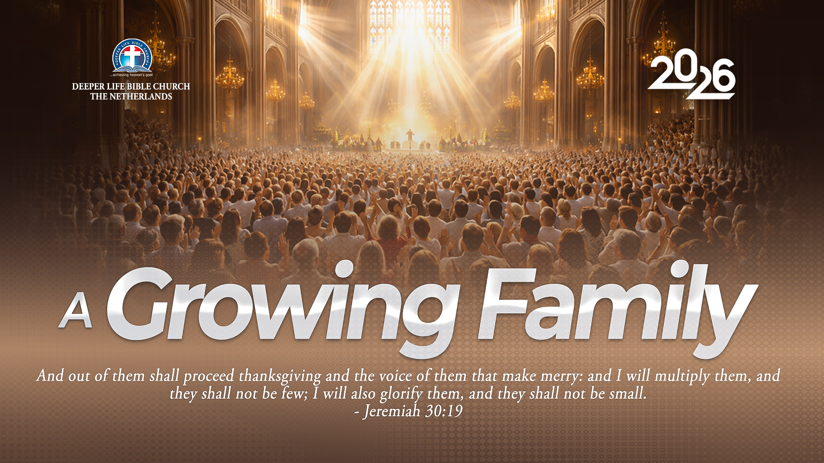
SUPER SUNDAY SERVICE
20-09-2026

Slide 2
HYMN
GHS 075: THE CHURCH’S ONE FOUNDATION

Slide 3
THE CHURCH’S ONE FOUNDATION [GHS 075]
1.
The Church’s one foundation,
Is Jesus Christ her Lord:
She is His new creation
By water and the word;
From heav’n He came and sought her
To be His holy bride;
With His own blood He bought her,
And for her life He died.

Slide 4
THE CHURCH’S ONE FOUNDATION [GHS 075]
2.
Elect from every nation,
Yet one o’er all the earth,
Her charter of salvation
One Lord, one faith, one birth,
One holy name she blesses,
Partakes one holy food,
And to one hope she presses,
With every grace endued.

Slide 5
THE CHURCH’S ONE FOUNDATION [GHS 075]
3.
Though with a scornful wonder
Men see her sore oppressed,
By schisms rent asunder,
By heresies distressed,
Yet saints their watch are keeping,
Their cry goes up, “how long?”
And soon the night of weeping
Shall be the morn of song.

Slide 6
THE CHURCH’S ONE FOUNDATION [GHS 075]
4.
’Mid toil and tribulation,
And tumult of her war,
She waits the consummation
Of peace for evermore.
Till with the vision glorious
Her longing eyes are blest,
And the great Church victorious
Shall be the Church at rest.

Slide 7
THE CHURCH’S ONE FOUNDATION [GHS 075]
5.
Yet she on earth hath union
With God the Three in One,
And mystic sweet communion
With those whose rest is won.
O happy ones and holy!
Lord, give us grace that we
Like them, the meek and lowly,
On high may dwell with Thee.

Slide 8

SEARCH THE SCRIPTURES
20-09-2026

Slide 9
REVIEW OF THE ASSIGNMENT FROM LAST STUDY
A Christian family observes a long-standing cultural tradition that conflicts with a clear biblical command. Family members insist that refusing the practice would dishonour their parents and community.
How should the believer respond to this with truth, humility and love? Explain how to distinguish between an acceptable cultural custom and an unscriptural tradition.
Be ready to share your answer with Bible references.
Volunteer please!
Christ exalts God’s commandments over traditions

Slide 10
LESSON 37:
Peter Confesses Christ
MEMORY VERSE: ……
  “And Simon Peter answered and said, Thou art the Christ, the Son of the living God.”
  (Matthew 16:16).
TEXT: Matthew 16:1–28; Mark 8:27–30; Luke 9:18–27; 18:31–34

Slide 11
INTRODUCTION
Peter’s confession that Jesus is “the Christ, the Son of the living God” is central to the Gospel. Others regarded Jesus as a prophet, but Peter declared the truth the Father had revealed to him. Believing in and confessing Christ are necessary for salvation.
Peter later resisted Christ’s coming suffering and death. This reminds us that knowing Christ must lead to submission to God’s will and faithful obedience, even through suffering.
Peter Confesses Christ

Slide 12
Peter Confesses Christ
KEY LESSONS IN THE STUDY OF TODAY
Like leaven (yeast), hypocrisy and false doctrine spread and corrupt our faith.
Salvation requires believing in and confessing Jesus Christ, the Son of God.
Christ builds His Church; the gates of hell shall not prevail against it. Believers exercise spiritual authority under Him.
Christ died and rose again to save sinners; Satan’s opposition through Peter reminds us to test all advice by God’s word.
True disciples deny themselves, take up their cross and follow Christ, ready for His return.

Slide 13
QUESTION 1
Why did Christ rebuke the insincere sign seekers and warn His disciples about the “leaven” (yeast) of the Pharisees?
Matthew 16:5-12; Luke 12:1;
1 Corinthians 5:6-8

Slide 14
QUESTION 2
Why is it important to have a proper knowledge of who Jesus is?
Matthew 16:15–17; John 17:3;
Romans 10:9,10.

Slide 15
QUESTION 3
What did Jesus mean by “Upon this rock I will build my church”?
Matthew 16:18; Ephesians 2:19,20

Slide 16
QUESTION 4
What was the aim of Satan in using Peter to rebuke Jesus?
Matthew 16:21–23

Slide 17
QUESTION 5
How do we follow Christ daily and prepare for His return?
Matthew 16:24–27; Titus 2:11–14

Slide 18
CONCLUSION
Our faith rests on the truth Peter confessed: Jesus is “the Christ, the Son of the living God”. Let your choices at home, at work and in church honour Him. Follow Him faithfully, even through suffering.
Peter Confesses Christ

Slide 19
ASSIGNMENT
Read Matthew 16:24–26.
Explain in your own words what it means to “deny yourself and take up your cross to follow Christ”. This week, choose and carry out one act of obedience to Christ, even if it costs you comfort or the approval of others. Be ready to share what you did and what you learnt.
Peter Confesses Christ

Slide 20


SEARCH THE SCRIPTURES SUMMARY

Slide 21
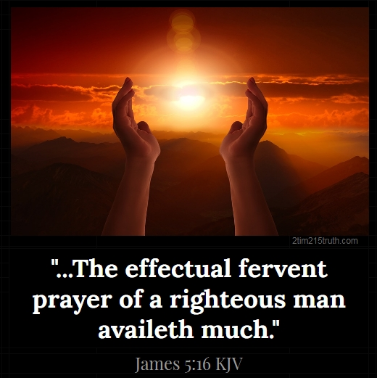
INTERCESSION

Slide 22
TITHES AND OFFERING
Kindly pay via one of the following options:
Your phone
Bank transfer to
Cash
IBAN: NL90ABNA0416385699
Remarks: Tithes (name of region)
“… God loves a cheerful giver”
- 2 Corinthians 9:7

Slide 23
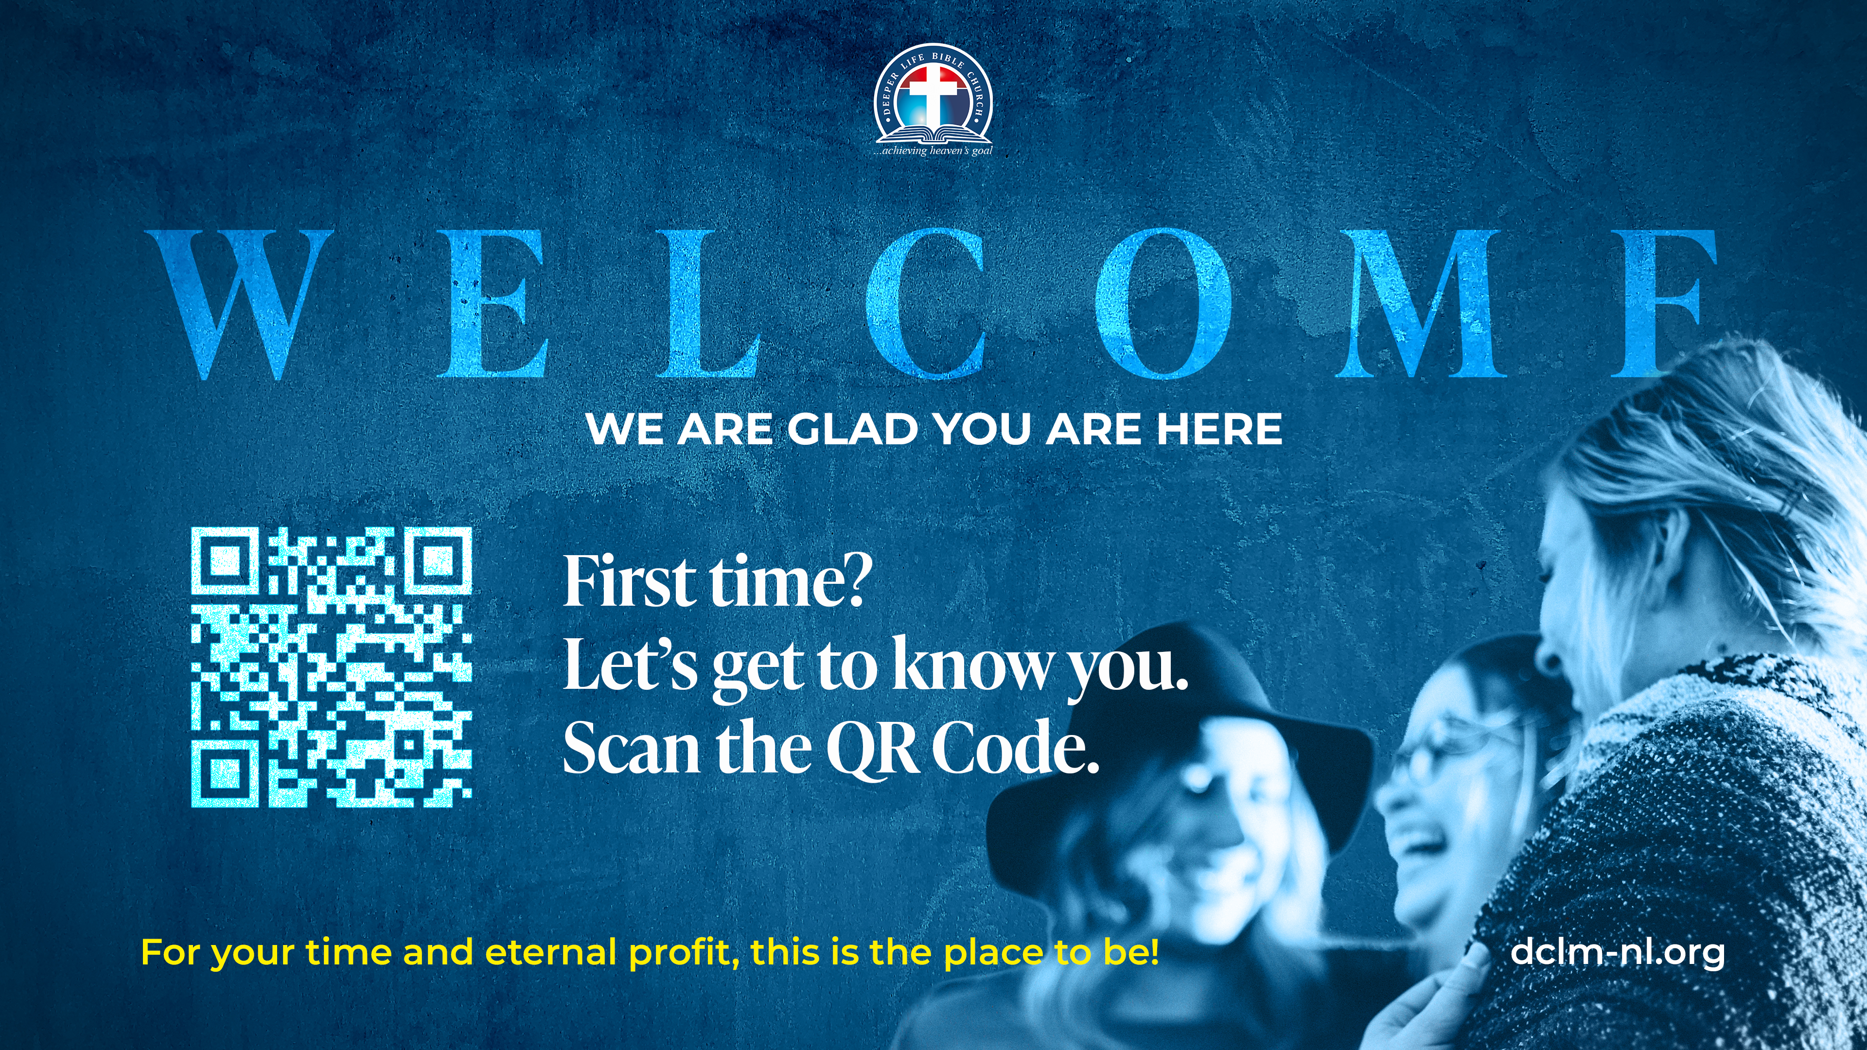

Slide 24





COUNSELLING
SERVICE SCHEDULES
Service | Day | Timing | Remarks
Worship Service | Sunday | 09:45-12:00 | Physical/Online
Bible Study | Tuesday | 19:30-20:30 | Online
Revival Service | Friday | 19:30-21:00 | Online/Physical
Night Vigil | Friday | 19:30-23:30 | First Friday Monthly
If you have questions or need guidance on challenging issues, kindly request for counselling.
Our pastor is here for you.
CONTACT
+31 207 856 683
info@deeperlife.nl
LOCATION DETAILS
Location | Telephone # | ZOOM Meeting ID
Amsterdam | +31 686 093 624 | 795-674-627
Eindhoven | +31 643 678 896 | 912-749-784
The Hague | +31 685 076 861 | 818-6898-8436
dclmnetherlands
www.dclm-nl.org

Slide 25
LESSON 38:
The Transfiguration of Christ
STS STUDY FOR NEXT WEEK:
MEMORY VERSE: ……
  "And was transfigured before them: and his face did shine as the sun, and his raiment was white as the
  light” (Matthew 17:2).
TEXT: Matthew 17:1-27; Mark 9:1-13; Luke 9:28-36

Slide 26
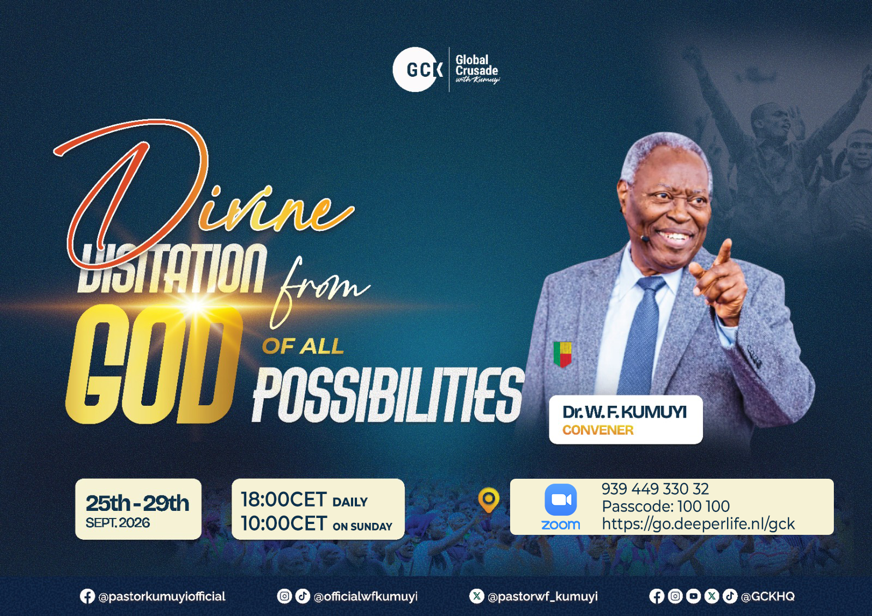

Slide 27
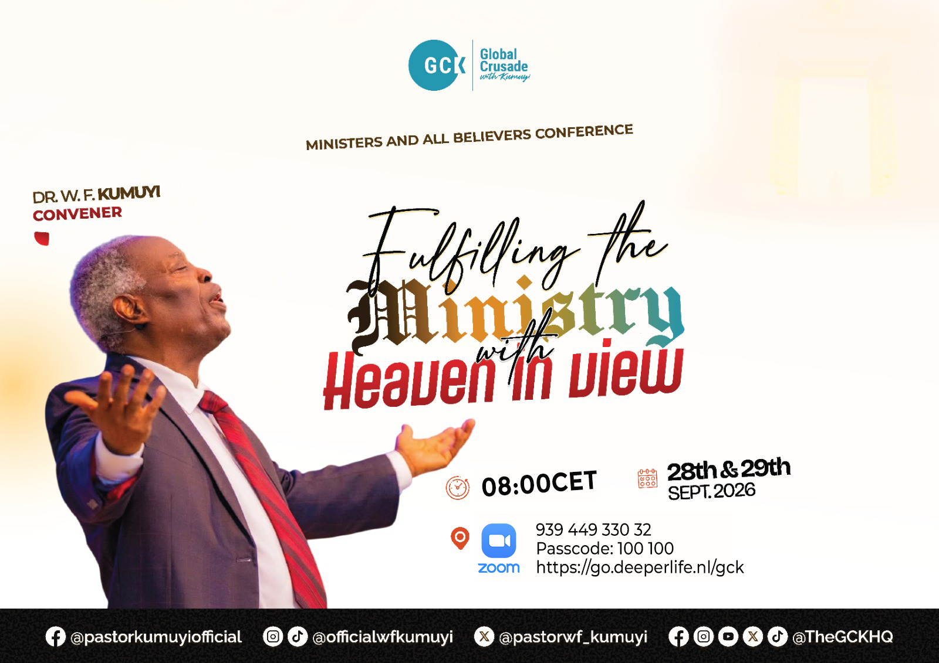

Slide 28


Slide 29
FASTING & PRAYER FOR THE NATIONAL CONFERENCE
DATE: October 1 – 21, 2026
HIGHLIGHTS
Corporate Prayer:
    Daily: 12:00 – 13:00(except Sunday)
    On Saturday 17 October: 10:00AM – 13:00
    Join via National Zoom ID: 795 674 627|| PC: 100100
Personal Prayer:
    On Sundays (4th, 11th, and 18th October)
    There will be prayer bulletin for each Sunday

Slide 30

NH Conference Centre Koningshof, Locht 113a Veldhoven

Slide 31


Slide 32


1 Thessalonians 1:1-10
Notes:
s

Slide 33
HYMN
GHS 105: I'll tell the world

Slide 34
I'LL TELL THE WORLD [GHS 105]
1.
I’ll tell the world that I’m a Christian –
I’m not ashamed His name to bear;
I’ll tell the world that I’m a Christian
I’ll take Him with me anywhere.
I’ll tell the world how Jesus saved me,
And how He gave me a life brand-new;
And I know that if you trust Him
That all He gave me He’ll give to you,
I’ll tell the world that He’s my Saviour,
No other one could love me so;
My life, my all is His forever,
And where He leads me I will go.

Slide 35
I'LL TELL THE WORLD [GHS 105]
2.
I’ll tell the world that He is coming -
It may be near or far away;
But we must live as if His coming
Would be tomorrow or today.
For when He comes and life is over,
For those who love Him there’s more to be;
Eyes have never seen the wonders
That He’s preparing for you and me.
O tell the world that you’re a Christian,
Be not ashamed His name to bear;
O tell the world that you’re a Christian,
And take Him with you ev’ry where.

Slide 36

CHOIR

Slide 37
TODAY’S SERMON
SHARING YOUR FAITH WITH CONVICTION AND POWER

Slide 38

TIME TO PRAY

