Slide 1
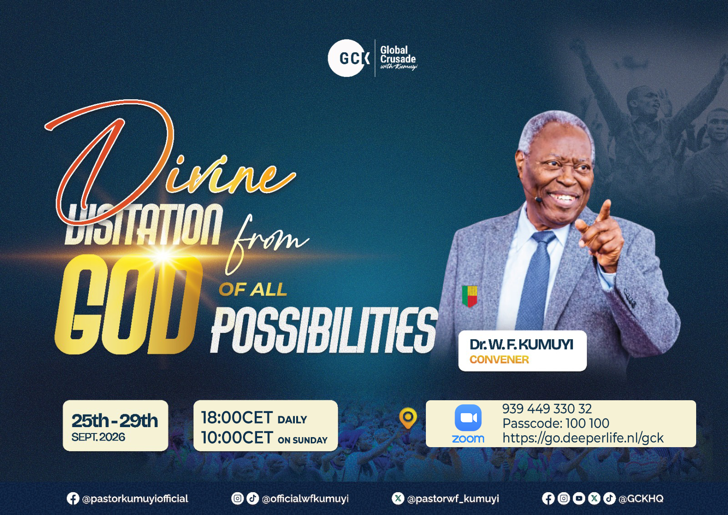

Slide 2
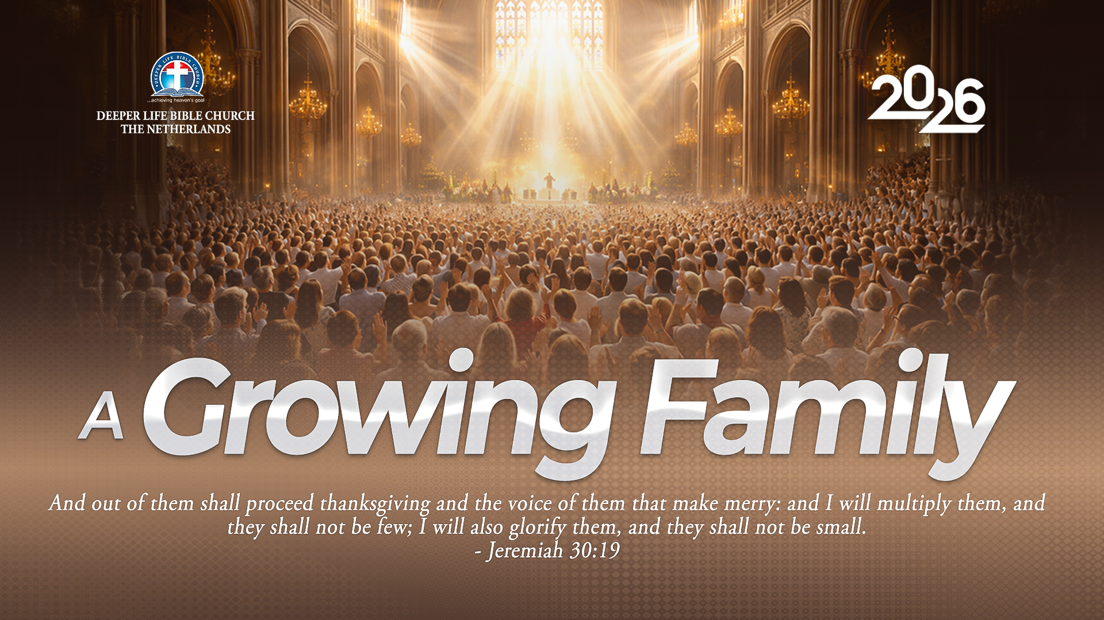
GLOBAL WORSHIP SERVICE
27-09-2026

Slide 3
HYMN
GHS 011: HOLY, HOLY, HOLY

Slide 4
HOLY, HOLY, HOLY [GHS 011]
1.
Holy, holy, holy,
Lord God Almighty!
Early in the morning
Our song shall rise to Thee;
Holy, holy, holy, merciful and mighty!
God in Three Persons, blessed Trinity!

Slide 5
HOLY, HOLY, HOLY [GHS 011]
2.
Holy, holy, holy!
All the saints adore Thee,
Casting down their golden crowns
Around the glassy sea;
Cherubim and seraphim
Falling down before Thee,
Who wert and art, and evermore shalt be.

Slide 6
HOLY, HOLY, HOLY [GHS 011]
3.
Holy, holy, holy!
Though the darkness hide Thee,
Though the eye of sinful man
Thy glory may not see,
Only Thou art holy;
There is none beside Thee,
Perfect in power, in love, and purity.

Slide 7
HOLY, HOLY, HOLY [GHS 011]
4.
Holy, holy, holy,
Lord God Almighty!
All Thy works shall praise Thy name,
In earth, and sky, and sea!
Holy, holy, holy, merciful and mighty!
God in Three Persons, blessed Trinity!

Slide 8

SEARCH THE SCRIPTURES
27-09-2026

Slide 9
REVIEW OF THE ASSIGNMENT FROM LAST STUDY
Read Matthew 16:24-26.
Explain in your own words what it means to “deny yourself and take up your cross to follow Christ”. This week, choose and carry out one act of obedience to Christ, even if it costs you comfort or the approval of others. Be ready to share what you did and what you learnt.
Volunteer please!
Peter confesses Christ

Slide 10
LESSON 38:
The Transfiguration of Christ
MEMORY VERSE: ……
  "And was transfigured before them: and his face did shine as the sun, and his raiment was white as the
  light” (Matthew 17:2).
TEXT: Matthew 17:1-27; Mark 9:1-13; Luke 9:28-36

Slide 11
INTRODUCTION
At the transfiguration, Jesus showed His majesty and divine glory to Peter, James, and John. This event strengthened their faith, confirmed that He is the Messiah and the Son of the living God, and pointed to His future glory. God the Father called Jesus His beloved Son and told the disciples to listen to Him.
This study also explores John the Baptist as Christ’s forerunner, the healing of the afflicted boy, Christ’s death and resurrection, and our responsibilities as Christians. It encourages us to serve the Lord with confidence, to live in holiness and righteousness, and to remain faithful until the end.

Slide 12
The Transfiguration
Of Christ
KEY LESSONS IN THE STUDY OF TODAY
Jesus is God’s beloved Son and our only Saviour. We must hear and obey Him; no dream, person or angel should lead us away from Him.
Like Elijah, John the Baptist called people to turn from sin. He prepared them for Christ.
Christ shows mercy and can heal and deliver. We must trust Him and pray.
Christ died for our sins and rose again so we can be made right with God.
Believers must work honestly, care for their families, help those in need and trust God to provide.

Slide 13
QUESTION 1
What does the transfiguration reveal about Jesus, and how should we respond?
Matthew 17:5; Luke 9:30-31

Slide 14
QUESTION 2
How was John the Baptist like Elijah?
Matthew 17:10-13; Luke 1:16-17

Slide 15
QUESTION 3
Why could the disciples not deliver the boy, and what can we learn?
Matthew 17:18-21; Mark 9:23-29

Slide 16
QUESTION 4
Why did Christ die and rise again, and how should we prepare to share His eternal glory?
Rom 4:25; Hebrews 12:14; Matthew 24:13

Slide 17
QUESTION 5
What does Christ’s payment of the temple tax teach us about our responsibilities?
Matthew 17:27; Rom 13:1,7;
1 Timothy 5:8

Slide 18
CONCLUSION
The transfiguration reveals Jesus Christ as the glorious Son of God, worthy of our worship, trust and obedience. Those who desire to share in His eternal glory must repent of sin, be born again, yield their lives to Him and receive grace to live in holiness.
Let us hear His word, fulfil our responsibilities and continue serving Him faithfully until the end.
“And there came a voice out of the cloud, saying, This is my beloved Son: hear him.” Luke 9:35.

Slide 19
ASSIGNMENT
A friend tells you that all religions lead to God and that Jesus is just one of many ways to salvation. Read Matthew 17:5 and John 14:6. Prepare a short, respectful reply explaining who Jesus is and why He is the only way to the Father.

Slide 20


SEARCH THE SCRIPTURES SUMMARY

Slide 21
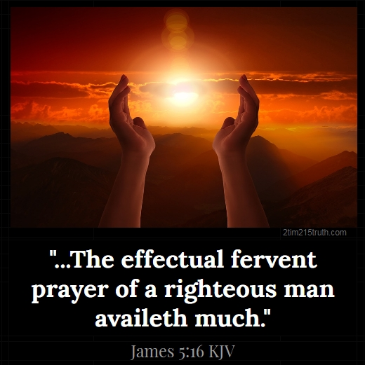
INTERCESSION

Slide 22
TITHES AND OFFERING
Kindly pay via one of the following options:
Your phone
Bank transfer to
Cash
IBAN: NL90ABNA0416385699
Remarks: Tithes (name of region)
“… God loves a cheerful giver”
- 2 Corinthians 9:7

Slide 23
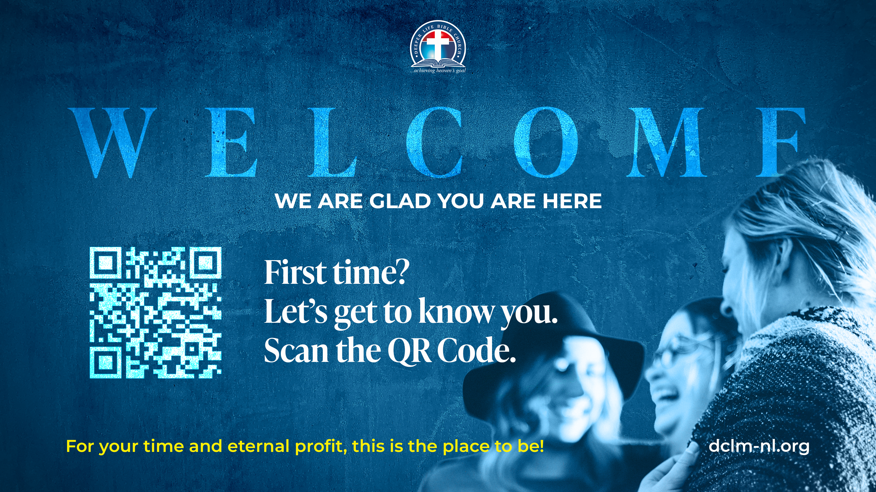

Slide 24





COUNSELLING
SERVICE SCHEDULES
Service | Day | Timing | Remarks
Worship Service | Sunday | 09:45-12:00 | Physical/Online
Bible Study | Tuesday | 19:30-20:30 | Online
Revival Service | Friday | 19:30-21:00 | Online/Physical
Night Vigil | Friday | 19:30-23:30 | First Friday Monthly
If you have questions or need guidance on challenging issues, kindly request for counselling.
Our pastor is here for you.
CONTACT
+31 207 856 683
info@deeperlife.nl
LOCATION DETAILS
Location | Telephone # | ZOOM Meeting ID
Amsterdam | +31 686 093 624 | 795-674-627
Eindhoven | +31 643 678 896 | 912-749-784
The Hague | +31 685 076 861 | 818-6898-8436
dclmnetherlands
www.dclm-nl.org

Slide 25
LESSON 39:
Christ teaches on forgiveness
STS STUDY FOR NEXT WEEK:
MEMORY VERSE: ……
  “Then came Peter to him, and said, Lord, how oft shall my brother sin against me, and I forgive him? till seven times? Jesus saith unto him, I say not unto thee, Until seven times: but, Until seventy times seven”
  (Matthew 18:21,22).
TEXT: Matthew 18:1–35

Slide 27


Slide 28
FASTING & PRAYER FOR THE NATIONAL CONFERENCE
DATE: October 1 – 21, 2026
HIGHLIGHTS
Corporate Prayer:
    Daily: 12:00 – 13:00(except Sunday)
    On Saturday 17 October: 10:00AM – 13:00
    Join via National Zoom ID: 795 674 627|| PC: 100100
Personal Prayer:
    On Sundays (4th, 11th, and 18th October)
    There will be prayer bulletin for each Sunday

Slide 29

NH Conference Centre Koningshof, Locht 113a Veldhoven

Slide 30


Slide 31

CHOIR

Slide 32
CONNECTION TO GCK

Slide 33

TIME TO PRAY

